Slide 1
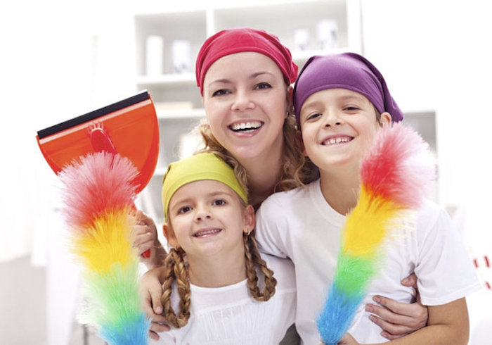

Slide 2
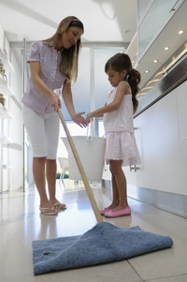
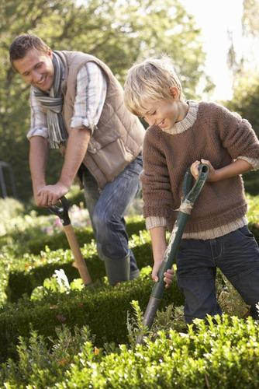
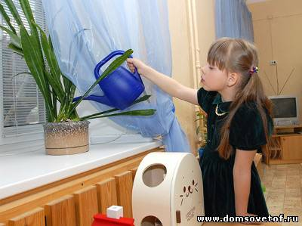

Slide 3
Тема урока: Home duties Домашние обязанности

Slide 4
Warm - up
Listen and read:
[ ɔ: ] water, walk, call, draw, door, floor
[ ɒ ] shopping, wash, clock, sock
[ i: ] clean, feed, meet, three
[ eɪ ] may, say, lay, make, table, today
[ әʊ ] phone, home, homework, photo, go

Slide 5
Warm - up
do not-
does not-
cannot-
will not-
have not-
has not-
did not-
was not-
were not-
don’t
doesn’t
can’t
won’t
haven’t
hasn’t
didn’t
wasn’t
weren’t

Slide 6
Переделай предложения по образцу.
Example: My sister does not write fairy tales.—
My sister doesn’t write fairy tales.
1. I have not got a brother.—
2. My grandmother does not listen to rock music.—
3. His sister cannot take photos.—
4. Her grandfather has not got a pet.—
5. Mag did not play puzzles yesterday.—
6. Our father will not watch the stars in the morning.—
7. Their mother was not at home at two o’clock.—
I haven’t got a brother.
Homework
My grandmother doesn’t listen to rock music.
His sister can’t take photos.
Her grandfather hasn’t got a pet.
Mag didn’t play puzzles yesterday.
Our father won’t watch the stars in the morning.
Their mother wasn’t at home at two o’clock.

Slide 7
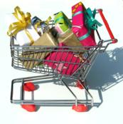
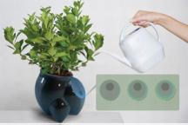
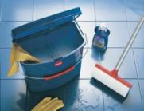
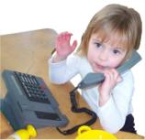
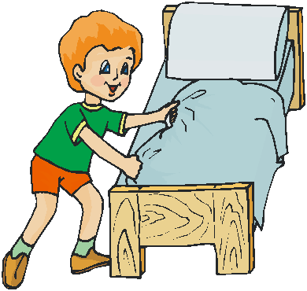
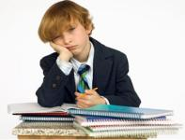
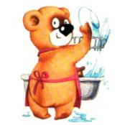
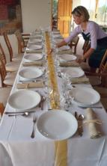
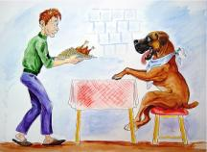
do homework
go shopping
make the bed
lay the table
do the washing up
answer phone calls
clean the room
feed the pet
water the flowers
1
6
2
7
3
8
4
9
5

Slide 8
do homework
clean the room
lay the table
go shopping
feed the pet
do the washing up
make the bed
answer phone calls
water the flowers

Slide 9
Do you help at home?
What do you do?

Slide 10
do homework
go shopping
make the bed
lay the table
do the washing up
answer phone calls
clean the room
feed the pet
water the flowers
I usually make my
bed in the morning, and you Sasha?

Slide 11
Present Simple
I
you
we
they
he
she
it
v
Mag usually lays the table in the evening.
V
Alex usually goes shopping on Sundays.
s

Slide 12
does her homework
lays the table
feeds her pet
goes shopping
cleans his room
does the washing up
makes his bed
answers phone calls
waters the flowers

Slide 13
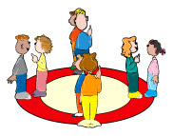
Inside-Outside Circle

Slide 14
Past Simple
I
you
we
they
he
she
it
help – helped
v
v
ed
,
II
go - went

Slide 15
feed
go
do
clean
water
help
answer
make
fed
made
helped
watered
lay
cleaned
answered
did
laid
went

Slide 16
feed – fed
lay - laid

Slide 17
Complete the text. Say how Mag helped her mum.
Last Sunday Mag got (get) up at 9 am. She … (wash)
her face and hands, … (clean) her teeth. Then she … (make)
her bed.
At half past nine Mag … (help) her mother to lay the table.
She … (have) breakfast with her mum, dad and sister Becky.
After breakfast Mag … (water) the flowers and … (feed) the
pets.
washed
cleaned
made
helped
had
watered
fed

Slide 18
Say what you did at home last Sunday morning.
Did you help your mum and dad? How?

Slide 19
Homework
Sb pg. 71 ex. 19
выучить слова стр.70

Slide 20
Thank you for attention!

