Slide 1
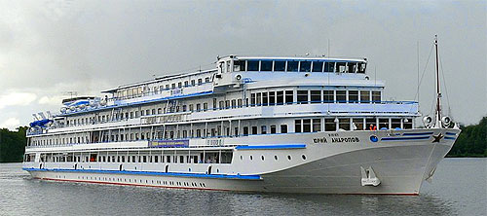
Tourist transportation Motor ship “Yuri Andropov”
Service on board
Made by: Panova G.

Slide 2
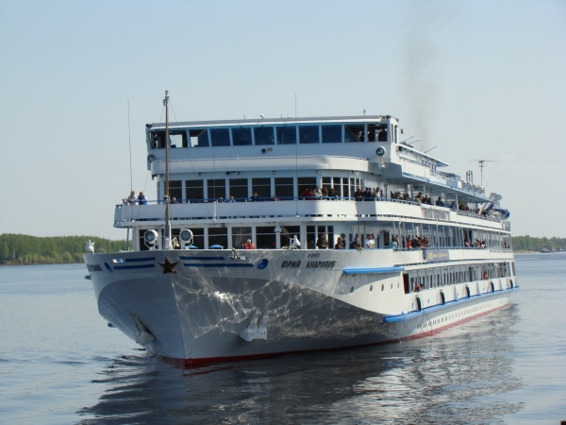
M/s «Yuri Andropov»
Project 302 was built in Germany in 1988.
Length: 129 m;
Width: 16 m;
Draft: 3 m;
Speed: 27 km/h;
Crew: 102-110
Passenger сapacity: 270 people.

Slide 3
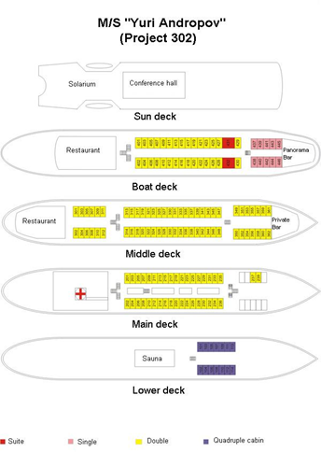
Accommodation:
2 suites
9 single cabins
128 double cabins
14 quadruple cabins

Slide 4
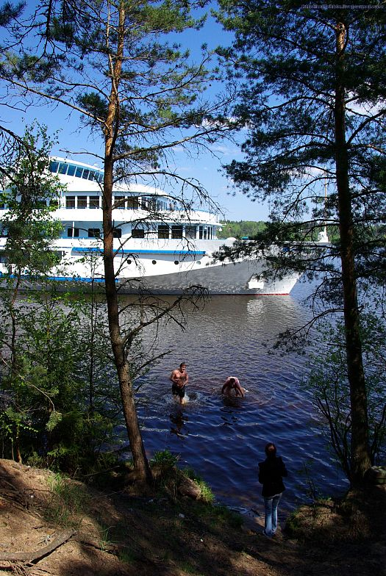
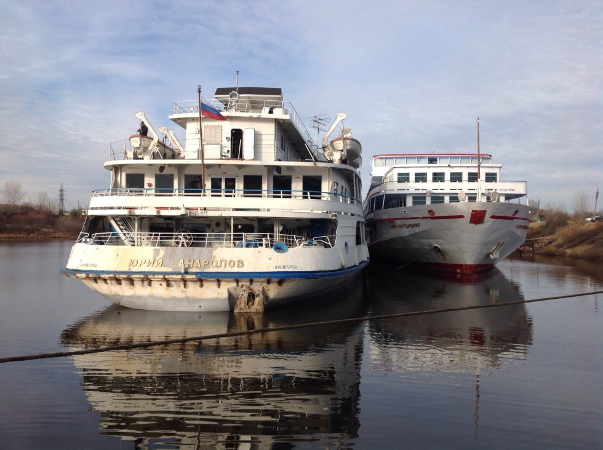
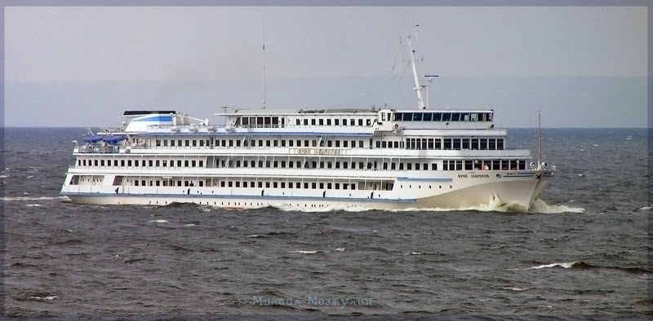

Slide 5
Suite cabin with living room and bedroom

Slide 6
Ordinary cabins
Double cabin
Single cabin

Slide 7
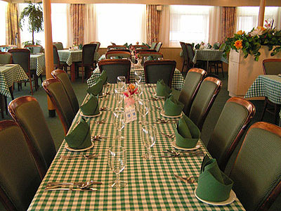
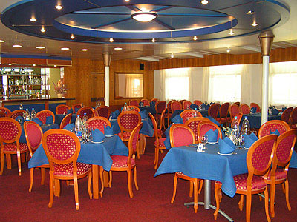
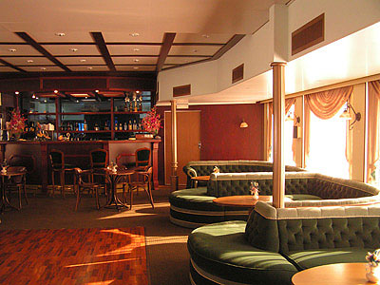
Services:
- Restaurant
- Disco Bar
- Bar «Panorama»
- Bar «Private»
- Conference hall
- Solarium
- Sauna
- Medical room
- Laundry
- Ironing room
- Souvenir shop

