Slide 1
Progress check 3
by A.V. Rezvykh

Slide 2
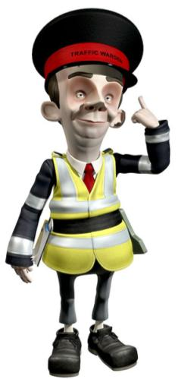
Fill in the gaps with can or can’t
You …….. go here.
can’t
You …….. turn right.
can’t
You …….. drive at 45 mph.
can
can
You …….. park here.
You …….. go straight here.
can
You ……. park here.
can’t

Slide 3
Guess the words
traffic
sign
yellow
lines
seat
belt
bike
lanes
zebra
crossing
door
handle
parking
zone
lean
out

Slide 4
Fill in: in, on, by, of
in
1. He’s travelling ….. the 8 o’clock train.
on
2. We go to school …. foot.
3. She is afraid of travelling … plane.
by
of
4. Don’t lean out … the window.
on
5. Walk … the pavement.

Slide 5
Write the opposites
go
come
turn left
turn right
go up the street
go down the street
red lights
green lights
fast
slow

Slide 6
Put the words in the correct order to form full sentences
1. Look both ways before you cross the road.
1. both/cross/ways/look/before/you/road/the
2. parked/cross/between/don’t/cars.
2. Don’t cross between parked cars.
3. traffic/against/ride/don’t.
3. Don’t ride against traffic.
4. bicycle/wear/helmet/a.
4. Wear a bicycle helmet.
5. pavement/stand/on/the.
5. Stand on the pavement.

Slide 7
Put sentences in the correct order to make a dialogue
2
Yes, there’s one quite near.
You’re welcome.
How can I get there?
Excuse me, is there a hospital near here?
Go down Bridge road and turn left into Green Street.
Thank you.
6
3
1
4
5

Slide 8
Resources
Учебное пособие – «Английский в фокусе для 6 класса», издательство Макмиллан, 2008
Тема презентации –http://www.free-power-point-templates.com/
Инспектор - http://www.ssmc.com.my/index.cfm?&menuid=27&parentid=3

