Slide 1
Time travellers grade 9 (English in mind 4)
Teacher: Vershkova D.V.
Pavlovskaya Gymnasium
2014

Slide 2
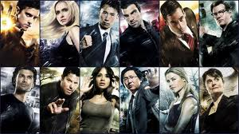
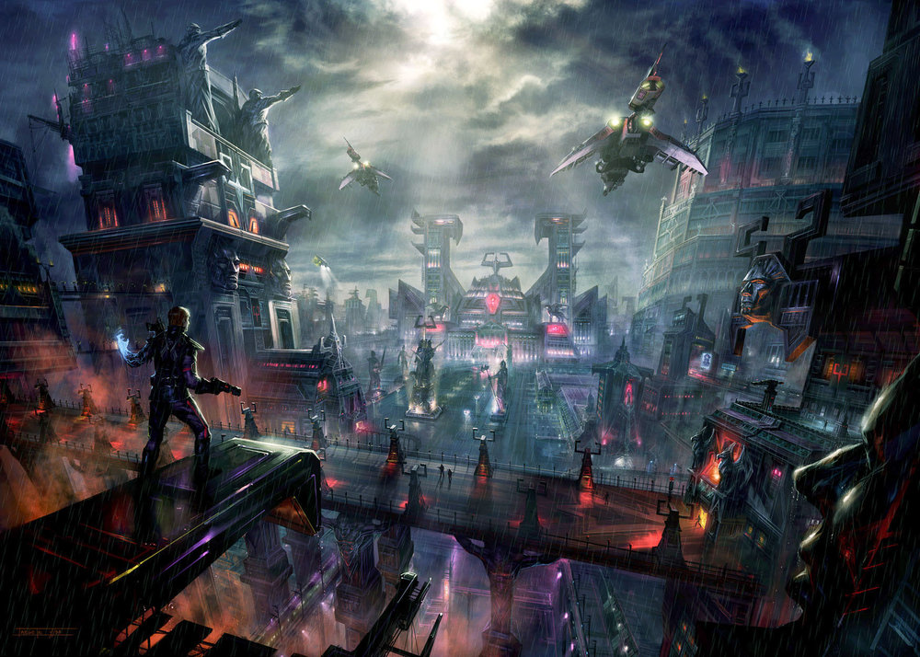
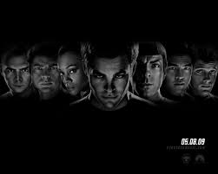

Slide 3
What does science fiction mean?
Think of as many science fiction films or TV programmes as possible.
Choose your favourite and explain it to your class.

Slide 4
Watch the trailer and guess the theme of the lesson.

Slide 5
What TV series is this?
charismatic /ˌkærɪzˈmætɪk/
enthusiastic /ɪnˌθjuːziˈæstɪk/
Doctor Who

Slide 6
Read the extract and complete the statements.
The wait is over. After more than 18 months without appearing regularly on our Saturday night TV screens, Doctor Who finally returns this evening. In this new series, the charismatic time-travelling Time lord is played by Matt Smith, while Karen Gillan plays enthusiastic assistant, Amy Pond. How well will Matt Smith do in one of the biggest roles on British TV? Watch tonight’s episode? The Eleventh Hour, and find out.

Slide 7
Vocabulary
to take over (to begin to do something that someone else was doing)
to launch (to start a major project such as a new project)
genre /ˈʒɒnrə/
dimensionally transcendental
to creep up on (to move towards someone quietly and slowly)
To crush someone to death (to injure or kill someone by crushing them)
To be glued to something (to be looking at something and not paying attention to anything else)
dimension
/daɪˈmenʃ(ə)n/ the size of something
transcendental /ˌtrænsenˈdent(ə)l/ uncertain, undefined

Slide 8
Discuss with your partner.
Doctor Who is capable of travelling back through time.
Think of the era you would like to visit and why.
Discuss what different things you would find if you visited another period of time.

