Slide 1


Slide 2
HOBBY

Slide 3
What do you think we will do today?
We will READ
WRITE
LISTEN
SPEAK ENGILSH
PLAY GAMES

Slide 4
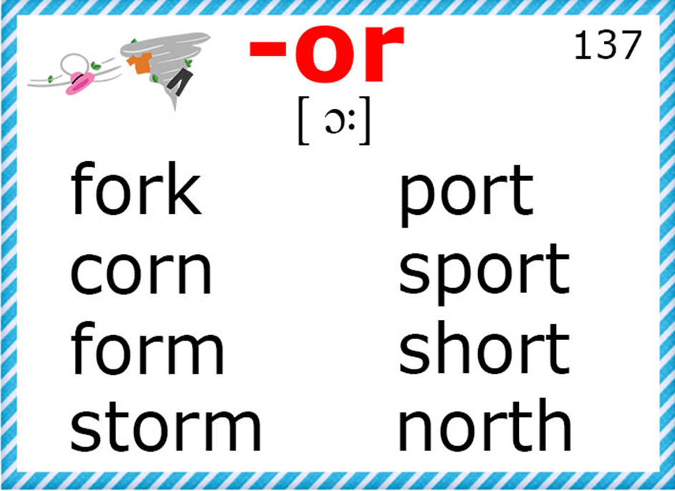

Slide 5


Slide 6
Homework
Нарисовать на альбомном листе ваше хобби, подписать

