Slide 1
Great Britain
English teacher: Natalie Ivanova
School 2070
Moscow

Slide 2
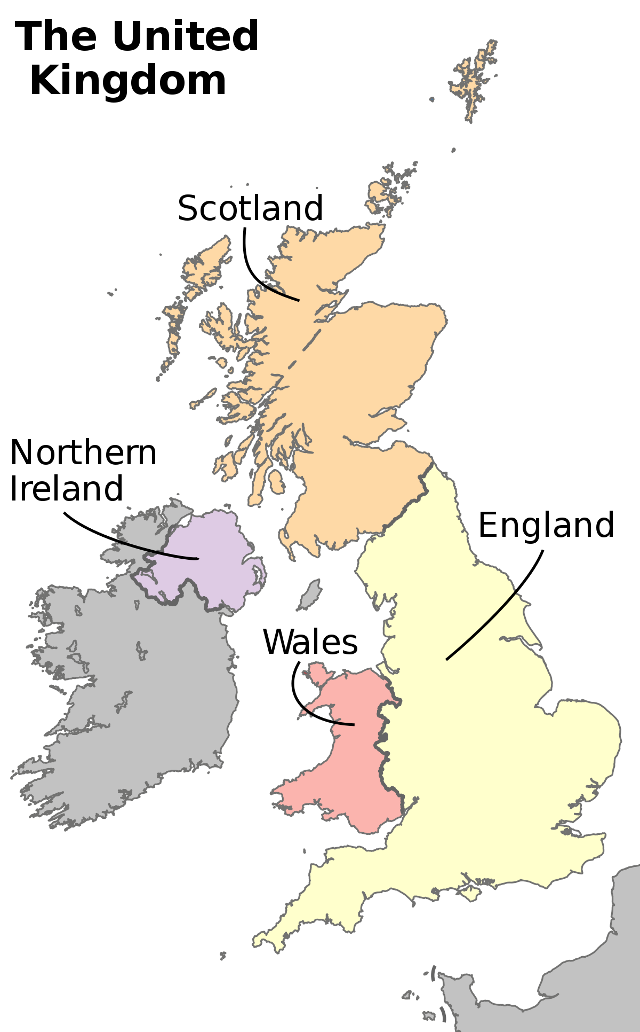
The United Kingdom of Great Britain and Northern Ireland
The United Kingdom of Great Britain was formed in 1707 as a result of the political unification of the kingdoms of Scotland and England.

Slide 3
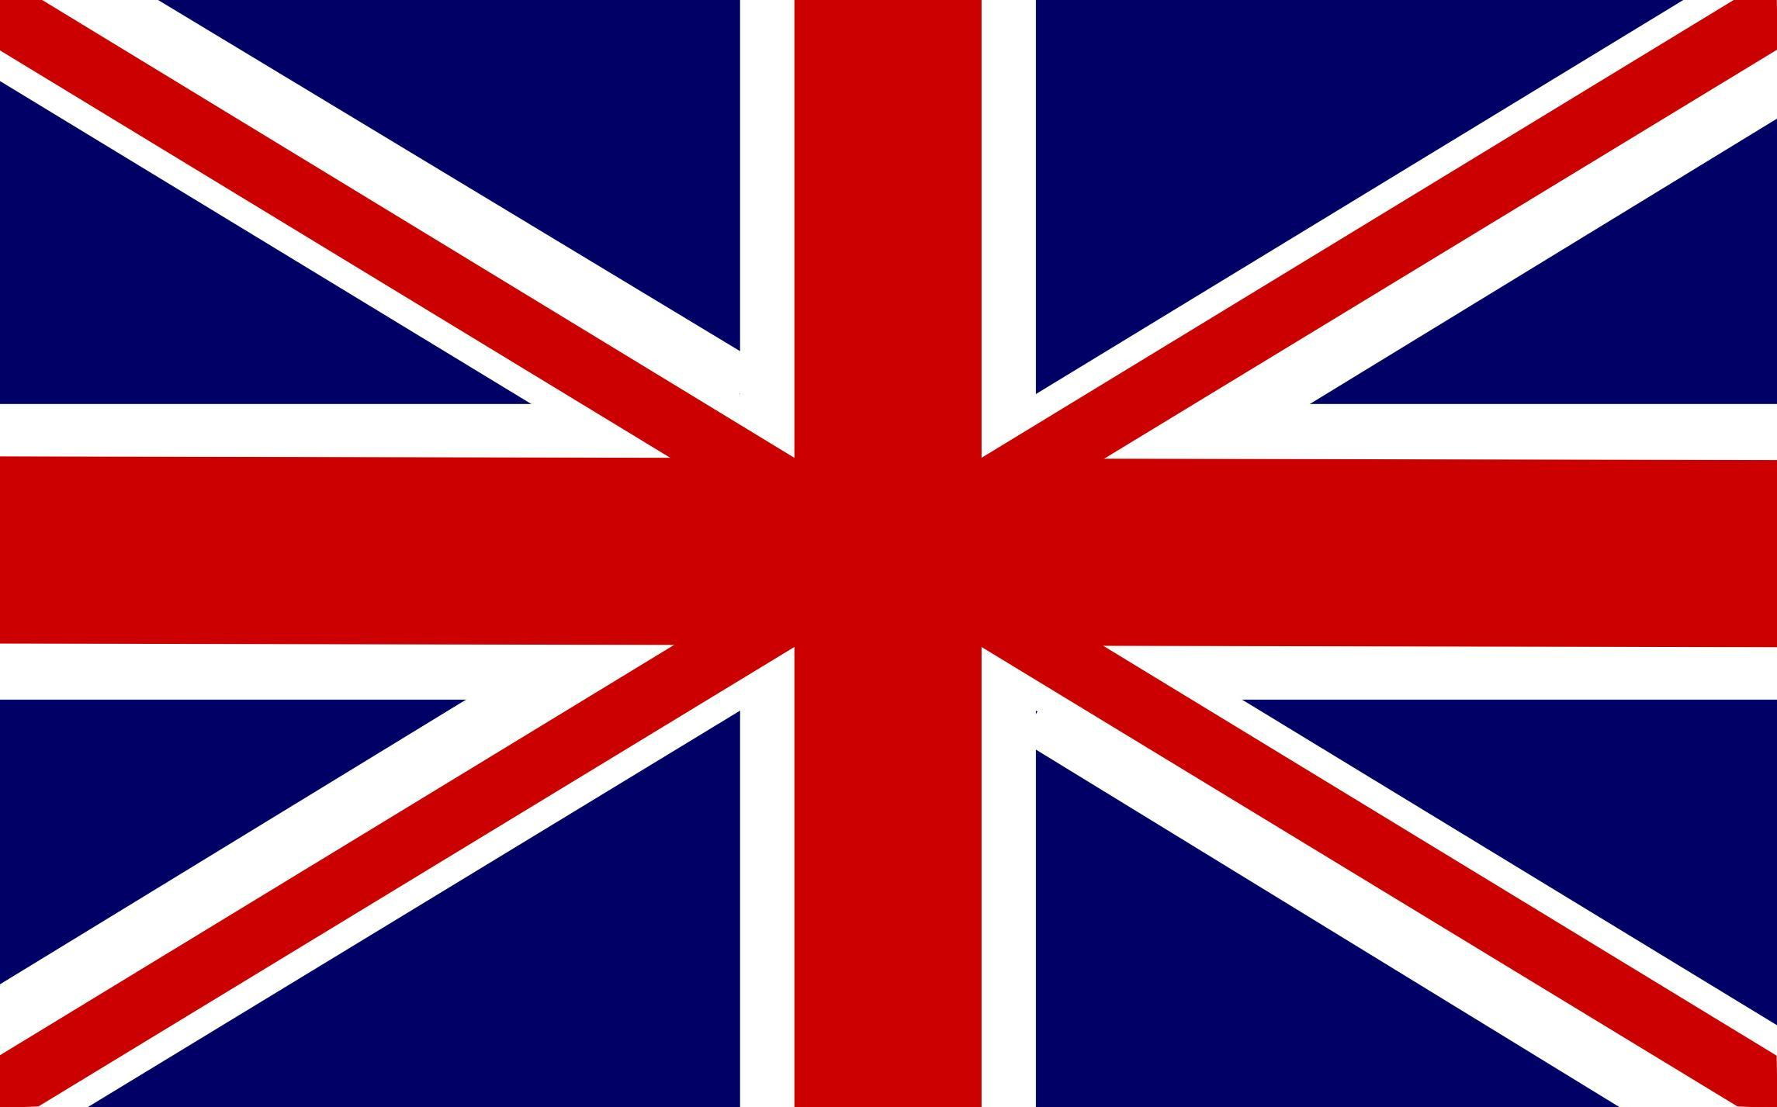
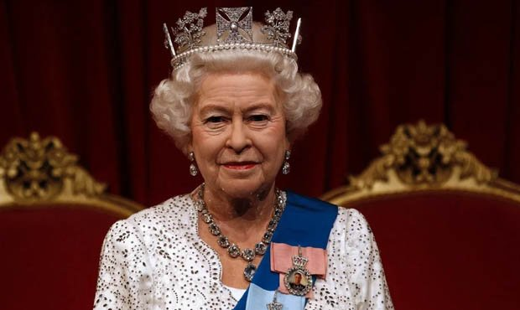
State flag of Great Britain is Union Jack:
The total area of ​​Great Britain is 244,017 square kilometres.
London is the capital of Great Britain.
The form of government is a constitutional monarchy.
The UK has a population of 62 million people.

Slide 4
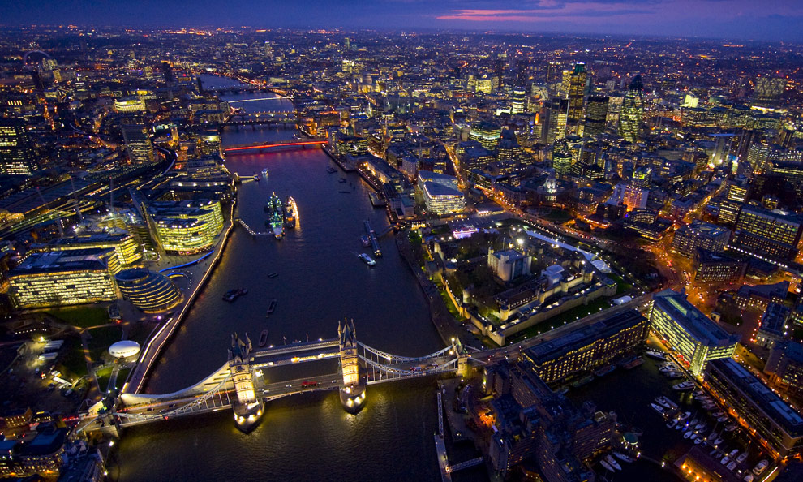
Sights

Slide 5
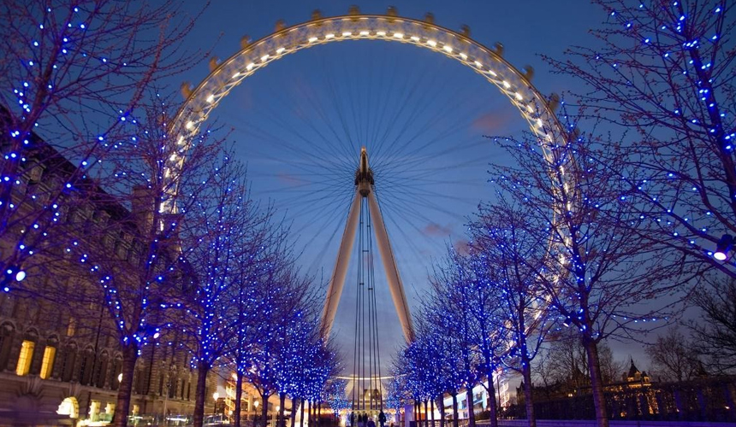
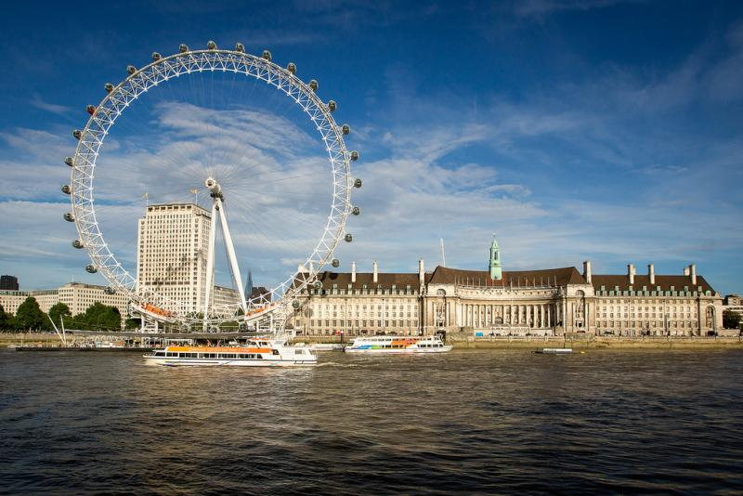
The London eye
The height is 135 meters.
The movement speed is relatively low, so it takes about half an hour to complete a full circle.
From a height you can see all the districts of London, the London eye itself is also visible from almost everywhere.
The cabins are spacious enough to accommodate 25 people.

Slide 6
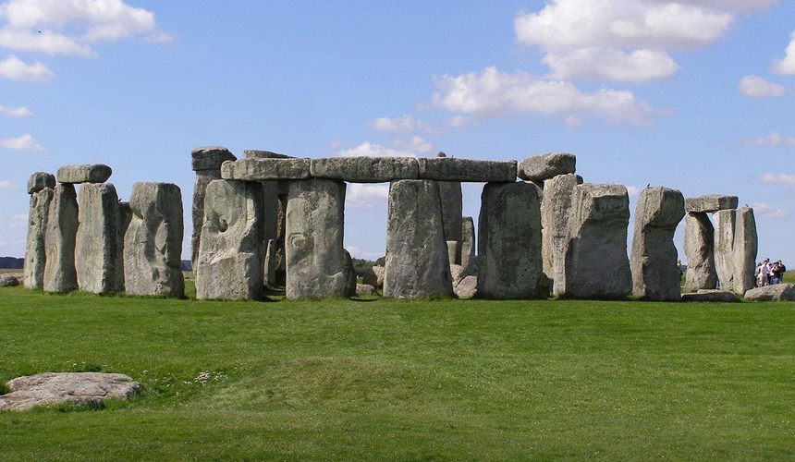
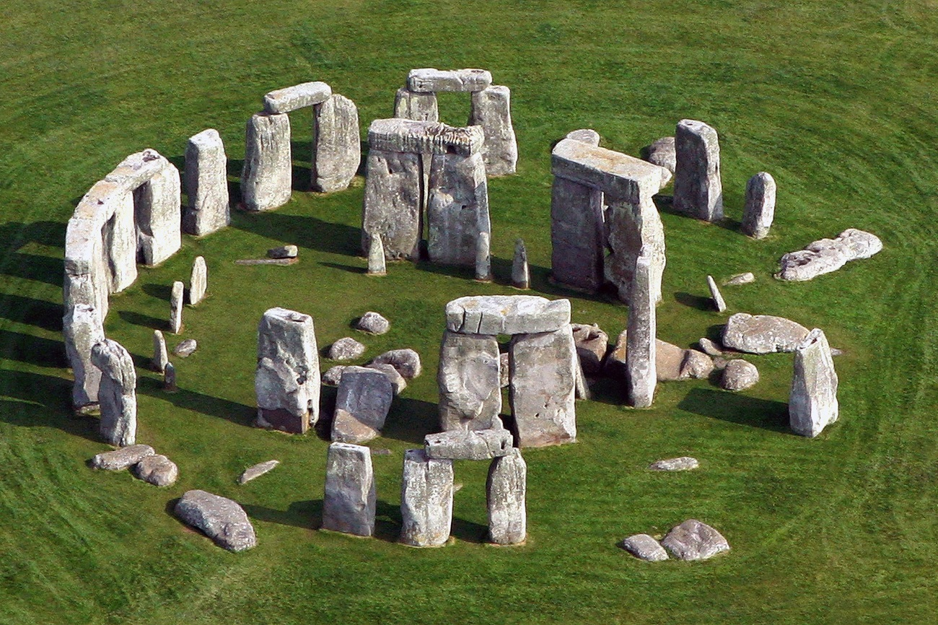
Stonehenge
This is a grand pile of stone megaliths weighing up to 45 tons. Scientists do not have a consensus on the purpose of this structure, there are only assumptions. The monument also belongs to the UNESCO World Heritage List. It is located 130 km from the capital.

Slide 7
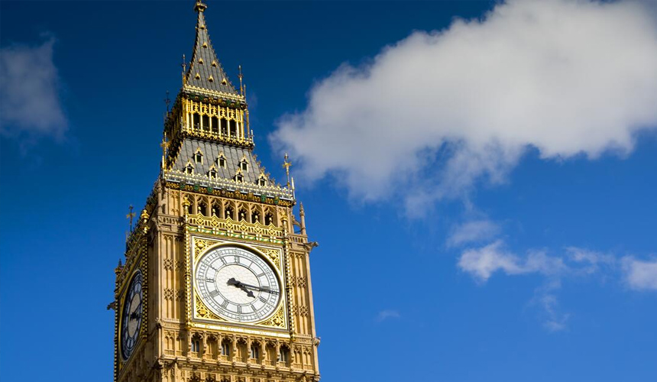
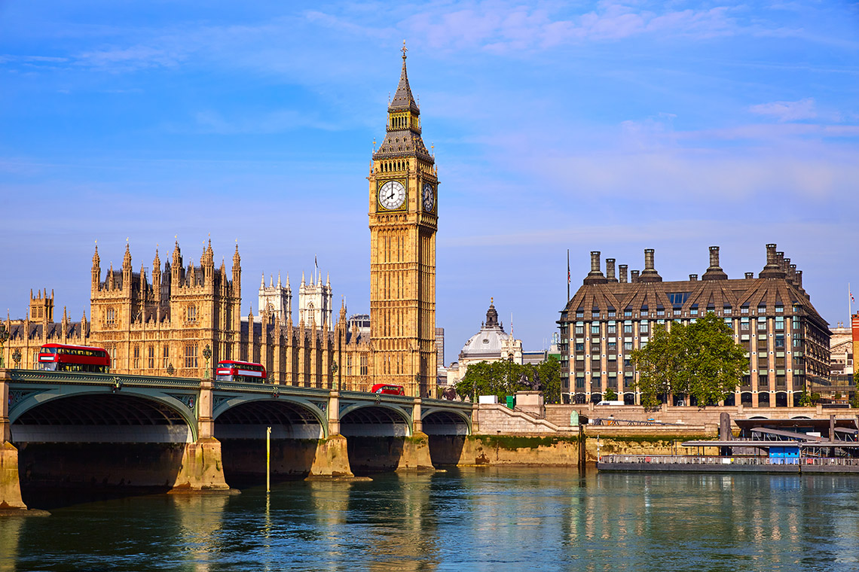
Big Ben
Big Ben is a symbol of London and the whole of Great Britain. A lot of people believe that only the clock and the clock tower are called so, but in fact this is the name of the largest bell of Westminster Palace, which beats the time. The diameter of this bell is 7 metres.

Slide 8
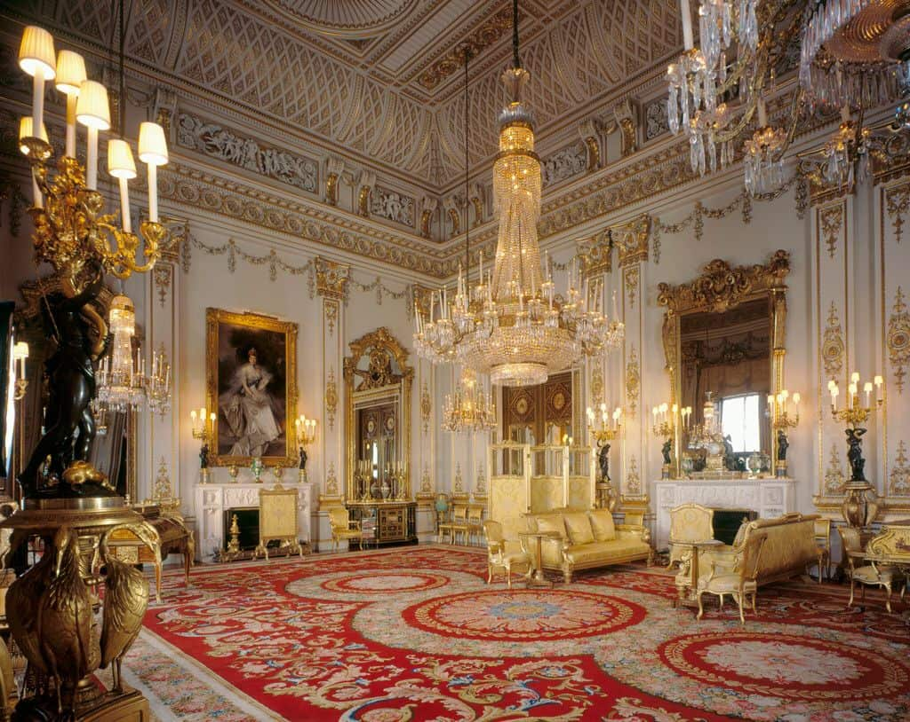
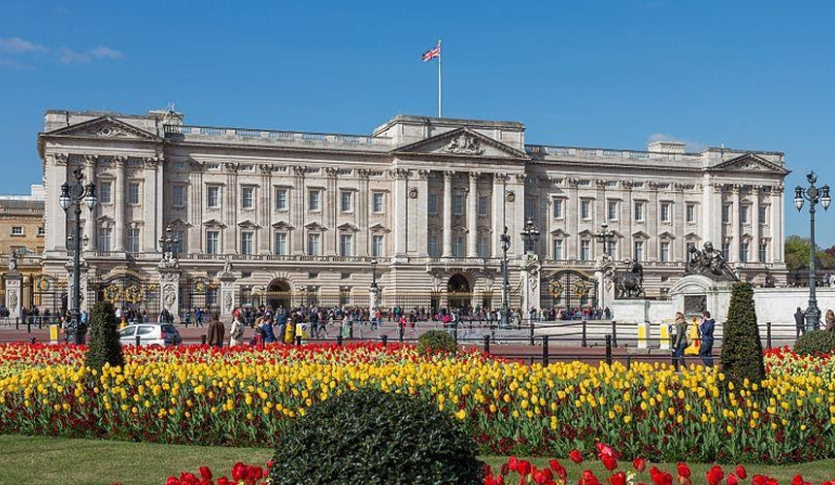
Buckingham Palace
Buckingham Palace is the current London royal residence. Today Queen Elizabeth II works and lives here. There is a hospital, a police station, a post office, a bar, a swimming pool. Many tourists want to get here to see how the guard of the guards is changing at the palace.

Slide 9
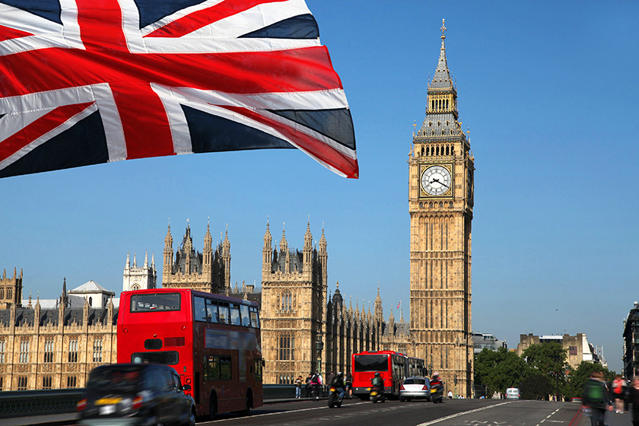
Thanks for attention!

