Slide 1
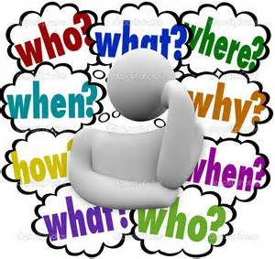
Урок-викторина “Who Wants to Be the Champion?” (9 класс)
Презентация учителя английского языка ГБОУ Школа №1239 Маккавеевой Е.Е

Slide 2
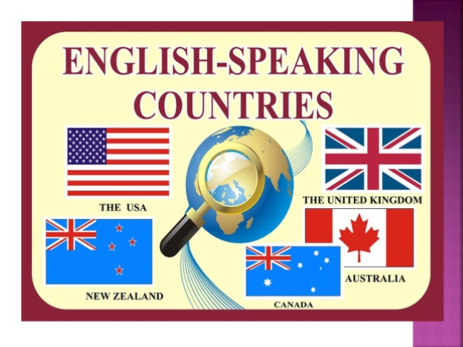
Sector 1
Preliminaries. «Guess the Country» Quiz.

Slide 3

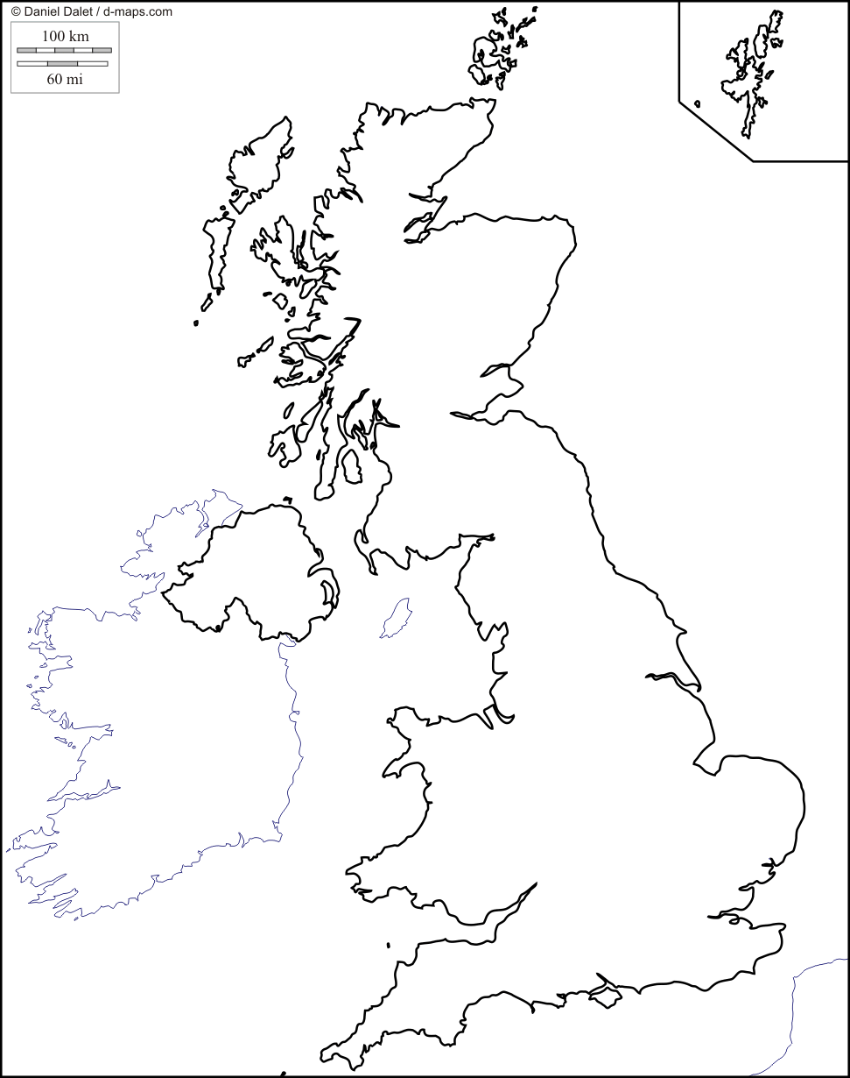
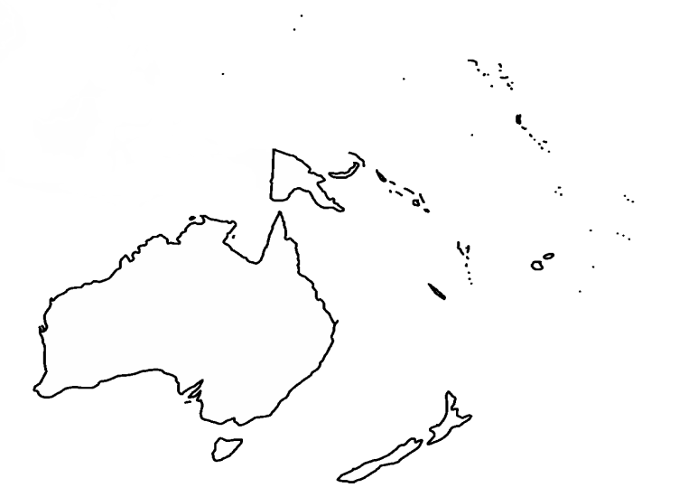
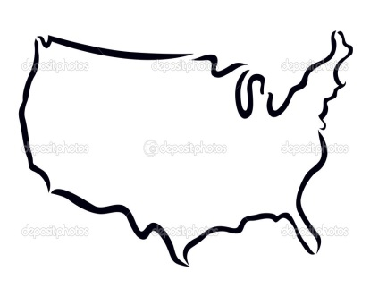
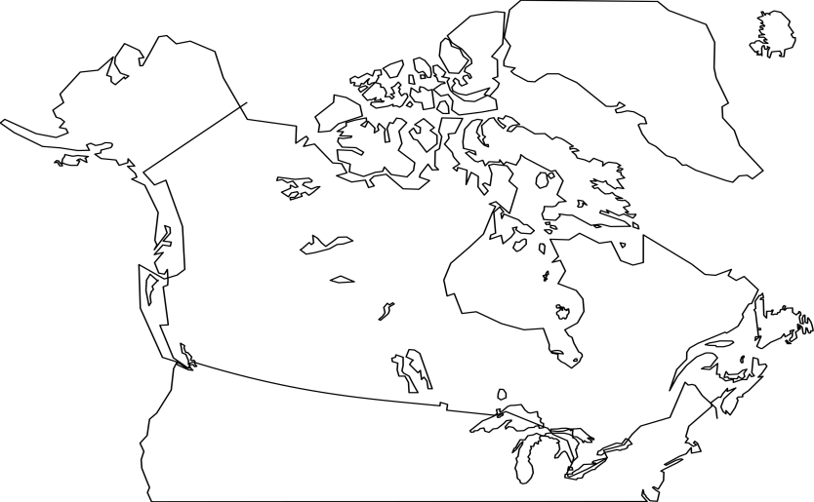
1-1 Preliminaries. Task 1. Задание «Shape».
Рисунок 2
Рисунок 3
Рисунок 1
Country 3
Рисунок 4
Country 1
Country 4
Country 2
Рисунок 5
Country 5

Slide 4
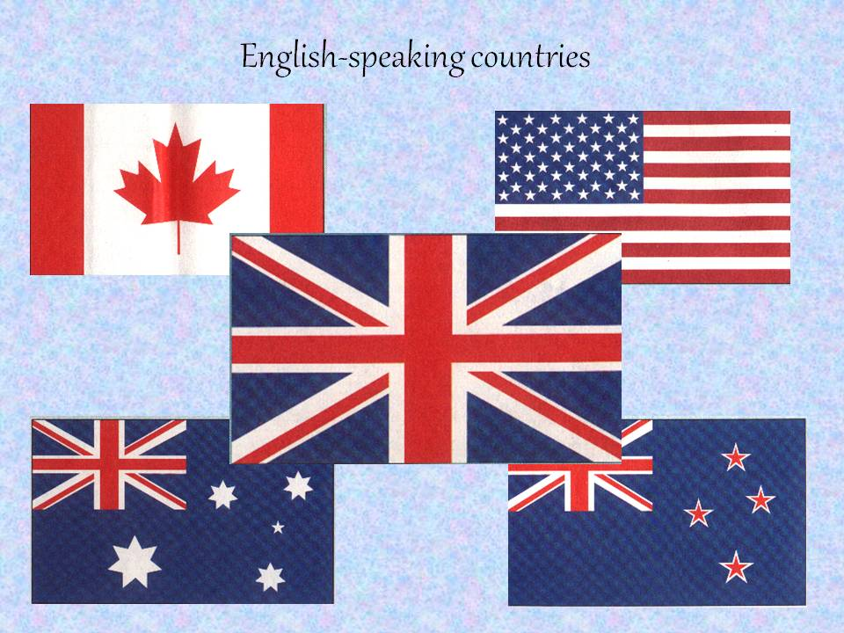
Preliminaries. Task 1. Задание «Stop Game».
Sector 2

Slide 5
2-1 The Description of Country 1:
The country is situated on a group of islands lying in the north-west part of the continent of Europe. It consists of four parts. The climate of the country is changeable. The surface of the country varies very much. The north of it is mountainous, while the south has beautiful valleys and plains. There are a lot of rivers in it, but they are not very long. The population of the country is almost 56 million. It is one of the highly developed industrial countries in the world with old cultural traditions and customs. The head of the state is the Queen.
(The United Kingdom of Great Britain and Northern Ireland).

Slide 6
2-2 The Description of Country 2:
The country is situated in the central part of the North American continent. Its western coast is washed by the Pacific Ocean and its eastern coast by the Atlantic Ocean. The population of the country is more than 236 million people. It is a very large country, the climate varies greatly. In the southern part it is subtropical while in the northern part it is arctic. There are many great rivers in the country. It is a country of highly developed industry and agriculture. It is one of the richest countries in the world. It is the fourth largest nation in the world. The head of the state is the President.
(The United States of America).

Slide 7
2-3 The Description of Country 3:
It is a country in the northern part of North America. It extends from the Atlantic to the Pacific, covering 9.98 million square kilometers. The population of the country is over 26 million people. The climate of the country varies greatly from arctic weather in the north, to hot summers in the southern regions. It is a federal state. There are two official languages in this country: English and French.
(Canada).

Slide 8
2-4 The Description of Country 4:
The country is situated some 1,500 kilometers east of Australia. It consists of the large islands called North Island, South Island and Stewart Island and around 600 smaller islands. The population of the country is over 3 million people. This country is a member of the United Nations, Commonwealth of Nations. It is identified as one of the world's most stable and well-governed states.
(New Zealand).

Slide 9
2-5 The Description of Country 5 :
The country is surrounded by the Indian and Pacific Oceans. It is a sovereign country comprising the mainland of whole continent, the island of Tasmania and numerous smaller islands. It is the largest country in Oceania and the world's sixth-largest country by total area. The country has an area of nearly 8 million square kilometers. The population of the country is over 16 million people.
(The Commonwealth of Australia).

Slide 10
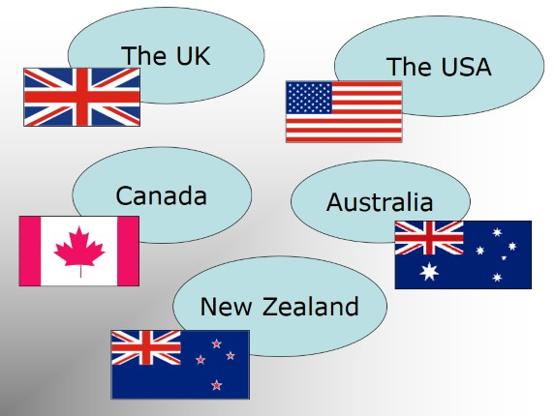
r
Sector 3
Countries

Slide 11
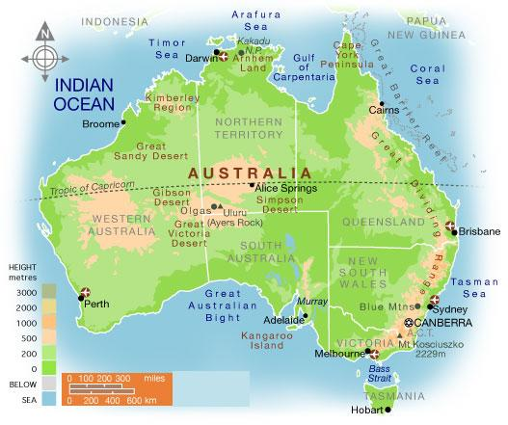
3-1 What country is the lowest continent in the world ?
Australia is the lowest continent in the world, with an average height of just 330m above sea level.

Slide 12
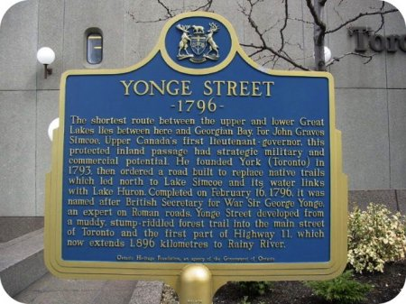
3-2 Which country is home to the longest street in the world?
Canada is home to the longest street in the world. Yonge Street runs north through Ontario to the Minnesota border, a distance of almost 2,000 km.

Slide 13
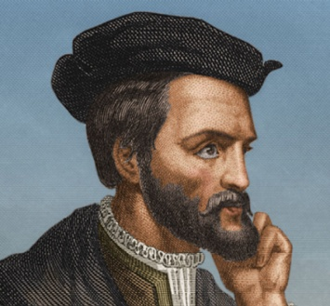
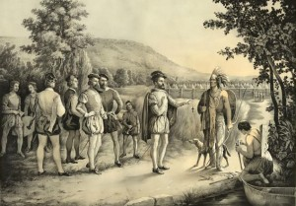
3-3 What country was named through a misunderstanding?
Canada was named through a misunderstanding. When Jaques Cartier, a French explorer, came to the new world, he met with local Natives who invited them to their 'kanata' (the word for «village»). It was mistakenly thought the name of the country was "Kanata" or Canada.

Slide 14
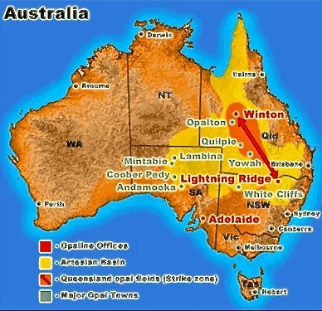
3-4 Where over 90% of the world's opals are mined?
Map showing opal mining towns

Slide 15
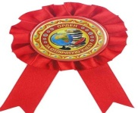
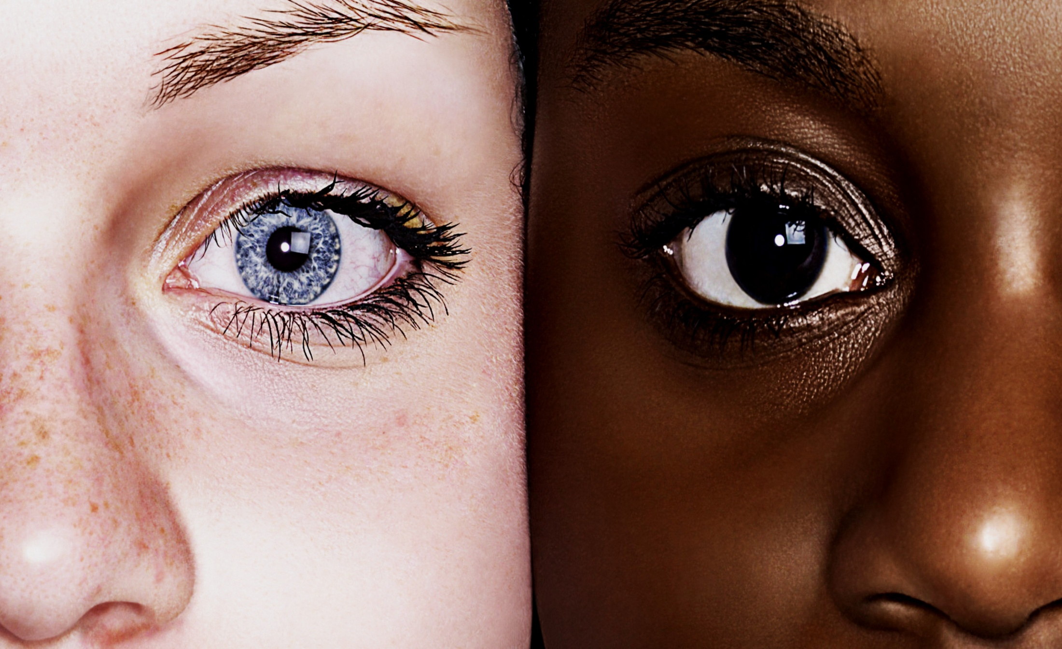
3-5 What country has the population just over four million?
The population of New Zealand is just over four million, making it one of the world’s least populated countries

Slide 16
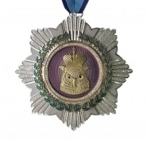
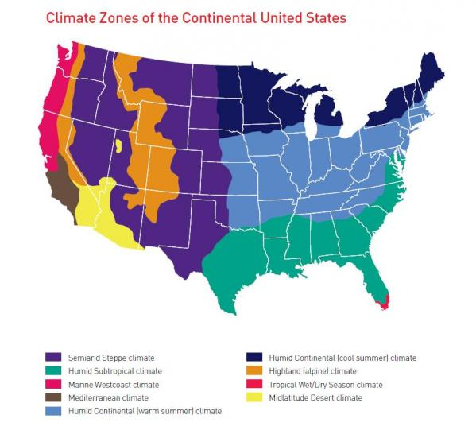
3-6 Which of English-speaking countries has practically every kind of climate?
The country has practically every kind of climate

Slide 17
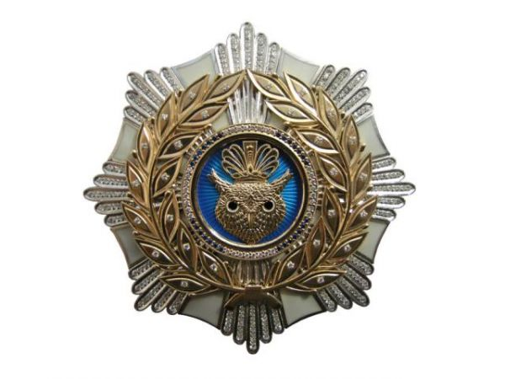
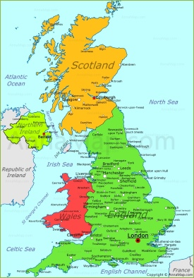
3-7 What country consists of four parts having their own capitals?
The United Kingdom (UK) comprises four countries:
England, Scotland and Wales (
which collectively make up Great Britain) and Northern Ireland

Slide 18
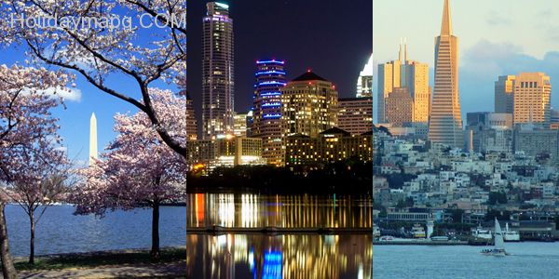
Sector 4
Cities

Slide 19
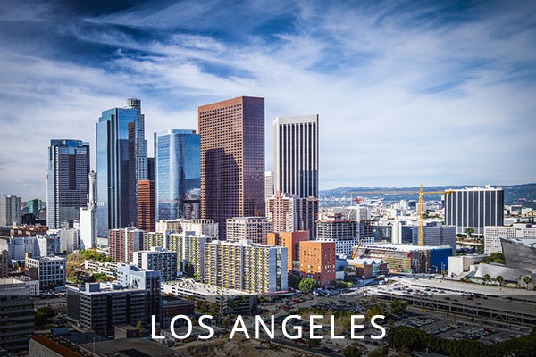
4-1 Where in the world is «the City of Angels» situated?
is America’s second largest city. Its name comes from the Spanish for ’the City of Angels’

Slide 20
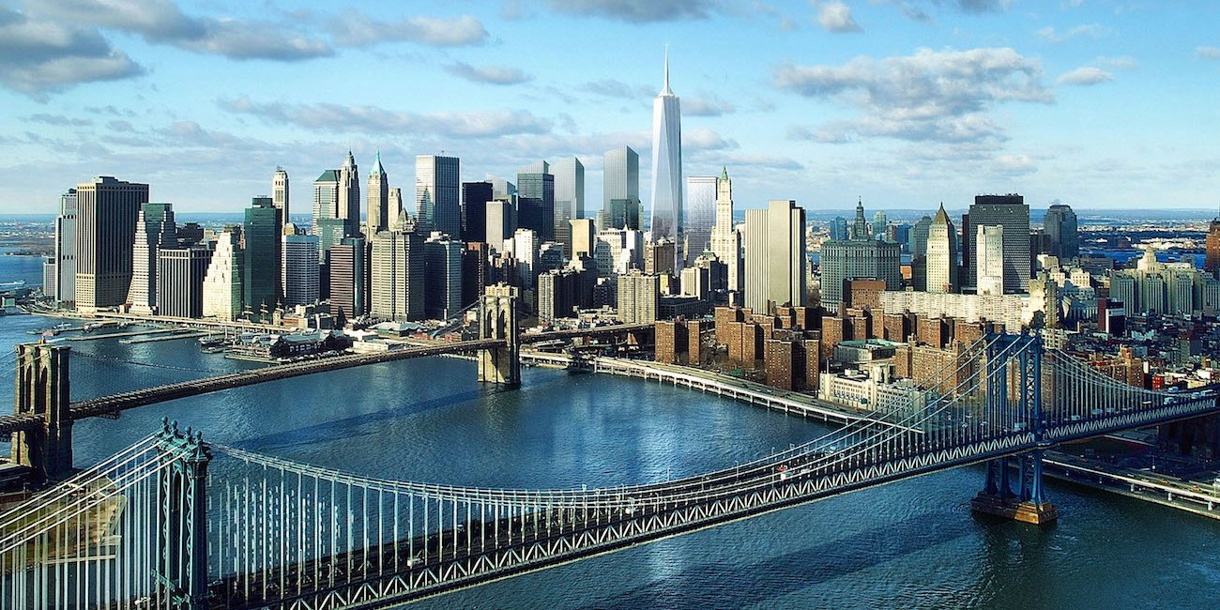
New York was called the "melting pot" because when people from other countries immigrated they mainly came to NY (all kind of immigrants fromeverywhere around the world are mixed in NYC ).
4-2 What city was called the "melting pot"?

Slide 21
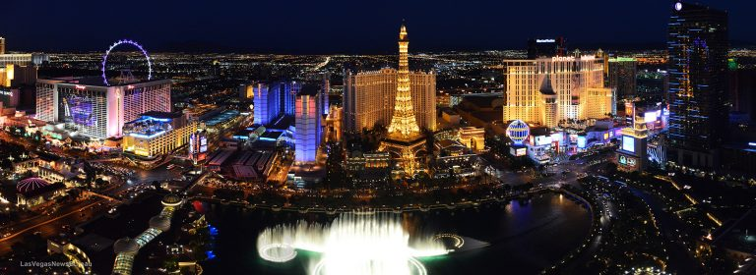
4-3 What city is famous as a city of casinos?
Las Vegas

Slide 22
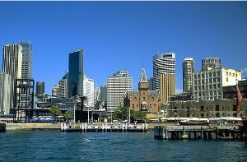
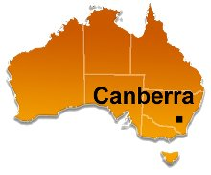
4-4 What is the capital selected due to not stop arguing which city should be the capital?
Canberra was selected as the capital of Australia because Sydney and Melbourne could not stop arguing which city should be the capital of Australia.

Slide 23
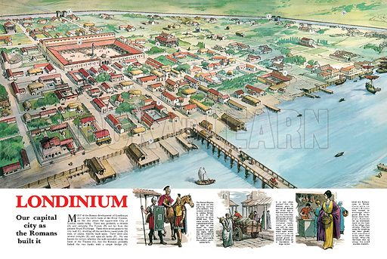
4-5 What city is the capital and has been a major settlement for two millennia?

Slide 24
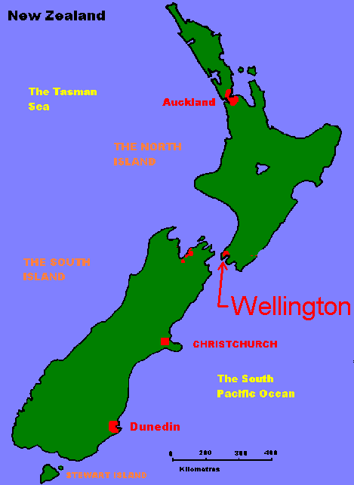
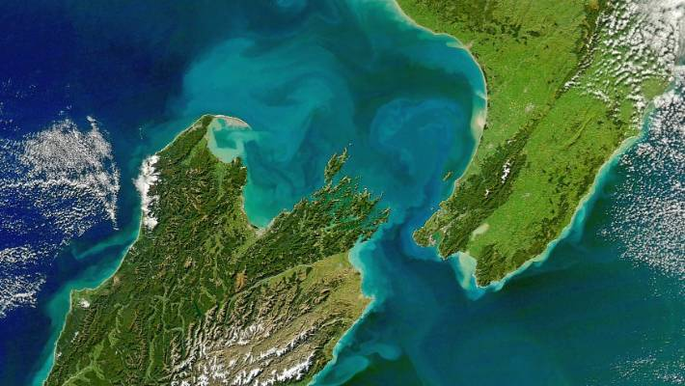
4-6 What capital is the world's windiest city?
"Wellington (NZ) in general is quite hilly which helps make it gusty, with winds tumbling over the hills and into the city. One of the strongest gusts recorded was 202kmh on Wellington's Mt Kaukau in 2013."

Slide 25
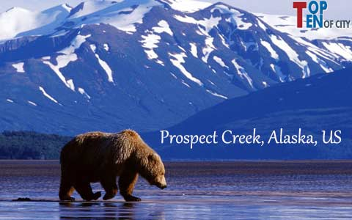
4-7 Where was the lowest temperature in the United States ever recorded ?
In1971,

Slide 26

People
Sector 5

Slide 27
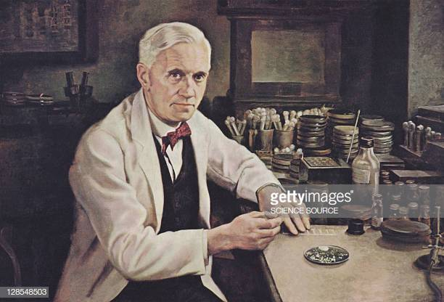
5-1 Where was the discoverer of penicillin born?
Alexander Fleming
was born in Scotland

Slide 28
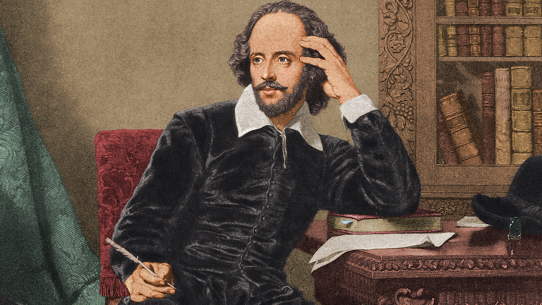
5-2 Who is one of the most famous writers in the world and whose plays were translated into almost every language?
William Shakespeare

Slide 29
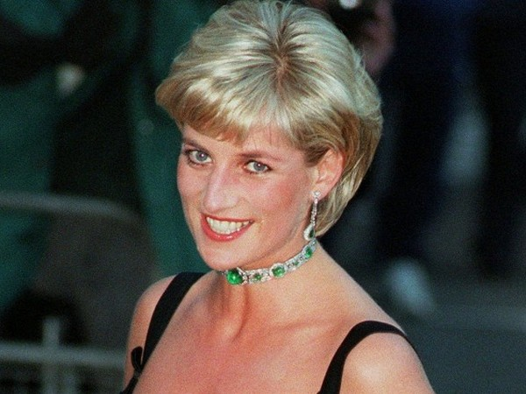
5-3 Who before becoming the most beloved person in Great Britain, worked as a cook or a nanny in the kindergarten?
Princess Diana

Slide 30
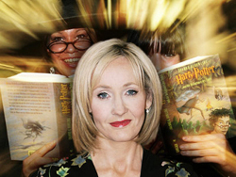
5-4 Who has achieved a record to make a billion dollars from writing books?
Joanne Rowling ( born 31 July 1965)

Slide 31
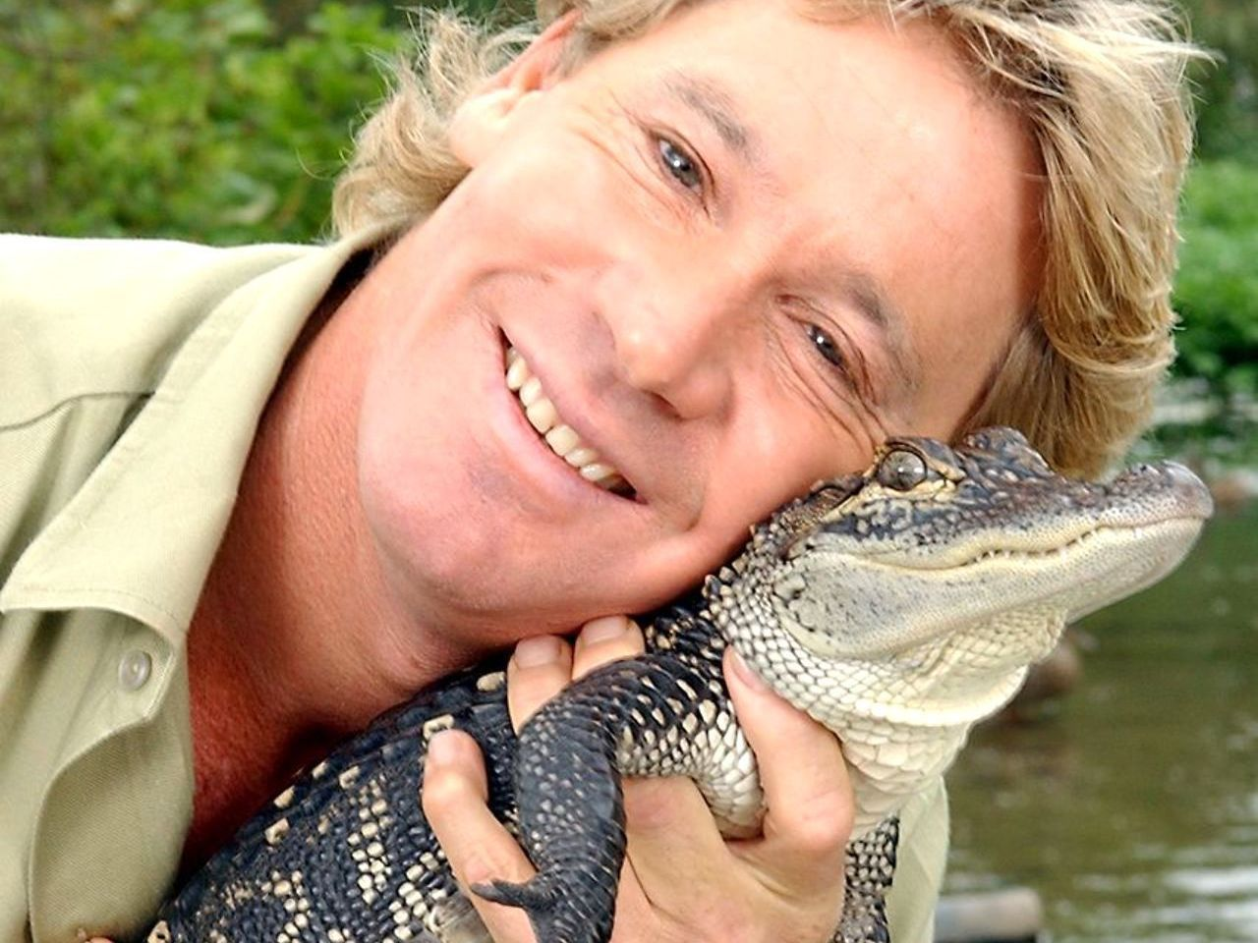
5-5 Whose show «The Crocodile Hunter» was an exciting adventure?
Steve Irwin, Australia
Steve Irwing

Slide 32
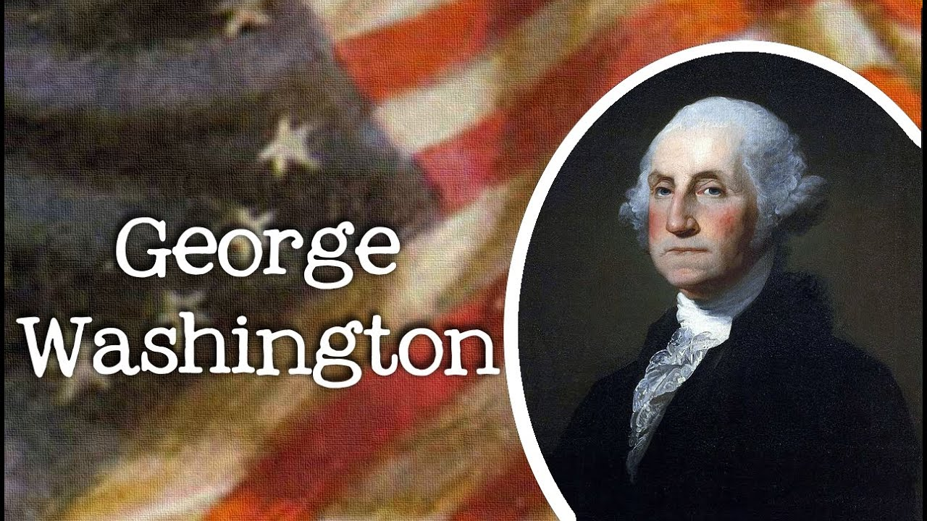
5-6 Who was the first president of the United States of America?

Slide 33
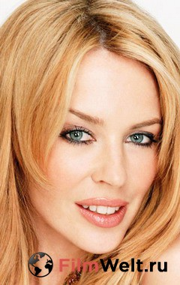
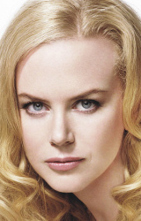
5-7 What nationality are the famous actresses
Kylie Minogue and
Nicole Kidman?
They are Australians

Slide 34

Sector 6

Slide 35
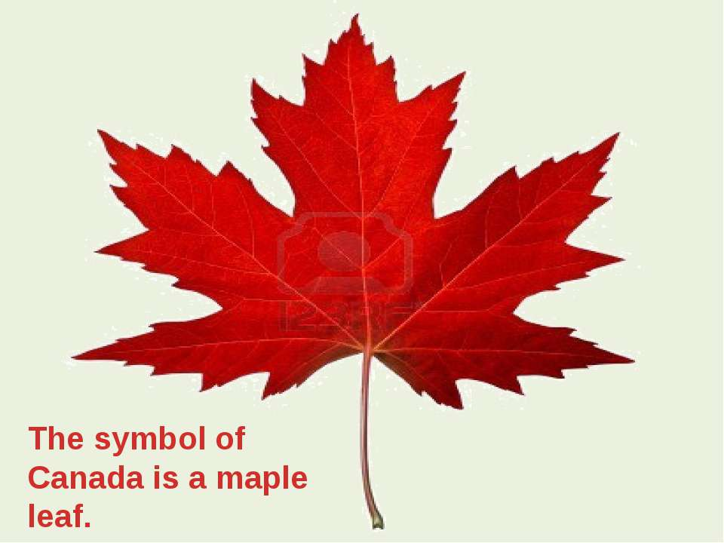
6-1 What is the national symbol of Canada?

Slide 36
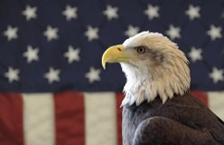
6-2 What is the National bird of the United States ?
The bald eagle

Slide 37
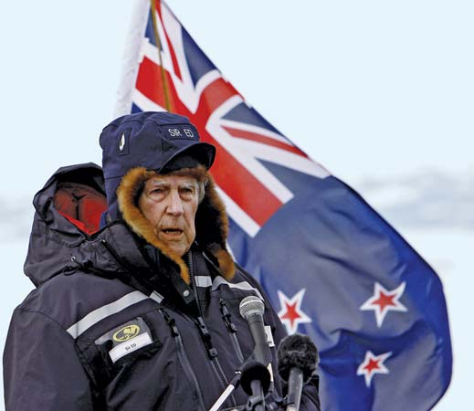
6-3 Who was the first person to climb Mount Everest in 1953?
Sir Edmund Hillary, a New Zealander

Slide 38
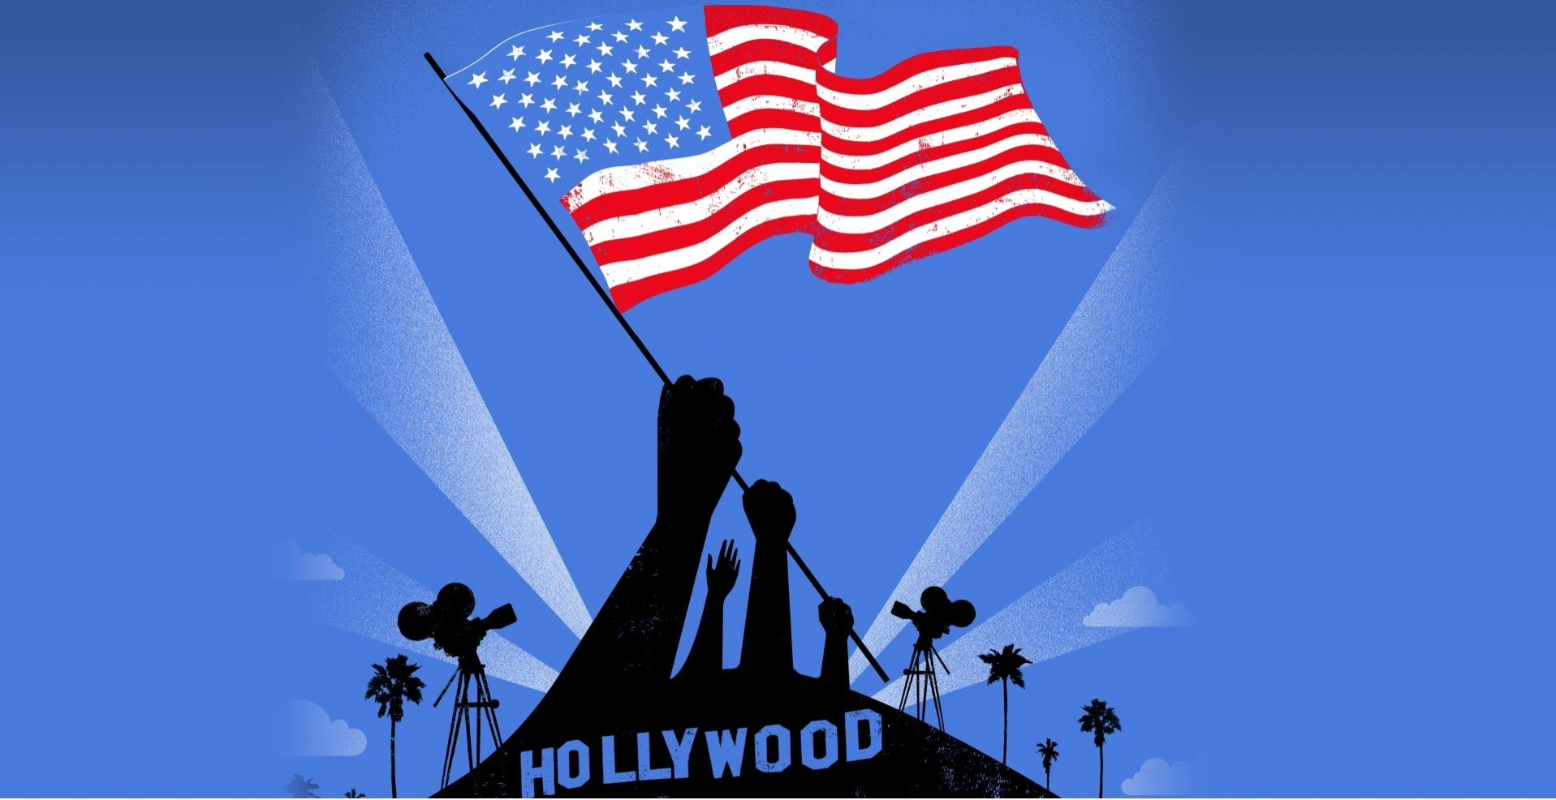
6-4 What place is considered to be the movie capital of the world?
America
,

Slide 39
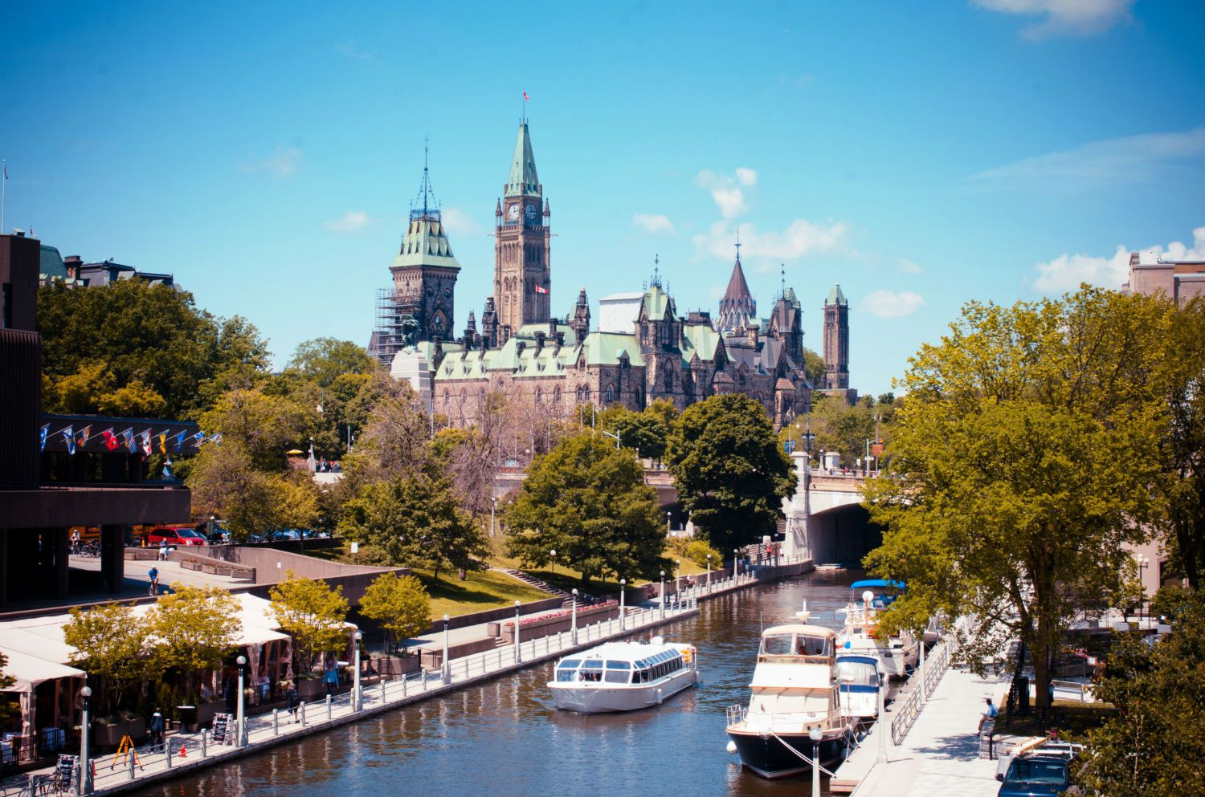
6-5 How was the city name "Ottawa" chosen?
From the Algonquin Odawa, meaning "to trade"

Slide 40
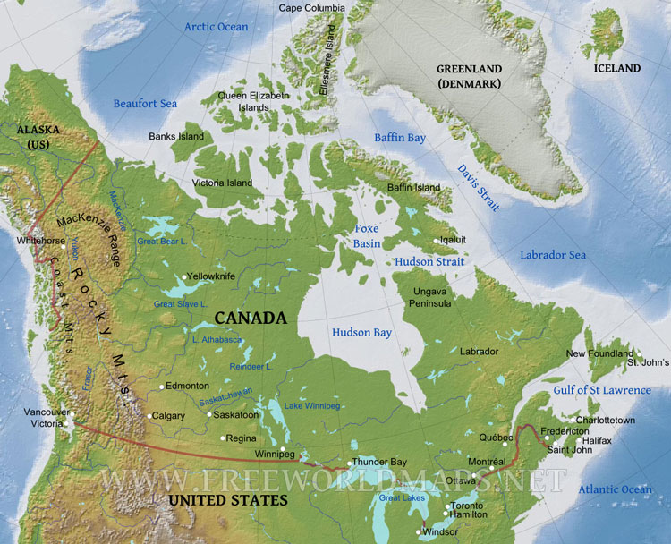
6-6 Which country has more lakes than any other country in the world?
has 561 lakes with a surface area larger than 100 km²

Slide 41
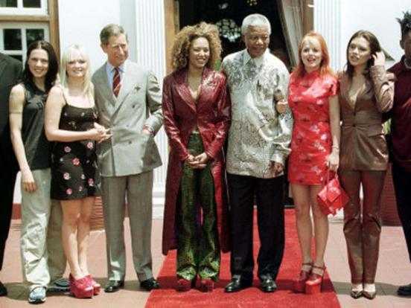
6-7 In what country did the pop girl group Nelson Mandela liked work?
Nelson Mandela called «The Spice Girls» (the UK) his heroes when he met them.

Slide 42

Sector 7. The Final
If necessary

Slide 43
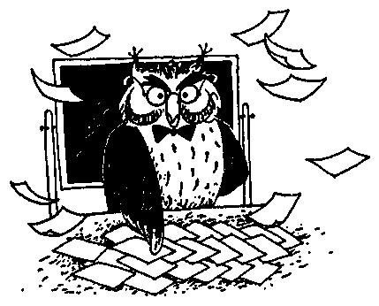
7–1 The Final
Make as many words as you can out of the word frightened.
Write them down.

Slide 44
The best result is 16 words.
Answers:
light, ghost, end, right, tent, finger, friend, high, height, flight, night, fight, bring, dig, fog, tree.

Slide 45

4-7 In what country worked the pop girl group Nelson Mandela liked?
The Spice Girls, the UK

Slide 46


The End.
Good Luck!

