Slide 1
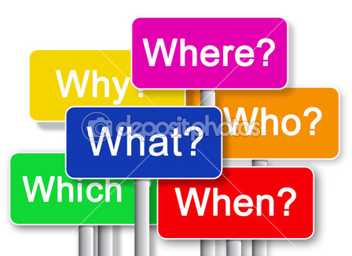
Урок-викторина “Who Wants to Be the Champion?”
Презентация учителя английского языка ГБОУ Школа №1239 Маккавеевой Е.Е

Slide 2
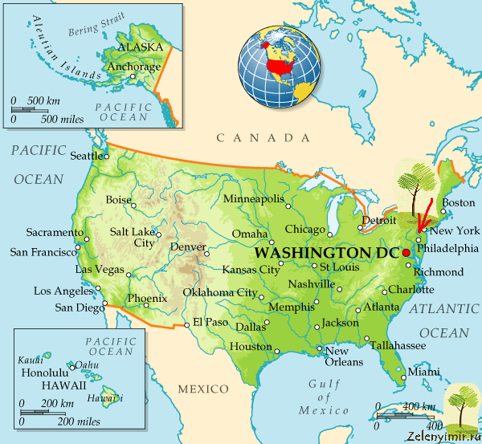
The USA Quiz. Sector 1

Slide 3

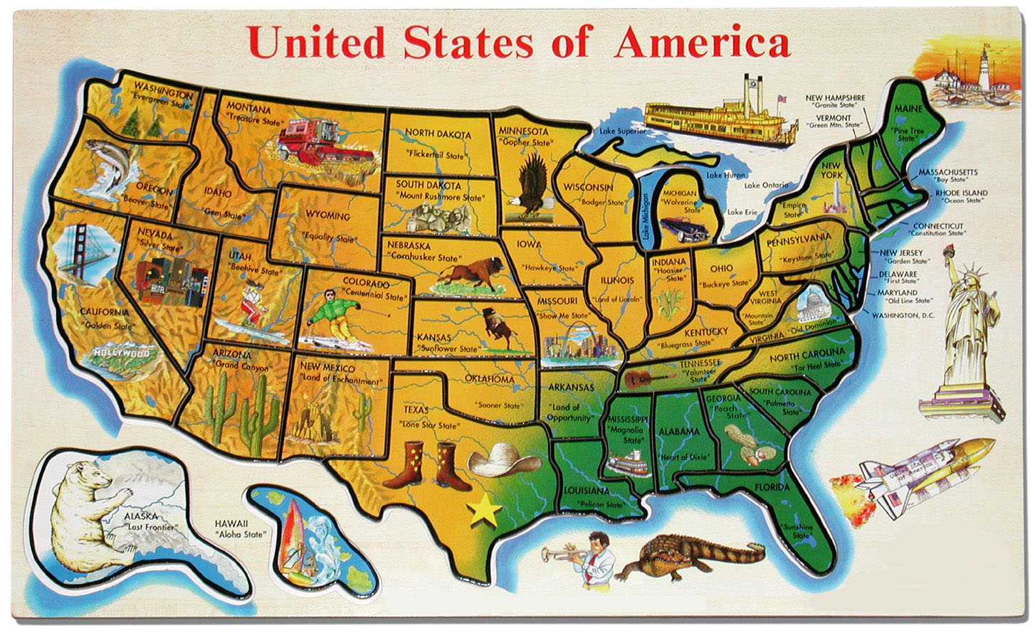
1-1 How many states are there in the USA?
50 states

Slide 4

1-2 How is the American flag called?
Nickname for the flag is The Stars and Stripes

Slide 5
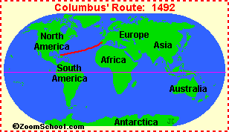
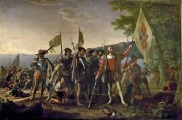
1-3 (Bonus!) When did Christopher Columbus discover America?

Slide 6
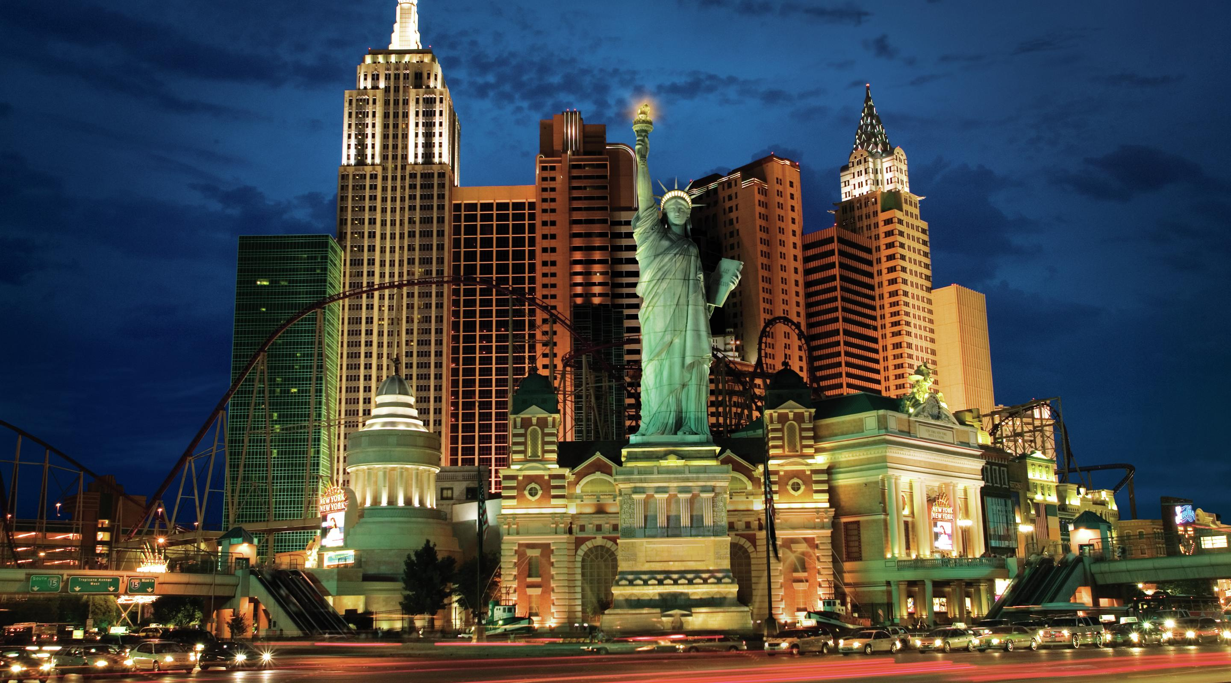
1-4 ( Bonus!) What do people call New York?
The Melting Pot, a reference to the wide variety of language groups in the city

Slide 7

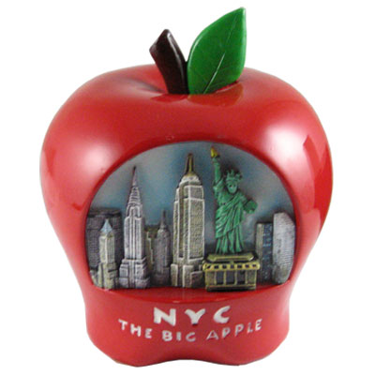

1-5 The “Big Apple” is a popular nickname-but for what?

Slide 8
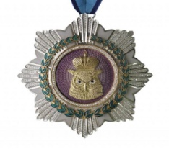
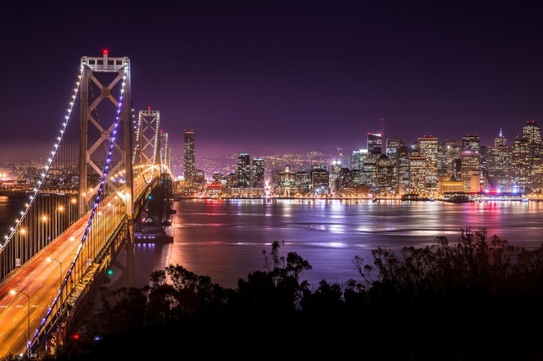

1-6 Where in the USА is the Golden Gate Bridge?
San Francisco

Slide 9

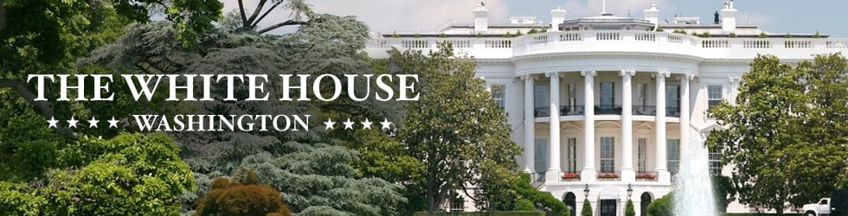
1-7 What is the home of the President?

Slide 10
The USA Quiz. Sector 2

Slide 11
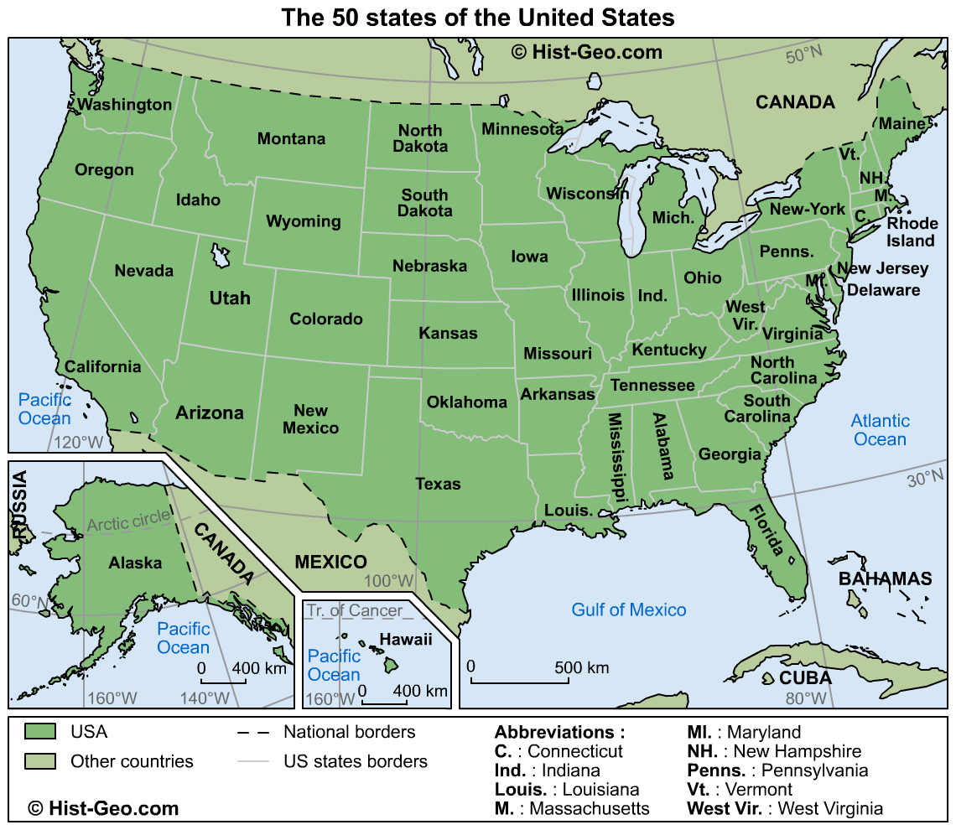
2-1 Which of the following is not the USA state?
Tahiti is not an American State
C)

Slide 12
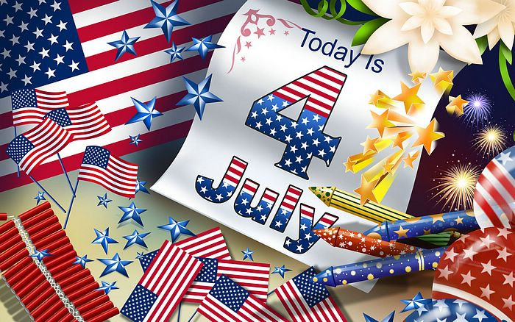
2-2 When is the birthday of the United States celebrated?

Slide 13
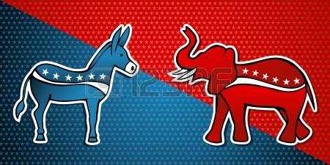
2-3 ( Bonus!) What animal represents the Democratic Party?
the Democratic Party
the Republican Party

Slide 14
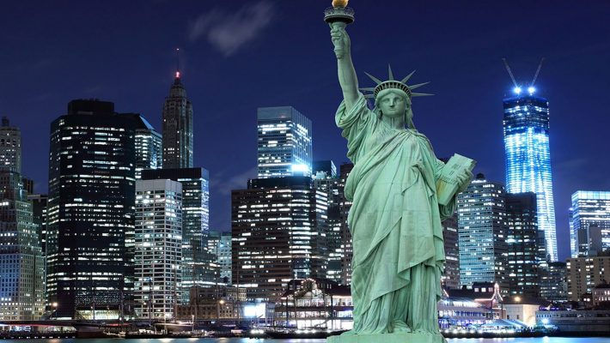
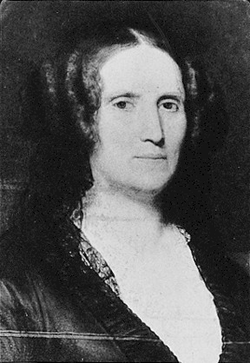
2-4 ( Bonus!) Who was the model for the Statue of Liberty?
The most likely model for sculptor Bartholdi was his mother, Charlotte Bartholdi

Slide 15
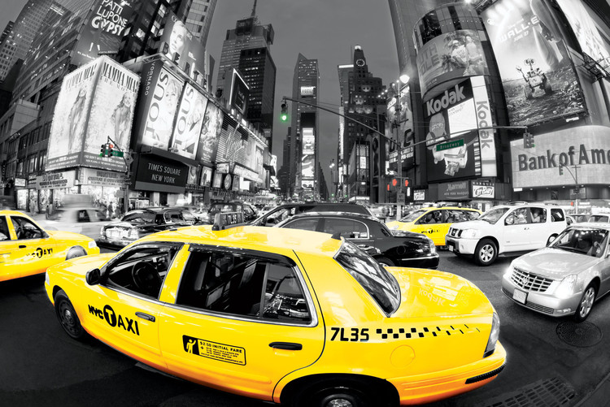
2-5. What colour are the taxis in New York?

Slide 16
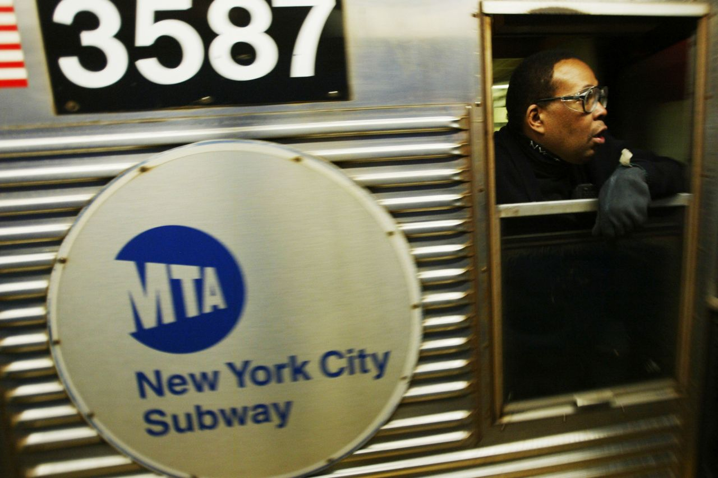
2-6 What is the New York underground called?

Slide 17
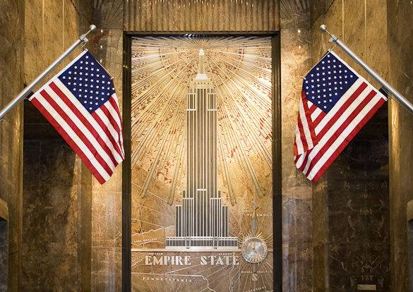
2-7. If you go to New York, you’ll see…
Building

Slide 18
The USA Quiz. Sector 3

Slide 19

3-1 “Let’s go and see a ball game.” What do Americans mean?
Baseball

Slide 20
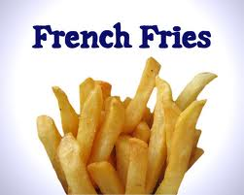
3-2 What do Americans call chips?
French fries (American English), chips (British English)

Slide 21
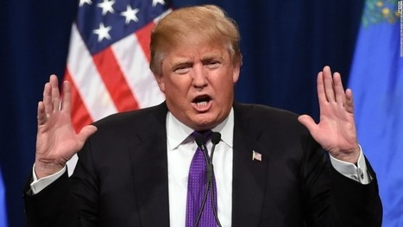
3-3 (Bonus!) How often do American people choose a new President?
The president is indirectly elected by the people through the Electoral College to a four-year term

Slide 22
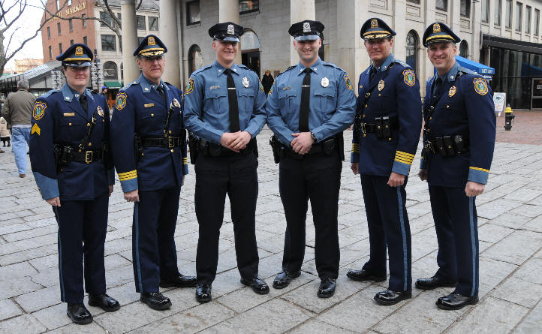
3-4 ( Bonus!) What do American people call their police officers?
A common nickname for a police officer is cop.

Slide 23
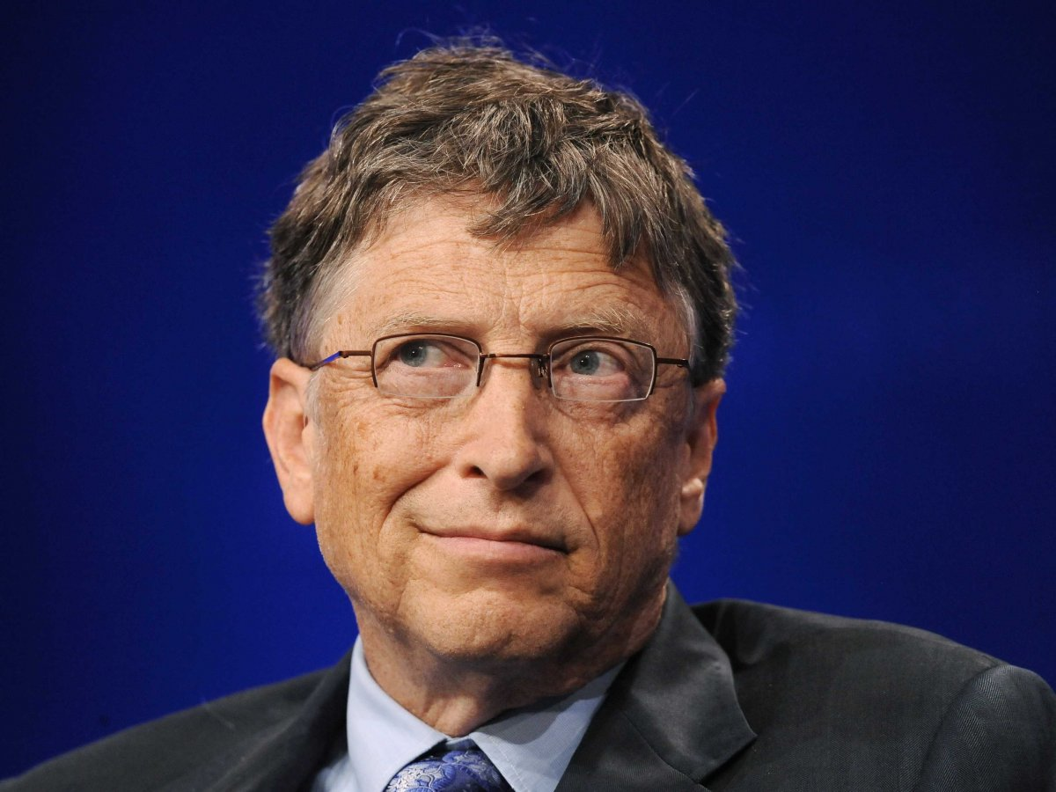
3-5. Which University did Bill Gates go to?
Bill Gates started studying at Harvard University in 1973. He did not go on to graduate from it.

Slide 24
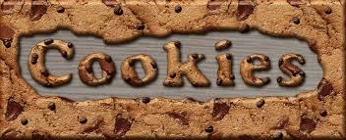
3-6 American people say…

Slide 25
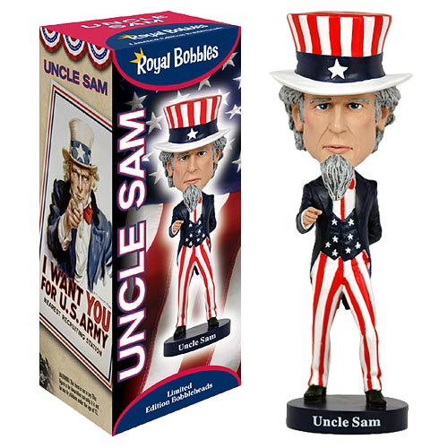
3-7 The cartoon symbol of the American government is…

Slide 26
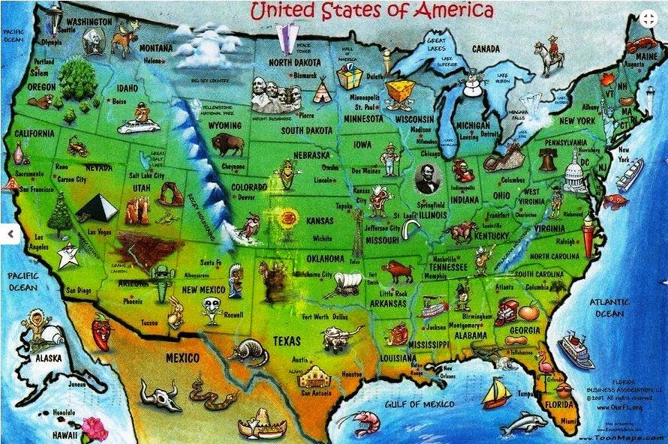
Sector 4. The Map

Slide 27
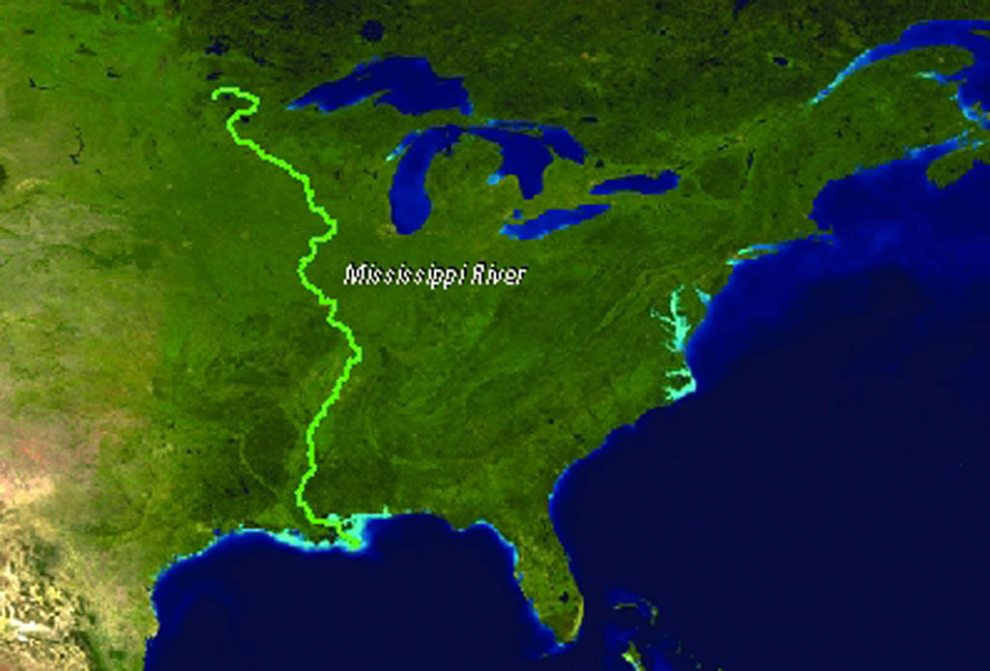
4-1 This river is the chief and the longest river in the USA

Slide 28
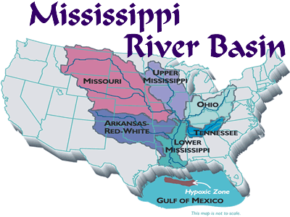
4-1

Slide 29
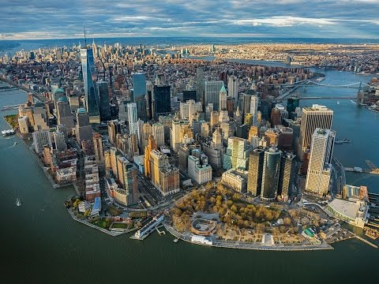
4-2 (Bonus!) It is the biggest and the most populous city in the country
New York

Slide 30
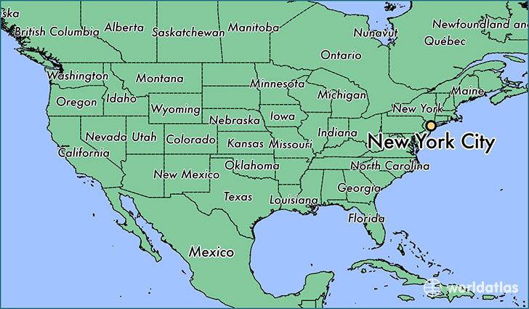
4-2 (Bonus!) It is the biggest and the most populous city in the country

Slide 31
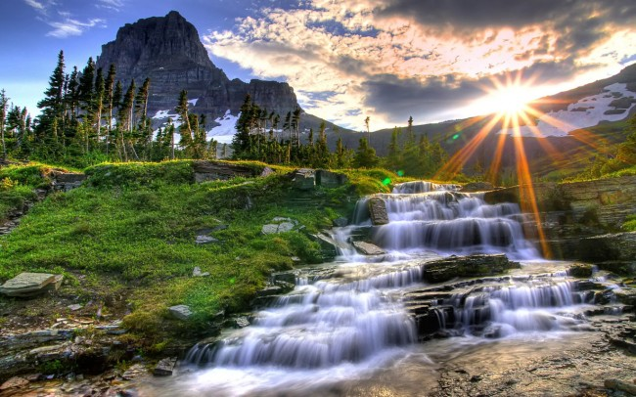
4-3 (Bonus!) It was the world’s first national park, set aside in 1872
Yellowstone National Park

Slide 32
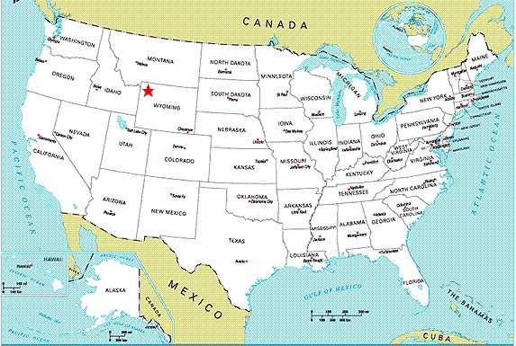
4-3 (Bonus!) It was the world’s first national park, set aside in 1872

Slide 33
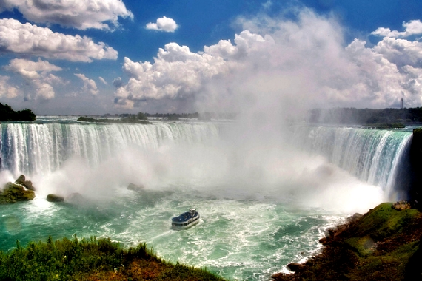
4-4 It is one of the most spectacular natural wonders on the North American continent
Niagara Falls

Slide 34
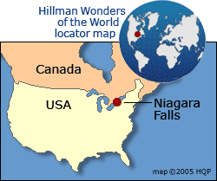
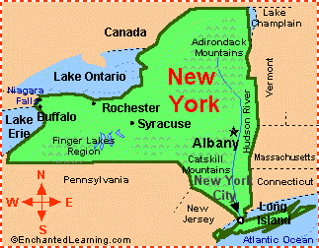
4-4 It is one of the most spectacular natural wonders on the North American continent

Slide 35
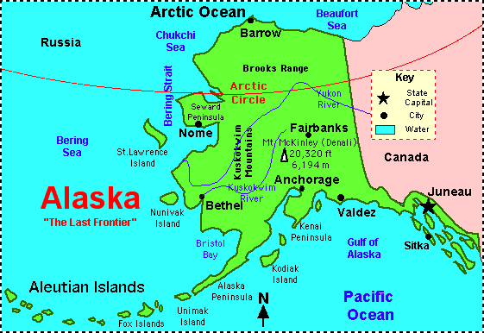
4-5 This state is the biggest American state

Slide 36
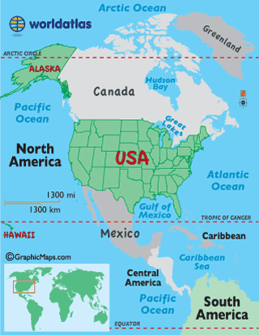
4-5 This state is the biggest American state

Slide 37
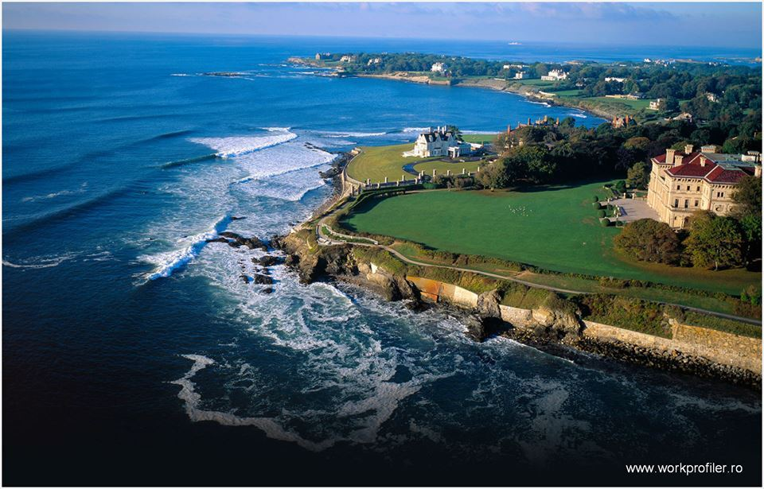
4-5 This state is the smallest American state
State Rhode Island

Slide 38
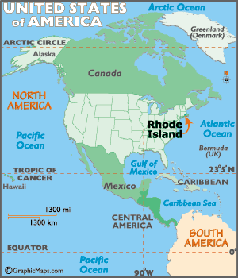
4-6 This state is the smallest American state

Slide 39
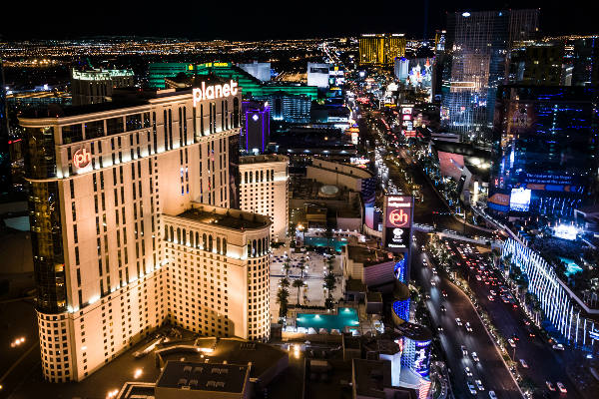
4-7 In this city you can get married immediately
Las Vegas

Slide 40
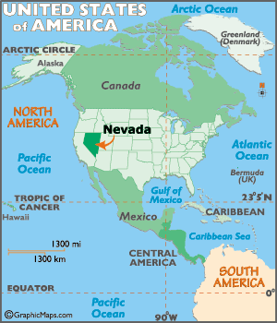
Las Vegas

Slide 41
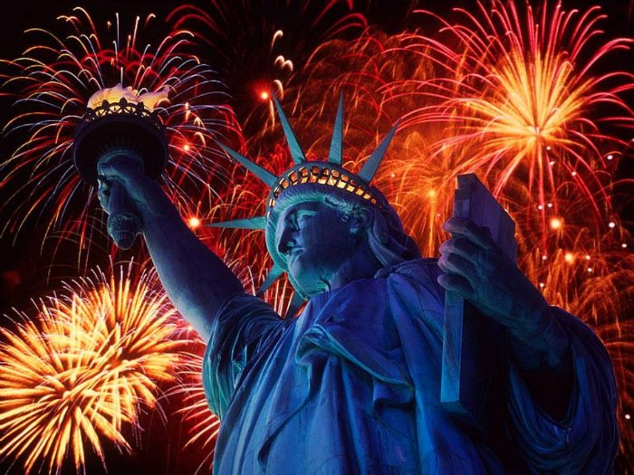
Sector 5
Holidays in the USA
Holidays in

Slide 42
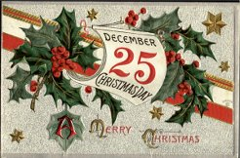
5-1(Bonus!) When is Christmas Day celebrated in the USA?

Slide 43
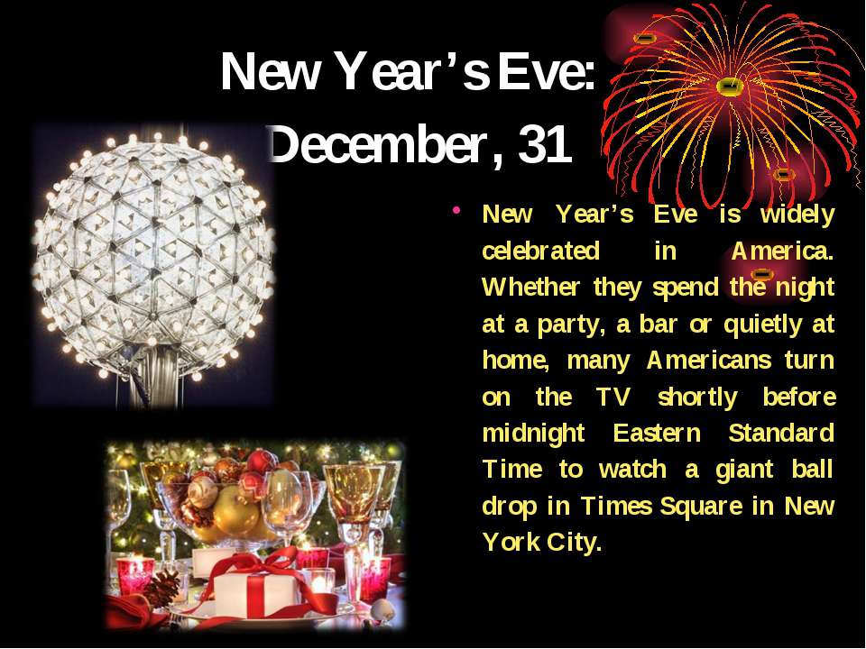
5-2 (Bonus!) When do Americans celebrate New Year?

Slide 44

5-3 When do Americans celebrate Independence Day?

Slide 45
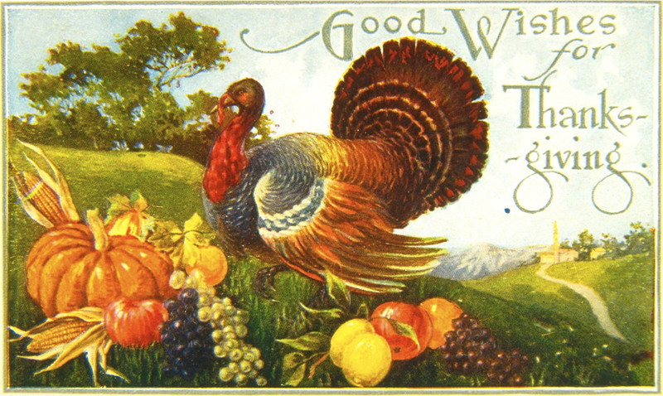
5-4 When is Thanksgiving Day celebrated in the United States?
on the fourth Thursday of November

Slide 46
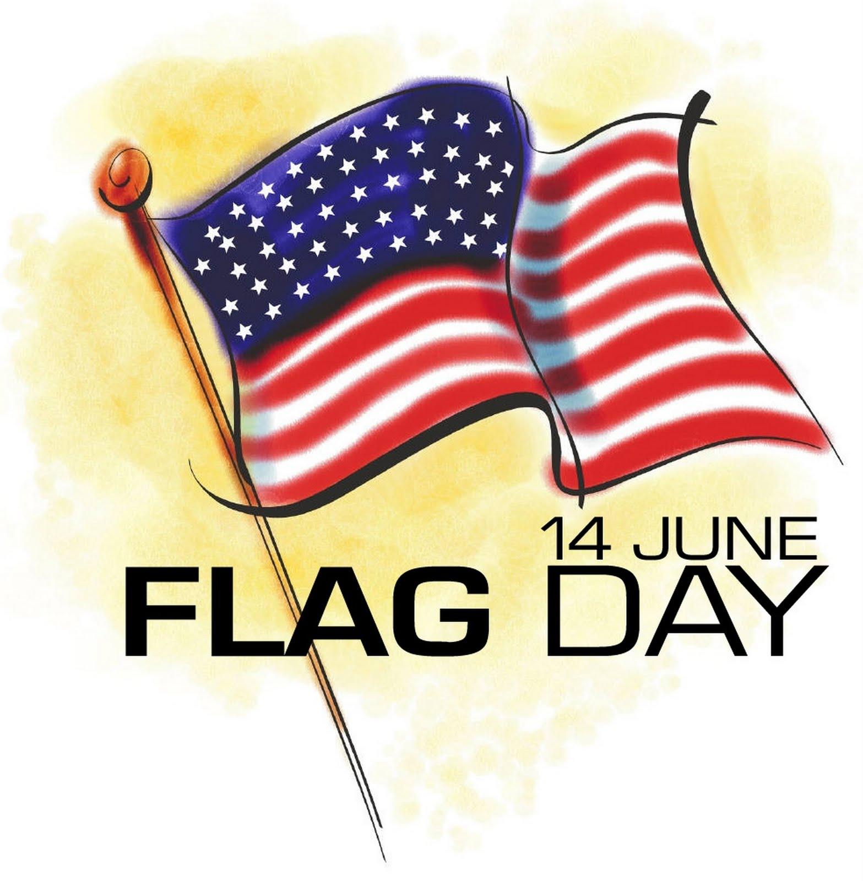
5-5 When is Flag Day celebrated in the USA?

Slide 47
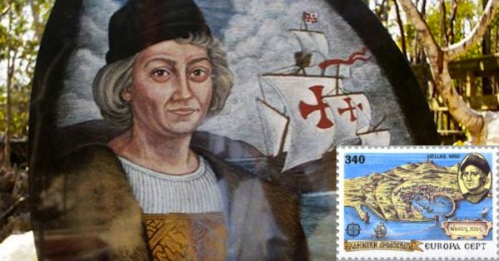
5-6 When is Columbus Day celebrated in the USA?
on the second Monday of October

Slide 48

5-7 When is Veterans Day celebrated in the USA?

Slide 49

Sector 6

Slide 50
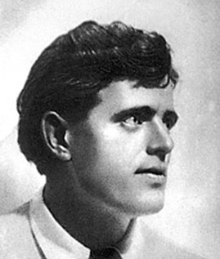
6-1 Jack London (1876 –1916)

Slide 51
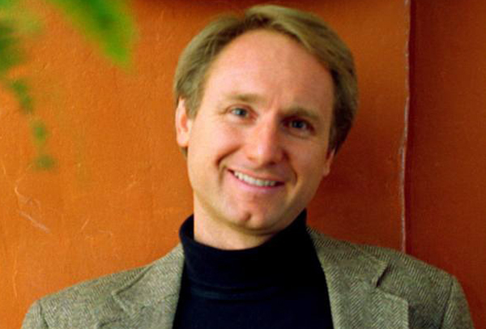
6-2 Daniel Gerhard "Dan" Brown (1964)

Slide 52
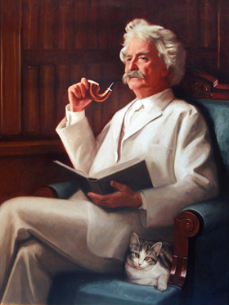
6-3 (Bonus!) Mark Twain (1835-1910)

Slide 53
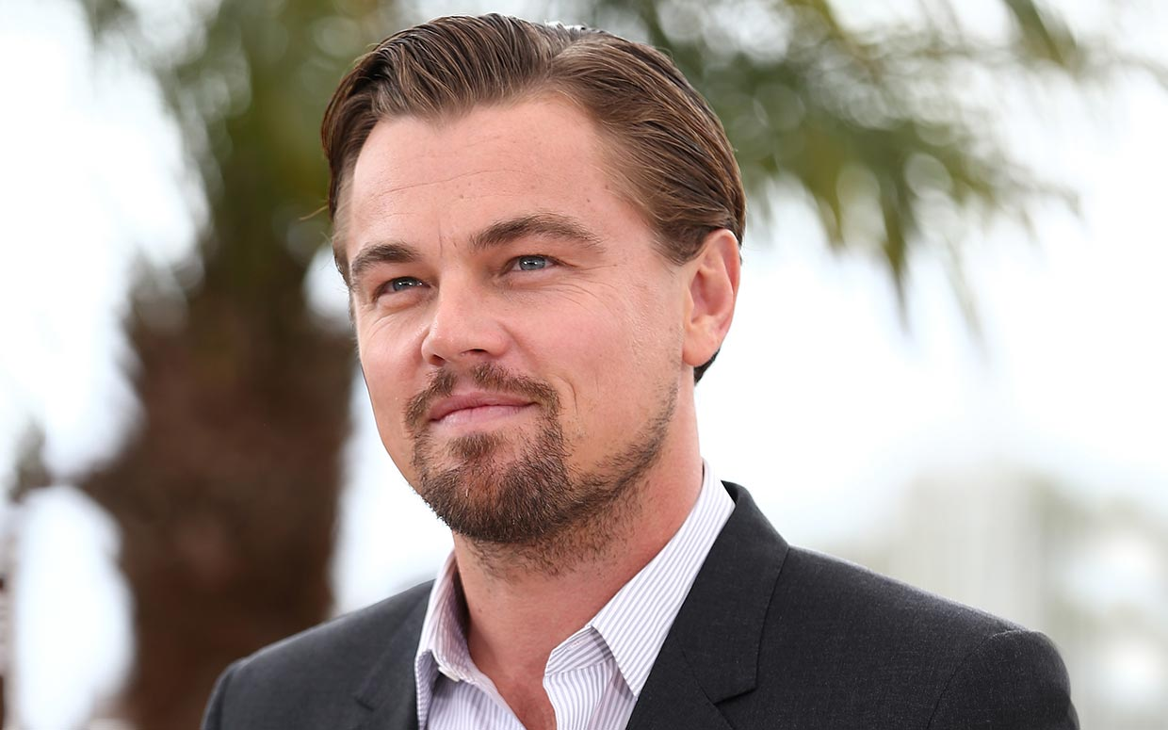
6-4 (Bonus!) Leonardo DiCaprio (11.11.1974)

Slide 54


6-5 Elwyn Brooks White (1899 – 1985)

Slide 55

6-6 Walter Elias “Walt” Disney (1901-1966)

Slide 56

6-7 Martin Luther King(1929-1968)

Slide 57

Sector 7. The Final
If necessary

Slide 58

7–1 The Final
Make as many words as you can out of the word «Christmas». Write them down.

Slide 59
The best result is 40 words.
Answers:
Sam, Tim, Christ, cat, rat, hat, star, cram, rats, hats, hit, miss, sit, his, ram, stir, cast, trim, art, ark, arm, smart, aim, ash, his, star, stars, shirts, mass, this, charts, Chris, as it is, him, ham, at, in, tam.

Slide 60

the best player is …..

Slide 61

The End.
Good Luck!

Slide 62


