Slide 1
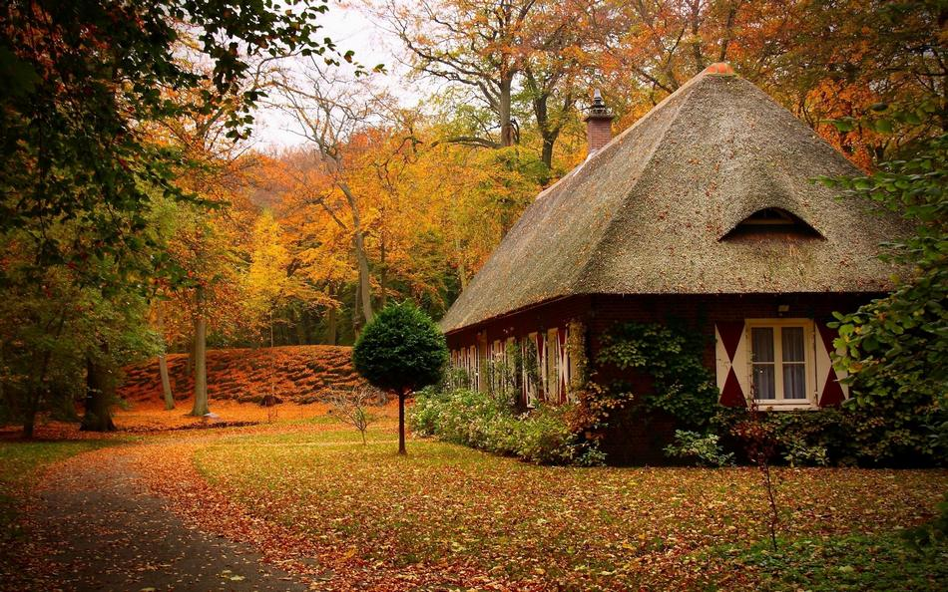
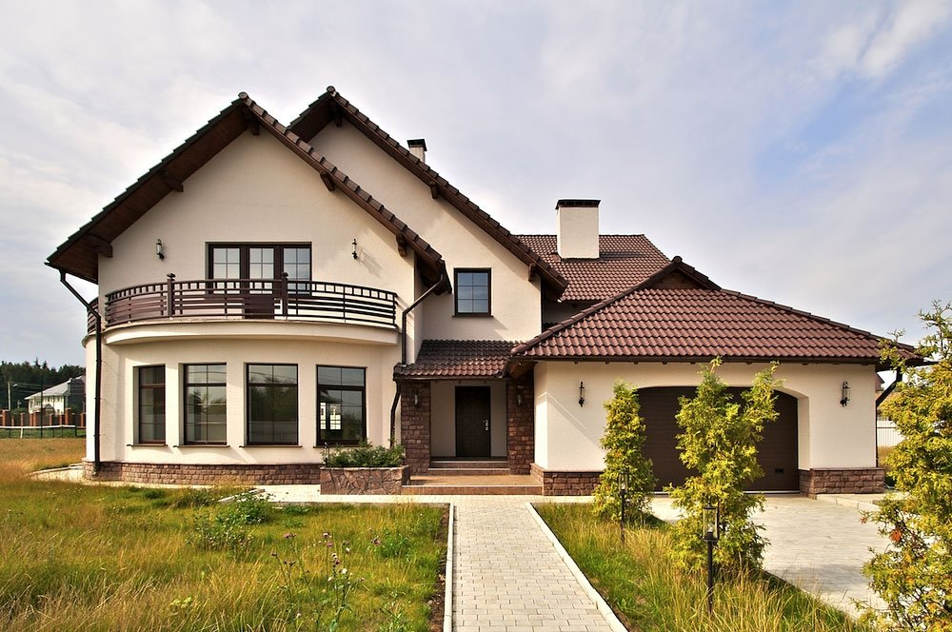
THE PLACE WE LIVE IN

Slide 2
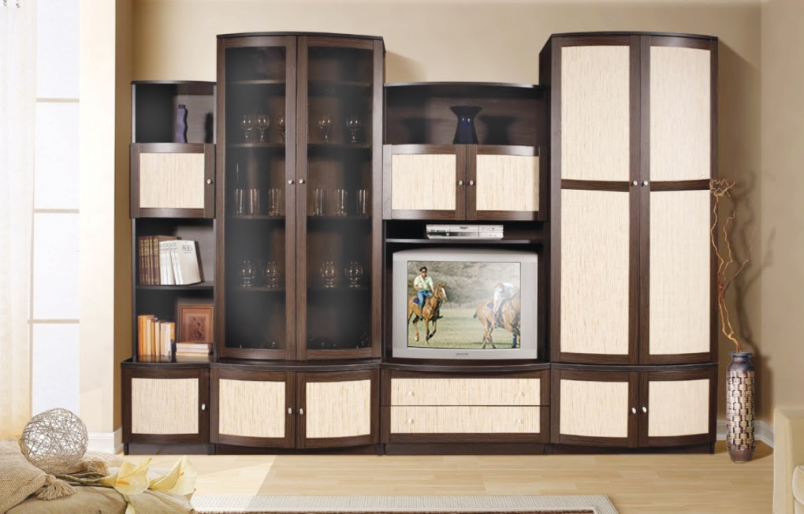
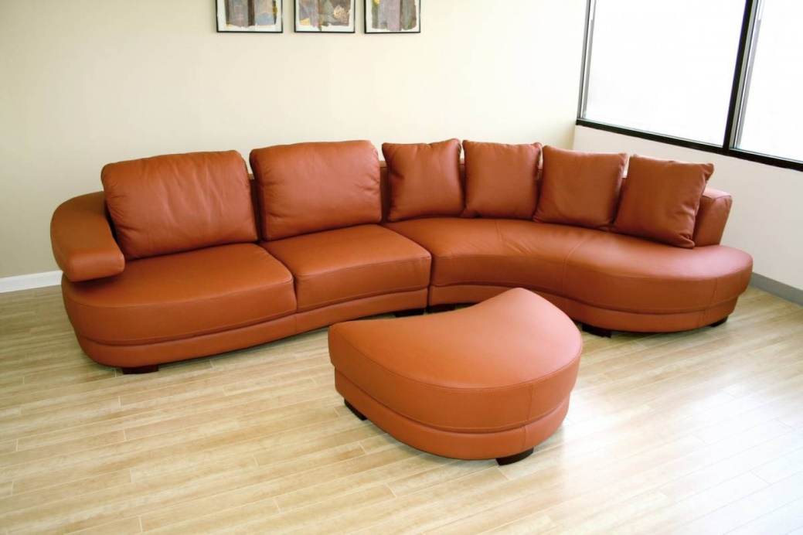
Task 1. Make the Furniture.
Here is a box of bricks with the English letters on them. I put them on the table for you to make up words on our topic and take them down. Read your words aloud.

Slide 3
Task 2. Choose the Decoration.
Choose the written word and think of a sentence with it in Present Simple, Past Simple, Future Simple or Present Continuous.
a kitchen, a hall, a fire, a curtain, a bedroom, a flat, a flower, a lamp, a living-room, a carpet

Slide 4
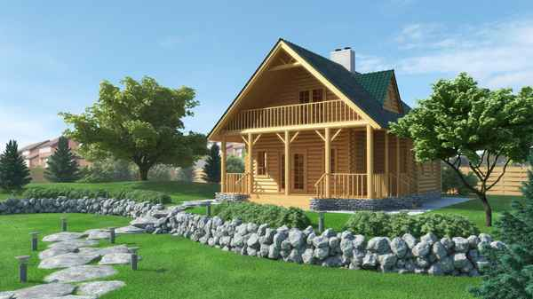
Task 3. Guessing Game.
You are going to explain the meaning of the words for the others to guess what it is.

Slide 5
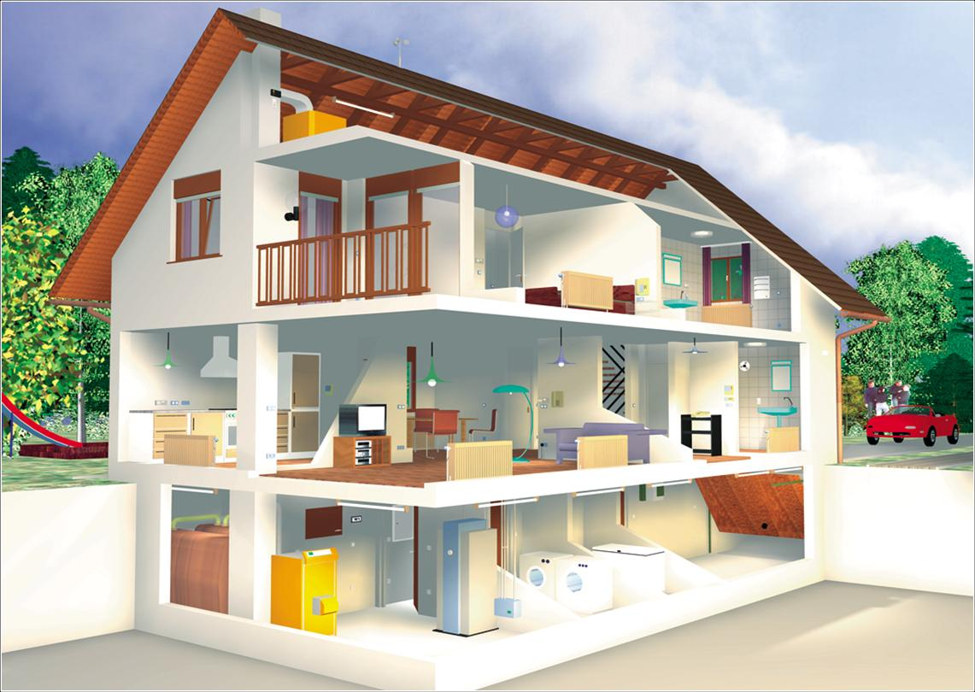
Task 4. Invitation Card.
Jack invited us to visit his house. He wants to show how a traditional English house looks. Ask each other questions and answer them
Ask each other:
- how many floors there are in his house;
- what rooms upstairs are;
- if there is a back door in it;
- where Jack takes off and puts on his clothes;
- where he washed up yesterday;
- where he is going to work tonight;
- where he usually has breakfast;
- where he left his keys when he came back yesterday;
- when he built his house.

Slide 6
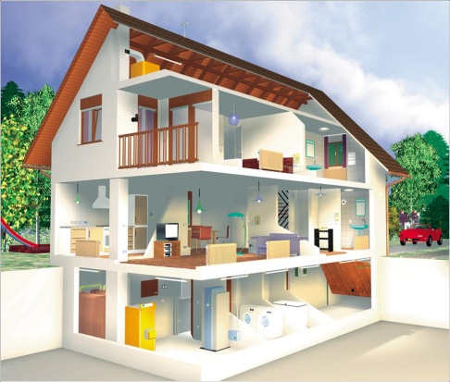
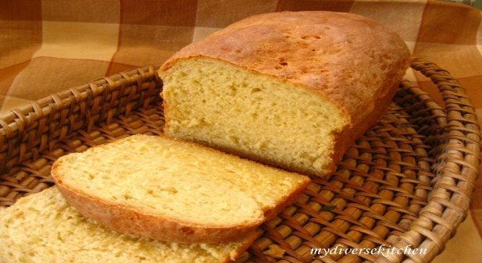
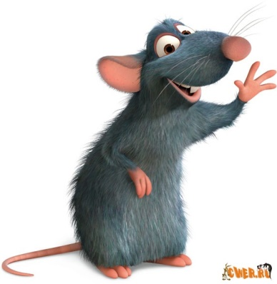
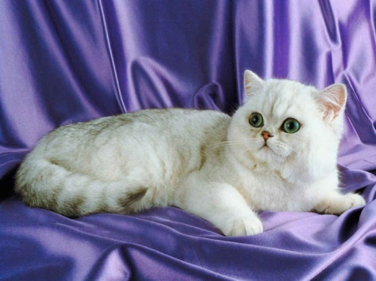
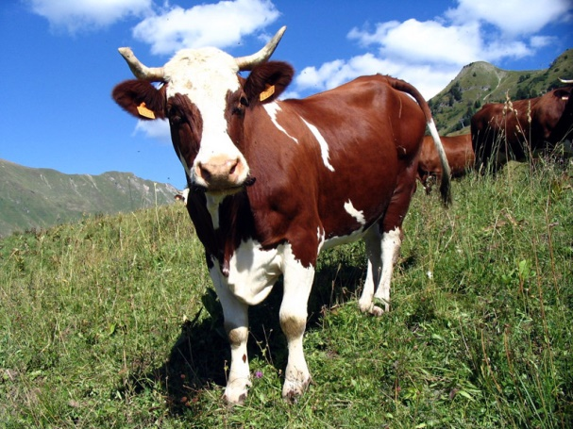


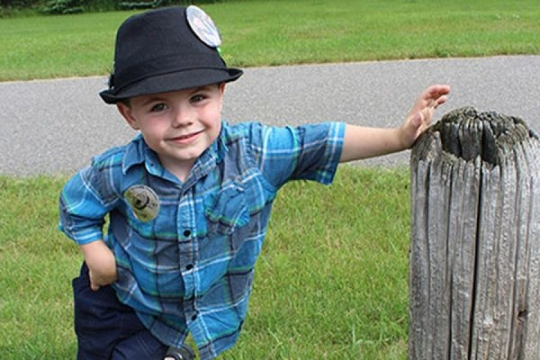
Now let’s recite the poem: “This Is the House That Jack Built”

Slide 7
Task 5: Furnish your flat.
Before furnishing the flat we have to revise the prepositions. Fill in the words.
1. in fr…n… of
2. b…h…n…
3. in the …id…le
4. n…x… to
5. a…o…e
6. …nd…r
7. …y
8. in the c…r…e…

Slide 8
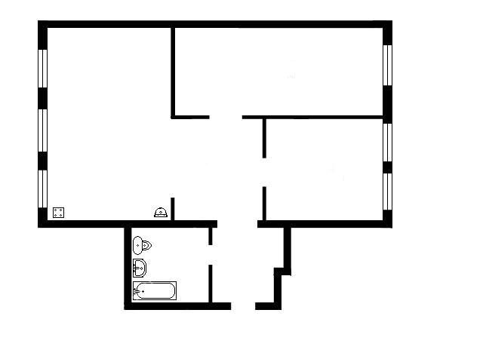
You can see the plan of our new flat. Choose one room and furnish it. You can work in two.

