Slide 1

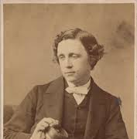
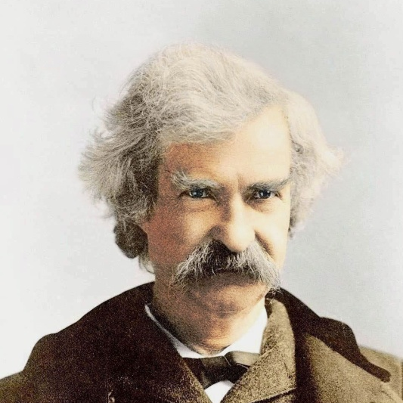
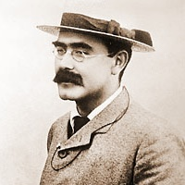
THREE WRITERS
–
THREE ANSWERS
Тетерина Ольга Афанасьевна

Slide 2
RUDYARD KIPLING

Slide 3

Kipling was born into the family of a writer.
True
False
NS

Slide 4


Sorry!
Wrong answer!
Read the text again!

Slide 5
The right answer is
False
because …

Slide 6
His father, an artist, was the head of the Department of Architectural Sculpture at the School of Art.

Slide 7
His school teachers considered the young Kipling a capable student.
True
False
NS

Slide 8
Sorry!
Wrong answer!
Read the text again!

Slide 9
The right answer is
NS
because …

Slide 10
In a new school Kipling discovered his talent for writing, eventually becoming the editor of the school newspaper.

Slide 11
Kipling studied at college.
True
False
NS

Slide 12
Sorry!
Wrong answer!
Read the text again!

Slide 13
The right answer is
False
because …

Slide 14
In 1882, Kipling was told by his parents that they didn't have enough money to send him to college, and he returned to India.

Slide 15
Kipling met his future wife due to his friend.
True
False
NS

Slide 16
Sorry!
Wrong answer!
Read the text again!

Slide 17
The right answer is
True
because …

Slide 18
He met Wolcott Balestier, an American publisher who became one of Kipling's great friends and supporters. Later, Kipling happily married Wolcott’s sister, Carrie.

Slide 19
The book ‘Just So Stories’ got its name due to Kipling’s daughter.
True
False
NS

Slide 20
Sorry!
Wrong answer!
Read the text again!

Slide 21
The right answer is
True
because …

Slide 22
The book's name had, in fact, come from his daughter, who asked her father to repeat each tale several times, or "just so," as she often said.

Slide 23
At the beginning of the 20th century, Kipling was given a prestigious literary award.
True
False
NS

Slide 24
Sorry!
Wrong answer!
Read the text again!

Slide 25
The right answer is
True
because …

Slide 26
In 1907 he was the first English writer to receive the Nobel Prize for Literature. It was international recognition of his talent.

Slide 27
Kipling’s son returned from the war with a problem with his eyesight.
True
False
NS

Slide 28
Sorry!
Wrong answer!
Read the text again!

Slide 29
The right answer is
False
because …

Slide 30
He even encouraged his son John to join the army though John had a serious problem with his eyesight.

Slide 31
Kipling continued creating tales for children until the end of his life.
True
False
NS

Slide 32
Sorry!
Wrong answer!
Read the text again!

Slide 33
The right answer is
False
because …

Slide 34
John was killed in France. Due to these sad circumstances, for the last 20 years of his life Kipling did not write any more of his wonderful children's tales.

Slide 35
MARK TWAIN

Slide 36
‘The Adventures of Huckleberry Finn’ was Mark Twain’s last book.
True
False
NS

Slide 37
Sorry!
Wrong answer!
Read the text again!

Slide 38
The right answer is
NS
because …

Slide 39
Mark Twain wrote ‘The Adventures of Huckleberry Finn’ in 1884. Since then, the book has been published in at least sixty languages, and some people say it is the best book ever created by an American writer.

Slide 40
The writer took his pen-name when working as an assistant to a publisher.
True
False
NS

Slide 41
Sorry!
Wrong answer!
Read the text again!

Slide 42
The right answer is
False
because …

Slide 43
He became a pilot on a steamboat that sailed on the Mississippi. He heard the riverboat workers call out the words "mark twain!" That was a measure for the depth of water. Later he used this word combination as a pen-name.

Slide 44
Mark Twain’s stories became popular due to his manner of writing.
True
False
NS

Slide 45
Sorry!
Wrong answer!
Read the text again!

Slide 46
The right answer is
True
because …

Slide 47
He developed his own narrative style – friendly, funny, and often satirical, which won him a wide audience.

Slide 48
It took Mark Twain two years to write ‘The Adventures of Huckleberry Finn’.
True
False
NS

Slide 49
Sorry!
Wrong answer!
Read the text again!

Slide 50
The right answer is
False
because …

Slide 51
He started writing in 1876, but put the story away after about two years of work. He returned to it in 1883, and the following year it was published.

Slide 52
Literary critics expressed different opinions of ‘The Adventures of Huckleberry Finn’.
True
False
NS

Slide 53
Sorry!
Wrong answer!
Read the text again!

Slide 54
The right answer is
True
because …

Slide 55
From the beginning, the book was strongly debated. Some critics praised its realism and honesty but the others strongly disliked it.

Slide 56
Ernest Hemingway strongly criticized ‘The Adventures of Huckleberry Finn’.
True
False
NS

Slide 57
Sorry!
Wrong answer!
Read the text again!

Slide 58
The right answer is
False
because …

Slide 59
In 1935 Ernest Hemingway wrote: “All modern American literature comes from one book by Mark Twain called Huckleberry Finn.”

Slide 60
The novel ‘The Adventures of Huckleberry Finn’ has been made into a movie in different countries.
True
False
NS

Slide 61
Sorry!
Wrong answer!
Read the text again!

Slide 62
The right answer is
True
because …

Slide 63
More than 20 screen versions of the book have been shot not only in America but in Europe, Russia and Japan. There are feature films, musicals, cartoons.

Slide 64
LEWIS CARROLL

Slide 65
Charles Dodgson was a brother of the famous English writer Lewis Carroll.
True
False
NS

Slide 66
Sorry!
Wrong answer!
Read the text again!

Slide 67
The right answer is
False
because …

Slide 68
Lewis Carroll was the pen-name of Charles Dodgson, an English writer and the author of two of the best loved children's books in English Literature – 'Alice's Adventures in Wonderland' and 'Through the Looking Glass'.

Slide 69
Charles Dodgson was the oldest child in the family.
True
False
NS

Slide 70
Sorry!
Wrong answer!
Read the text again!

Slide 71
The right answer is
NS
because …

Slide 72
His family was large; his parents had 11 children, 4 boys and 7 girls.

Slide 73
Charles Dodgson was a good mathematician.
True
False
NS

Slide 74
Sorry!
Wrong answer!
Read the text again!

Slide 75
The right answer is
True
because …

Slide 76
Apart from being a creative writer, he was also a Mathematics Don (professor) at Oxford and a well-known logician.

Slide 77
Charles Dodgson had different hobbies.
True
False
NS

Slide 78
Sorry!
Wrong answer!
Read the text again!

Slide 79
The right answer is
True
because …

Slide 80
He was interested in photography and music. He sang very well, played chess and enjoyed creating and solving puzzles.

Slide 81
Charles Dodgson enjoyed his years in the boarding schools very much.
True
False
NS

Slide 82
Sorry!
Wrong answer!
Read the text again!

Slide 83
The right answer is
False
because …

Slide 84
Later in life, he remembered his boarding school experience without any warm feelings.

Slide 85
Charles Dodgson invented fantastic stories for his friend’s daughters.
True
False
NS

Slide 86
Sorry!
Wrong answer!
Read the text again!

Slide 87
The right answer is
True
because …

Slide 88
Charles often entertained the girls by telling them stories about imaginary worlds with fantastic creatures.

Slide 89
Charles Dodgson’s children enjoyed reading his books about Alice.
True
False
NS

Slide 90
Sorry!
Wrong answer!
Read the text again!

Slide 91
The right answer is
NS
because …

Slide 92
It is not stated in the text if he had any children or not.

Slide 93
Charles Dodgson travelled a lot around the world.
True
False
NS

Slide 94
Sorry!
Wrong answer!
Read the text again!

Slide 95
The right answer is
False
because …

Slide 96
Charles Dodgson himself didn’t like being away from home. The only occasion on which (as far as it is known) he went abroad was a trip to Russia in 1867.

Slide 97
Тетерина Ольга Афанасьевна
104-199-441
THANK YOU!

Slide 98
Credits
№ слайда | Иллюстрация | Ссылка
1, 35 | Mark Twain | http://www.rogerogreen.com/wp-content/uploads/2015/04/marktwain.jpg
1, 2 | Rudyard Kipling | https://armonte.files.wordpress.com/2011/08/rudyard-kipling2.jpg
1, 64 | Lewis Carroll | http://www.fanphobia.net/uploads/actors/7526/lewis-carroll-profile-picture.jpg
Использованные информационные источники
«Федеральный институт педагогических измерений» (http://fipi.ru/) / Открытый банк заданий ОГЭ/ Чтение/ Стр.6/ Задание F2BA90 Текст «Rudyard Kipling»: http://85.142.162.126/os/xmodules/qprint/index.php?proj_guid=8BBD5C99F37898B6402964AB11955663&theme_guid=E96F93EEDE6CA8634B72F9611B0CA56D&groupno=4&groupno=5
«Федеральный институт педагогических измерений» (http://fipi.ru/) / Открытый банк заданий ОГЭ/ Чтение/ Стр.3/ Задание 7019С7 Текст «Mark Twain»: http://85.142.162.126/os/xmodules/qprint/index.php?proj_guid=8BBD5C99F37898B6402964AB11955663&theme_guid=E96F93EEDE6CA8634B72F9611B0CA56D&groupno=1&groupno=2
«Федеральный институт педагогических измерений» (http://fipi.ru/) / Открытый банк заданий ОГЭ/ Чтение/ Стр.4/ Задание 960Е73 Текст «Lewis Carroll»: http://85.142.162.126/os/xmodules/qprint/index.php?proj_guid=8BBD5C99F37898B6402964AB11955663&theme_guid=E96F93EEDE6CA8634B72F9611B0CA56D&groupno=2&groupno=3

