Slide 1
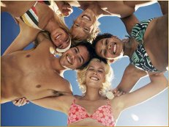
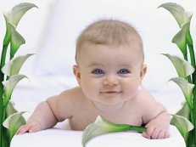
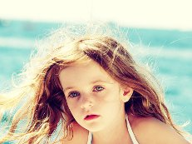
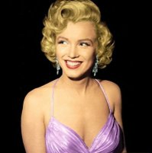
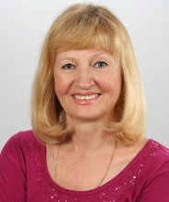
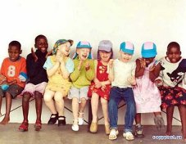
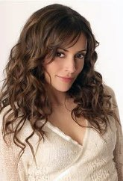
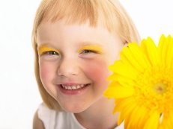
Who’s who?
Учимся описывать внешность.

Slide 2
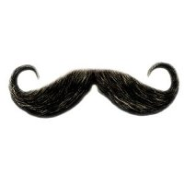
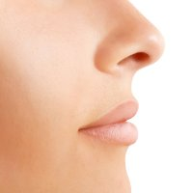
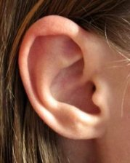
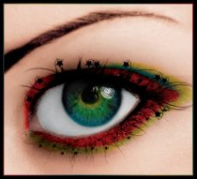
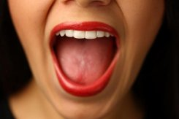
Facial features
Mouth - рот
Nose - нос
Moustache - усы
Eyes - глаза
Ears - уши

Slide 3
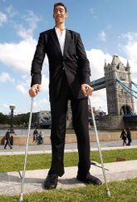
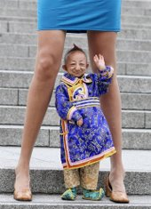
Height
Short
Tall

Slide 4
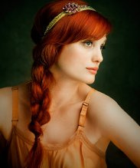
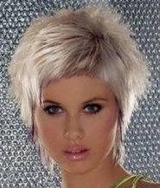
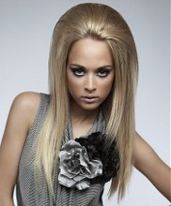
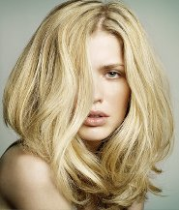
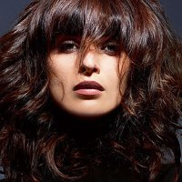
Hair
Red
Short
Fair
Long
Brown

Slide 5
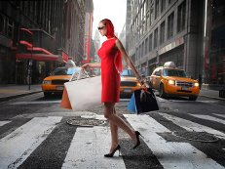
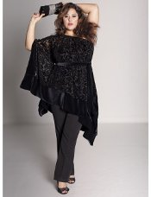
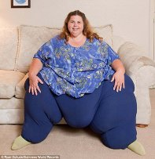
Build
Plump
Fat
Thin

Slide 6
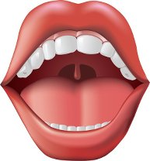
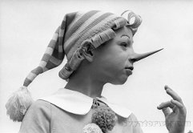
Big
Big mouth
Big nose

Slide 7
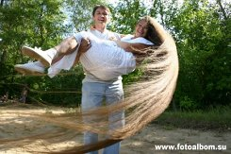
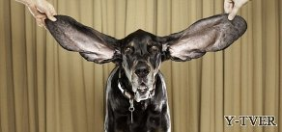
Long
Long ears
Long hair

Slide 8
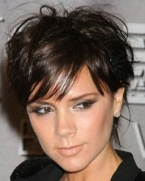
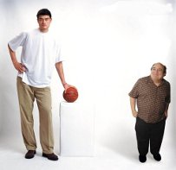
Short
Short hair
Short man

Slide 9
Describe people
Is she tall or short?
She is short.
What is the colour of her eyes?
Her eyes are blue.
What is the colour of her hair?
Her hair is fair.
Is she plump?
She isn’t plump. She is thin.

Slide 10
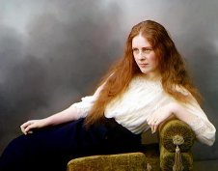
Describe people
Has she got short hair?
No, she hasn’t. Her hair is long.
Is she tall?
Yes, she is. She is tall.
What is the colour of her hair?
Her hair is red.

Slide 11
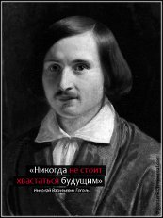
Describe people
Has he got a moustache?
Yes, he has.
What is the colour of his hair?
His hair is brown.
Is his nose short?
No, his nose is long.

Slide 12
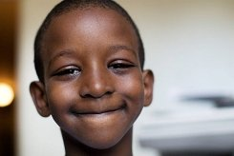
Describe people
Name: Handy
Country: Africa
Age: 11
Family: 2 sisters and a brother

Slide 13
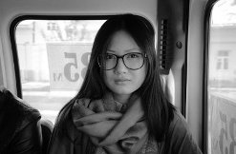
Describe people
Name: Shuhg
Country: Japan
Age: 25
Family: a mother and a sister

Slide 14
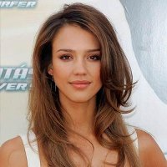
Describe people
Name: Jane
Country: America
Age: 30
Family: a husband and a daughter

