Slide 1

Муниципальное бюджетное общеобразовательное учреждение
«Школа № 13» города Сарова, Нижегородская область
Friendship
(«Английский язык. Brilliant»: учебник для 5 класса общеобразовательных организаций /
Ю.А. Комарова, И.В. Ларионова, Ж. Перретт – 4-е изд. – М.: ООО «Русское слово – учебник»:
Макмиллан, 2015. – 152 с.: ил. – (Инновационная школа)
Учитель английского языка
Бармина Надежда Васильевна
2016

Slide 2
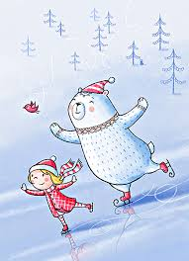
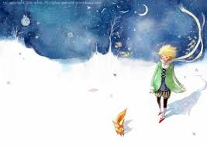
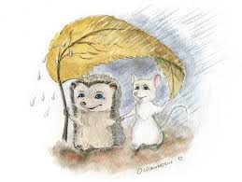
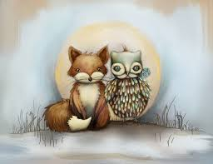
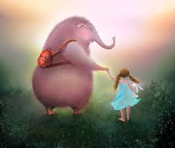
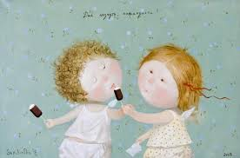

We are going to talk about…
THEY
Fight for you
Respect you
Include you
Encourage you
Need you
Deserve you
Stand by you
Notes:
Pictures appear one by one while the teacher reads the lines (see below). The pupils are supposed to guess the theme of the lesson.
The first step: pupils suggest such theme as “Friends”. The second step: the teacher asks them to form the general noun that refers to 1) a state of being friends; friendly relation, or attachment, to a person, or between persons, or 2) a relationship that can survive the test of time and remain unconditional. Finally they elicit the theme of the lesson that is “Friendship”.
Text for audio:
Fight for you
Respect you
Include you
Encourage you
Need you
Deserve you
Stand by you

Slide 3
Task 1. a) Match the English proverb with its Russian equivalent. b) Explain the meaning of the proverb
A friend in need is a friend indeed.
a) Старый друг – лучше новых двух.
b) Друг познается в беде.
c) Не имей сто рублей, а имей сто друзей.

Slide 4
Grammar spot
Frequency Adverbs (Part I)
! We use adverbs of frequency to say how often we do things, or how often things happen.
Notes:
The pupils write down the rules and the chart in their copy-books.

Slide 5
Grammar spot
Frequency Adverbs (Part II)
1. Read and compare two sentences given below. What do you notice about the position of the adverbs?
a) I am always on time; b) He always goes to school by bus
! Frequency adverbs can go before the main verb. But they come after the verb to be.
2. Read and compare two sentences given below. What do you notice about the adverb “never”?
a) I don’t walk to school; b) I never walk to school.
! If we use the adverb “never” we mustn’t use another negative form.
Notes:
The pupils are supposed to find out the rules themselves by comparing and analyzing given examples.

Slide 6
Task 2. a) Listen to the questionnaire and write down your own answers to the questions (1-6) using A, B, C, D, E. There are some pictures to help you understand the new words.
A – always, B – usually, C – often,
D – sometimes, E – never
b) Open the Students’ Books (p. 36,
ex.2). Listen to the questionnaire
once again, read it and correct your
answers if it’s necessary.
c) Turn your books upside down and look at
the key. Please count your points and tell
your partner if you are a good friend.

Slide 7
Cooperative game “Jokeys & Horses”
“Jockeys” get cards with words and expressions taken from Ex.2 (SB p. 36)
“Horses” get cards with words and expressions that have the similar meaning
The aim of the game: “jockeys” must find their “horses”.
Course of the game: one pupil (“a joсkey”) reads a word or an expression while another pupil (“a horse”) must read an appropriate word or a phrase.
Notes:
Word list
“Jockeys”: 1) to be friendly; 2) to be on time; 3) to be a good listener; 4) to tell the truth; 5) to remember friends’ birthdays; 6) to help friends
“Horses”: 1) sociable; 2) never be late; 3) to listen attentively when somebody speaks; 4) to be honest; 5) to keep in his or her mind friend’s birthdays; 6) to give help

Slide 8

P.T. break

Slide 9
Task 3. Write true sentences about you with always / usually / often / sometimes / never
I am … friendly.
I am … a good listener.
I … remember my friends’ birthdays.
I’m … on time.
I … tell the truth.
I … help my friends.

Slide 10
Task 4. Speaking: a) complete the sentences about your best friend; b) work with your classmates in groups of 4-5 and find things which are the same about your friends. Than report the results of your surveys to the rest of the class.
Notes:
Each pupil gets a card and complete the first part of the task (a) individually. Than pupils work in groups. After that the group choses one speaker to present the results of the survey.

Slide 11
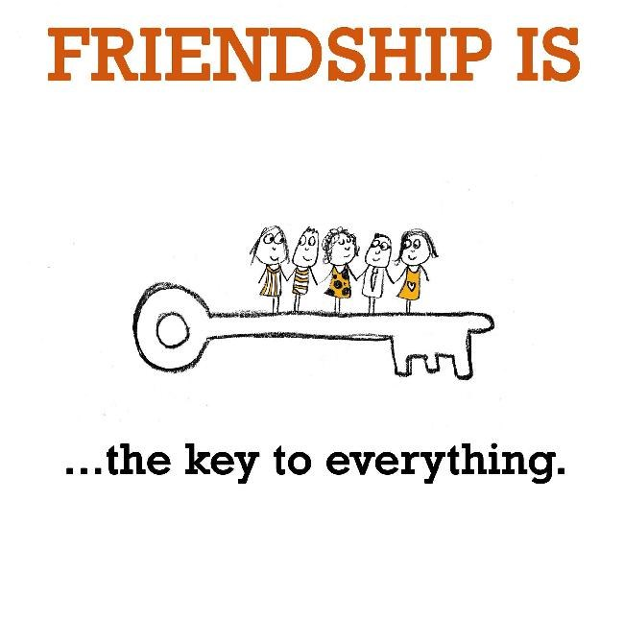
Home task
Mini – project “FRIENDSHIP IS…”
Plan
Choose 3 characteristics related to the idea of friendship
Make 3 posters reflecting each characteristic you’ve chosen. See the example below.
You may use any materials and techniques.
Good luck and have fun!

Slide 12

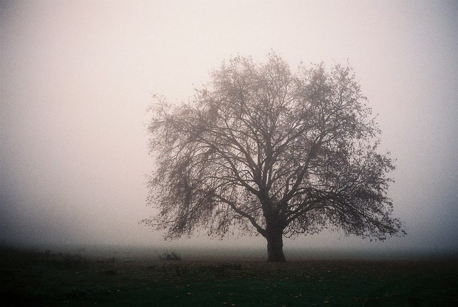
Self analysis
1 2
Notes:
Ask the pupils to look at the pictures and write on the sheets of paper number 1 if they like the lesson (the theme seemed to them important and interesting, it made them analyze their behavior and features of character), and number 2 if they don’t like the lesson for any reason. All the papers are anonymous.

Slide 13
I wish everyone could say
I can talk with a friend
and walk with a friend
and share my umbrella in the rain.
I can play with a friend
and stay with a friend
and learn with a friend and explain.
I can eat with a friend
and compete with a friend
and even sometimes disagree.
I can ride with a friend
and take pride with a friend.
A friend can mean so much to me!
Notes:
The teacher reads the poem.

Slide 14
Thank you for your attention and participation!
Notes:
Resources (Ресурсы):
1. «Английский язык. Brilliant»: учебник для 5 класса общеобразовательных организаций / Ю.А. Комарова, И.В. Ларионова, Ж. Перретт – 4-е изд. – М.: ООО «Русское слово – учебник»: Макмиллан, 2015. – 152 с.: ил. – (Инновационная школа).
2. Книга для учителя к учебнику английского языка «Английский язык. Brilliant»: учебник для 5 класса общеобразовательных организаций / Ю.А. Комарова, И.В. Ларионова, М. Кондро – 2-е изд. – М.: ООО «Русское слово – учебник»: Макмиллан, 2015. – 216 с.: ил. – (Начальная инновационная школа).
3. Рабочая тетрадь к учебнику английского языка «Английский язык. Brilliant»: учебник для 5 класса общеобразовательных организаций / Ю.А. Комарова, И.В. Ларионова, Ж. Перретт – 4-е изд. – М.: ООО «Русское слово – учебник»: Макмиллан, 2015. – 126 с.: ил. – (Начальная инновационная школа).
4. Электронное периодическое издание «Эффективные образовательные технологии». Выпуск 1. 2008 г. Главный редактор, д.п.н. профессор Гузеев В.В. Дистанционные технологии и обучение

