Slide 1

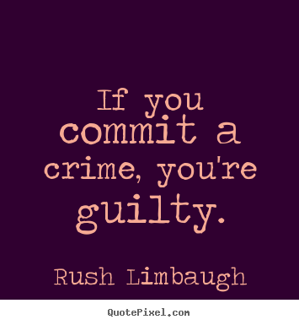
Crime & Punishment

Slide 2
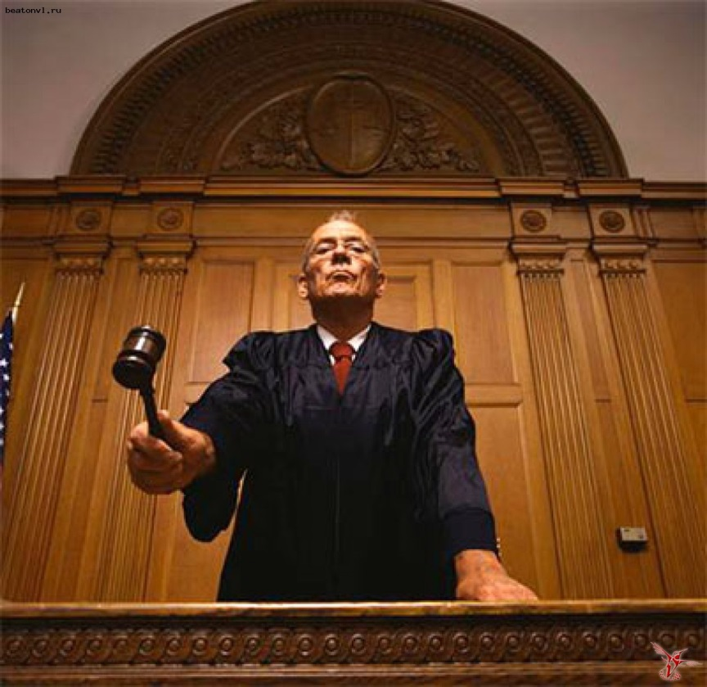
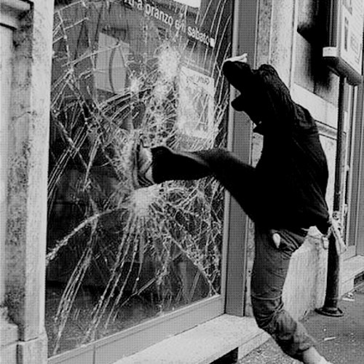
1What is the connection between the pictures? 2 Would you like to be a judge? Why/Why not? What do you know about the prison system in our and other countries?

Slide 3
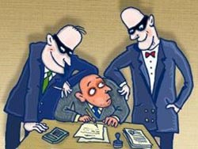
For or Against?
Crime is inevitable in any society.
The number of crimes committed in the society shows the state of it.
The reason of many crimes committed by people is poverty.

Slide 4

Why do people commit crimes?
Don’t forget to use some linking devices: First of all, Secondly, Moreover, Besides, Furthermore, In addition to it, Finally.

Slide 5

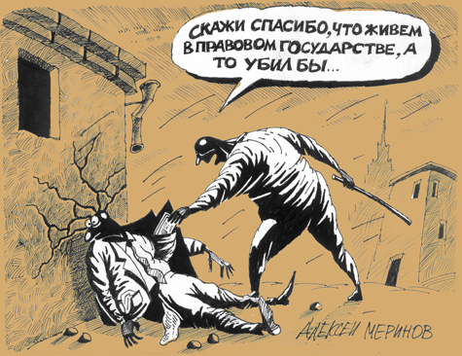
Listening Answers: CEGABF

Slide 6

Word formation
Answers:
Accused
Investigation
Evidence
Lawyers
Proof
Thief
Robberies
Conviction
Forgery
Imprisonment

Slide 7
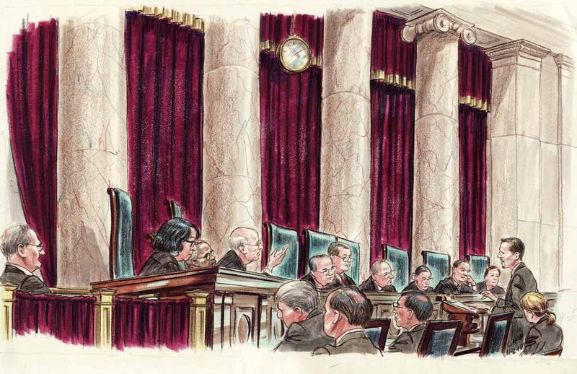
Vocabulary
1 plead
2 released
3 lawyer/solicitor
4 evidence
5 capital punishment
6 deterrent
7 case
8 charged
9 life imprisonment
10 Not guilty

Slide 8

Reading Answers: HBDGEFA
AAAA

Slide 9

Corruption: Answers: 3412231

Slide 10
What types of criminals do you remember:
А thief is someone who …
An arsonist is someone who …
A kidnapper is someone who …
A mugger is someone who …
A burglar is someone who …
A murderer is someone who…
A hijacker is someone who …
A vandal is someone who …
A forger is someone who …
A robber is someone who…
A shoplifter is someone who …

Slide 11
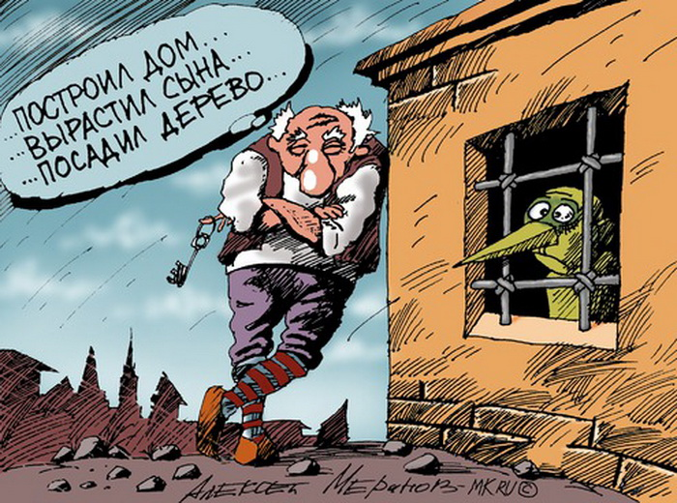
The Criminal they can’t lock up
Answers: ABDDBAB

Slide 12
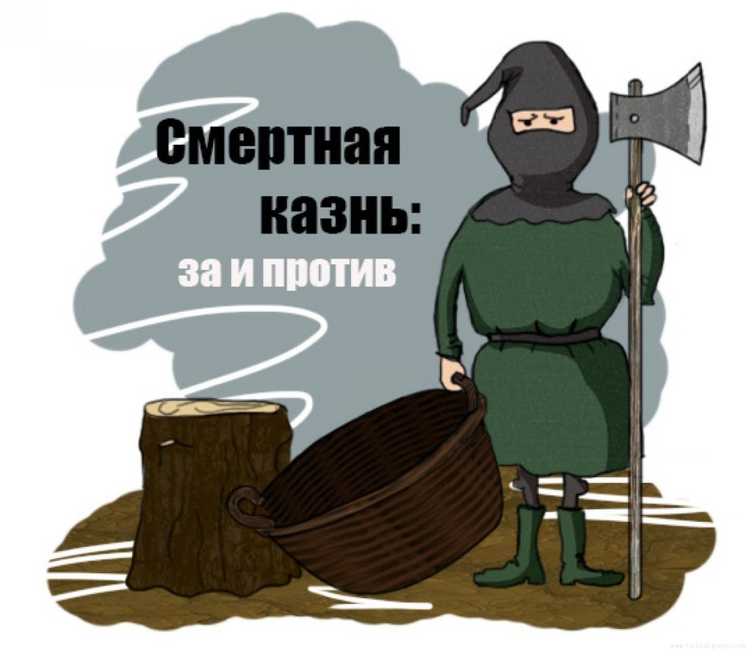
Capital Punishment: For or Against?
Answers: CGBADEF

Slide 13
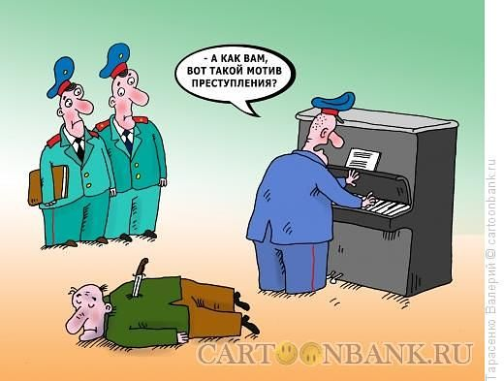

Literary Translation

Slide 14
Hometask
An essay “The crime rate in our city is too high and extreme measures should be taken to reduce it”.

Slide 15
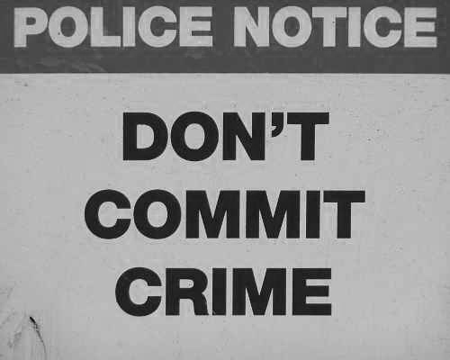

Thanks a lot!

