Slide 1
Урок актуализации и систематизации лексико-грамматического материала Модуля 4, УМК «Spotlight 3»
Решитько Юлия Ивановна
учитель английского языка
МБОУ СОШ №3, г. Чехов

Slide 2
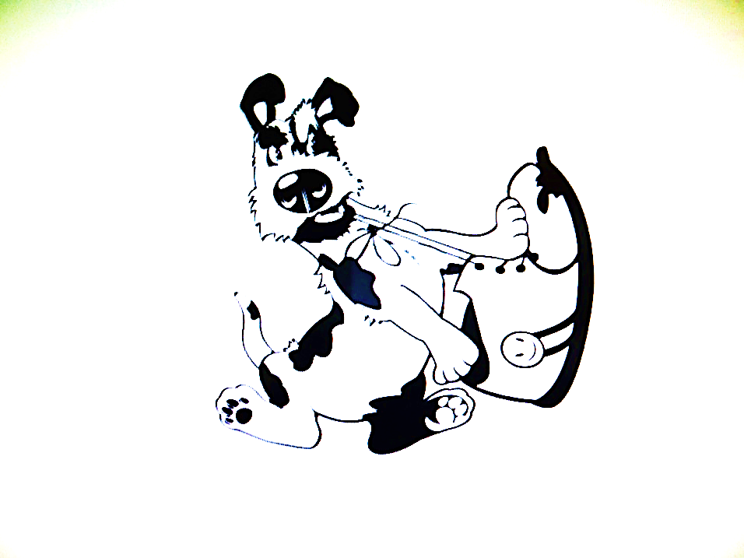
If a dog chews shoes whose shoes does he choose?

Slide 3
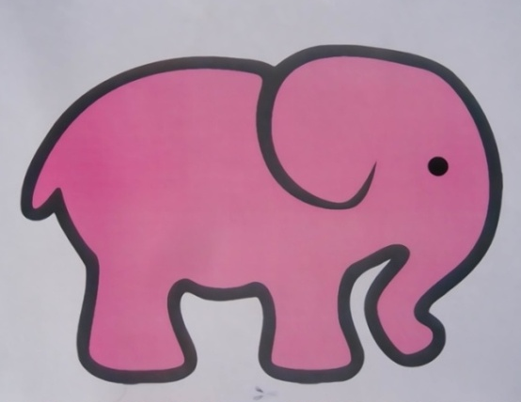
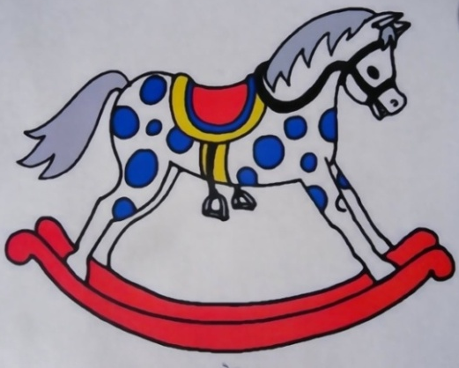
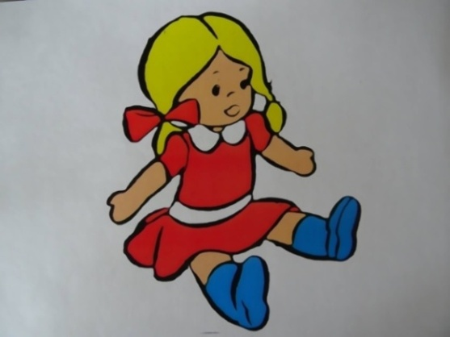
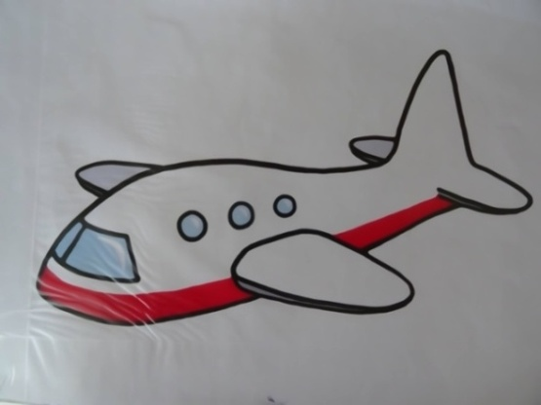
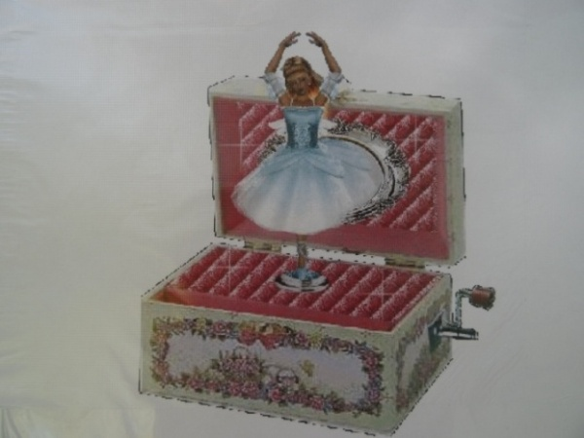
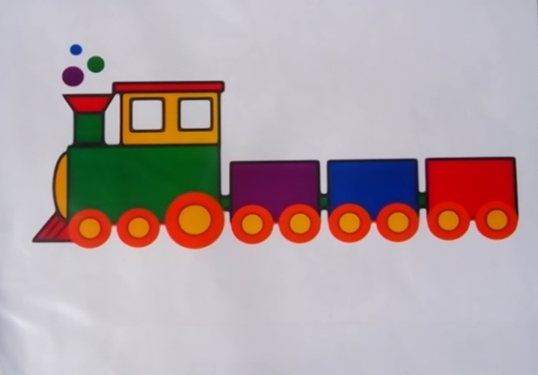
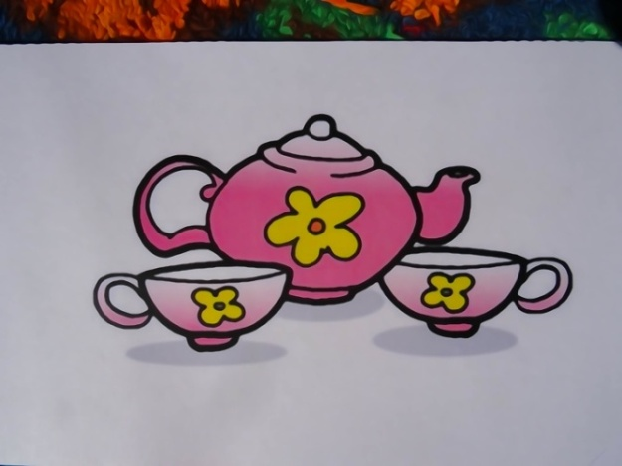
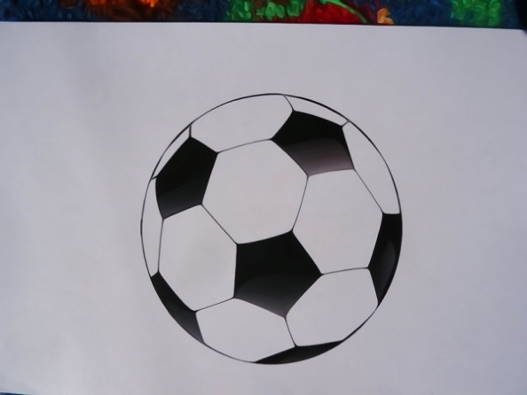
In my toy box

Slide 4
Вставим пропущенные буквы
_u s _ c _ l
_ o _
_ _ a _ n
_ _ a s _ t
_ er _ p _ _ n _
d _ l _
_ a l _
r _ _ k _ n_ h _ _ s _
_ l _ _ h _ n _

Slide 5
There is a toy box in my room
And there are many toys.
Some toys are only good for girls
And some for girls and boys.
For boys
For girls
For boys and girls

Slide 6
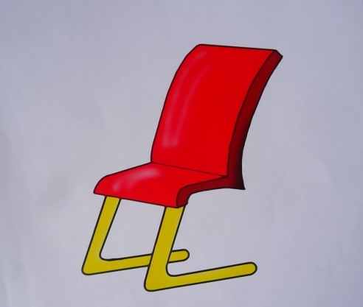
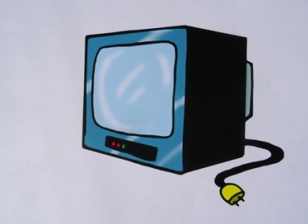
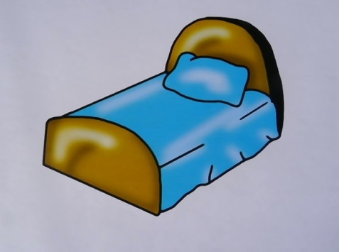
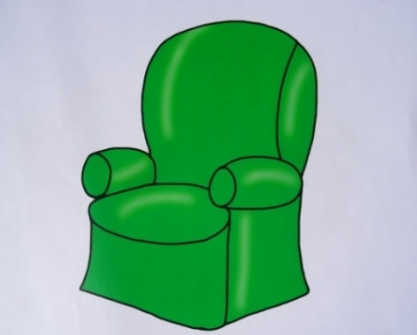
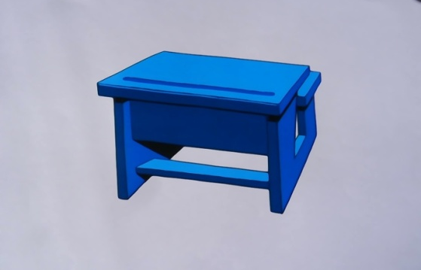
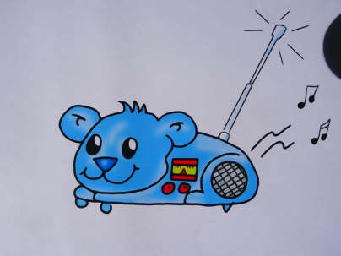
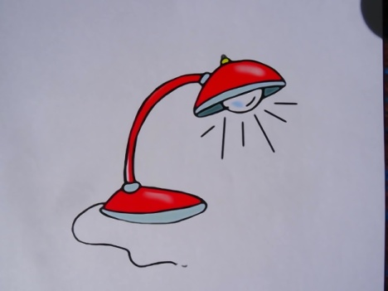
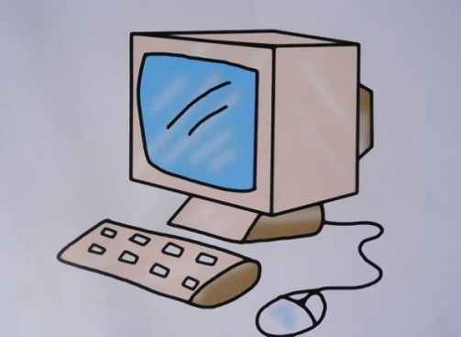
In my room
Computer
Desk
TV
Lamp
Chair
Armchair
Radio
Bed

Slide 7
This
These
That
Those
is
are
is
are

Slide 8
Составим из слов предложения
table
These
This
Is
is
a
desk
are
That
are
my
Those
These
our
pens
your
That
are
toys
bear
teddy
books
is
a
a

Slide 9





This that these those
… is my lamp.
… are my dolls.
… are my balls.
… is my radio.

Slide 10
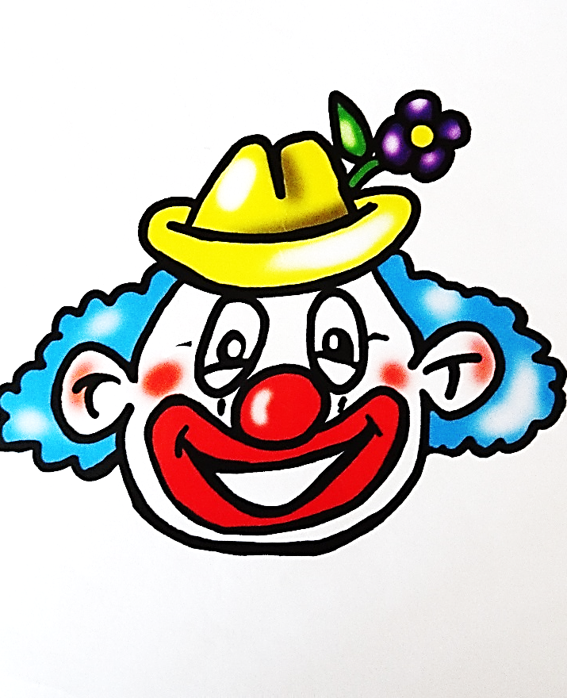
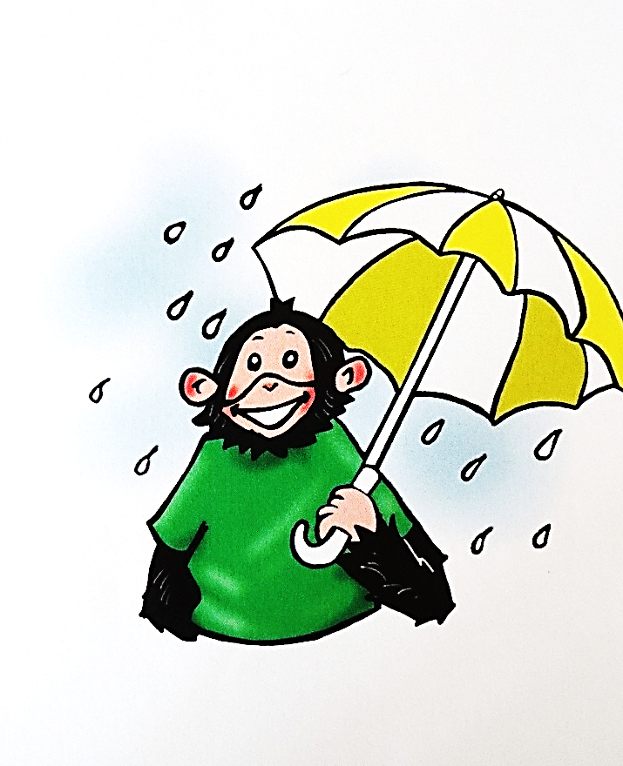
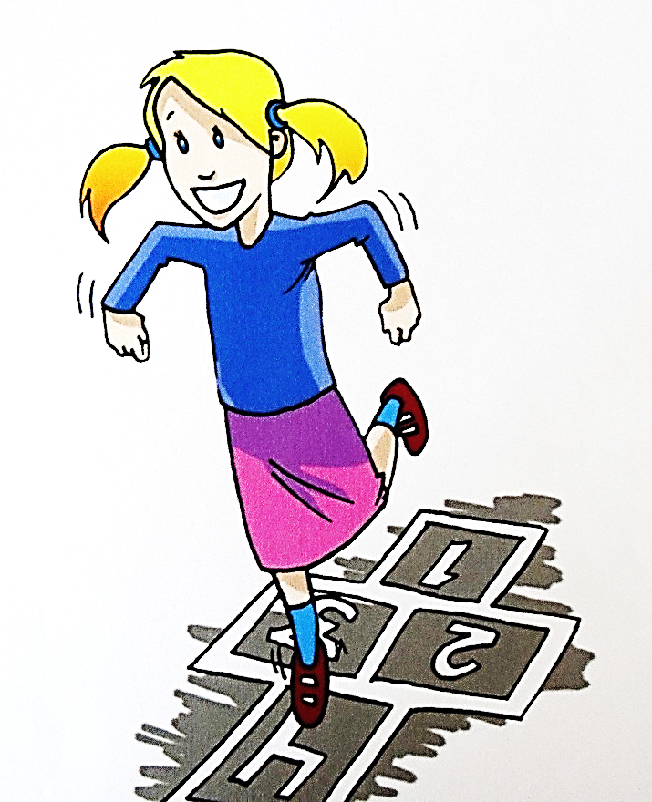
Clown/hat
Monkey/umbrella
Girl/skirt

Slide 11
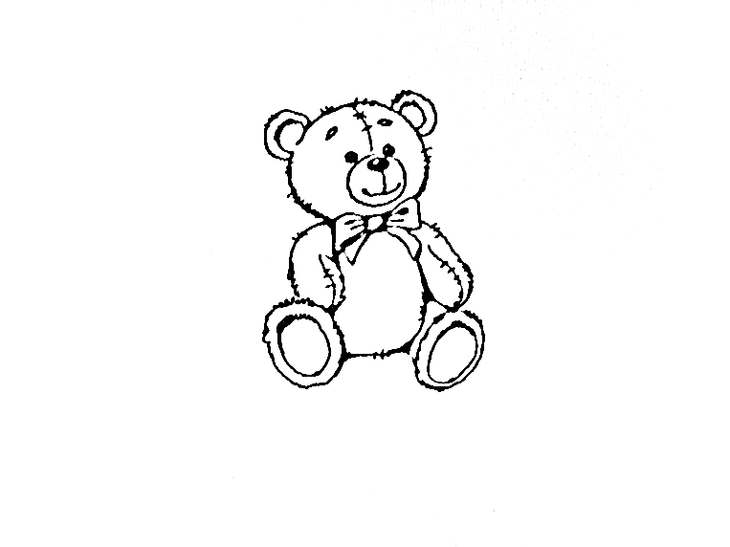
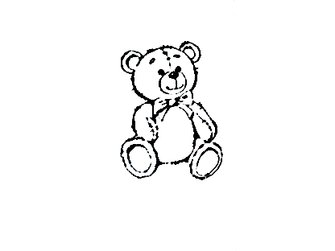
This bear
This bear is white.
That bear is brown.
This bear is in the Zoo.
That bear is in the town.
This bear is big.
That bear is small.
This bear has a drum.
That bear has a ball.
This bear likes ice-cream.
That bear likes jam.
This bear is Michael.
That bear is Sam.
That bear

Slide 12
Артикли
tea set
animal
umbrella
orange
ruler
doll
а
an

Slide 13
Выберем правильный ответ
What’s this?
What are those?
Whose is this ball?
a) It’s a doll
b)These are trains
a) A desk
b) It’s Mike
a) It’s Mike’s
b) Armchairs

Slide 14
The lesson is over.
Goodbye!

