Slide 1

Урок-викторина “Who Wants to Be the Champion?”
Презентация учителя английского языка ГБОУ Школа №1239 Маккавеевой Е.Е

Slide 2

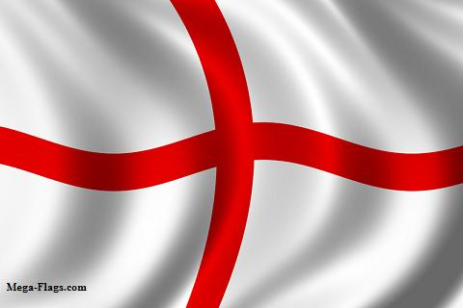

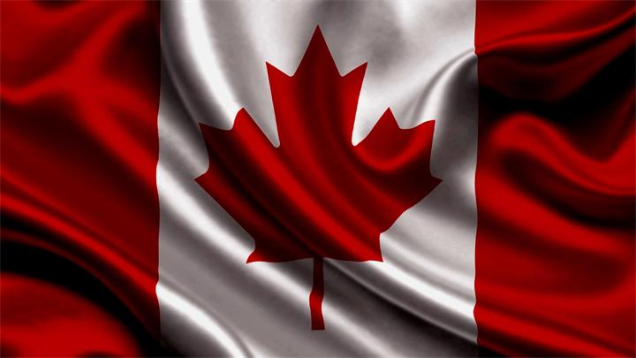
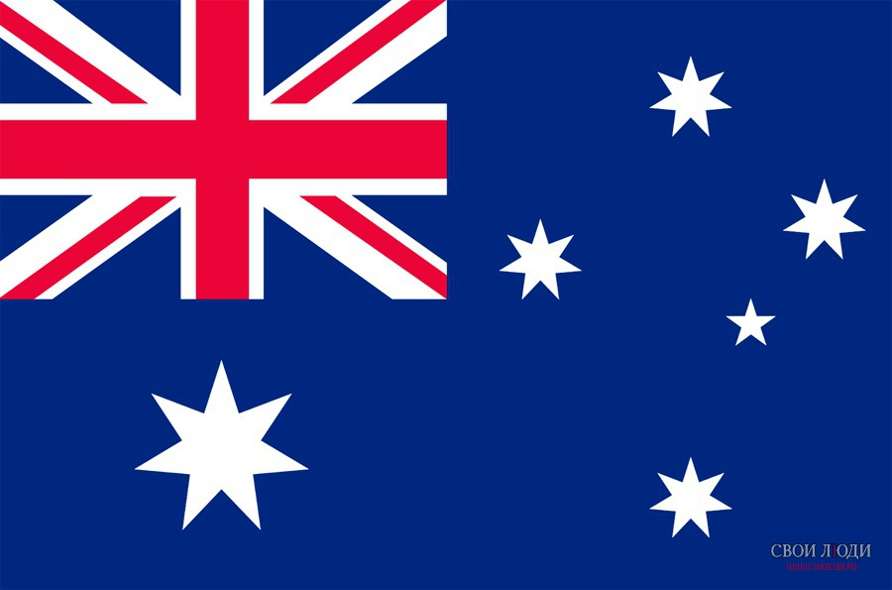
1 Flags

Slide 3

1-1 Which continent was the first to be discovered?

Slide 4

1-2 What country consists of 4 parts?

Slide 5
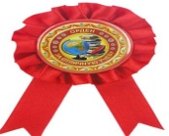
1-3 What country lies to the north of the USA?

Slide 6
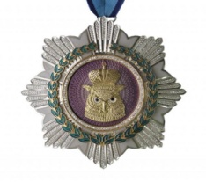
1-4 What country lies to the north of England?

Slide 7
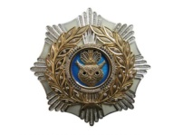

1-5 What country lies to the south of Scotland?

Slide 8
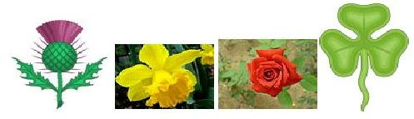
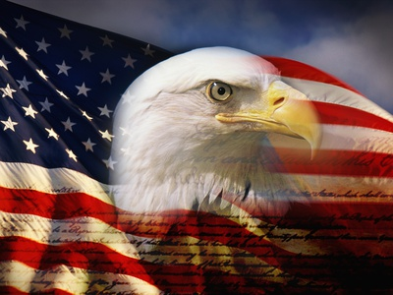
2 Symbols

Slide 9

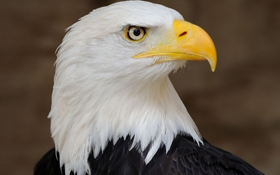
2-1 What is the national symbol of the United States of America?

Slide 10

2-2 What is the national symbol of Scotland?

Slide 11
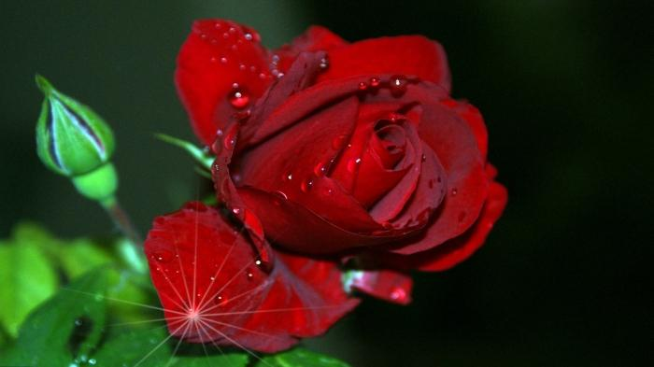
2-3 What is the national symbol of England?

Slide 12
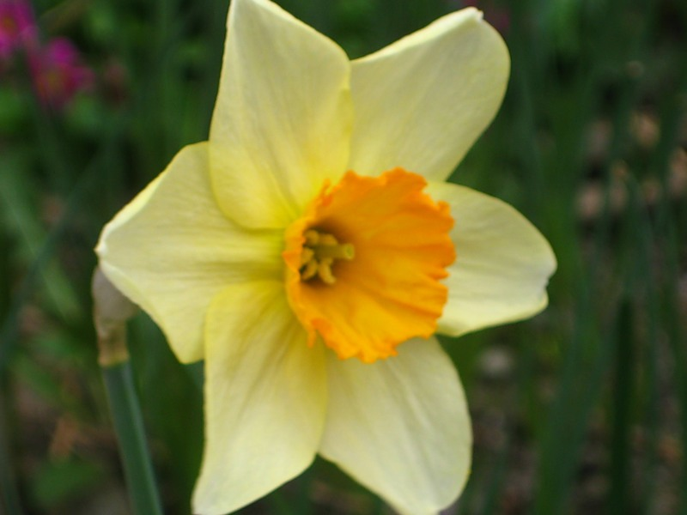
2-4 What is the national symbol of Wales?

Slide 13
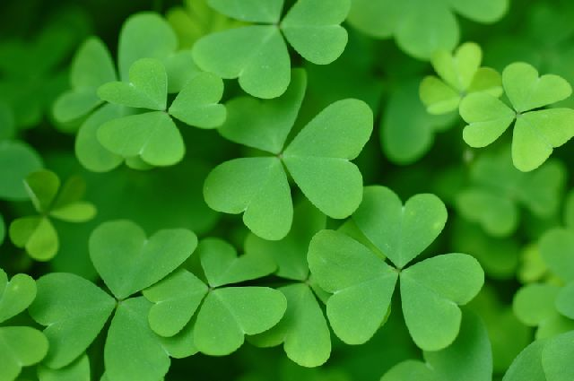
2-5 What is the national symbol of Ireland?

Slide 14
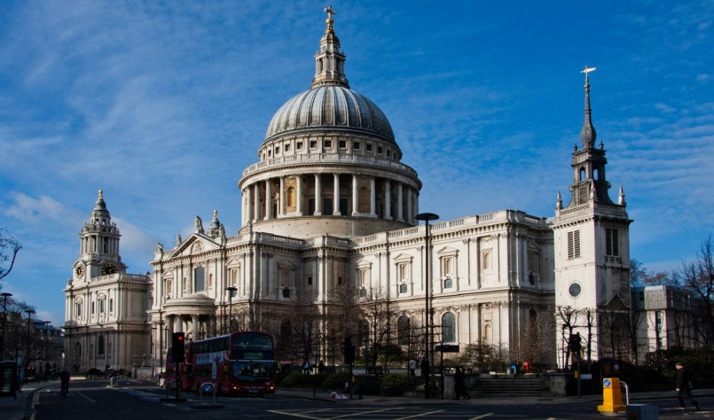
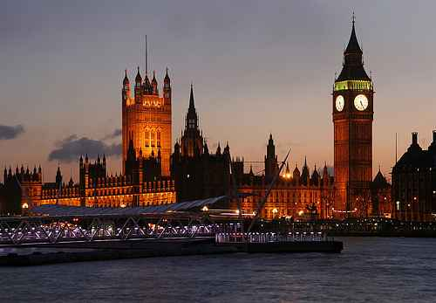
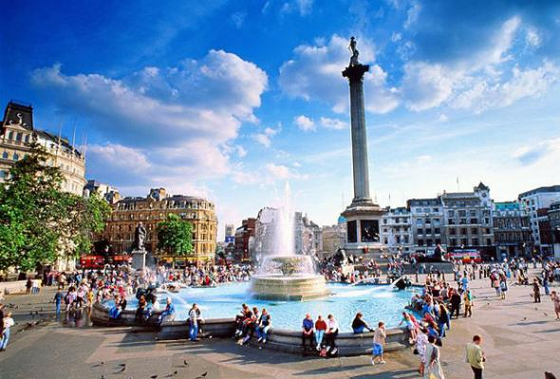
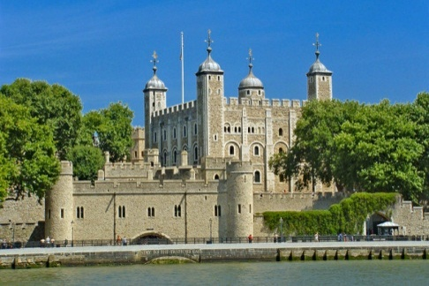
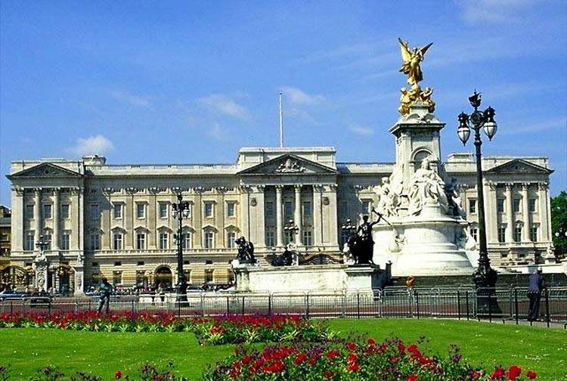
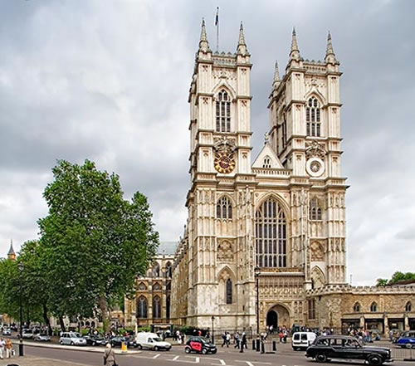
3 London Sights

Slide 15

3-1 What building has Big Ben?

Slide 16
3-2 It was a fortress , a prison, the royal palace. Now it is a museum and a Royal Treasury.

Slide 17
3 (Bonus!) Nelson's Column is in the centre of the square.

Slide 18
3-3 It is a royal church. There are tombs of many British kings and queens and other famous people there.

Slide 19
3-4 What is the home of the Queen?

Slide 20
3-5 This building is the seat of the Bishop of London, one of the most famous and most recognizable sights in London.

Slide 21
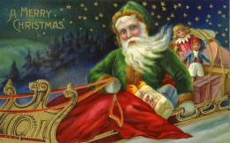
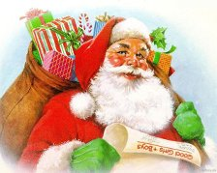

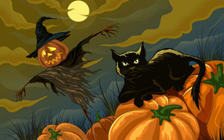
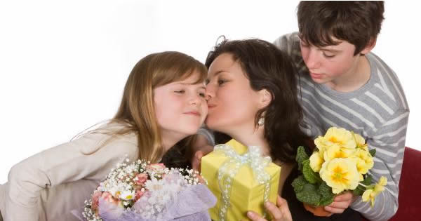
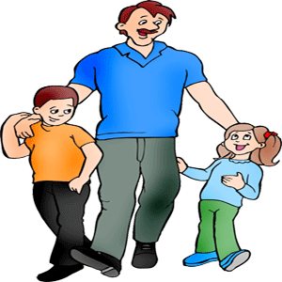
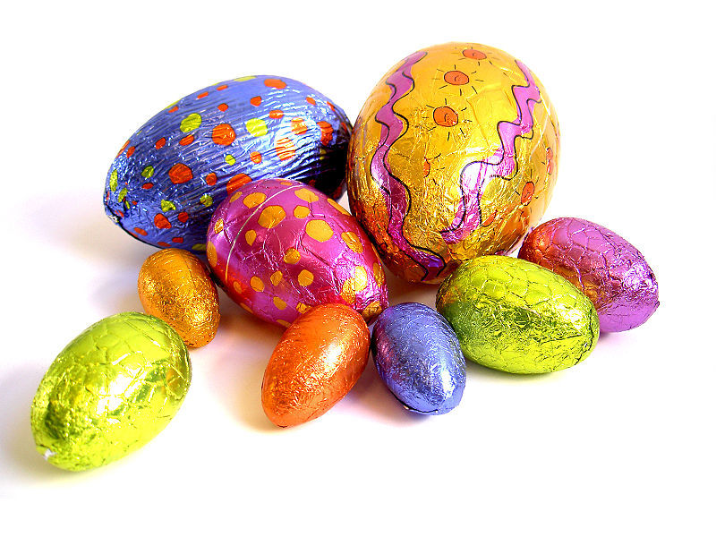
4 Holidays

Slide 22

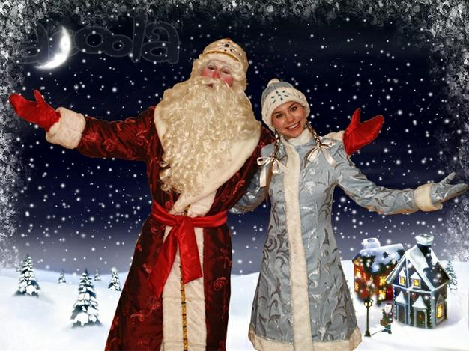
4-1 It is not so popular in England as in Russia, but it is rather popular in Scotland.

Slide 23

4-2 This holiday is celebrated on the 14-th of February as a day of love and friendship.

Slide 24
4 (Bonus!) This holiday comes on the second Sunday in May. It is a day when Americans honour their mothers.
Notes:
earest

Slide 25
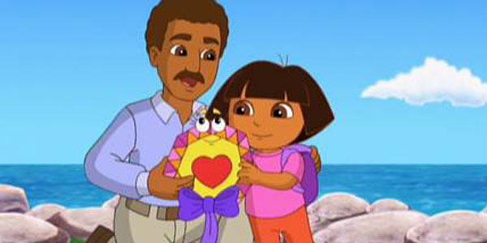
4 (Bonus!) This is an occasion to express gratitude towards your dad for all his love and support.

Slide 26
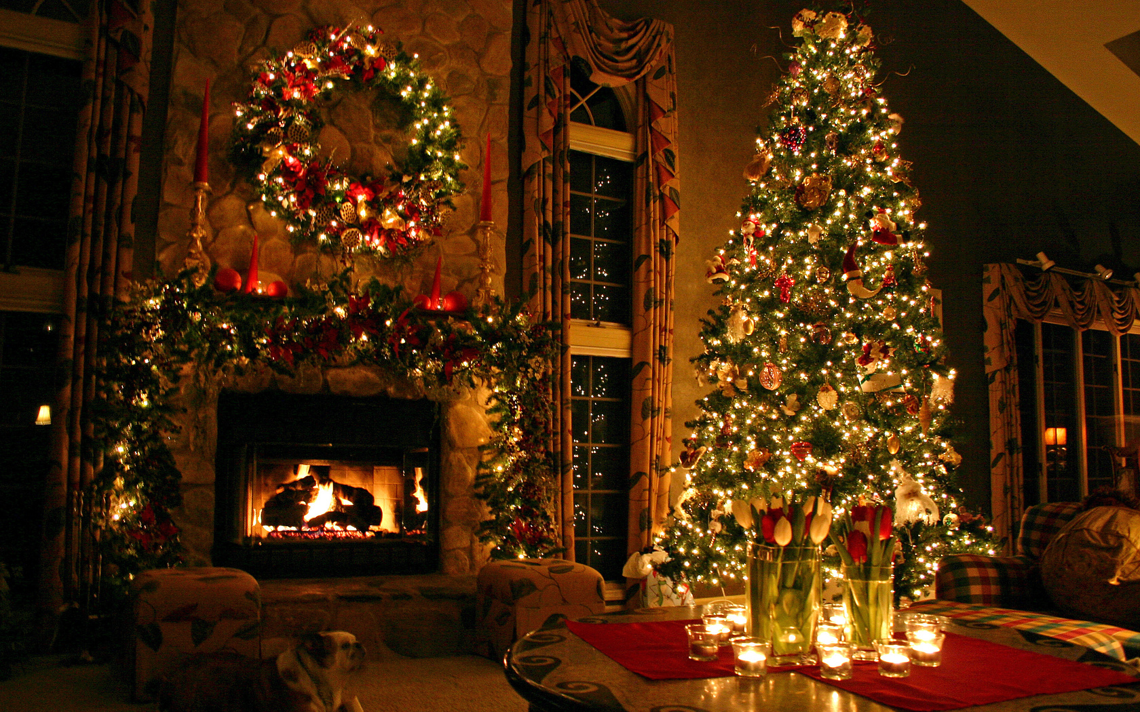
4-3 Parents put their presents into stockings. The traditional meal is roast turkey and pudding. They also decorate streets, rooms and a tree.

Slide 27

4-4 Children usually eat chocolate eggs and Cross Buns on this day.

Slide 28
4-5 Children make lanterns out of pumpkins, dress as witches and ghosts and go from house to house and say: “Trick or Treat!”

Slide 29
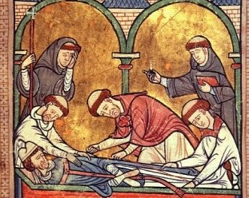
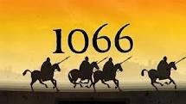
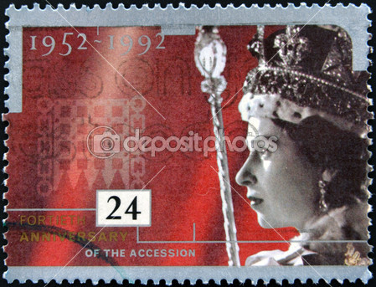
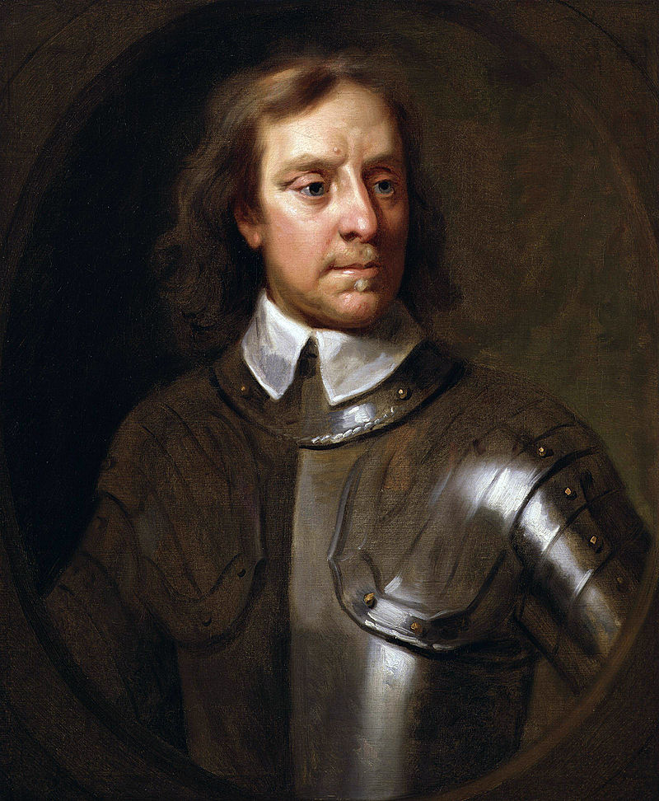
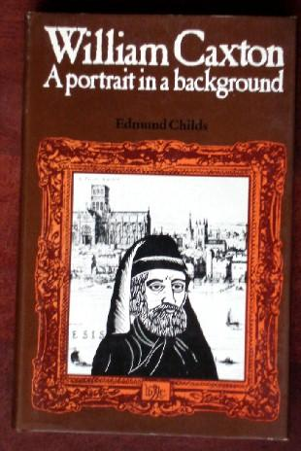
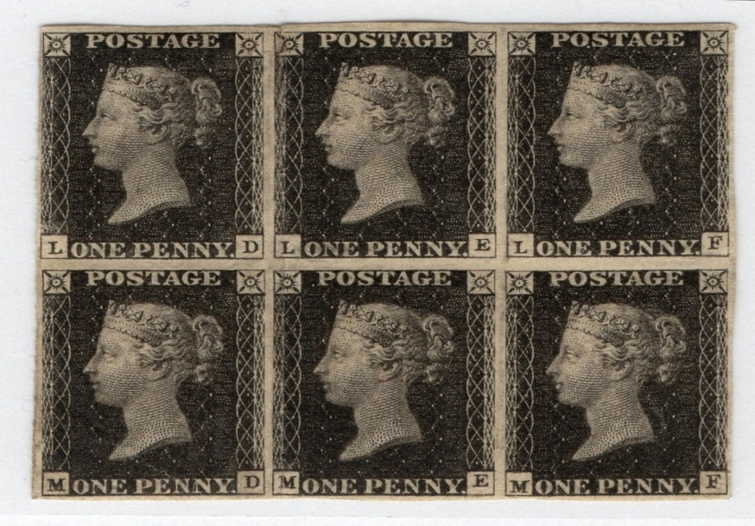
5 Dates
1170
1952
1840
1653
1476

Slide 30
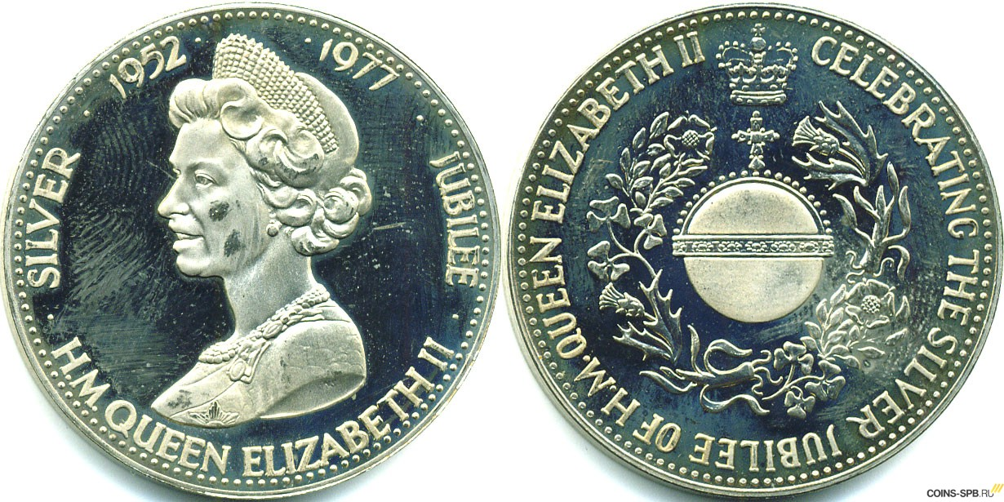
5-1 When did Elizabeth II come to throne?

Slide 31
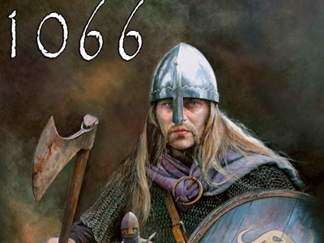
5-2 When did the Norman Conquest of England happen?

Slide 32
5 (Bonus!) He was an English military and political leader and later Lord Protector of the Commonwealth of England, Scotland and Ireland. When did he become Lord Protector ?
Oliver Cromwell (25 April 1599 – 3 September 1658) - was invited by his fellow leaders to rule as Lord Protector of England, Wales, Scotland and Ireland from 16 December 1653.

Slide 33
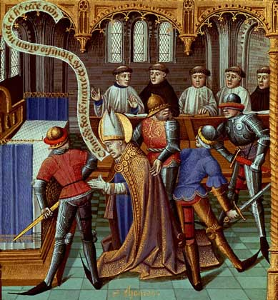
5-3 When was Thomas Becket murdered in Canterbury Cathedral?
His death happened on 29 December 1170.

Slide 34

5-4 Who and when introduced a printing press into England?
He is thought to be the first English person to work as a printer and the first to introduce a printing press into England, which he did in 1476.

Slide 35
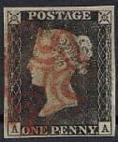
5-5 When did the first stamp “Penny Black” appear?
It was only in 1840 that the first official stamp, the Penny Black, was issued in Great Britain.

Slide 36
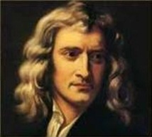
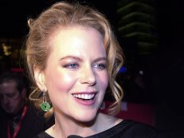
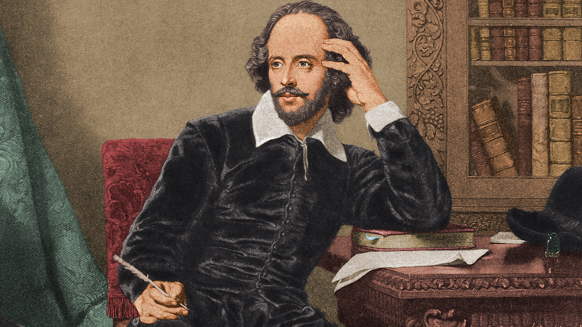
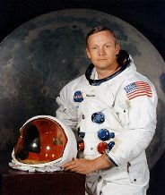
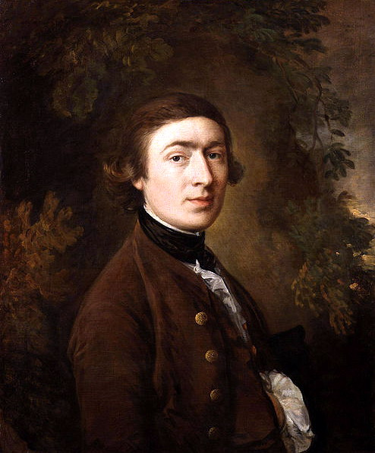
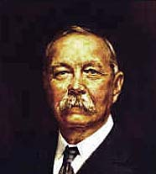
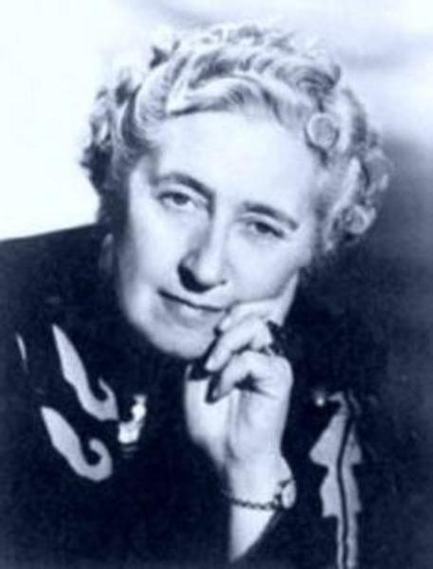
6 Famous People

Slide 37
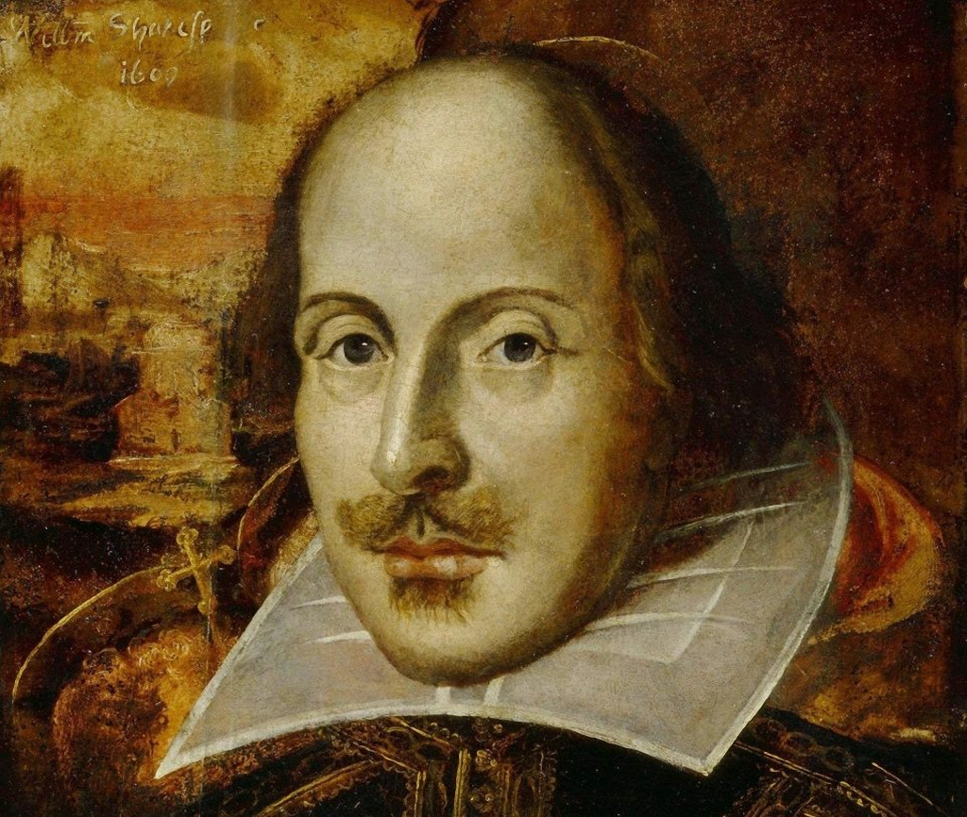
6-1 The real fame came to him when he started to write plays and pieces of poetry.

Slide 38
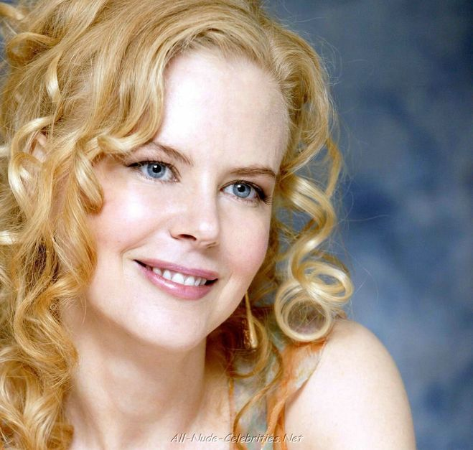
6-2 When she was 17, the whole Australia voted for her as the best actress of the year.

Slide 39
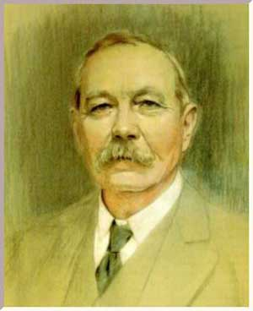
6 (Bonus!) He was a Scottish writer and physician, most noted for his fictional stories about the detective Sherlock Holmes in the field of crime fiction.

Slide 40
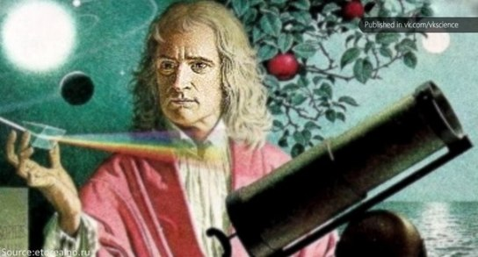
6 (Bonus!) He was as a key figure in the scientific revolution (described in his own way as a “natural philosopher ")

Slide 41
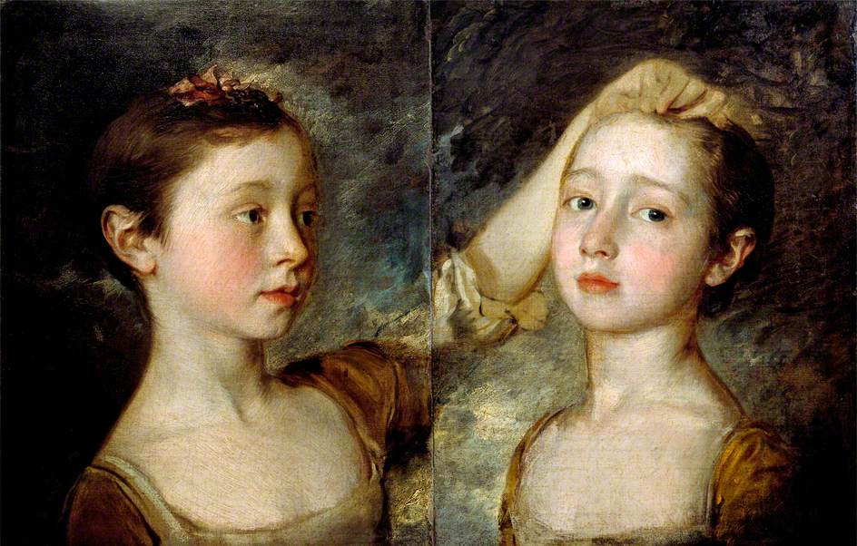
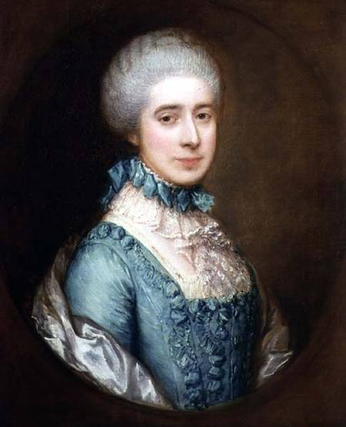
6-3 Who became the dominant British portraitist of the second half of the 18th century?
He was an English portrait and landscape painter. He surpassed his rival Reynolds to become the dominant British portraitist of the second half of the 18th century. He painted quickly, and the works of his maturity are characterised by a light palette and easy strokes. He preferred landscapes to portraits.

Slide 42

6-4 He was a spaceman and the first person to walk on the Moon.
Neil Alden Armstrong (August 5, 1930 – August 25, 2012) was an American astronaut and the first person to walk on the Moon.

Slide 43

6-5 Who wrote 75 detective stories?

Slide 44








7 Well-Known Writers

Slide 45

7-1 She is a British novelist best known as the author of the Harry Potter fantasy series.

Slide 46

7-2 This famous writer was born in 1835 in a small American town.
He never finished elementary school. Among his best novels are «The Adventures of Tom Sawyer» (1867) and its sequel, «The Adventures of Huckleberry Finn » (1885).

Slide 47

7 (Bonus!) This English poet, playwright, and actor was widely regarded as the greatest writer in the English language.

Slide 48

7 (Bonus!) He created some of the world's best-known fictional characters and is regarded as the greatest novelist of the Victorian era.

Slide 49

7 (Bonus!) She wrote the world's longest-running play, a murder mystery, The Mousetrap. In 1971 she was made a Dame for her contribution to literature.

Slide 50

7-3 This American writer was born in 1899. The book «Stuart Little» was written by him in 1945.

Slide 51


7-4 He was born in 1859 in Scotland. He was a doctor, then he began to write detective stories. The famous character Sherlock Holmes was created by him.

Slide 52

7-5 He was born in 1874. He was the British Prime Minister. For his historical studies he was given the Noble Prize for Literature in 1953.

Slide 53














8 Guess the Home-Reading Characters:

Slide 54

8-1 Who is this character?
He is an orphan who discovers at the age of 11 that he is a wizard, who lives within the ordinary world of non-magical people. His ability is inborn, he is invited to attend an exclusive magic school to succeed in the wizarding world and it is there where most of the events in the series take place.

Slide 55

8-2 Who is this character?
He enjoys travelling. During his first voyage, he is washed ashore after a shipwreck and finds himself a prisoner of a race of tiny people, less than 6 inches tall, who are inhabitants of the island country. After giving assurances of his good behaviour, he is given a residence in this country and becomes a favourite of the court.

Slide 56

8 (Bonus!) Who is this character?
He was a sailor. One day there was a storm in the sea and the ship was wrecked. He swam to an island. He lived on the island alone for a long time and he had a friend called Friday.

Slide 57

8-3 Who is this character?
One of the main characters of the book is a mouse. His life is full of adventures and funny episodes.

Slide 58

8-4 Who is this character?
He lives with his half-brother Sid, his cousin Mary, and his stern Aunt Polly in the (fictional) town of St. Petersburg, Missouri. There is no mention of Tom's father. Tom is the son of Aunt Polly’s dead sister.

Slide 59

8-5 Who is this character?
She looked after children. The wind had brought her over. She usually had a bag and an umbrella in her hands. In her bag she had an armchair, a piano and a magic bottle.

Slide 60


Slide 61

9 The Final
If necessary

Slide 62

9–1 The Final
Make as many words as you can out of the word Sportsmen. Write them down.

Slide 63
The best result is 23 words.
Key: Sport, or, port, men, sort, to, ten, rose, nose, stop, pot, post, most, on, no, not, pet, more, rest, nest, pen, note, top.

Slide 64


Slide 65

the best player is …..

Slide 66

Thank You for Attention!
Good Luck!

