Slide 1
Some facts about
HALLOWEEN
Подготовила учитель
английского языка МБОУ ЦО
г-к Кисловодска
Варданян Армине Тельмановна

Slide 2
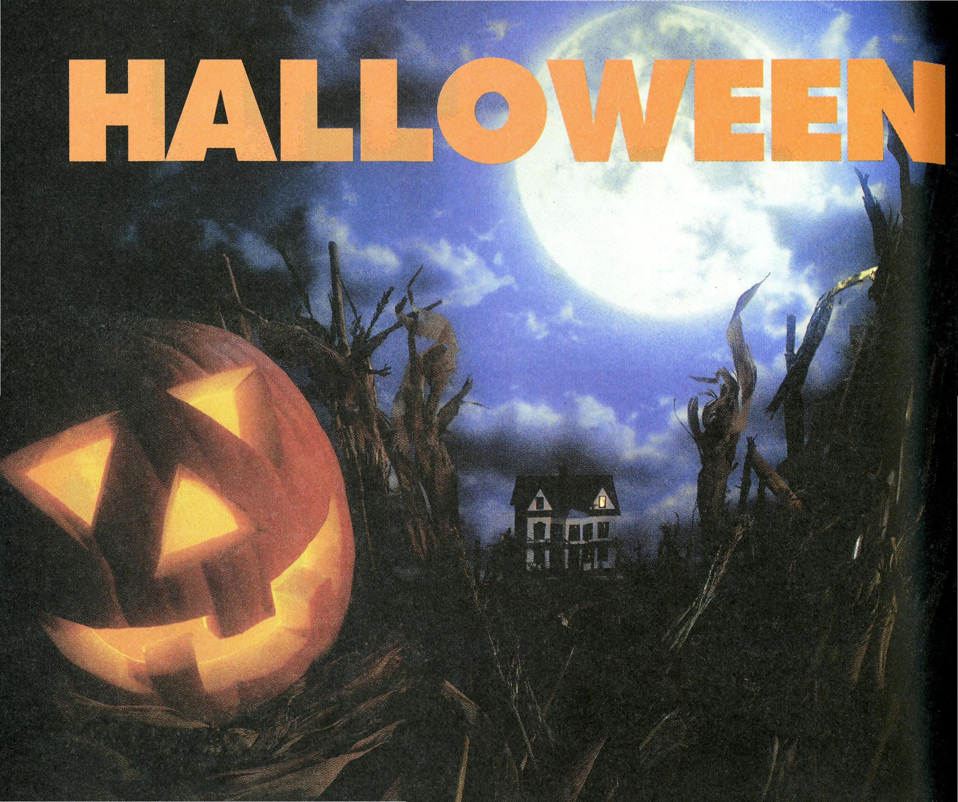
IT’S HALLOWEEN
It’s Halloween! It’s Halloween!
The moon is full and bright
And we shall see what can’t be seen
On any other night.
Skeletons and ghosts and ghouls,
Grinning goblins fighting duels,
Werewolves rising from their tombs,
Witches on their magic brooms.
In masks and guns we haunt the street
And knock on doors for trick or treat.
Tonight we are the king and queen,
For oh tonight it’s Halloween!

Slide 3
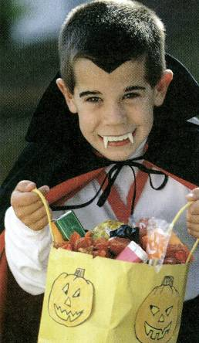
The History
In the year 835 A* D. the Roman Catholic Church made November 1st a church holiday to honor all the saints. This day is called All Saint's Day. The Mass said on All Saints' Day was called Allhallowmass. The day before All Saints' Day was known all hallows' Eve or All Hallow e'en.
Since that time many years have passed. Some traditions are gone, new traditions appeared.
In the United States children wear costumes and masks and go trick-or-treating. Many of them carve jack-o'-lanterns out of pumpkins. Fortunetelling and storytelling about ghosts and witches are popular activities

Slide 4
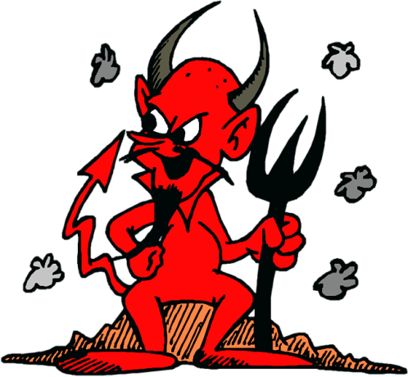
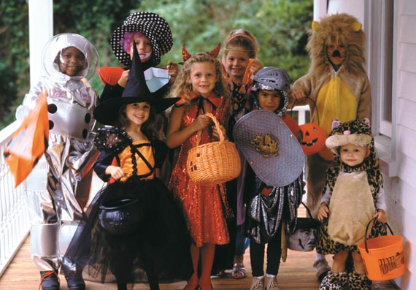
The tradition of dressing in costume for Halloween has both European and Celtic roots. Hundreds of years ago, winter was an uncertain and frightening time. Food supplies often ran low and, many people afraid of the dark, the short days of winter were full of constant

Slide 5
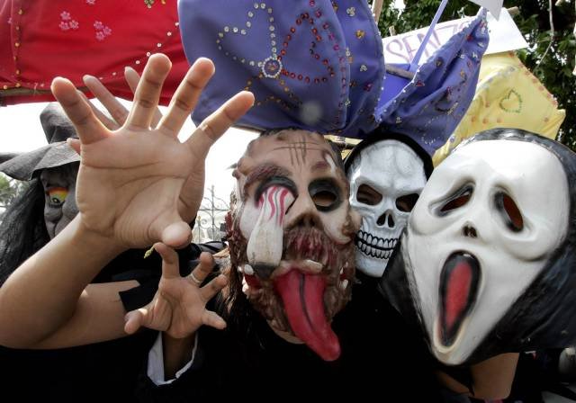
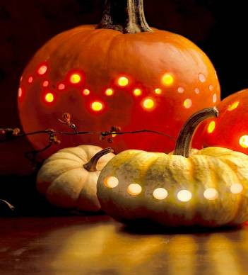
On Halloween, when it was believed that ghosts came back to the earthly world, people thought that they would encounter ghosts if they left their homes. To avoid being recognized by these ghosts, people would wear masks when they left their homes after dark so that the ghosts would mistake them for fellow spirits.
On Halloween, people placed bowls of food outside their homes to appease the ghosts and prevent them from attempting to enter their home.
Fire was very important to the Celts as it was to all early people. In the old days people lit bonfires to ward away evil spirits and in some places they used to jump over the fire to bring good luck. Today, we light candles in pumpkin and then put them outside our homes to ward of evil spirits.

Slide 6
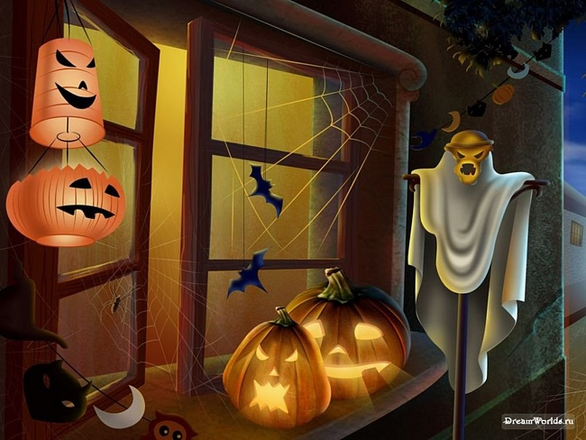
Jack-o'-lanterns are hallowed-out pumpkins with face carved into one side.
Most jack-o'-lanterns contain a candle inside. An Irish legend says that jack-o'-lanterns are named after the man called Jack.
He could not enter heaven because he was a miser, and he could not enter hell because he had played jokes on devil. As a result, Jack has to walk on the earth with his lantern until Judgment Day.

Slide 7
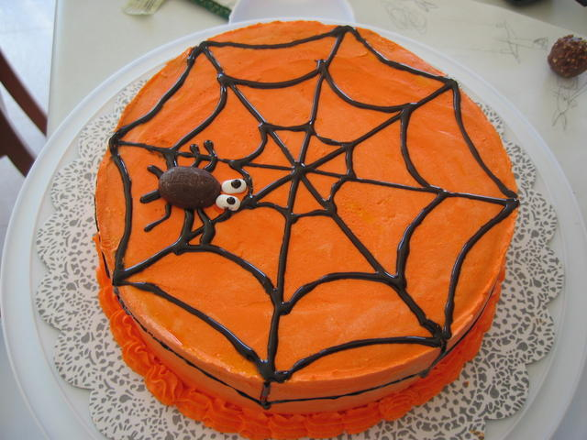
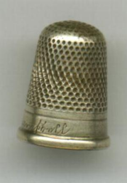
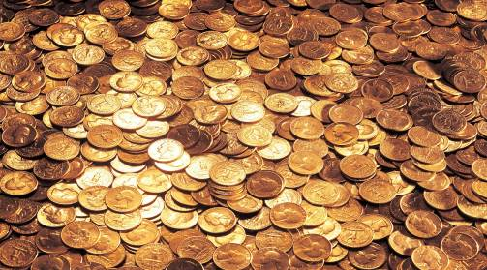
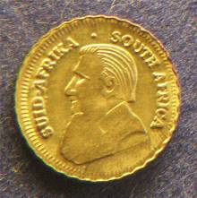
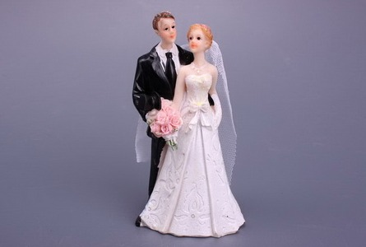
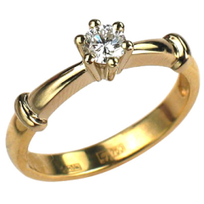
Fortunetelling is an important part of Halloween.
For example, a coin, a ring, and a thimble were baked into a cake. It was believed that the person who found the coin would become wealthy. The one who found the ring would marry soon. And the person who found the thimble would never get married. Today people practice cardreading or palmistry.

Slide 8
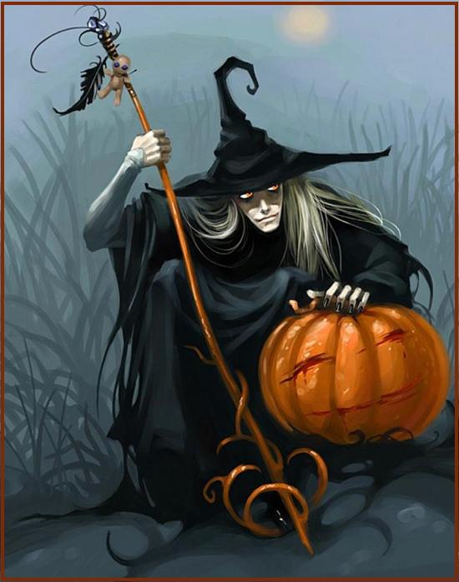
People once believed that there were many ghosts and witches on the Earth and that they met on October 31 to worship the devil. Today, people do not believe in ghosts and witches but they like to tell stories about them on Halloween.
Halloween was sometimes called Nut Crack Night or Snap Apple Night in England. Families would sit by the fire and tell stories while they ate apples and nuts.

Slide 9
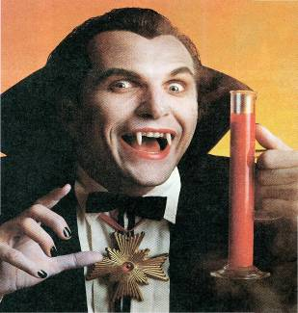
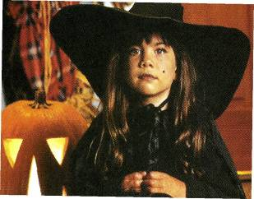
Halloween is celebrated by nearly all British and American children, and over 70% of adults. Many families carve pumpkins and decorate the outside of their houses.
Part of the fun of Halloween is to get scared out of your wits. This can easily be done by visiting a haunted house.
Why do spirits hate the living and try to scare them away?
The living always want to clean up their homes, while ghosts prefer dust, spiders and darkness.

Slide 10
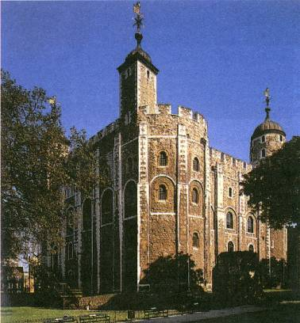
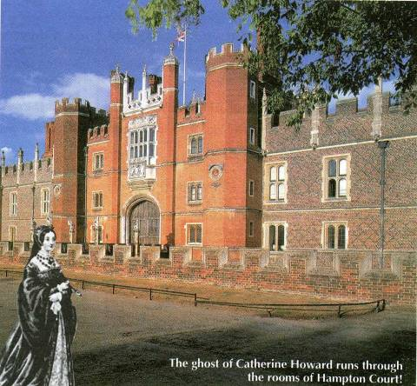
The ghost of his fifth wife, Catherine Howard, runs through the rooms of Hampton Court.
The Tower of London is said to have 30 ghosts! Visitors have seen Queen Anna Boleyn, for example, the second wife of King Henry VIII .

Slide 11
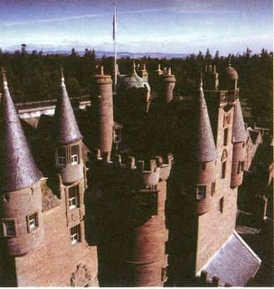
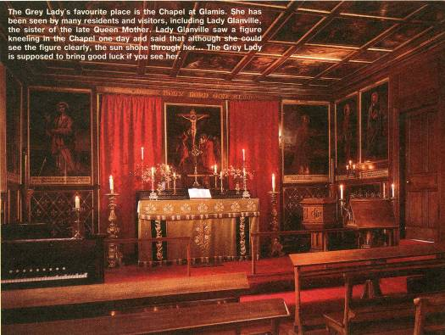
The Chapel at Glamis is the Grey Lady’s favourite place.
The beautiful Glamis Castle has a reputation as the most haunted castle in Scotland.

Slide 12
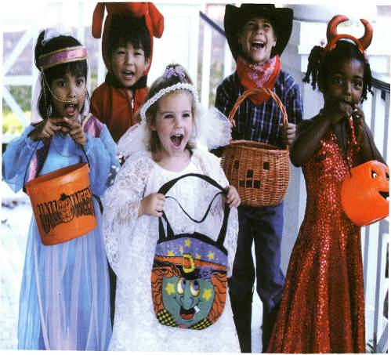
Most children have a wonderful day on Halloween. They go trick-or- treating. Often, there’s a party at a friend’s home. At most parties, prizes are given for the best costumes.
Bobbing for apples, telling fortunes, and snacking on caramel apples, cider, and pumpkin pie.
Trick or Treat was first known as Mischief Night. Halloween was a time for making mischief — many parts of England still recognize this date as Mischief Night Children dress in costumes and masks and go from door to door saying "trick or treat". The neighbours give children such treats as candy, fruit and pennies so that children do not play tricks on them.

Slide 13
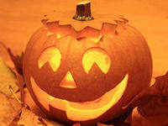
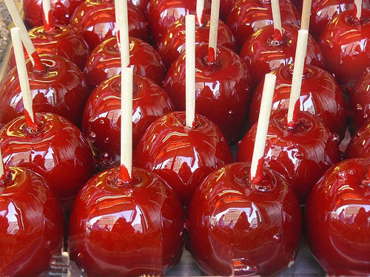
Another tradition is Apple Bobbing.
It has the roman origins. The Roman festival for remembering the dead was also in October. During this time, the Romans remembered their goddess, Pomona. She was the goddess of the trees and fruits, and when the Romans came to Britain, they began to hold these two festivals on the same day as Samhain. Apples probably became associated with Halloween because of this festival. Some people believe that, if you slice an apple through the equator (to reveal the five-pointed star within) and then eat it by candlelight before a-mirror, your future spouse will appear over your shoulder.

Slide 14
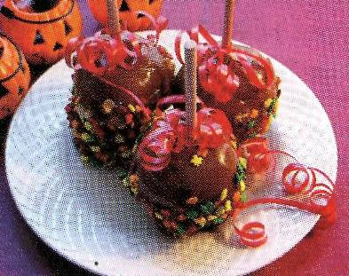
CARAMEL APPLES
8 apples
2 packet of caramel
¼ cup water
8 sticks
Put the saucepan with the caramels and water over a pan of boiling water. Boil the water until the caramels melt. Put a wooden stick into the top of each apple, dip the apple into the caramel. Let them cool on wax paper.

Slide 15
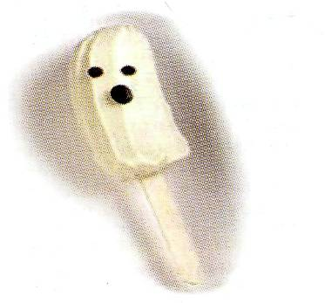
BANANA GHOSTS
4 bananas
1 bar of white chocolate
8 sticks
Peel the bananas and cut them in halves. Push a stick into each half and freeze until firm (about 3 hours). Put a bar of white chocolate in a saucepan and melt it. Spread the melted chocolate on the frozen banana halves. Put them on a dish. Press on candies or nuts for eyes and mouths and return them to the freezer until they are ready to serve.

Slide 16
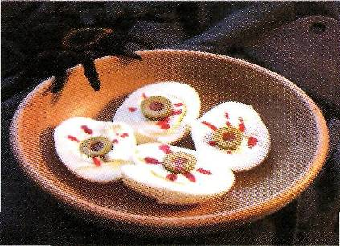
DEVIL’S EYEBALLS
6 eggs (boiled hard)
Cream cheese
12 olives
Ketchup
Cut the eggs in halves. Remove yolks and fill the hole with cream cheese. Cut the olives and press them into each cream cheese eyeball. Dip a toothpick into ketchup and draw broken blood vessels in the cream cheese. These eyeballs look terrific!

Slide 17
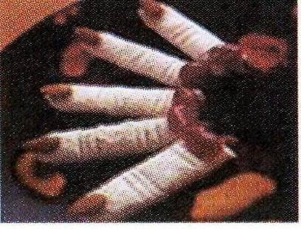
FINGER SANDWICHES
Thin sliced white bread
Soft butter
Cream cheese
Almonds
Ketchup
Gently flatten the slices of bread and spread them with a little butter and cream cheese. Stick an almond on to each tip to form the nails and add some tomato ketchup for the blood!

Slide 18
PERSONALITY TEST
You love mystery. You believe there are things which don’t have a logical explanation.
You love feeling scared. You like to imagine the worst and you think feeling scared is exciting.
You have your feet on the ground. For you, every problem has a logical solution and you don’t believe in the supernatural.
So, the quiz is for you.

Slide 19
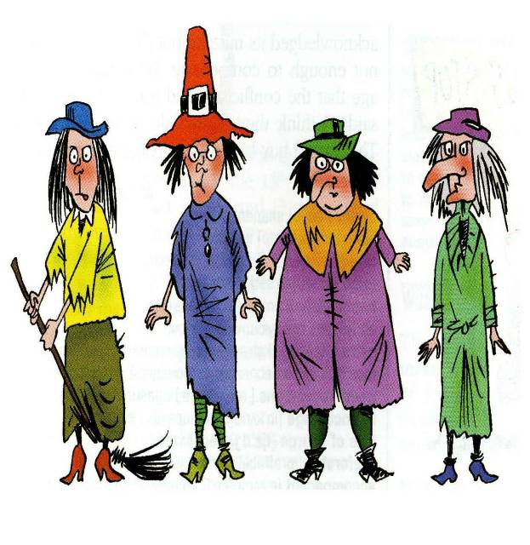
1. Dabra hasn’t got a broom.
2. Wabra hasn’t got a big hat.
3. Dabra and Abra haven’t got long noses.
4. The fat witch isn’t Cadabra.
5. Abra isn’t standing next to Wabra.

Slide 20
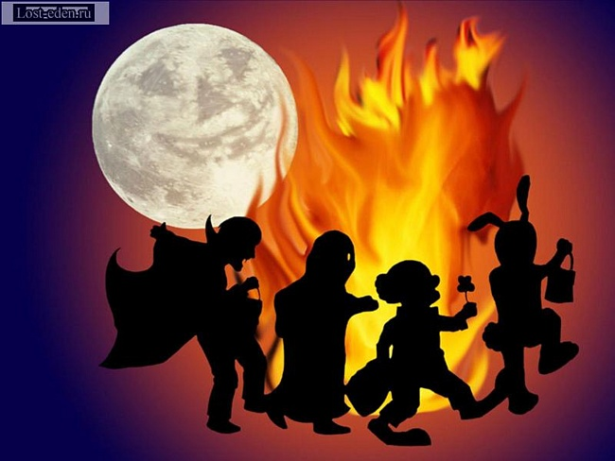
SPOOKY Quiz
The word “Halloween” has its origins in the … church.
Lutheran b. Catholic c. Christ
2. The custom of Halloween was brought to America in the… .
19th century b. 2 0th c. 18th
3. The jack-o-lantern custom probably comes from … folklore
English b. Spanish c. Irish
4. The Irish used … as the jack-o-lanterns originally instead of pumpkins.
Squash b. turnips c. cabbages

Slide 21
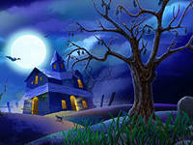
The night of horror - Halloween
5. When is Halloween celebrated?
December 25th b. February 14th
c. October 31st
6. What colors are associated with Halloween?
Red and green b. yellow and blue c. black and orange
7. What is worn to keep vampires away? a) garlic b) onion c) pepper
8. When are werewolves supposed to come out?
a) during a full moon b) after midnight
c) on a Halloween night

Slide 22
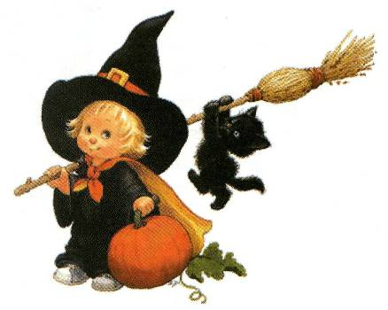
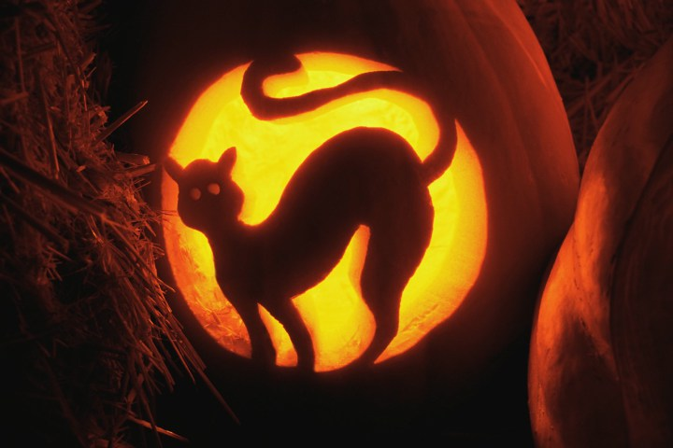
Who can walk through walls?
Witches b) goblins c) ghosts
10. What does a witch use for transport?
a hat b) a motorbike c) a broomstick
11.What would you call a group of witches?
a) Coven b) gang c) mob

Slide 23
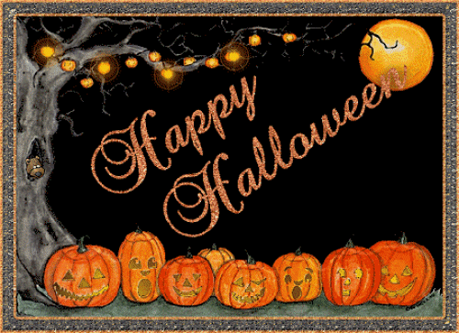
“Boo!”

