Slide 1
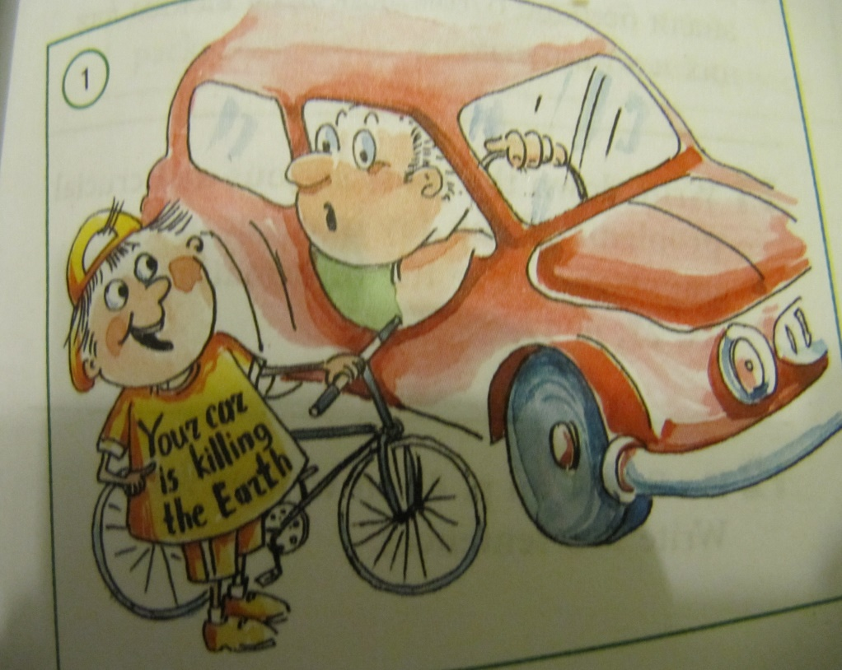
Keep Environment Clean. Conditionals.
Урок английского языка в 8 классе
МБОУ «СОШ №13» г. Северодвинска Архангельской области
Автор: Булатецкая Татьяна Павловна, учитель высшей категории

Slide 2
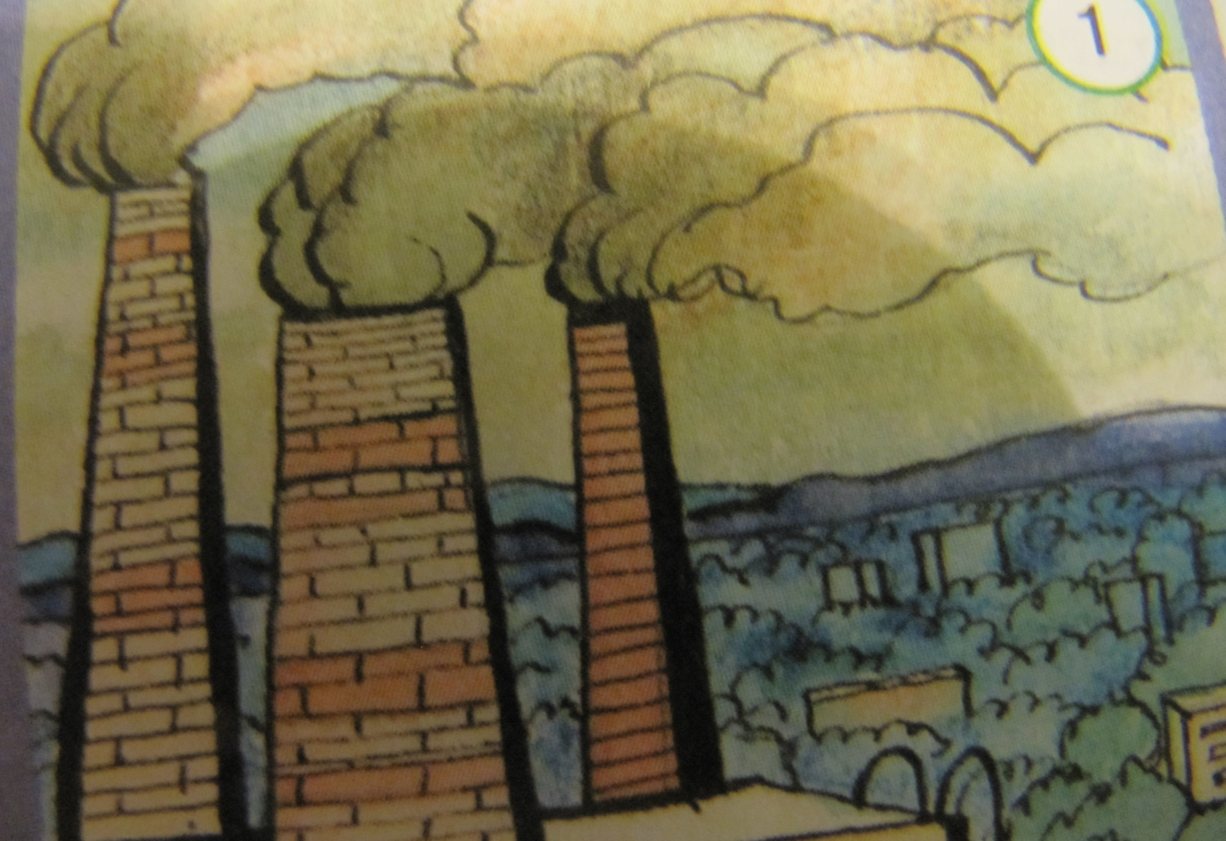
Let’s Describe the Picture

Slide 3
Let’s do a Sinquan
1 ………………….
2.Clean, polluted
3.To protect, to prohibit, to reduce
4.Keep in order
5.Nature
1.Environment
2.Clean, polluted
3.To protect, to prohibit, to reduce
4.Keep in order
5.Nature

Slide 4
Find the unnecessary word
Variant I
Protect
Waste
Invite
Pack
Pollute
Throw
Clean
Recycle
Variant II
Responsible
Protective
Recycling
Dangerous
Environmental
Throwaway
Polluting
Poisonous

Slide 5
Check up!
Invite
Responsible

Slide 6
Find the synonyms
Variant I
1.Damage
2.To get rid of
3.The packaging
4.Litter
a.rubbish
b.the wrapping
c.hurt
d.throw away
Variant II
1.Make
2.Material
3.Save
4.Horrible
a.terrible
b.do
c.stuff
d.protect

Slide 7
Check Up!
1 – c
2 – d
3 – b
4 - a
1 – b
2 – c
3 – d
4 – a

Slide 8
Translate the sentences
1.Если бы люди больше думали о своем будущем, они бы не загрязняли реки.
2.Если бы люди не выбрасывали так много мусора, город был бы сейчас чище.
3.Если бы люди не использовали ядовитые вещества, воздух был бы чище.

Slide 9
Check Up!
If people had thought more about their future, they wouldn’t have polluted rivers.
If people hadn’t thrown away so much rubbish, the town would have been cleaner.
If people hadn’t used poisonous materials, air would have been cleaner.

Slide 10
Tasks for Groups
Group№1: Watch the film, do the schemes and tell what is the film about. Propose three ways to save the Earth.
Group№2: Watch the film, make up questions and ask them to other groups. Propose three ways to save the Earth.
Group№3: Watch the film and make up six sentences about environmental problems. Propose three ways to save the Earth.

Slide 11
The Dead Sea in Danger
The Dead Sea, the saltiest body of water of the earth and a wonderful natural treasure, is becoming smaller and smaller because of decisions by people to use part of its waters.
The Dead Sea is located at the lowest point of the earth, almost 400 meters below sea level. It is 50 kilometers long. Just 40 years ago it stretched 80 kilometers in length.
One of the main reasons for the sea’s shrinking is lack of water. 90% of the waters that flow from the Jordan River, which traditionally goes into the Dead Sea, is taken for drinking and agriculture in Israel and Jordan.
Besides, local industry adds to the Dead Sea’s problems. They use the water for getting necessary minerals. It’s a real disaster for the Sea.
Now hundreds of thousands of tourists come to the Dead Sea every year. Its water is so salty that a man can read a newspaper comfortably while lying on his back on the water. The water contain a lot of sulphur, and the thick black mud that is found at the sea’s beach is very useful for people with skin diseases. Tourists treat their bodies with the black mud, but they don’t think about the Dead Sea’s troubles.
It can be saved – but time is running out.

Slide 12
Do the Tasks to the Text:
1.Where is the Dead Sea located?
a) At the highest point of the Earth.
b) At the hottest place of the Earth.
c) At the lowest point of the Earth.
d) At the coolest place of the Earth.
2.How long is the Dead Sea now (according to the text)?
a) 400 meters
b) 50 kilometers
c) 80 kilometers
d) 40 kilometers
3.Find in the text and underline the sentence that says why the Dead Sea is in danger.
4.Why does the text finish with the words: It can be saved but time is running out?

Slide 13
Check Up!
1 – c
2 – b
3 - 90% of the waters that flow from the Jordan River, which traditionally goes into the Dead Sea, is taken for drinking and agriculture in Israel and Jordan.

Slide 14
Self-Estimation
Communicative skills: (описание картинки, фронтальная беседа по теме, выступление в групповых проектах);
Comprehension skills: (просмотр и понимание мультфильма, выполнение заданий в групповой работе);
Grammar skills: (перевод предложений с Conditionals);
Reading skills: (чтение и понимание текста).

Slide 15
REFLEXION
What did you learn at the lesson today?
What was remembered today?
What was the most useful for you at the lesson?
What have you done best?
How can you describe your results at the lesson in few words?

