Slide 1
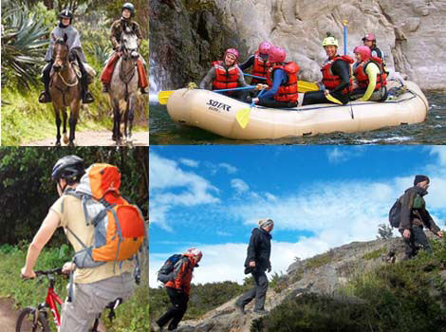
On Holiday

Slide 2
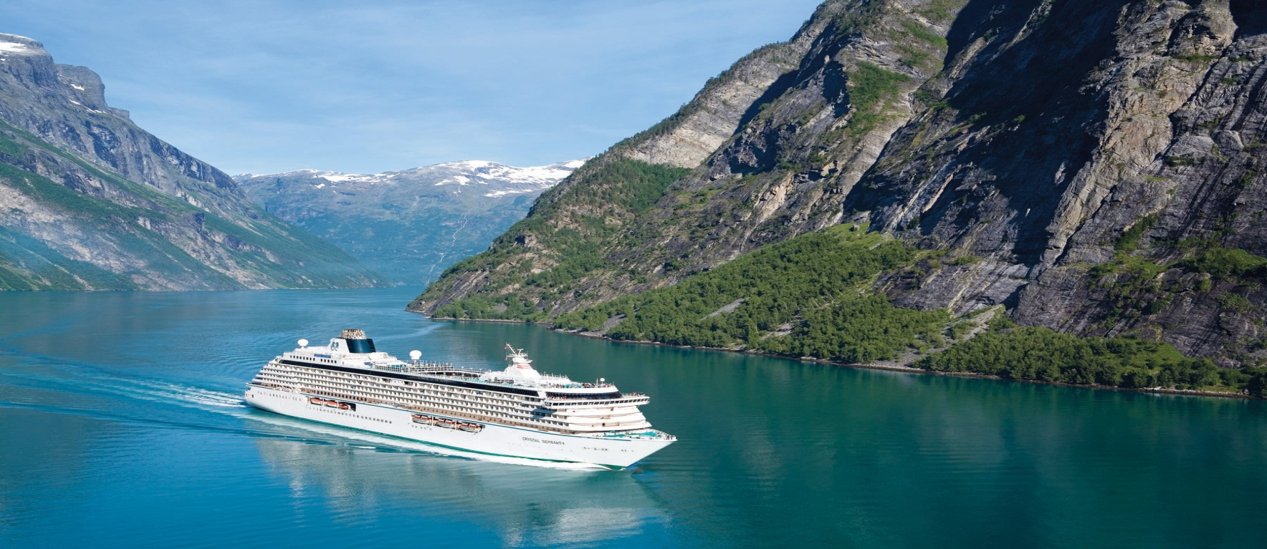
СRUIS
a journey by sea, visiting different places, especially as a holiday

Slide 3
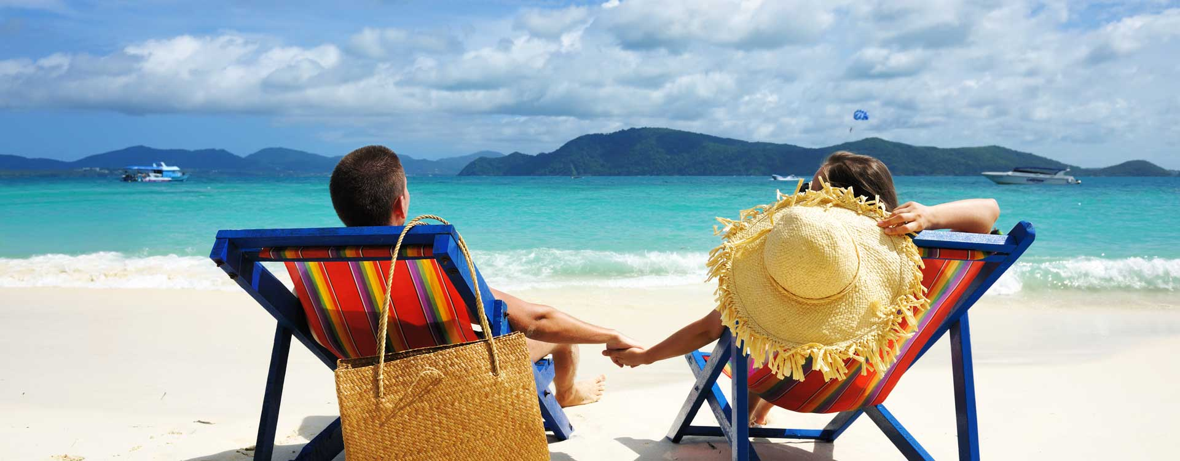
BEACH HOLIDAY
A period of time spent resting away from home

Slide 4
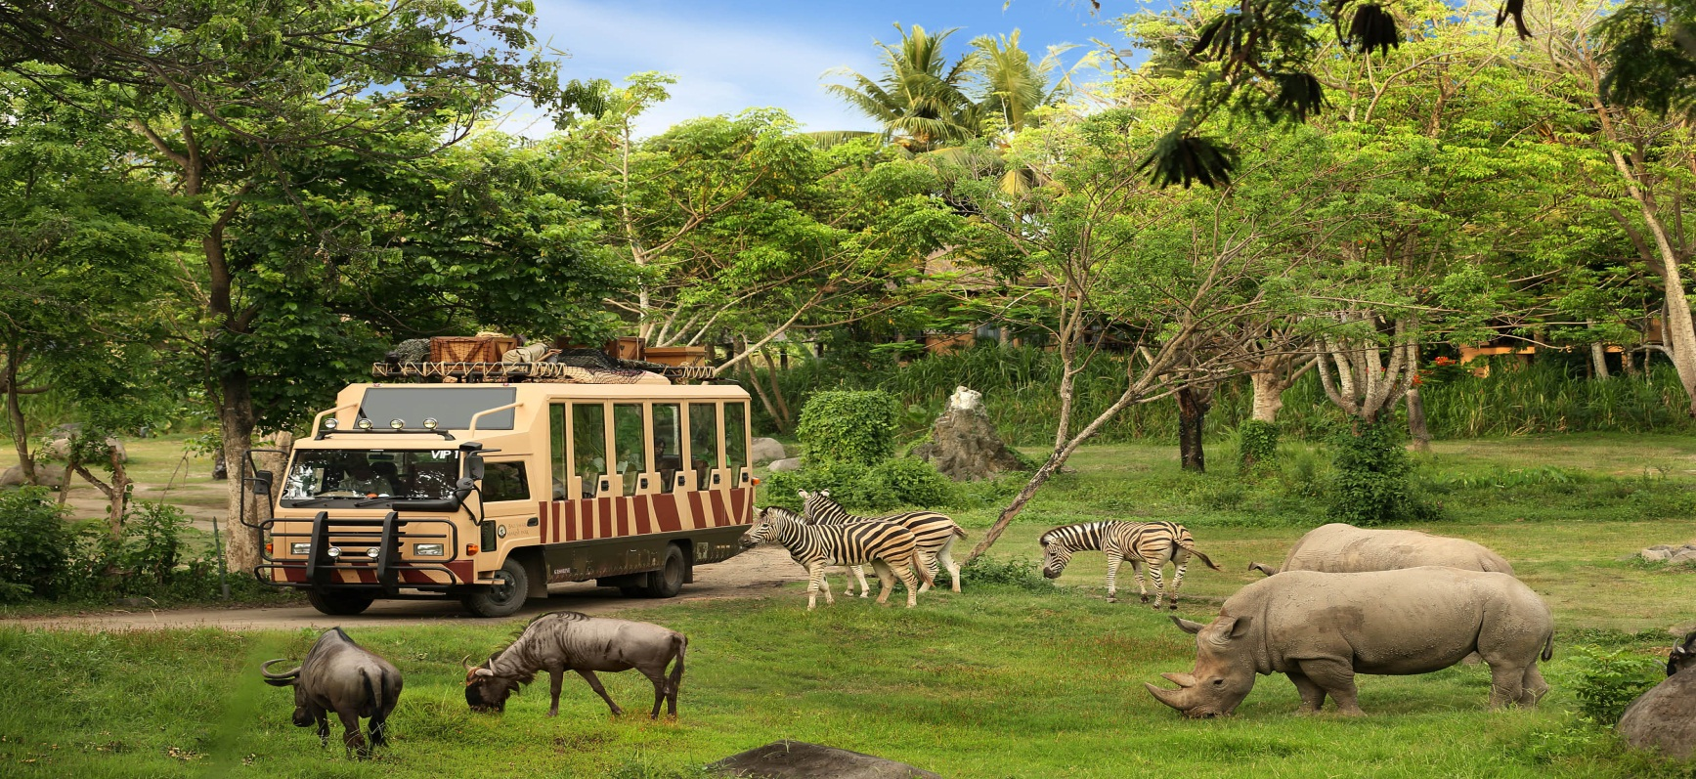
SAFARI
A trip to see or hunt wild animals, especially in east or southern Africa

Slide 5
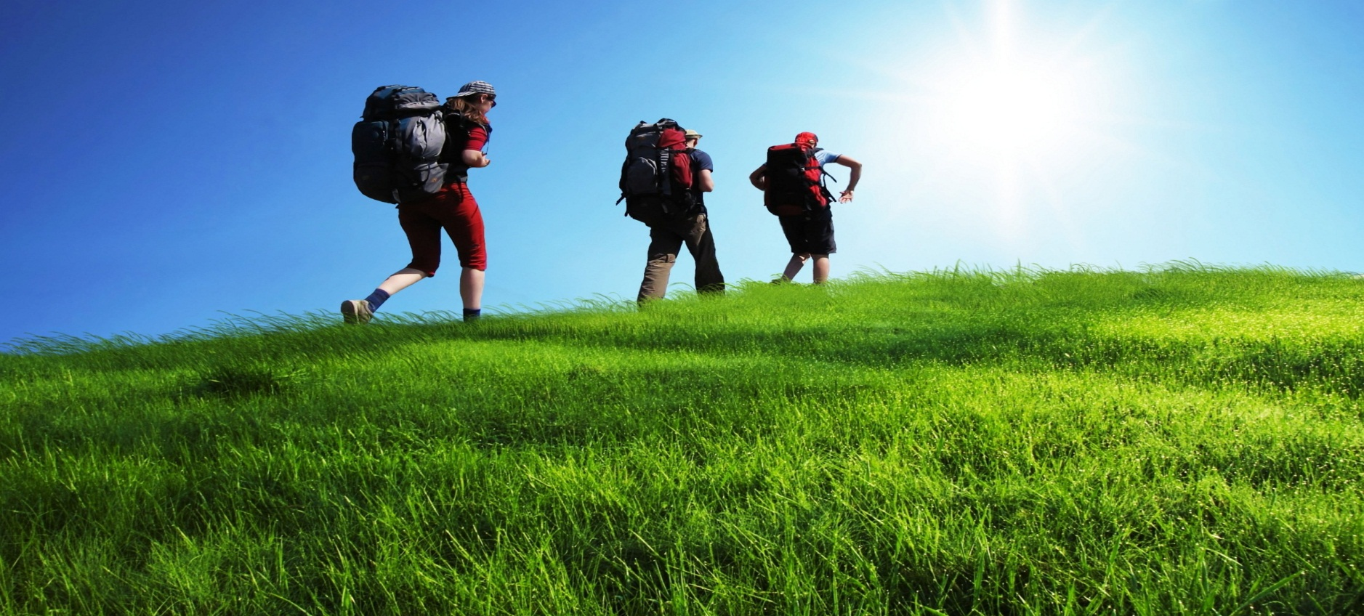
BACKPACKING HOLIDAY
To travel on holiday carrying your equipment and clothes in a backpack

Slide 6
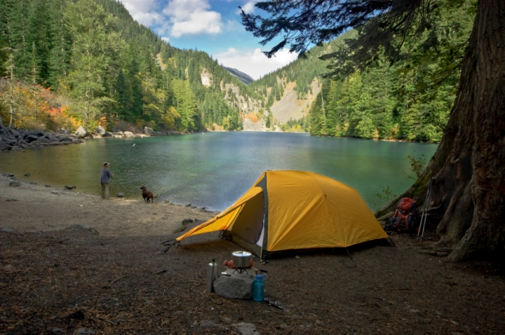
CAMPING HOLIDAY
Living in a tent on holiday

Slide 7
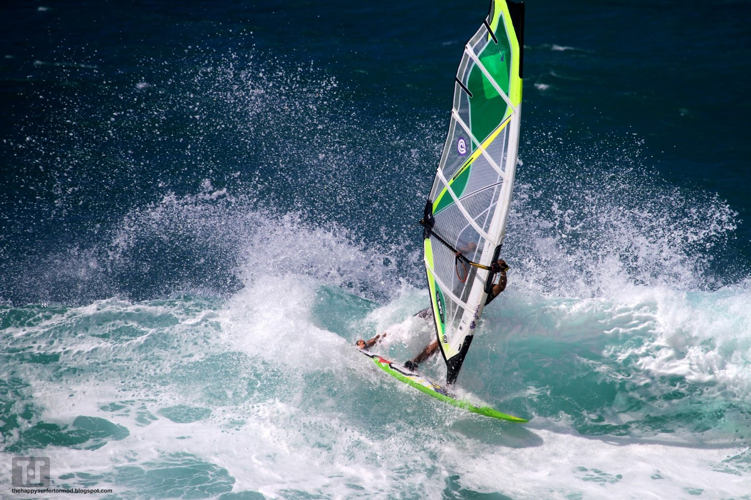
ACTIVITY HOLIDAY
A holiday on which you spent your time doing a particular activity such as walking, canoeing….

Slide 8



Slide 9
I usually go on a ……………………
This summer, I’ll probably go on a ………

Slide 10
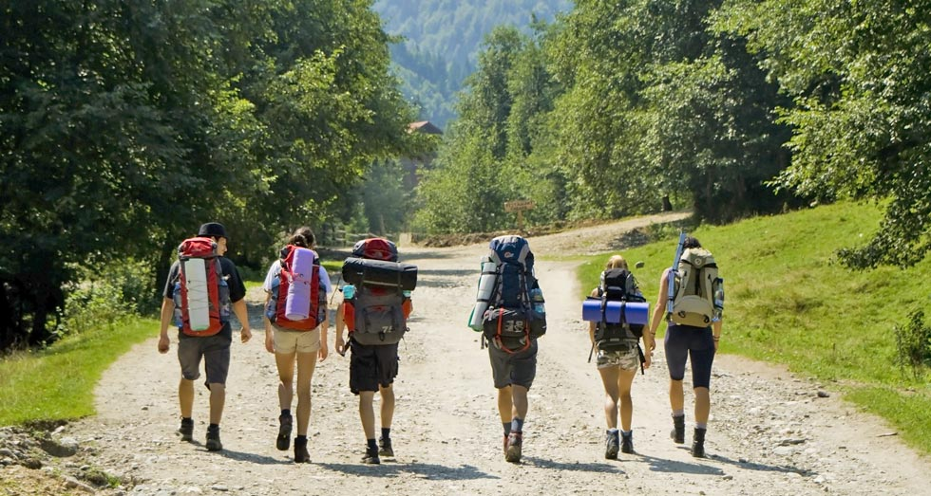
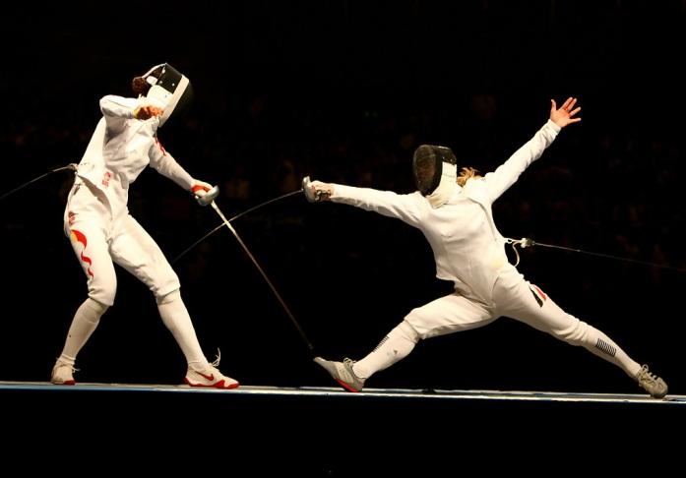

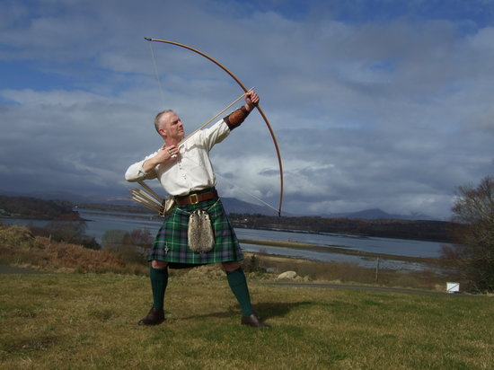
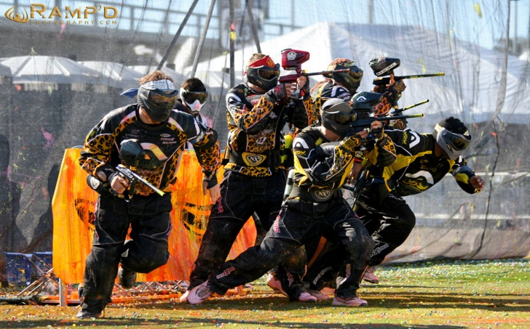
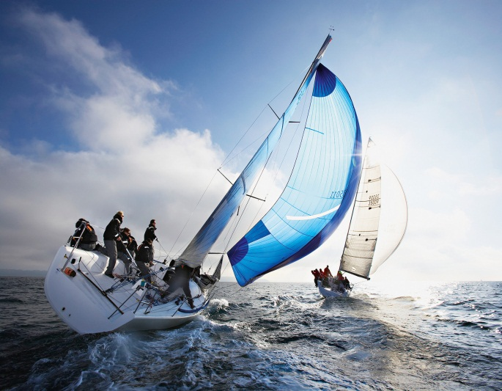
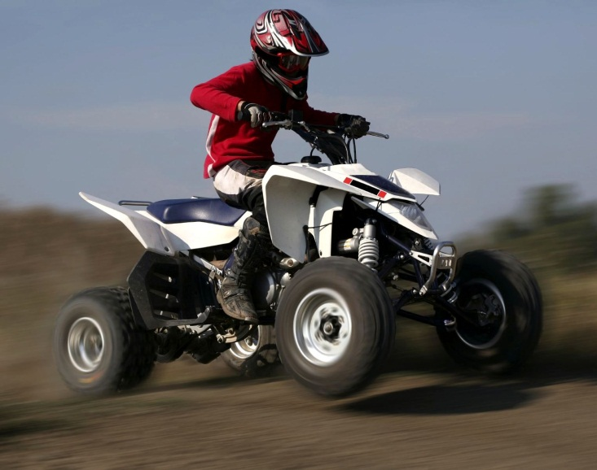
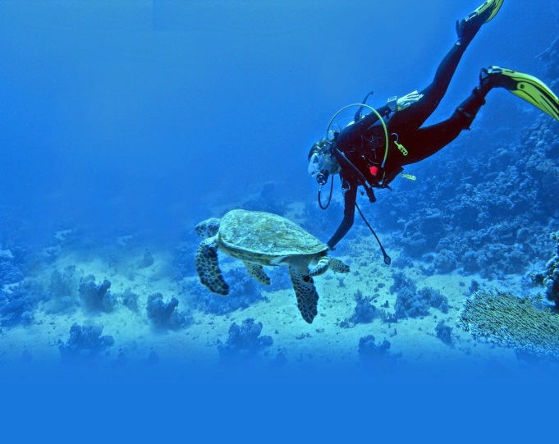
ACTIVITIES

Slide 11


