Slide 1
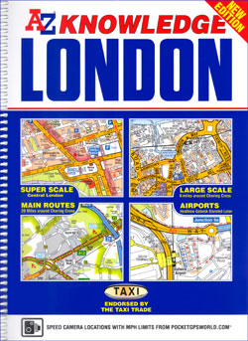
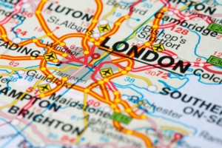
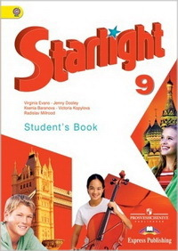
ТHE KNOWLEDGE
MODULE 1
104-199-441

Slide 2
ТHE KNOWLEDGE
Transport | Museums | The USA | London’s History | Sights of London
£ 100 | £100 | £100 | £100 | £100
£ 200 | £200 | £200 | £200 | £200
£300 | £300 | £300 | £300 | £300
£400 | £400 | £400 | £400 | £400
£500 | £500 | £500 | £500 | £500
104-199-441

Slide 3
£100
Transport
It is more than 150 years old. It is the world’s oldest rapid transit system. It was the first to operate electric trains. It has 268 stations and 400 kilometres of track. It is the oldest system in the world by route length. It was named after its shape.

Slide 4

£100
Transport
What do you know about the Tube (the London Underground)?

Slide 5
£200
Transport
They are world-famous, an image associated with the city. They have become an icon of London. They first appeared in 1956. They were bright-red and could be easily seen in gloomy and foggy London.

Slide 6
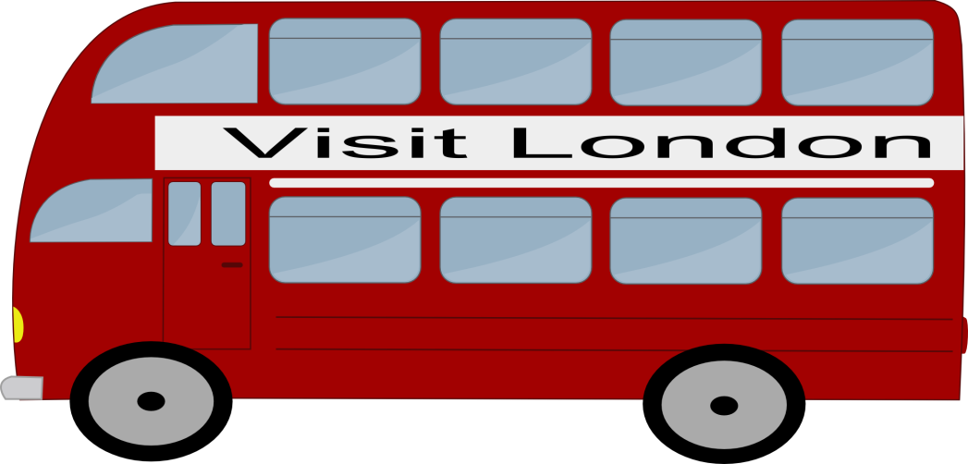
£200
Transport
What do you know about
a double-decker bus?

Slide 7
£300
Transport
There are more than 23,000 of them in London. Their job is claimed to be most stressful and dangerous in Britain. They know every corner of London because all of them have to take an exam, called the Knowledge. They should also know all the parks, cinemas, theaters and museums in the city.

Slide 8
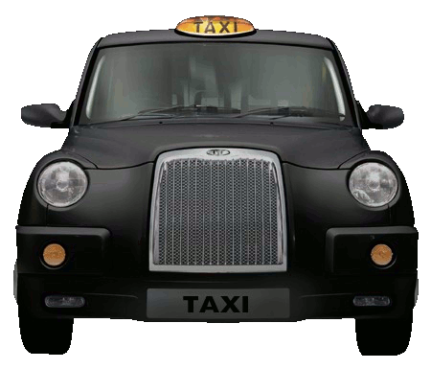
£300
Transport
What do you know about London taxi-drivers?

Slide 9
£400
Transport
It is getting more and more popular in London. The reasons are obvious - there is no ‘carbon waste’ and it prevents obesity and heart disease. For tourists, it is often also the quickest and the easiest way to see London. The casual user hires it at one of the numerous stations, and then returns it to any of the docking stations.

Slide 10
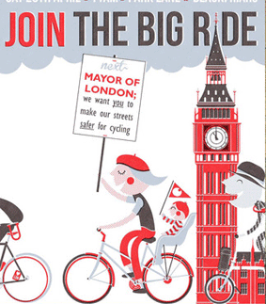
£400
Transport
What do you know about cycling?

Slide 11
£500
Transport
It is an electronic smart card ticket. It is definitely the easiest way to travel around the London Transport system. Simply touch it on the yellow reader to get through the Tube gates or board other London public transport.

Slide 12
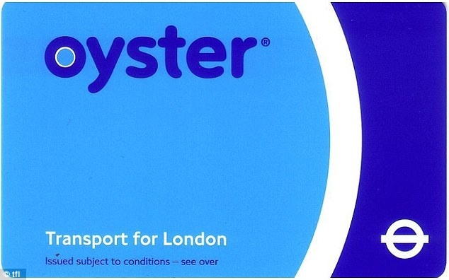
£500
Transport
What do you know about Oyster?

Slide 13
£100
Museums
It is more than 900 years old. It used to be a palace, a prison and even the Royal Zoo. Now it is a museum. Crown jewels are kept there. Black ravens live in it. The Yeoman warders or Beefeaters will show you around and tell you about its ghosts.

Slide 14
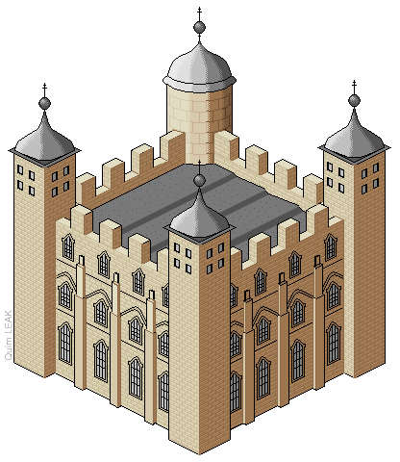
£100
Museums
What do you know about
the Tower?

Slide 15
£200
Museums
It is worth visiting. There are more than 80 vehicles, including a red London bus and the world's first Underground train. The galleries are full of interactive exhibits for young people to play on – including real buses and trains!

Slide 16

£200
Museums
What do you know about
the London Transport Museum?

Slide 17
£300
Museums
It is a world famous museum of wax figures of different celebrities. More than 250 measurements are taken to create the right figure.

Slide 18

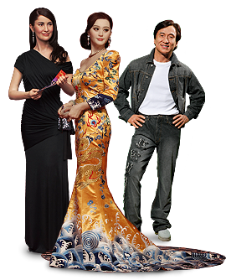
£300
Museums
What do you know about Madame Tussaud’s Museum?

Slide 19
£400
Museums
Here you can see 70 mln specimen. Explore the wonders of nature in one of London’s finest museum buildings, come face to face with animals from the past and the present and watch out for the dinosaurs!

Slide 20

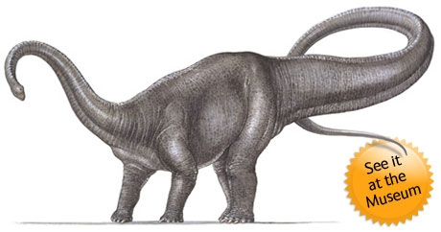
£400
Museums
What do you know about
the Natural History Museum?

Slide 21
£500
Museums
It is the most famous museum of London which is situated in Trafalgar Square. The museum tells the story of human culture from its beginning to the present day. It has the largest library in the UK.

Slide 22

£500
Museums
What do you know about
the British Museum?

Slide 23
£100
The USA
It is the capital of the USA. It was named after the first president of the USA. There are no plants and factories in this city. It is a city of the government and tourists. There are no skyscrapers in it because no building can be higher than the Capitol. All the museums in the Mall are free of charge.

Slide 24
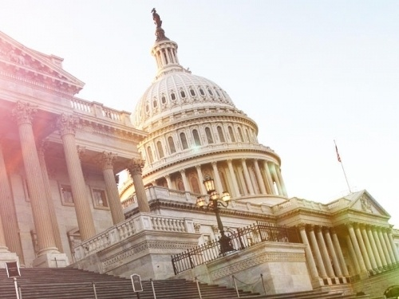
£100
The USA
What do you know about Washington?

Slide 25
£200
The USA
It is the largest city in the USA. It is situated on the islands of the Hudson River. It has two nicknames: Big Apple and Manhattan. It is a very cosmopolitan city.

Slide 26
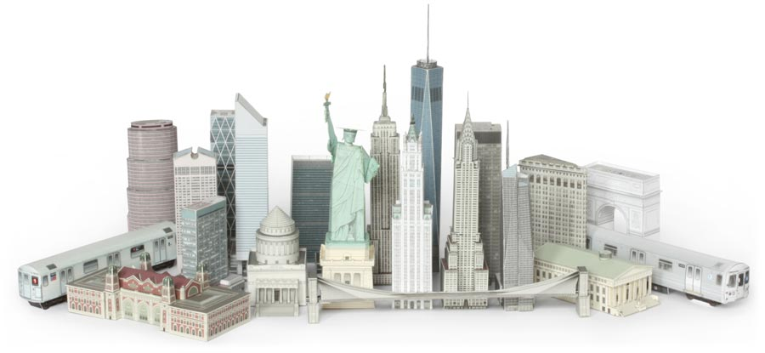
£200
The USA
What do you know about
New York?

Slide 27
£300
The USA
It is the symbol of the United States. Each President of the United States has lived in this residence. Originally it was grey. It was given its present name in 1901. It used to be open to the public. However, since September 11, 2001 the public tours have been prohibited.

Slide 28
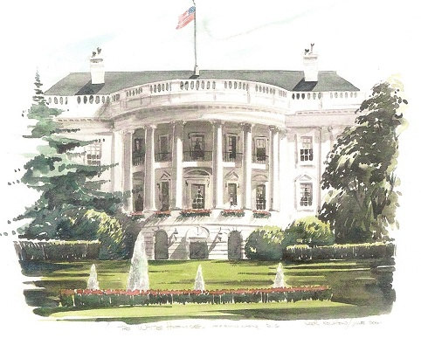
£300
The USA
What do you know about
the White House?

Slide 29
£400
The USA
The USA got it as a present from French people on July 4, 1886. It is the symbol of New York and American democracy. It is a large statue of a woman holding a torch and the Declaration of Independence. You can get to its island by ferry.

Slide 30
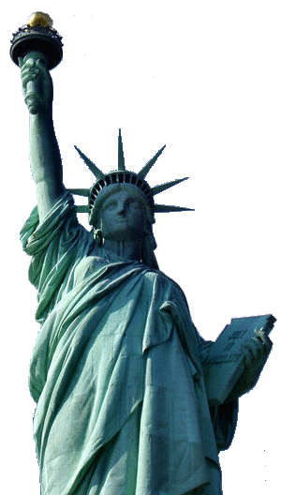
£400
The USA
What do you know about
the Statue of Liberty?

Slide 31
£500
The USA
It is located in New York harbour. It used to be an immigrant inspection station. It was called the “Island of Tears”. Now there is a large museum there.

Slide 32

£500
The USA
What do you know about
Ellis Island?

Slide 33
£100
London’s History
Almost 2,000 years ago, the army of Ancient Rome landed on the coast of Britain and headed north. They founded a settlement, which they called ... It was an ideal site for a port. It became an important trading centre.

Slide 34
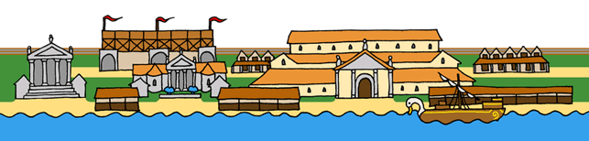
£100
London’s History
What do you know about Londinium?

Slide 35
£200
London’s History
It was first built of wood – and then rebuilt time and time again. Later, a stone one was constructed. By the 1350s there were nearly 200 houses and shops on top of the bridge, and the road across it was very narrow. So, the first traffic jams appeared.

Slide 36
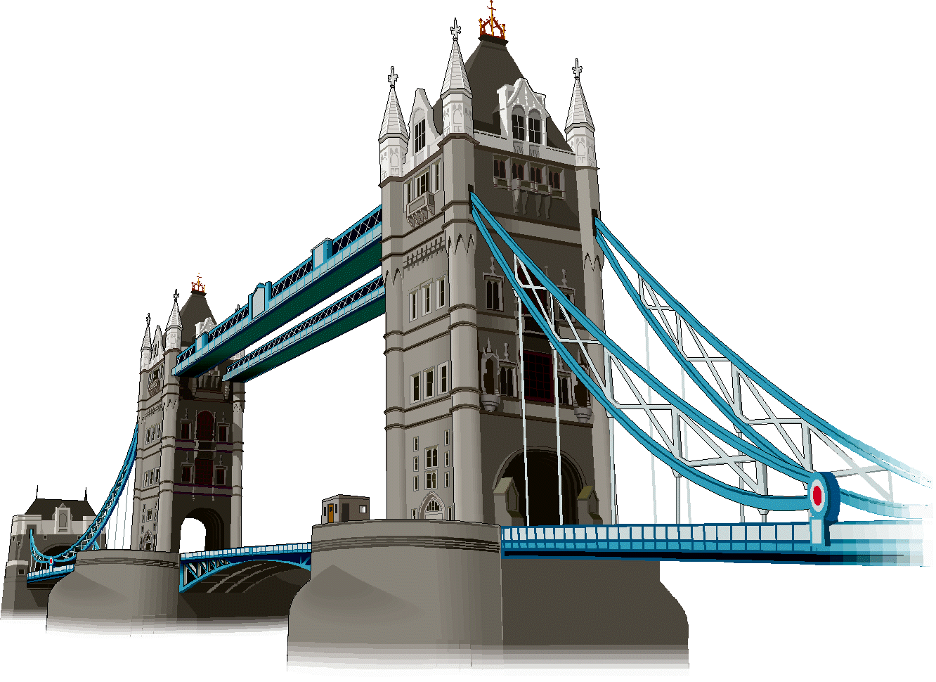
£200
London’s History
What do you know about London Bridge (Tower Bridge)?

Slide 37
£300
London’s History
It started in September 1666 in Pudding Lane, in a baker’s shop. It was the second tragedy to hit London during one year. Fully 80% of the city was destroyed. Surprisingly, very few people were killed. The Monument was built to commemorate this event.

Slide 38
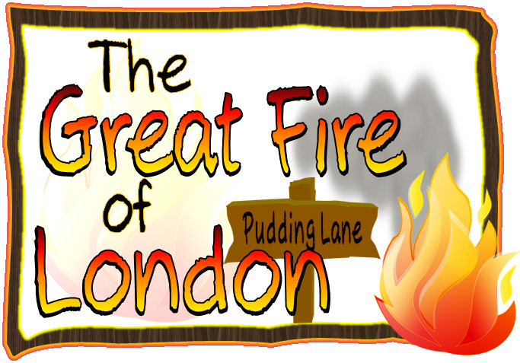
£300
London’s History
What do you know about
the Great Fire of London?

Slide 39
£400
London’s History
It happened in 1665. It was called the Black Death. Thousands of people died in the poor parts of London. Over 1,000 deaths per week were reported in the city. It was said that 100,000 people had died in and around London. It was the worst and the last of the epidemics in Great Britain.

Slide 40
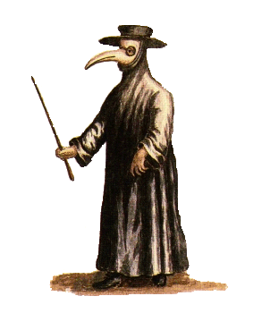
£400
London’s History
What do you know about
the Great Plague?

Slide 41
£500
London’s History
It is the residence of the British Queen in London. It has 600 rooms. There is a monument to Queen Victoria in front of it.

Slide 42
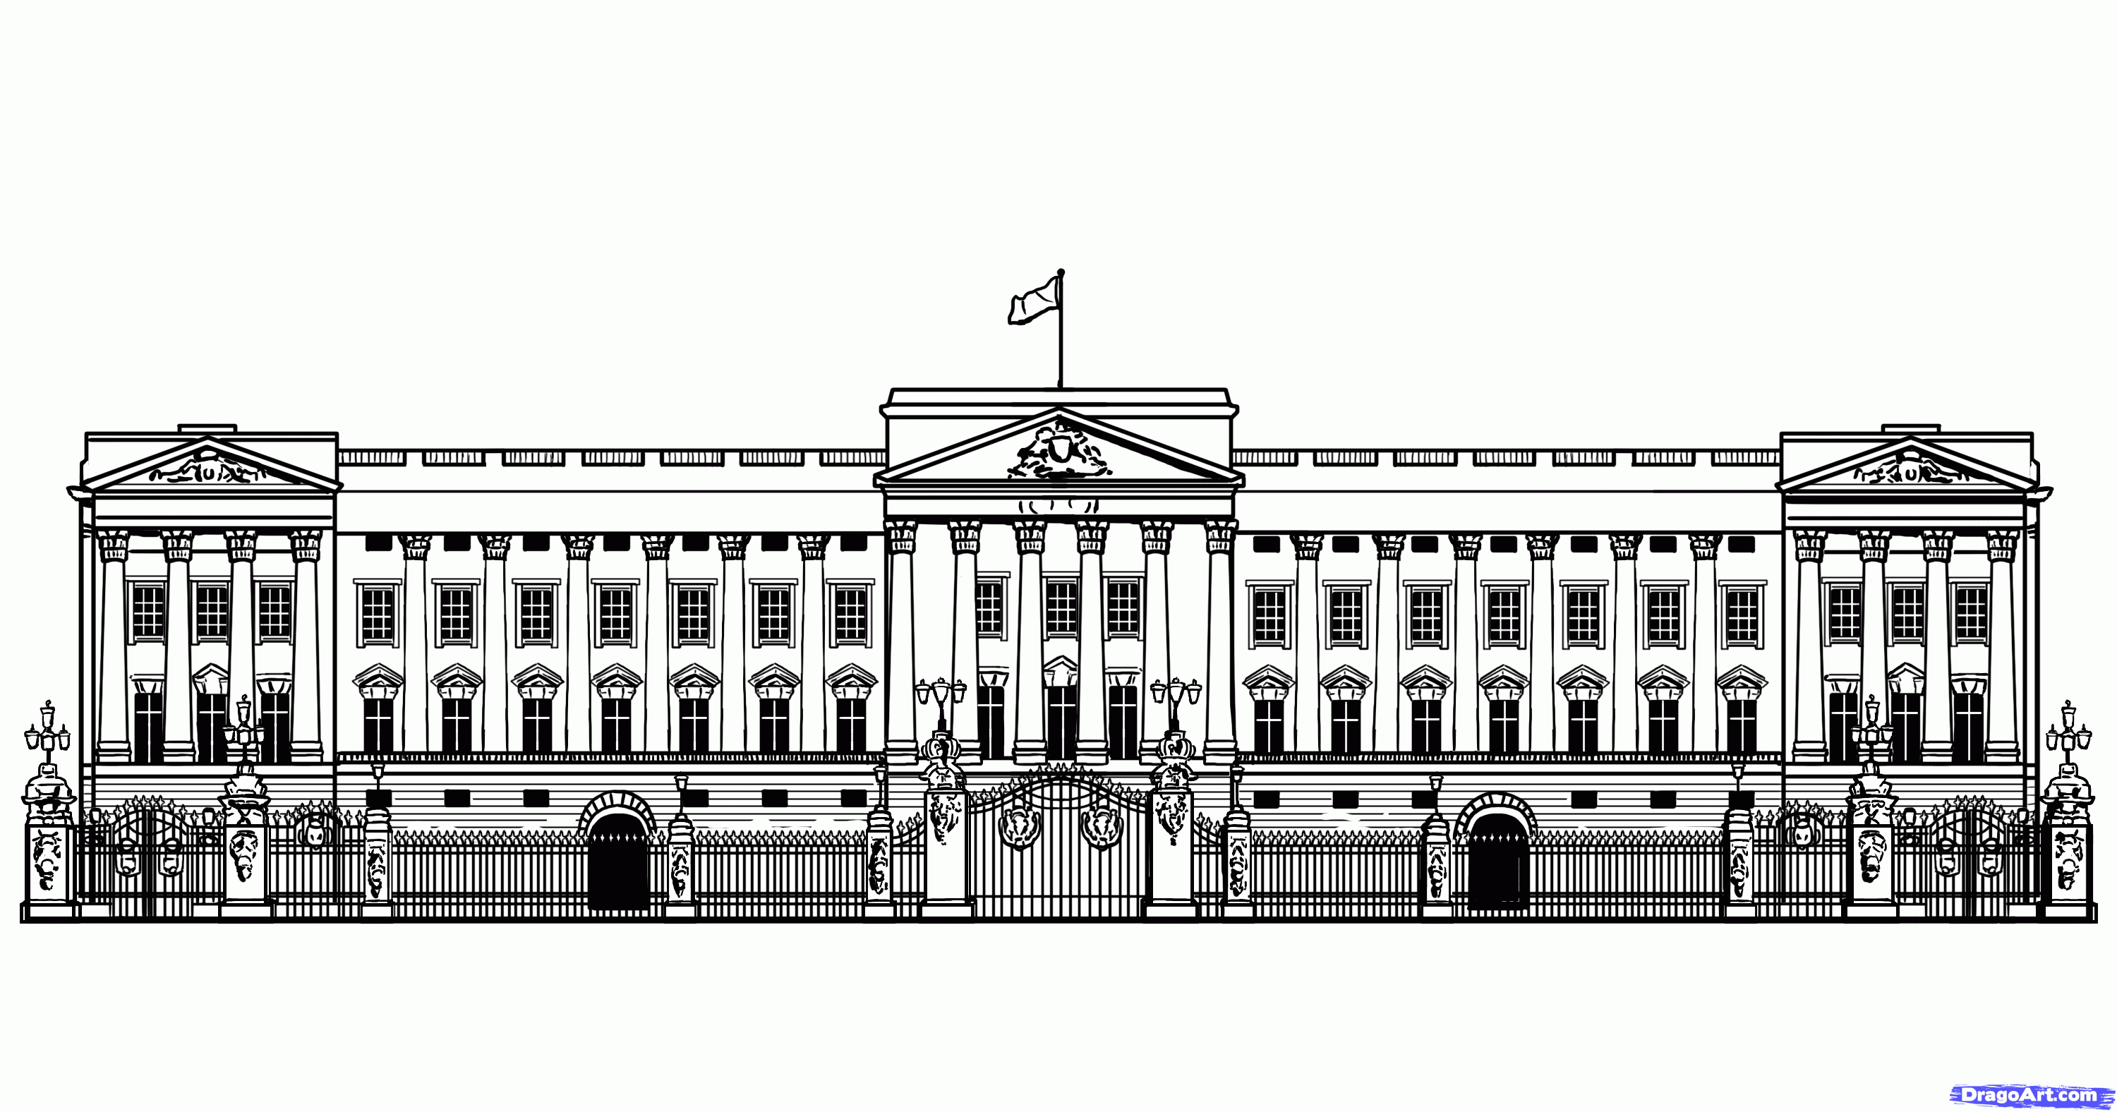
£500
London’s History
What do you know about
Buckingham Palace?

Slide 43
£100
Sights of London
It is situated in central London. It is one of the greatest and most famous tourist attractions. Any visit to the capital usually begins with this place. It’s absolutely necessary for every tourist to see Nelson’s Column. Everyone should admire its lovely fountains of the square. Also, you can’t say that you’ve been to London if you don’t take a picture of yourself in it.

Slide 44
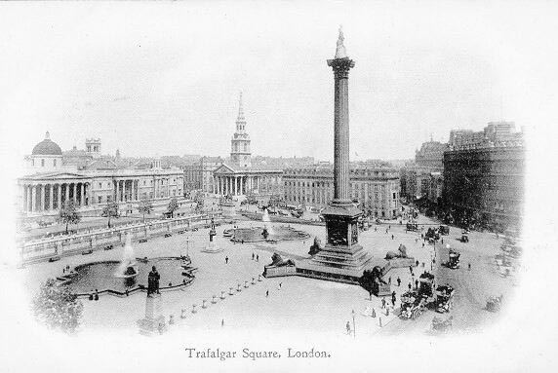
£100
Sights of London
What do you know about Trafalgar Square?

Slide 45
£200
Sights of London
It is one of London's best-known sights. It is actually the nickname of the big bell inside the Tower. It was named after Sir Benjamin Hall. It is not open to the general public. A tourist from abroad can’t visit it.

Slide 46
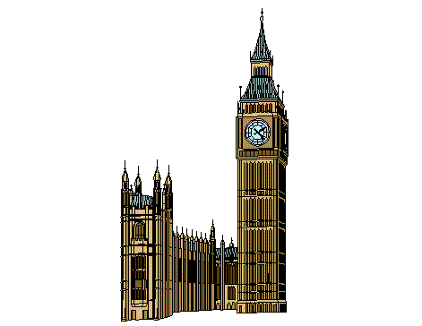
£200
Sights of London
What do you know about
Big Ben?

Slide 47
£300
Sights of London
It is the seat of the British government, which consists of two Houses. It is situated on the bank of the Thames River. Both UK residents and tourists can enter it for free and watch its members debating.

Slide 48

£300
Sights of London
What do you know about
the Houses of Parliament?

Slide 49
£400
Sights of London
More than three million people visit it every year. It is the tallest in Europe and it was opened on 31st December, 1999 to celebrate the new millennium. The passengers have a fantastic view over London.

Slide 50
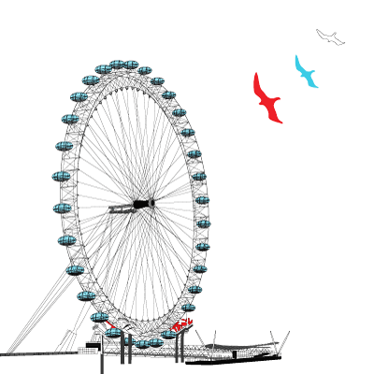
£400
Sights of London
What do you know about
the London Eye?

Slide 51
£500
Sights of London
It is Sir Christopher Wren’s masterpiece. It took him 35 years to build it. His gravestone in it features a Latin inscription: 'If you seek his memorial, look about you.' Its architectural style is a beautiful mix of the Medieval, Classical, and Baroque. The inside is gorgeous. Nowadays, it is the largest working Protestant church in England.

Slide 52
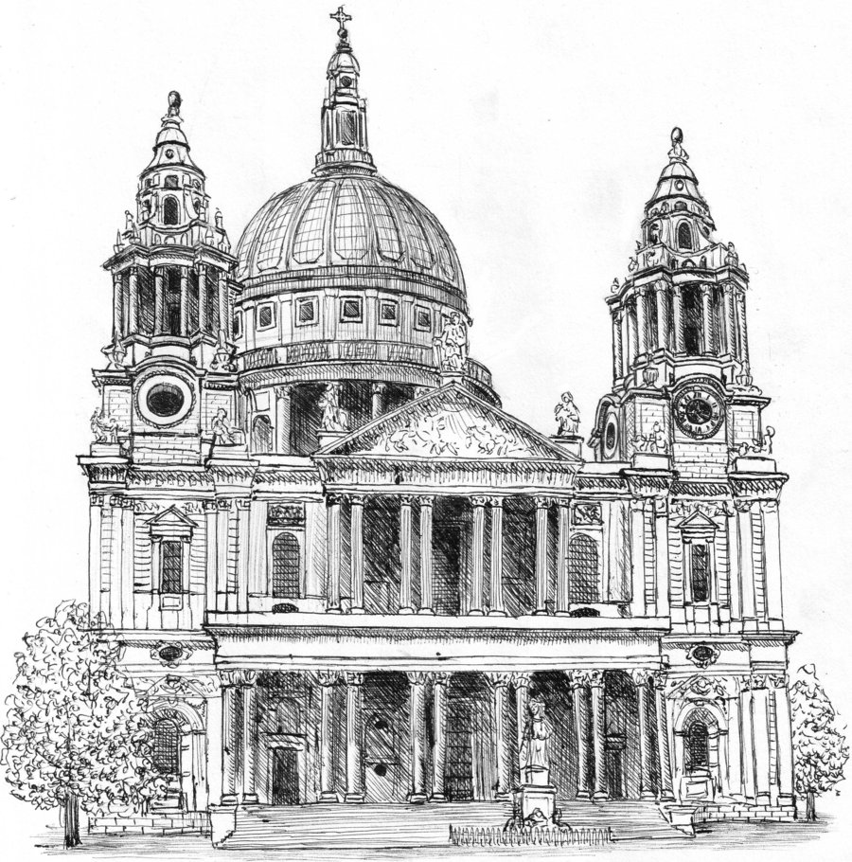
£500
Sights of London
What do you know about
St. Paul's Cathedral?

Slide 53

CПАСИБО ЗА ВНИМАНИЕ!
Тетерина Ольга Афанасьевна
КОГОАУ «Гимназия №1»
Г. Кирово-Чепецк Кировской области
2016 г.
104-199-441

Slide 54
Special Thanks To …
№ | Иллюстрация | Ссылка
01 | Map of London | http://bigstock.7eer.net/c/77643/209157/1736?u=http%3A%2F%2Fwww.bigstockphoto.com%2Fimage-6149009%2Fstock-photo-road-map-around-london
01 | The Knowledge | https://www.saxo.com/dk/london-knowledge-atlas_geographers-a-z-map-company_spiralryg_9781843486756
04 | London Underground | http://unenagudeseletaja.blogspot.com/2011/02/miks-me-magame.html
06 | double-decker | http://www.clipartsheep.com/big-trucks-frees-that-you-can-download-to-clipart/dT1hSFIwY0RvdkwzZDNkeTVqYkdsd1lYSjBZbVZ6ZEM1amIyMHZZMnhwY0dGeWRITXZPV2w2TDAxWU5TODVhWHBOV0RWeU4xUXVjRzVufHc9NjAwfGg9NDA0fHQ9cG5nfA/
08 | taxi | http://bbcsherlockpickuplines.tumblr.com/post/16805369970/if-convenient-meet-me-in-my-bedroom-if
10 | cycling | http://www.kenga.co.uk/pages/bike_ride3.htm
12 | oyster | http://shutterstock.7eer.net/c/77643/108110/1305?u=http%3A%2F%2Fwww.shutterstock.com%2Fpic-173786645%2Fstock-photo-london-uk-january-the-oyster-card-uses-near-field-communication-technology-for-public.html
14 | Tower | http://orig12.deviantart.net/ab31/f/2006/004/2/4/tower.gif
16 | London Transport Museum | http://www.museum-mile.org.uk/images/museums/09_londontransport_240.gif
18 | Madame Tussaud’s Museum | http://www.madametussauds.com/
20 | Natural History Museum | http://archive.constantcontact.com/fs028/1101907064473/archive/1103648727943.html
20 | Natural History Museum | http://www.nhm.ac.uk/kids-only/dinosaurs/what-dinosaur/diplodocus.html
22 | British Museum | http://www.museum-mile.org.uk/images/museums/02_britishmuseum_240.gif

Slide 55
Special Thanks To …
№ | Иллюстрация | Ссылка
24 | Washington | http://data2.whicdn.com/images/5887077/thumb.jpg
26 | New York | http://www.buildyourownnewyork.com/NYSkyline6.jpg
28 | White House | http://www.whitehousemuseum.org/images/white-house-drawing1.gif
30 | Statue of Liberty | http://www.tysto.com/articles04/q3/20040928statue.shtml
32 | Ellis Island | http://heightstechnology.edublogs.org/files/2011/09/amhis_nation_grows-o8sitx.gif
34 | Londinium | http://www.nashfordpublishing.co.uk/kids/london/images/londinium.gif
36 | Tower Bridge | http://www.kleinbonaire.org/Resources/Image15.gif
38 | Great Fire of London | http://www.cliftonprimary.bham.sch.uk/blog/wp-content/uploads/2015/03/the-great-of-london-title-page.png
40 | Great Plague | http://tecfa.unige.ch/tecfa/teaching/UVLibre/9900/bin57/peste2.gif
42 | Buckingham Palace | http://cdn.imgs.steps.dragoart.com/how-to-draw-buckingham-palace-step-21_1_000000131073_5.gif
44 | Trafalgar Square | http://photos.francisfrith.com/frith/london-trafalgar-square-1890_l130190.jpg
46 | Big Ben | http://us.cdn1.123rf.com/168nwm/chenyunpeng/chenyunpeng1309/chenyunpeng130900317/22081087-london-illustration.jpg
48 | Houses of Parliament | http://www.sparklebox.co.uk/misc/display/_wp_generated/ppb276bec1_02.jpg
50 | London Eye | http://www.alamy.com/image-details-popup.asp?imageid={8586878D-E039-4FB5-A678-7D8F11CEC348}
52 | St. Paul’s Cathedral | http://img13.deviantart.net/a52c/i/2009/270/6/1/st_paul__s_cathedral_by_neral85.jpg

