Slide 1
The world of superstitions and good luck or bad luck omens
There are some superstitions in Russia that are very unusual. At the same time they are also so common that they make up a big part of everyday communication.

Slide 2

Complete the superstitions
If the tip of the nose feel itchy,
it’s a sure sign that a party with alcohol is coming.

Slide 3
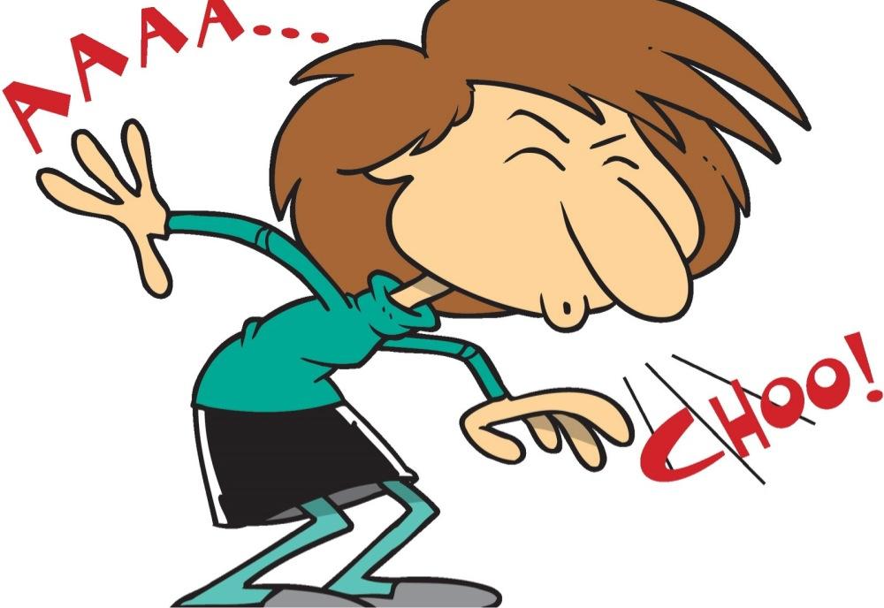
Complete the superstitions
If a person sneezes during a conversation,
It means that he confirms what has just been said. Often, after sneezing, they say: “True!” or “Exactly!”

Slide 4
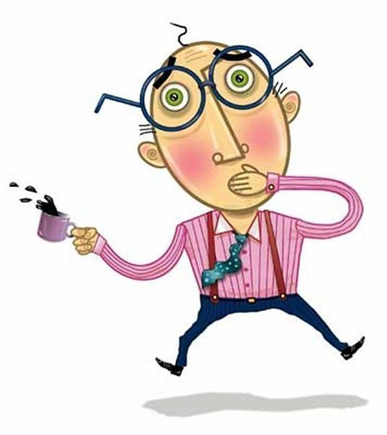
Complete the superstitions
If a person is having hiccups,
it is believed that someone
is thinking about him. If in that
moment you start quickly
going through your friends in
your memory, then when your
hiccups stop – that was the person who was thinking about you.

Slide 5
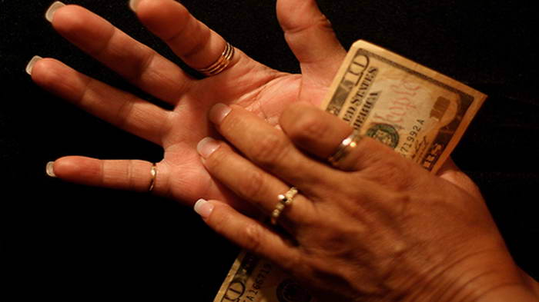
Complete the superstitions
If your right palm is itching,
you will come into money.
If your left palm is itching,
you will give someone money.

Slide 6
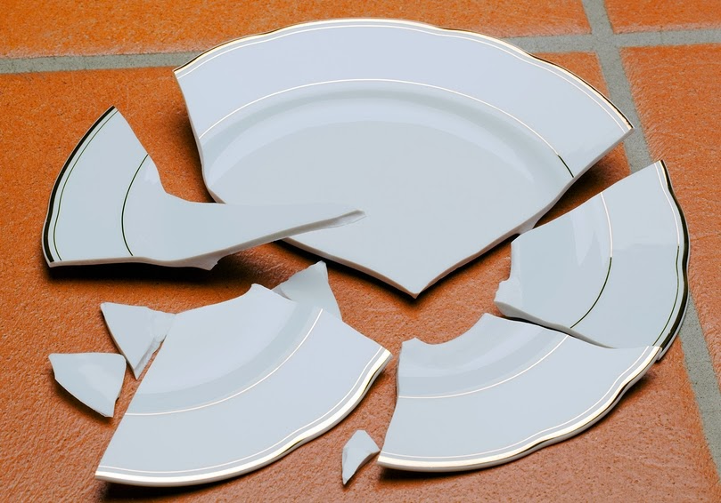
Complete the superstitions
If you break a glass or a plate,
everyone will smile and say, “It’s a good omen!”

Slide 7
Complete the superstitions
If you make a wish when sitting between two people with the same name,
then it will come true. To make sure it comes true, you shouldn’t tell anyone about it.

Slide 8
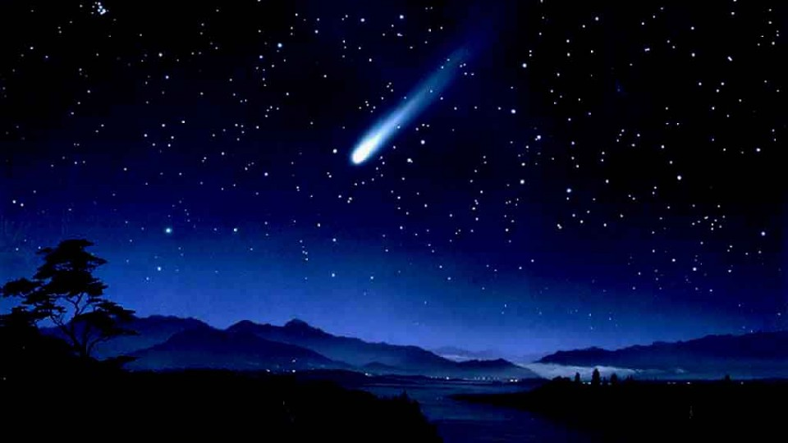
Complete the superstitions
If you see a falling star at night and quickly make a wish,
then it will definitely come true.

Slide 9
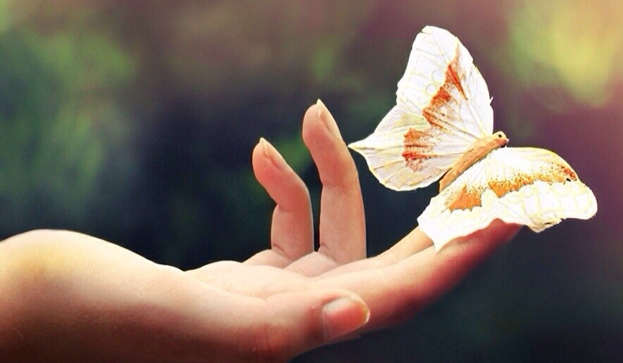
Complete the superstitions
If the first butterfly that you see in a year is white
this means that you will have good luck all through the year, similarly, if you see three butterflies together then this will be a sure sign of good luck.

Slide 10
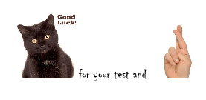
How superstitious are you?
1. Would you like to have an oral test at school on Friday 13th ?
2. Do you open an umbrella when you are inside a building?
3. Do you turn around to prevent a black cat from crossing your way?
4. Do you easily walk underneath a ladder?

Slide 11
How superstitious are you?
5. Do you throw salt over your left shoulder if you have spilt some on the table?
6. Do you say, “God Bless you”, after somebody sneezes?
7. Do you knock on wood when you talk about accidents?
8. Do you carry a rabbit’s foot for good luck?

Slide 12
Check exercise 1(Workbook)
Never step on a spider; it brings bad luck.
Has a ladybird just landed on your hand? Lucky you!
Oh, no, a broken mirror! This means seven years of bad luck.
Look a shooting star! Make a wish, quickly!
Why are you walking under this ladder? Do you want to have bad luck?
We’re so lucky! We’ve just seen a rainbow and it’s not even raining!
Do you really believe that a four leaf clove brings good luck?
My dad says that if the first butterfly you see in the year is white, good luck will follow you all year round.

Slide 13
Check exercise 4(Workbook)
C – Why, what’s the matter?
E – But… what’s troubling you?
A – You don’t really believe that, do you?
D – I didn’t know you were so superstitious!
B – There’s nothing to be anxious about.

Slide 14
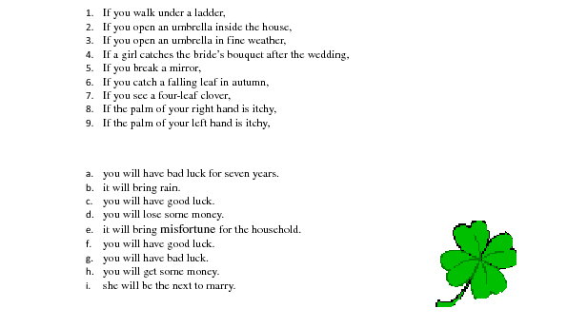
Superstitions in England

