Slide 1
Backpacks
Made by Anna Gorokhova

Slide 2
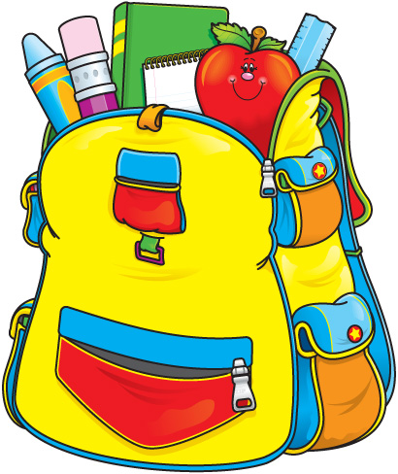
A backpack (also called rucksack, knapsack, packsack, or pack) is, in its simplest form, a cloth sack carried on one's back and secured with two straps that go over the shoulders.

Slide 3
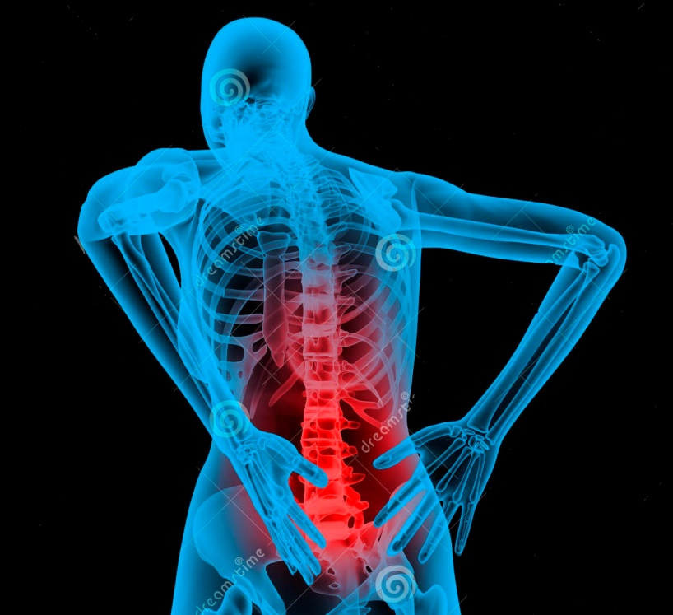
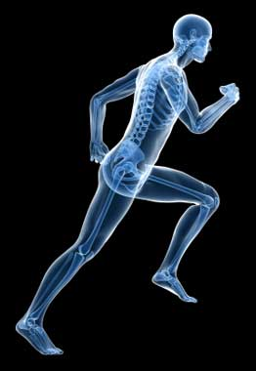
Important for your health
After wearing a bag
Wearing a rucksack
Help!!!!
Thanks!!!

Slide 4
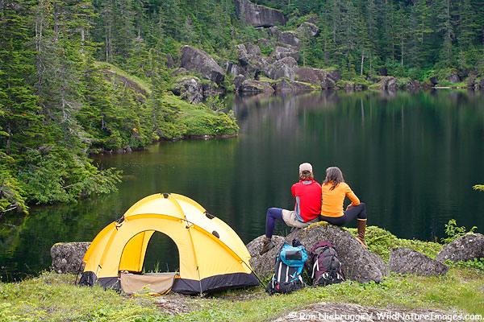
Perfect for school and travelling

Slide 5
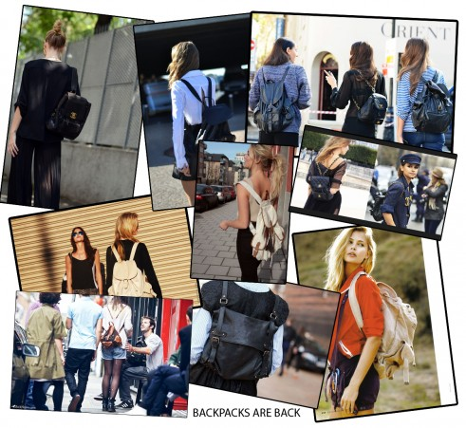
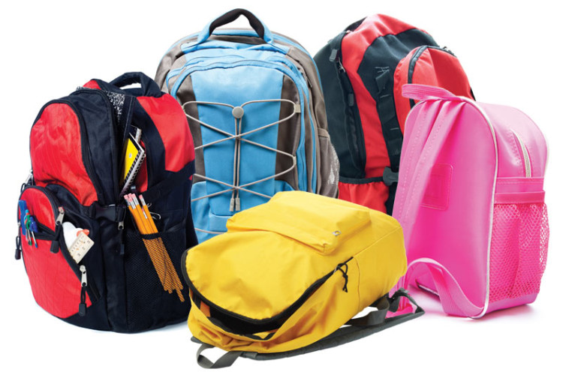
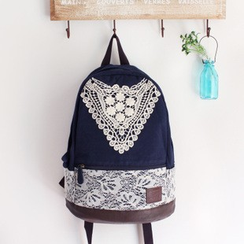
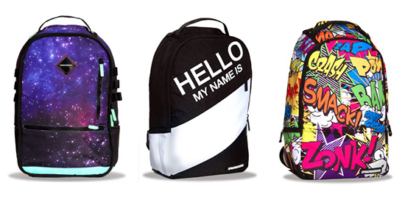
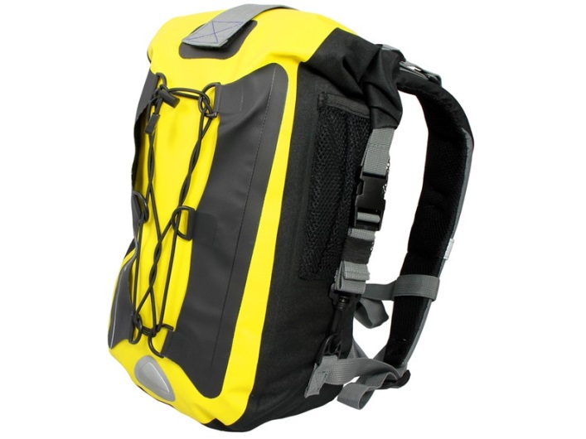
Come in different varieties

Slide 6
Thanks for watching this ad!!!

