Slide 1
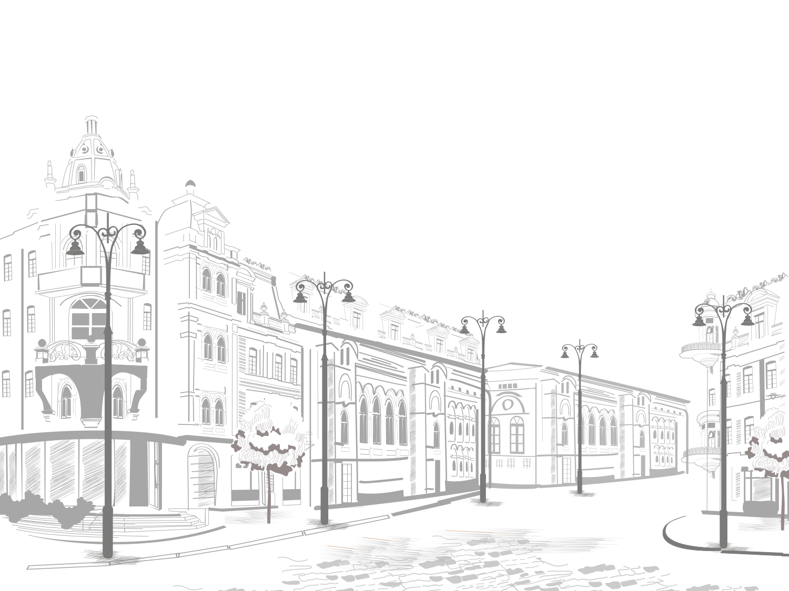
Great people and legend
Учитель английского языка
МБОУ СОШ №1 г-к Анапа
Якушина Оксана Николаевна

Slide 2
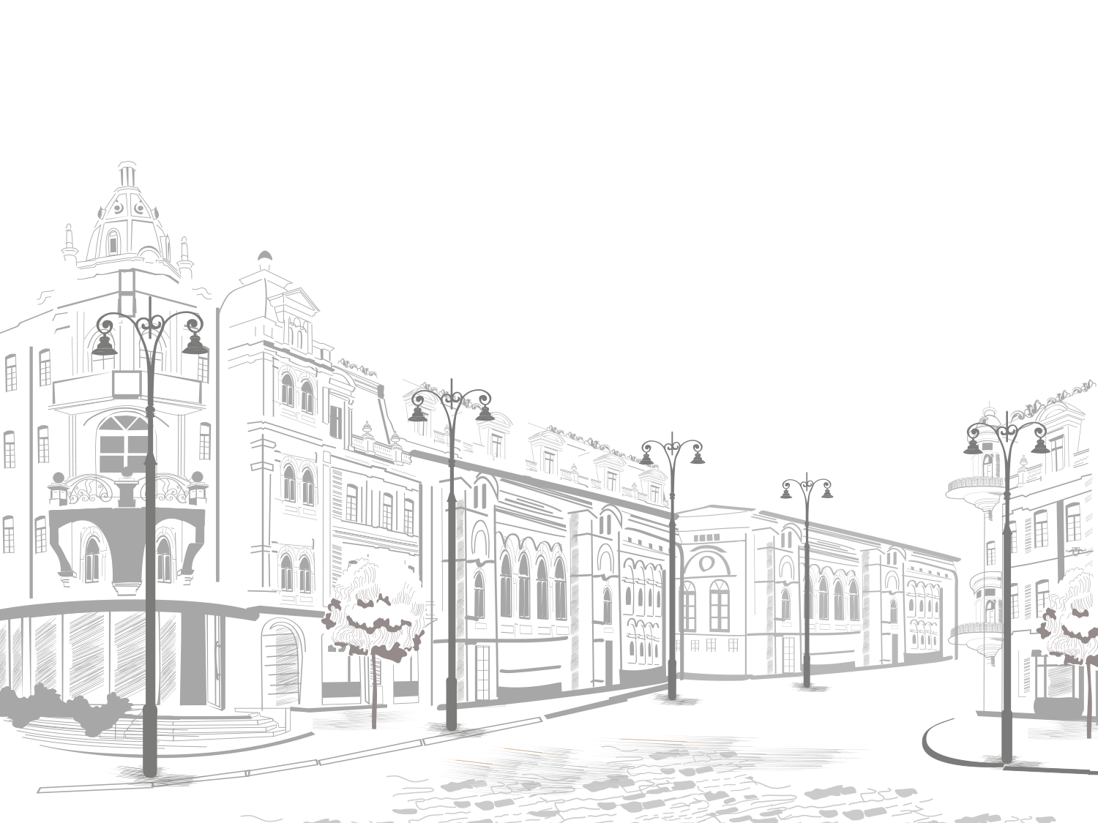

Slide 3
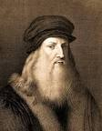
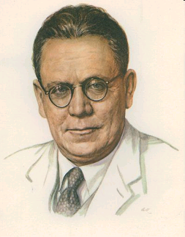
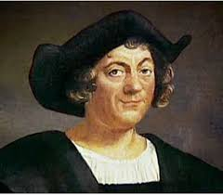
Over to you!
Which of these people impresses you the most?
Think of another famous person from history who impresses you. Complete the sentence.
.....really impresses me because.....

Slide 4
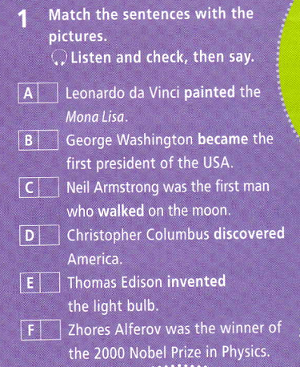

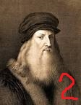
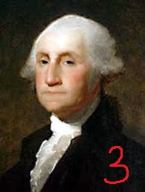
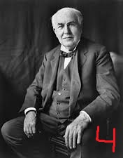
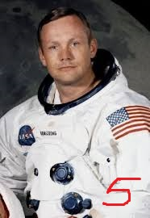
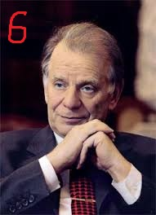
2
3
5
1
4
6

Slide 5
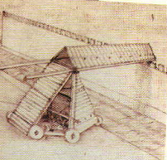
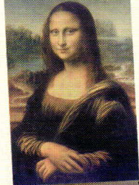
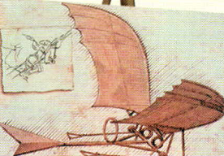


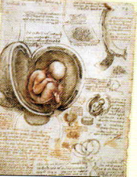

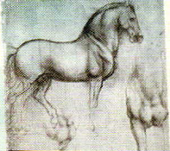


Label the pictures with the verbs. Listen and check, then say. studied designed painted invented sketched

Slide 6
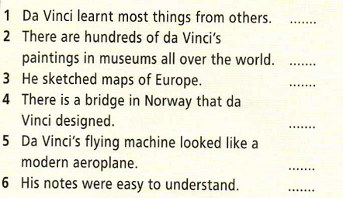
Leonardo da Vinci did all the things in Ex1. What do you know about him? What else would you like to know? Write four questions about what he did. Listen and read the text to see if you can answer your questions. Read again and mark the sentences T(true), F(false) or NS(not stated).
F
F
Ns
T
Ns
F

Slide 7
Choose the correct item. 1 When did you … this picture? A finished B finish C finishing 2 Who … that invention? A created B did create C create 3 … writing on the table! A stop B stopped C stopping 4 My sister … painting last year. A tryed B tried C trying 5. Why did he …. so early? A died B dyed C die 6 . What … he … in his life? A did achieve B was achieving C achieved 7. At five we … in the garden. A were walking B waked C walking 8. … did that girl go last night? A When B How long C Where 9. It was raining ….. A yesterday B all day C last week 10…. cities have you visited in the UK? A What B Which C How

Slide 8
Basic Lexis. Match the words
Talented | добиваться
intelligent | талантливый
curious | точный
lifetime | интеллигентный
achieve | рассматривать
incredible | любопытный
survive | Основанный на
consider | Продолжительность жизни
engineer | промышленность
industry | выжить
accurate | конструировать
canal system | невероятный
construct | подробный
based on | инженер
detailed | Система каналов

Slide 9



