Slide 1
Celebrities
«A celebrity is a person who works hard all his life to become well known, and then wears dark glasses to avoid being recognized.» Fred Allen
«There is only one thing worse than being talked about, and than is not being talked about.» Oscar Wilde

Slide 2
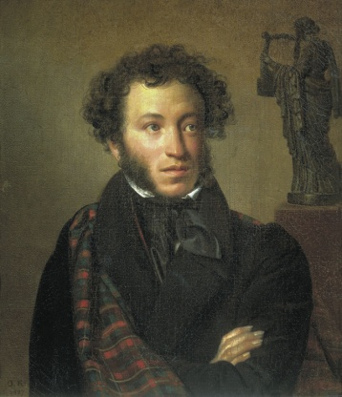
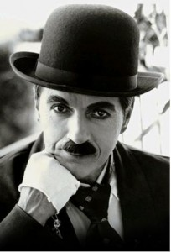
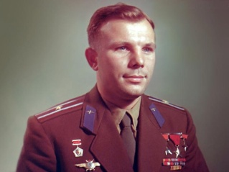
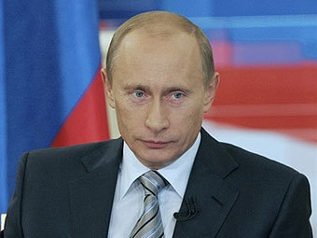
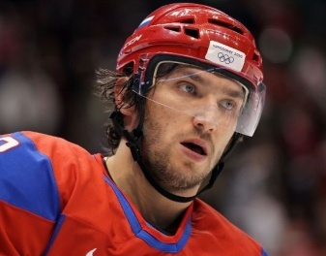
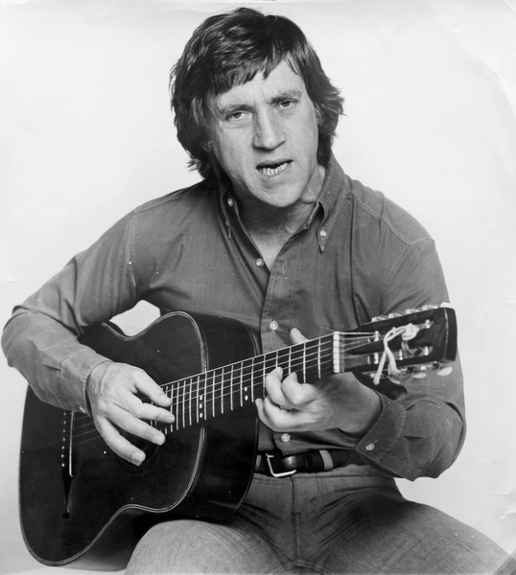
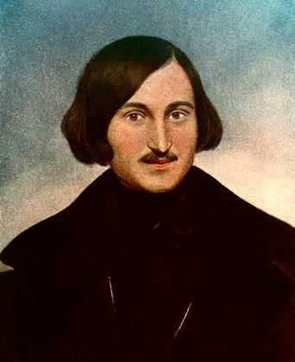
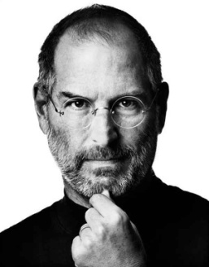
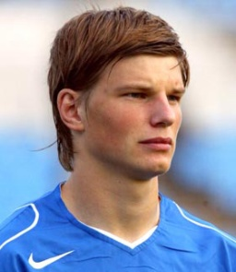
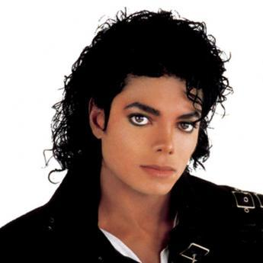
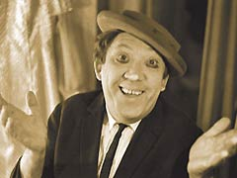
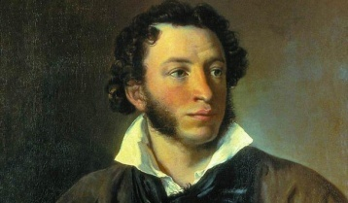
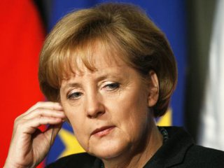
Why do we want to hear bad news about famous people more than good news? In what ways are celebrities unreal?
What do you understand by «reality TV»? Are there TV programmes in your country like the ones described in the article? What are they like?
What is the mentality of stalkers? What makes someone want to kill the object of their obsession?

Slide 3
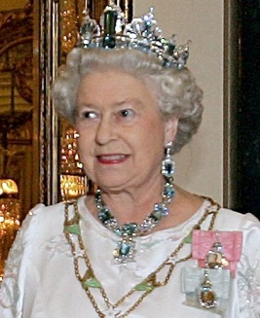
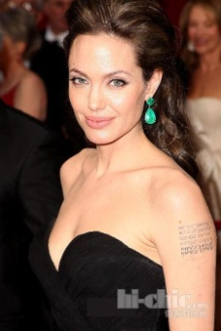
2 categories of fame
Some are born famous (like royalty).
Some achieve fame (like film stars).

Slide 4
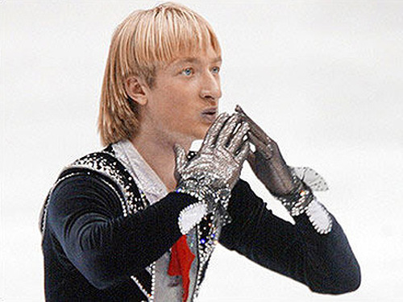
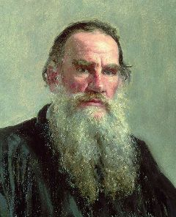
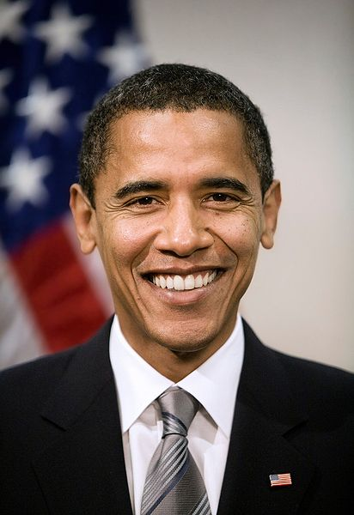
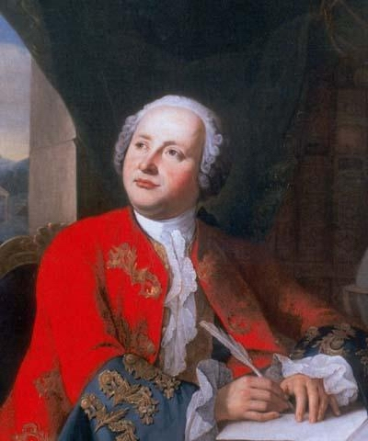
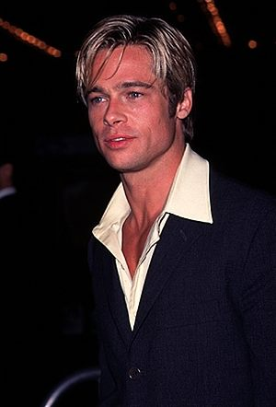
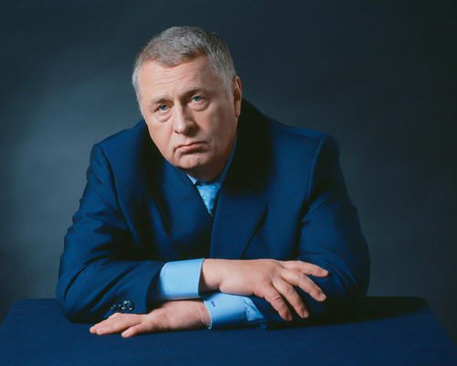
What are they famous for?

Slide 5
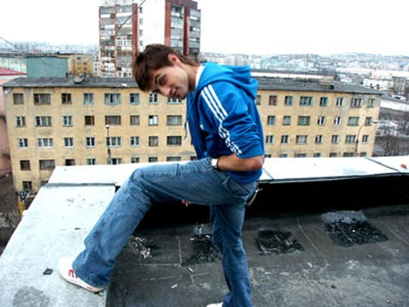

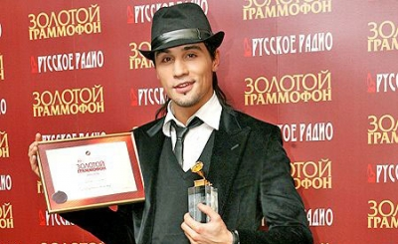
Dima Bilan (Viktor Nikolaevich Belan, 24 December 1981 in Ust-Dzheguta, Karachay-Cherkessia) is a Russian actor and pop singer.
When he was two years old, his family moved to his grandmother’s place in the city of Naberezhnye Chelny in Tatarstan. When he was six years old, his family moved to Kabardino-Balkaria where he went to school with his sister.
He graduated from Gnesins Musical College as a classical vocal performer.
Bilan made his debut when he reached fourth place at the Russian/Latvian festival "New Wave" in 2002.In 2003, Bilan released his debut album titled Nochnoy Huligan (Night Hooligan).
In December 2005, Bilan received two golden gramophones for the song "Ty dolzjna ryadom byt'" (The Russian version of "Not That Simple", actually meaning "You should be beside me") in Saint Petersburg and Almaty.

Slide 6
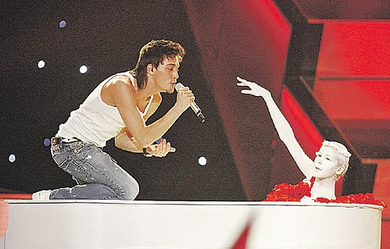
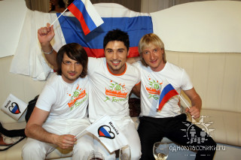
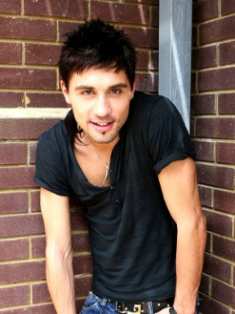
In the middle of March 2006, Bilan was chosen internally by the Russian broadcaster Channel One to represent Russia at the Eurovision Song Contest, that year in Athens, Greece. Out of 37 participating countries, Bilan took second place with the dark pop song "Never Let You Go”.
In 2008, Bilan once again represented Russia in the Eurovision Song Contest with the song "Believe", accompanied by Hungarian violinist Edvin Marton and Russian olympic and three-time world champion figure skater Evgeni Plushenko. On 24 May 2008, Bilan won first place in the contest, receiving 272 points and seven twelves. His victory's integrity was questioned by Ukraine's officials later in May.
In the Summer of 2010, Bilan produced and starred in the short film “Theatre of the Absurd”.

Slide 7
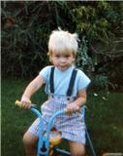
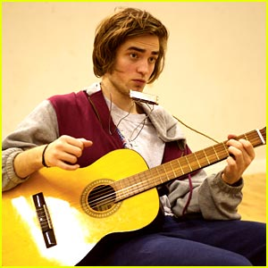
Robert Douglas Thomas Pattinson(born 13 May 1986) is an English actor, model, musician, and producer.
Pattinson began modelling when he was twelve years old, but the number of jobs began to decrease only four years later. In December 2008 he blamed the lack of work as a model on his masculine appearance.
Pattinson plays guitar and piano, and composes his own music. He also appears as the singer of two songs on the Twilight soundtrack: "Never Think", which he co-wrote with Sam Bradley, and "Let Me Sign", which was written by Marcus Foster and Bobby Long.

Slide 8
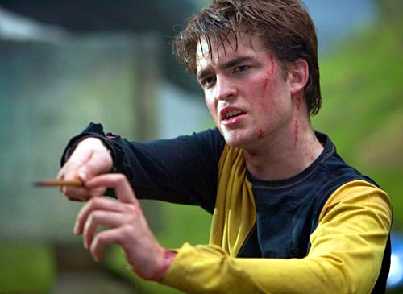
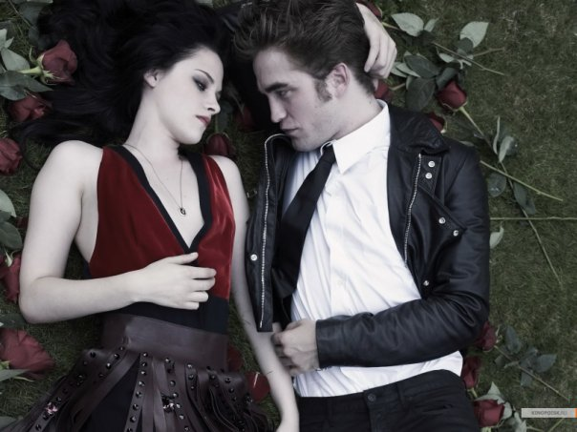
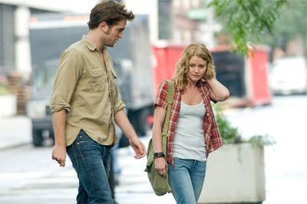
Pattinson had supporting roles in the made for television film Ring of the Nibelungs in 2004. In 2005 he played Cedric Diggory in Harry Potter and the Goblet of Fire. For this role he was named that year's British Star of Tomorrow by The Times.
Pattinson played Edward Cullen in the film Twilight, based on Stephenie Meyer's best-selling novel of the same name, which was released on 21 November 2008 in North America.
He reprised his role as Edward Cullen in the Twilight sequels The Twilight Saga: New Moon, The Twilight Saga: Eclipse, which was released 30 June 2010 and The Twilight Saga: Breaking Dawn, which was released 17 November 2011.
In 2010, Pattinson executively produced and starred in the film Remember Me, which was released on 12 March 2010.

Slide 9
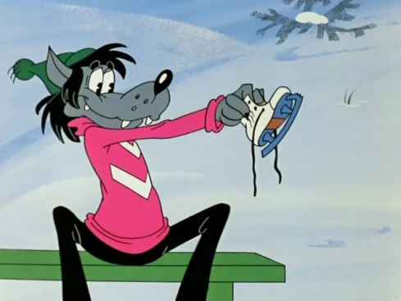
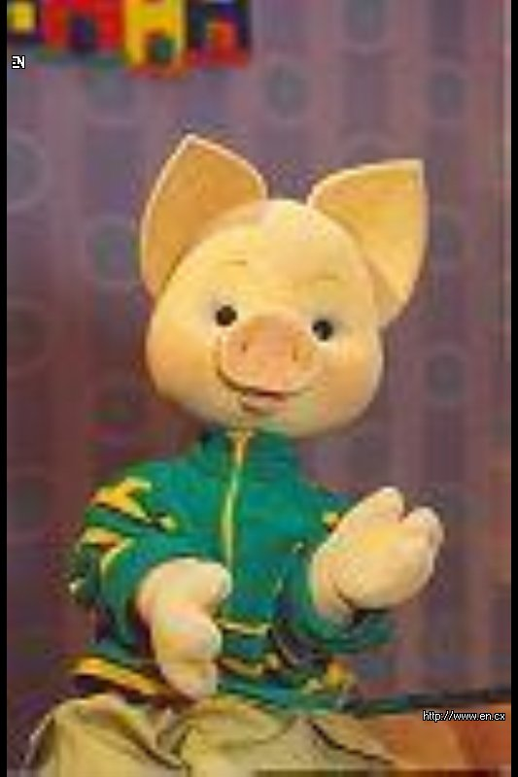
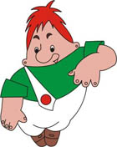


Not only people can be celebrities. Their recipe for success.

