Slide 1
How much do you know about Scotland?
Quiz

Slide 2

1. What is the capital city of Scotland?
Glasgow
Edinburgh
St Andrews

Slide 3
2. What is the national flower of Scotland?
Shamrock
Daffodil
Thistle

Slide 4
3. What colour is the official Scottish national flag?
Red cross on white background
White cross on blue background
White cross on red background

Slide 5
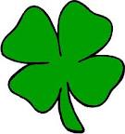
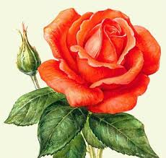
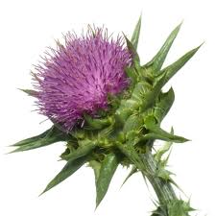
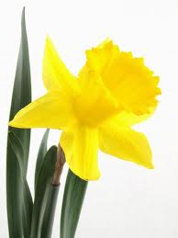
4. Match the symbol and the country

Slide 6
5. Which one of these men was NOT a Scot?
Charles Dickens
Robert Burns
Walter Scott

Slide 7
6. Who is the patron saint of Scotland?
St Patrick
St Andrew
St David

Slide 8
7. What creature is believed to inhabit one of Scottish lakes?
Nessie
Yeti
A shark

Slide 9
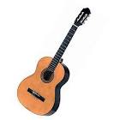

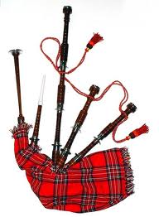
8. Which musical instrument is typically Scottish?

Slide 10

9. Match the author and the book

Slide 11
10. Is kilt men’s or women’s clothing?
Men’s only
Women’s only
Both

