Slide 1
MARKETING
Business Studies
2011

Slide 2
Marketing
is the process used to determine what products or services may be of interest to customers, and the strategy to use in sales, communications and business development
Marketing Mix:
P P P P

Slide 3
Product
Consumer product:
Producer product:

Slide 4
Price
The objectives of the business
The degree of competition in the industry
The channels of distribution
The business image
Price strategies:

Slide 5
Promotion
Promotion refers to the tactics that a business uses to make consumers aware of their product(s) and to entice them to purchase the products, creating sales revenue for the business
Promotion can often be referred to as either:
'above the line’
'below the line’

Slide 6
Place
This refers to:
firstly to the stores and the retail outlets where consumers can purchase the products of the business
secondly to the channels of distribution that the business uses to get its products from the factory to these outlets.

Slide 7
SWOT
STRENGTHS | WEAKNESSES
OPPORTUNITIES | THREATS

Slide 8
SWOT-analysis of Starbucks, Moscow
STRENGHTS | WEAKNESSES
OPPORTUNITIES | THREATS

Slide 9
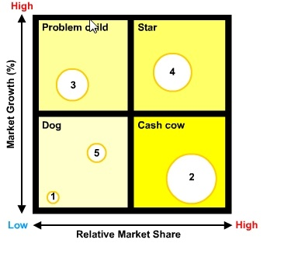
Boston Matrix

Slide 10
Boston Matrix
Examples:
Problem child:
Star:
Dog:
Cash cow:

Slide 11
PESTEL Analysis
Politics
Economics
Social
Technics
Environment
Legal

Slide 12
PESTEL Analysis (Apple)
Politics
Economics
Social
Technics
Environment
Legal

Slide 13
Product Life-Cycle
This shows the various stages that a product is expected to pass through and it also indicates the likely level of sales that can be expected at each stage.
Generally, there are six stages to the lifecycle –
_______________, ________________, ___________, _________________, ________________ and ________________.

Slide 14
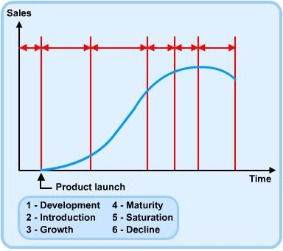

Slide 15
Extension strategies
If a business believes that a product which has reached the saturation stage of the lifecycle can still produce a higher level of sales, then it may choose to implement one or more extension strategies to improve the product's ailing level of sales, such as :
changing the appearance and the packaging of the product
trying to find new uses for the product
trying to find new markets for the product
trying to entice customers to use the product more frequently

Slide 16
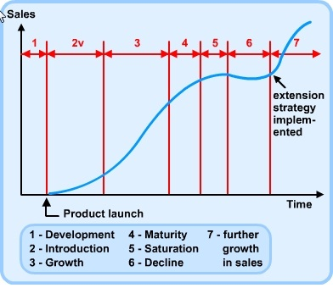
The effects of an extension strategy on a product lifecycle can be represented in the diagram below:

