Slide 1
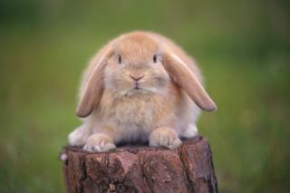
WE READ FAIRY TALES
The Open English Lesson
The theme of the lesson: Why Hares Have got Long Ears
The teacher: Galieva Yana Nickolaevna

Slide 2
The purpose of the lesson: we’ll read a very interesting story about a little hare
Our tasks are:
Have practice in pronunciation some English sounds
Check up your homework
Listen to the poem
Play games
Read the story about The little Hare
Role-play the dialogue
Solve the puzzle

Slide 3
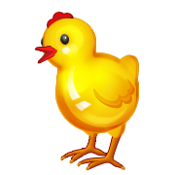
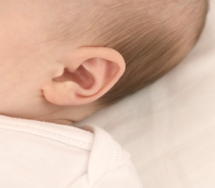
Phonetic exercise
[з:] [e]
[I] [i:]
[Iə] [au]
[l] [w]

Slide 4
Let’s remember some words
il_
c_me
a _ir_f_e
A b_d(_n b_d)
k_nd
There are words but some letters are missing.
Write them down and put the necessary letters.

Slide 5
Warming up
Here it is. Вот здесь
I wonder- интересно
Have a look at it- Взгляни
Where is my cat?
Here it is. Have a look at it.
Oh, thank you very much.
Wh… is my cat, I wonder?
Open your box and h… a l..k at it.
Oh, thank . . . … ….

Slide 6
Riddles

Slide 7
The Cat and the Mouse
flat-квартира
Poor[puə]-бедный
Little mouse, little mouse,
Where is your house?
Little cat, little cat
I haven’t got a flat
I am a poor mouse
I haven’t got a house
Little mouse, little mouse,
Come into my house
Little cat, little cat,
I cannot do that.
I’m a poor mouse
You want to eat me!

Slide 8
It’s time to read
Ten,get,I get, he gets, get a hen, get a toy. Can you get it for me?
Not, long,a long street, long skis. My dad has got a long skis.
Here, ear, an ear-ears, long ears.-Who has got long ears?- The hare has.
Her, bird, a bird-birds, many birds. Can you see many birds there? The birds is yellow and blue.
See, tree,a tree-trees, green trees, in a tree. The bird is in a tree.

Slide 9
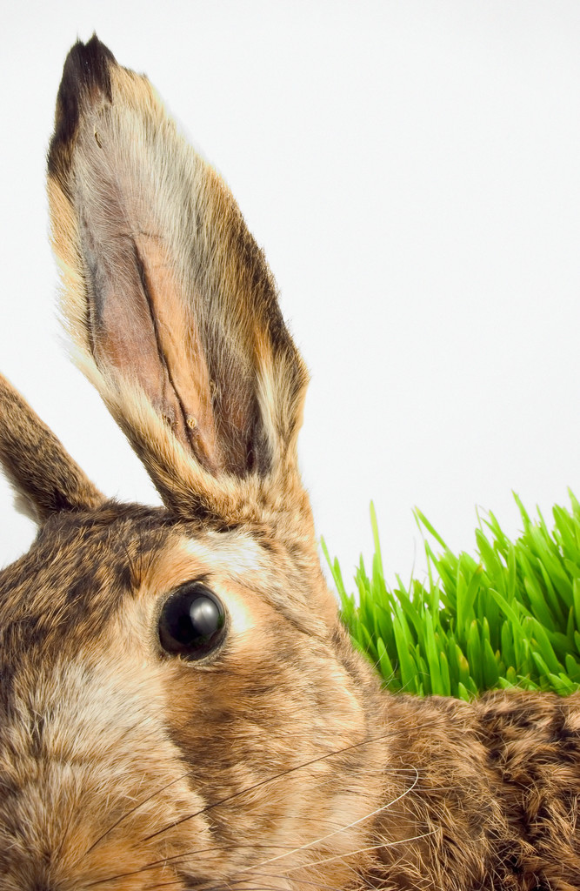
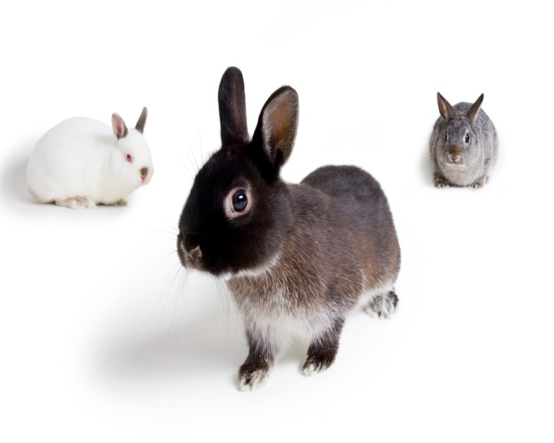
Why Hares Have got Long Ears

Slide 10
True or false
Brother Hare is big.
He wants to be very, very kind.
One day he comes to his Granny.
Brother Hare doesn’t want to be clever.
Aunt Mammy-Bammy wants to help him.
She asks him to bring her the Bird.

Slide 11
Complete the dialogue using the story
H…, Aunt Mammy-Bammy. How … you?
I’m …,thank …. And …?
I’m very …,t… Aunt M….-B….,can…help me?
What do…want?
I have got a …wish. I …to be very…and …clever.
I can help you if you do what I want. I want to have that bird. …it for me.

Slide 12
PUZZLE TIME
TO SOLVE THE PUZZLE YOU SHOULD WRITE THE NAMES OF 11 ANIMALS

Slide 13
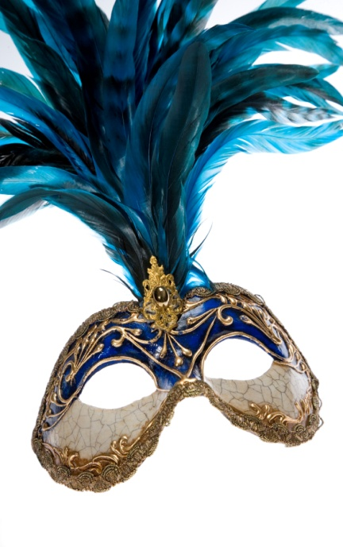
Could you put down your home task
I like your work today
Thank you
P.48 ex. 13(dictation)
Make up the dialogue using the text about the other animal.
Don’t forget to make the mask of the animal.

Slide 14
The lesson is over See you later
Have a good day

