Slide 1
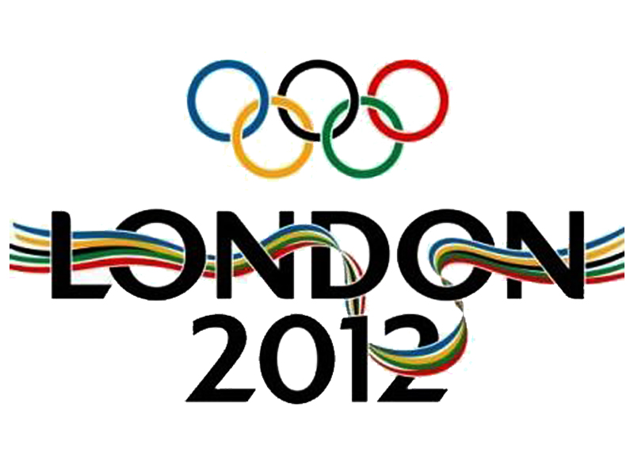

Slide 2
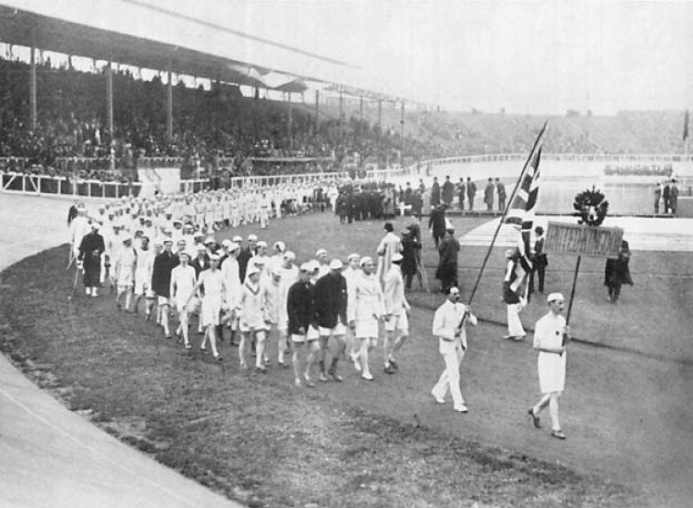
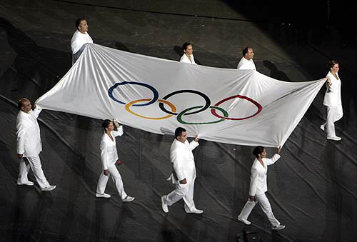
They`ll be hold in London, the capital of Great Britain, from 27 July till 12 August.
Summer Olympic games 2012 are thirtieth summer Olympic ones.

Slide 3
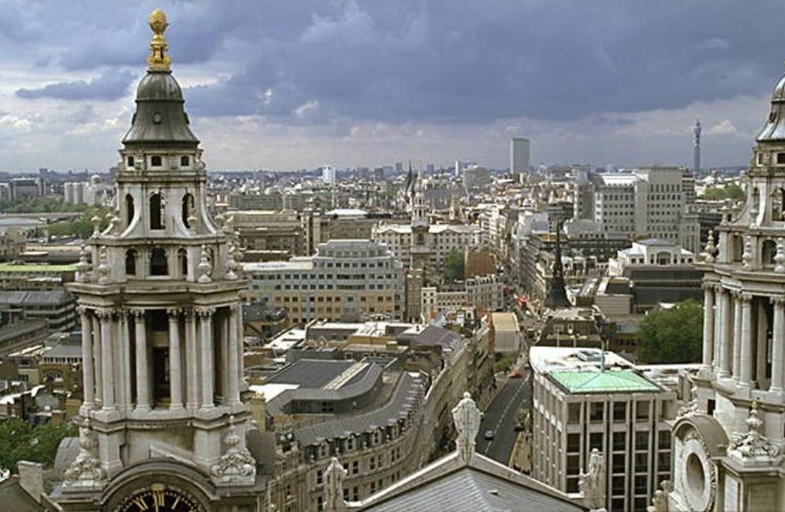
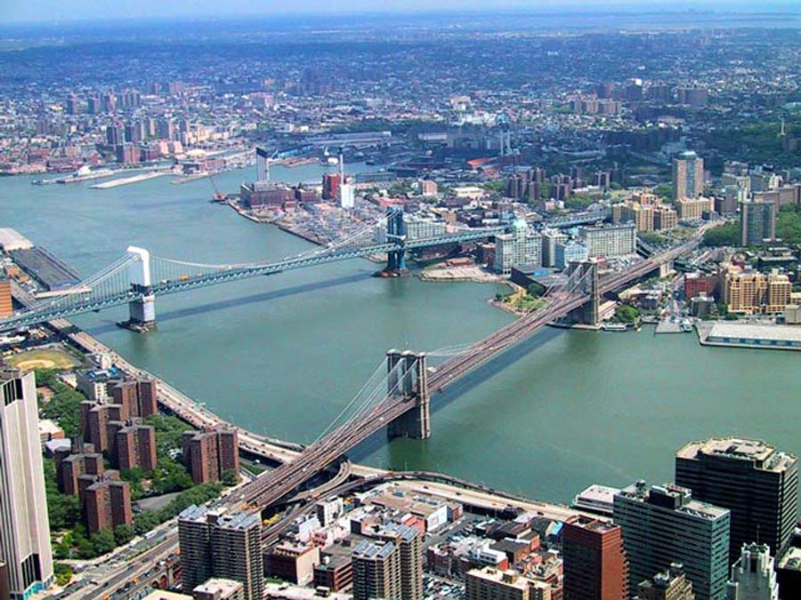
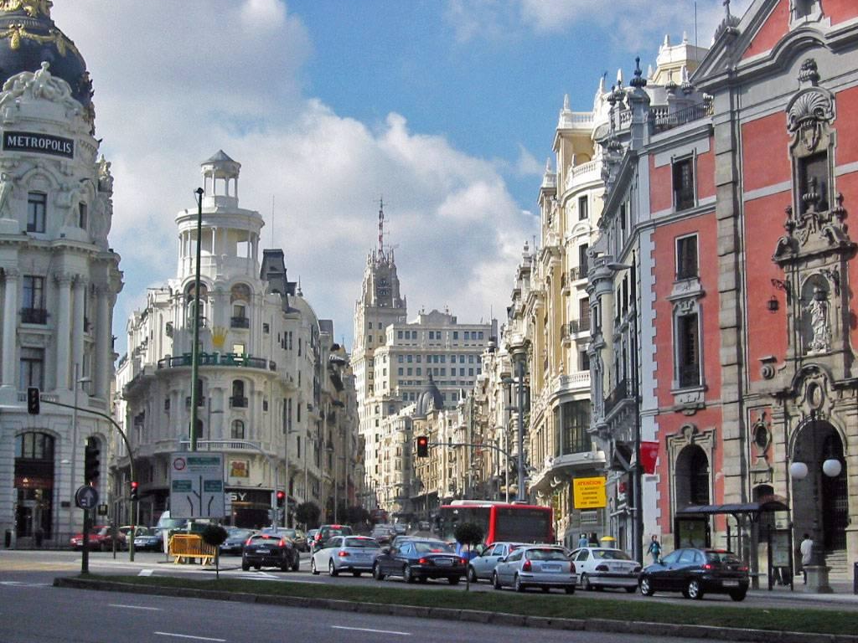
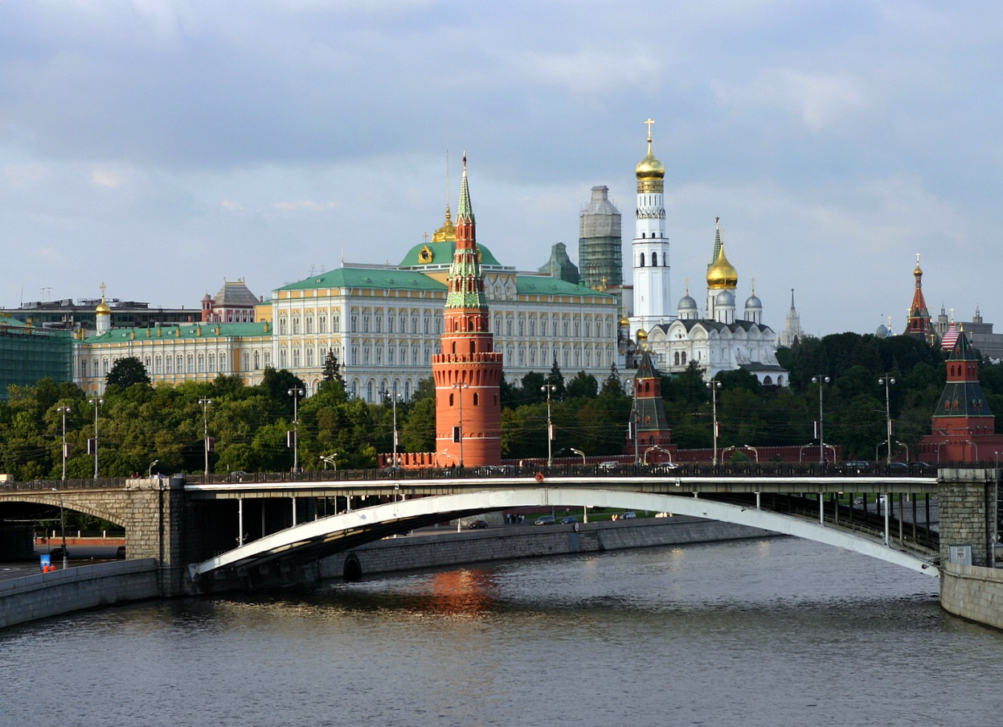
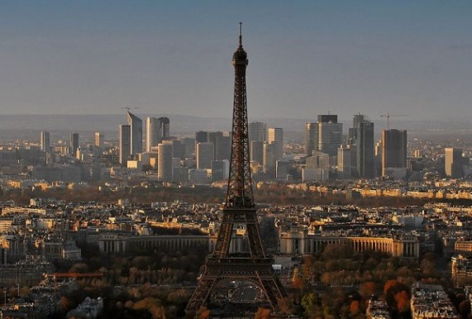
Choosing of the city
On the 18th of May in 2004 the International Olympic committee chose 5 cities after the discussing of all putting applications for taking place Summer Olympic Games 2012.
These 5 cities were:
London was chosen
on the 6th of July in 2005.
Madrid
Moscow
New York
Paris
London

Slide 4
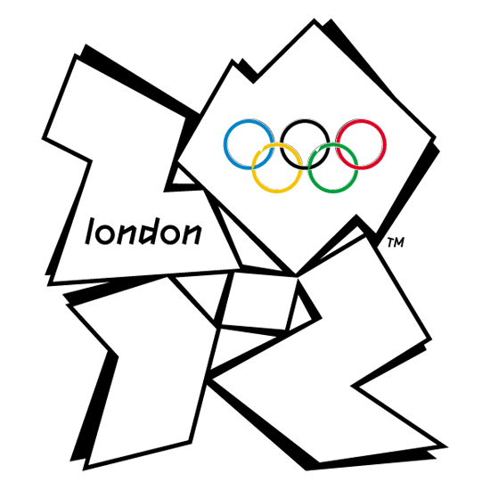
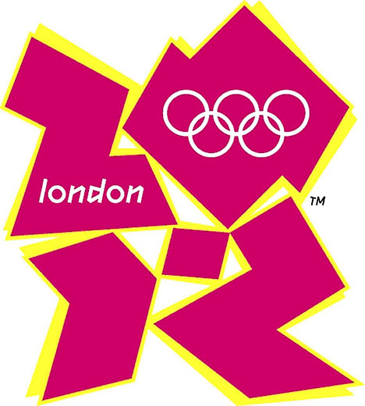
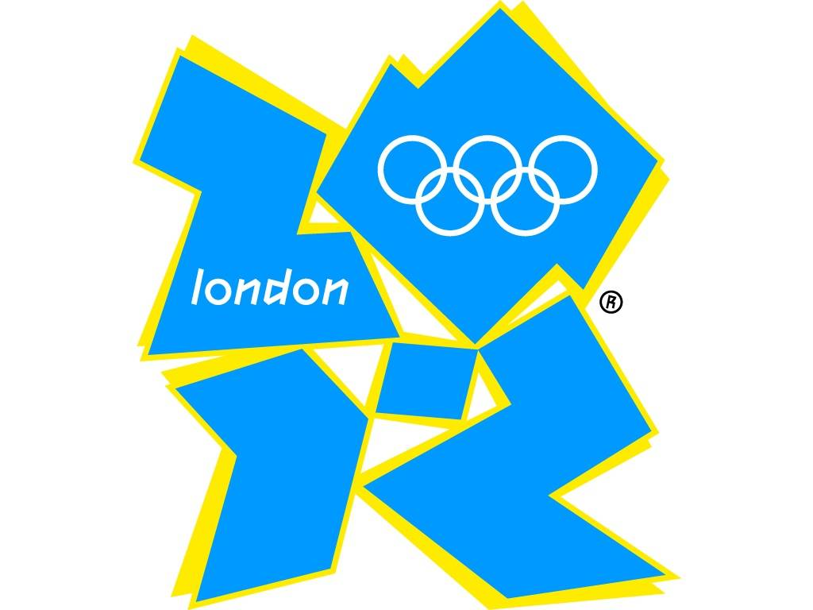
The emblem consists of the four parts in the form of irregular polygons which symbolize numbers of the Olympic year
«2», «0», «1», «2».
One part includes the word «London» and another has the image of the five Olympic rings.

Slide 5
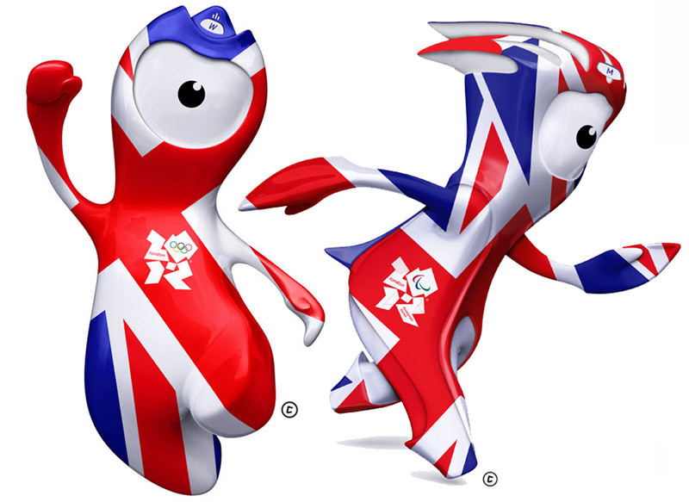
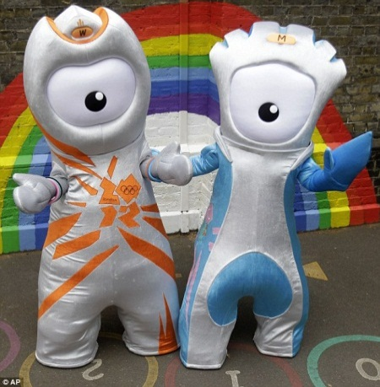
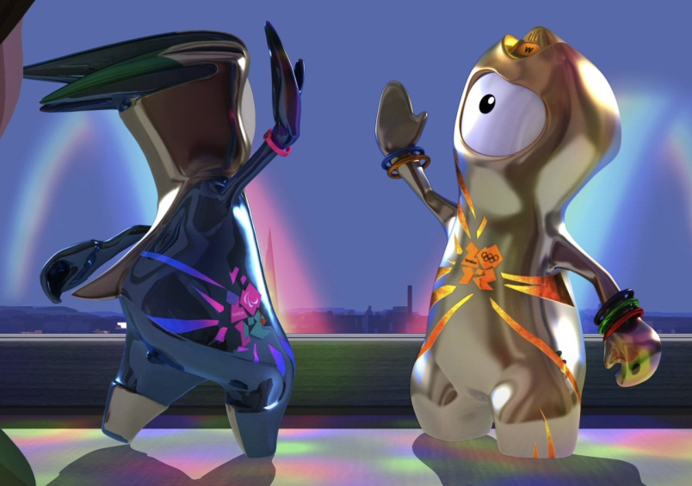
The Olympic talismans were named on the 19th of May in 2010.
Talismans
They were called in the honor of the town Mach-Wenlock where the first competitions were held similarly to the Olympic games and the village Stock-Mandevil where the first Parolympics were held in Great Britain. Both talismans have one eye, they wear bicyclic helmets and the Olympic logotypes are drawn on them.
They have become the two steel drops from Bolton. Their names are Venlok and Mandevil.

Slide 6
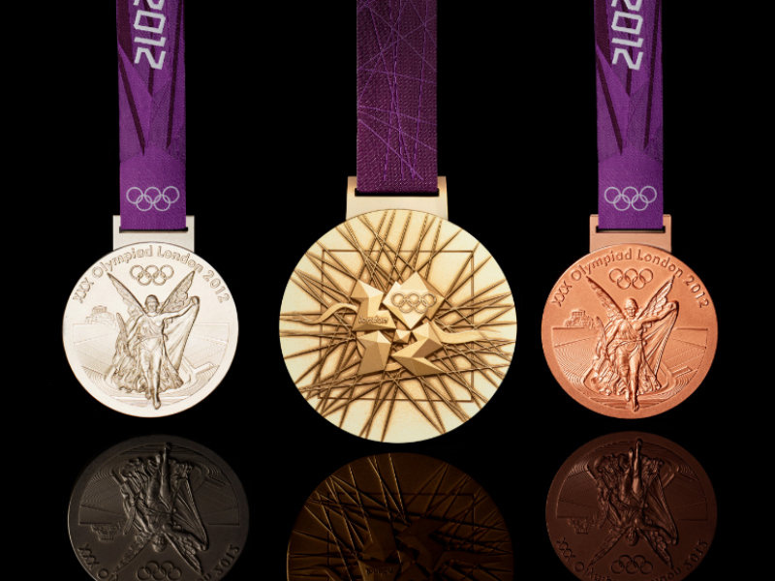
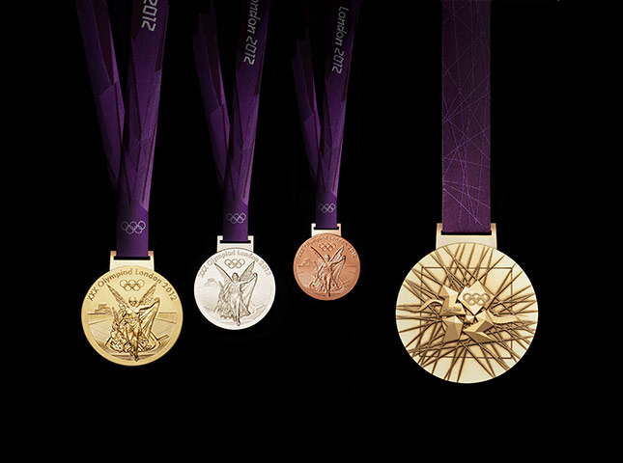
Medals
The diameter of one medal will be about 85 millimetres and 7 millimetres in thickness. The weight of one medal will be about 375—400 grammes. These medals will be the largest ones in the history of the Olympic Games. In all 2100 medals will be issued for the Olympic Games in London.
The logotype of Games with the rays will be found on the medals of different values. The goddess Nika and the river Thames will be represented on the reverse side. The author of this project became the designer David Watkins.

Slide 7
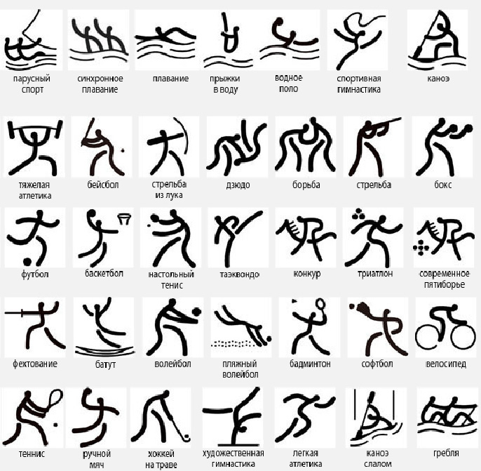
Olympic kinds of sports

Slide 8
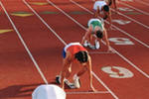
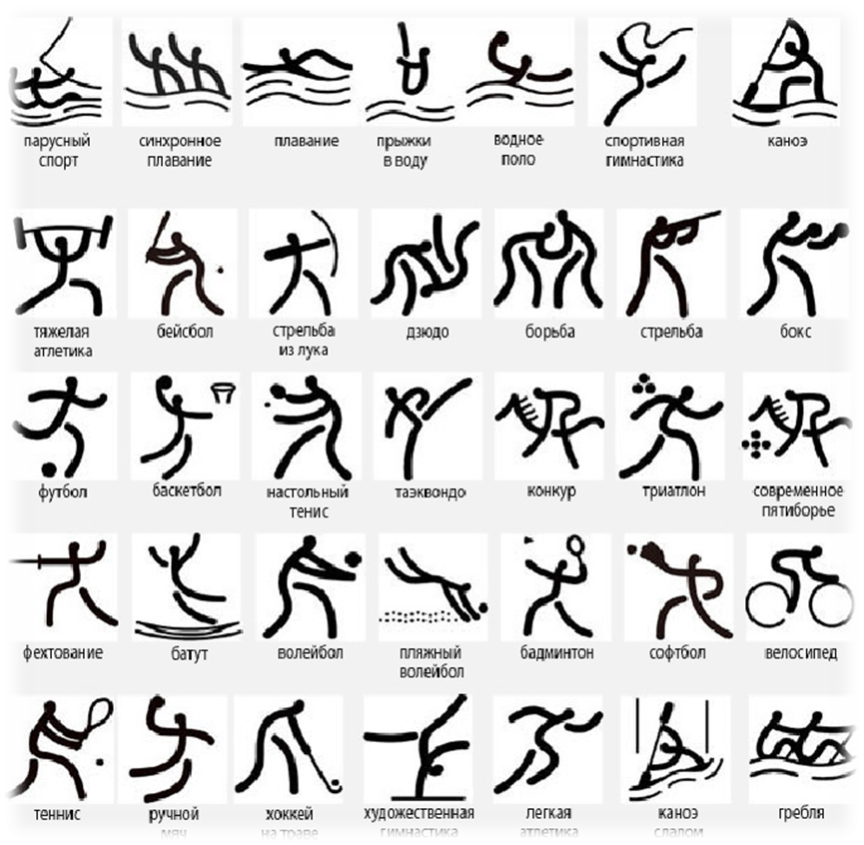
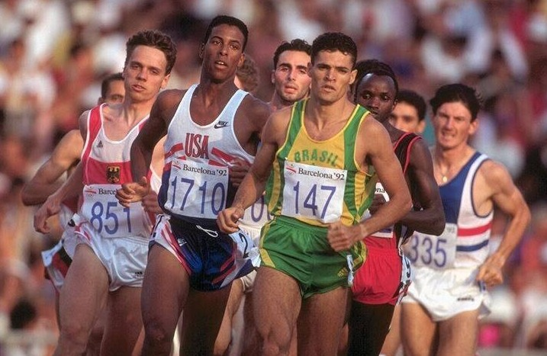
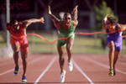

Track and field athletics

Slide 9
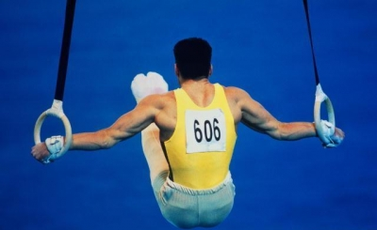

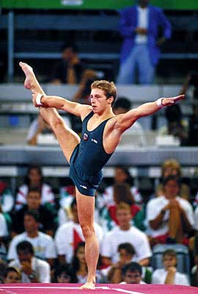
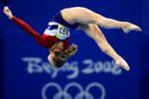
Gymnastics

Slide 10
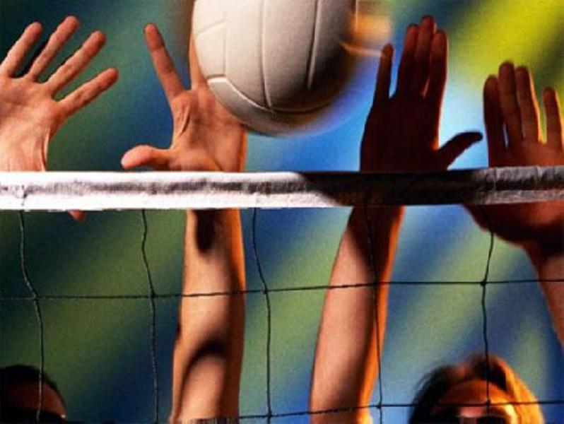
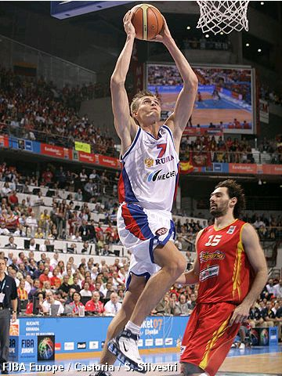
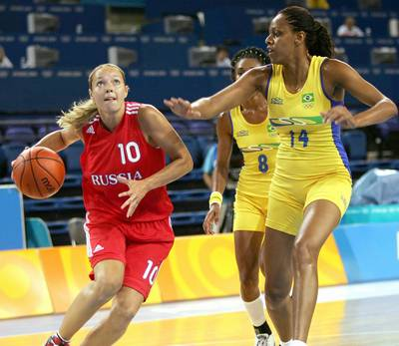


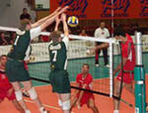
Basketball
Volleyball

Slide 11
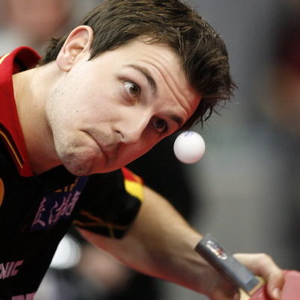
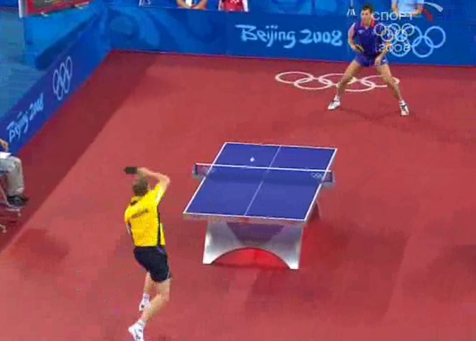

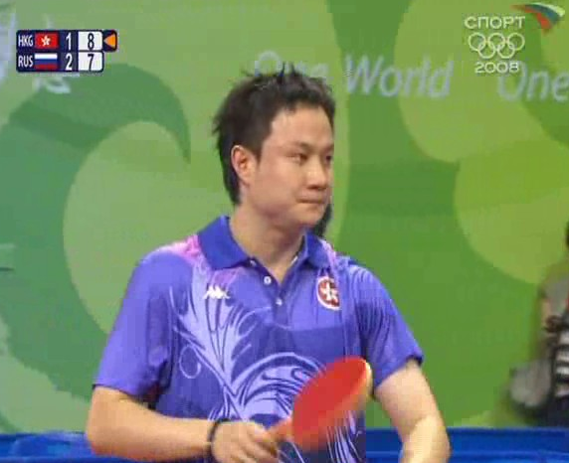
Table tennis

Slide 12
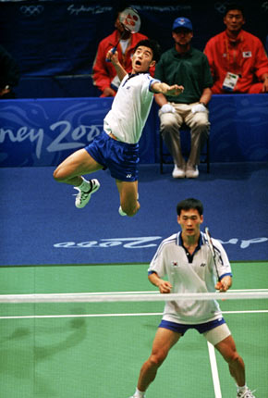
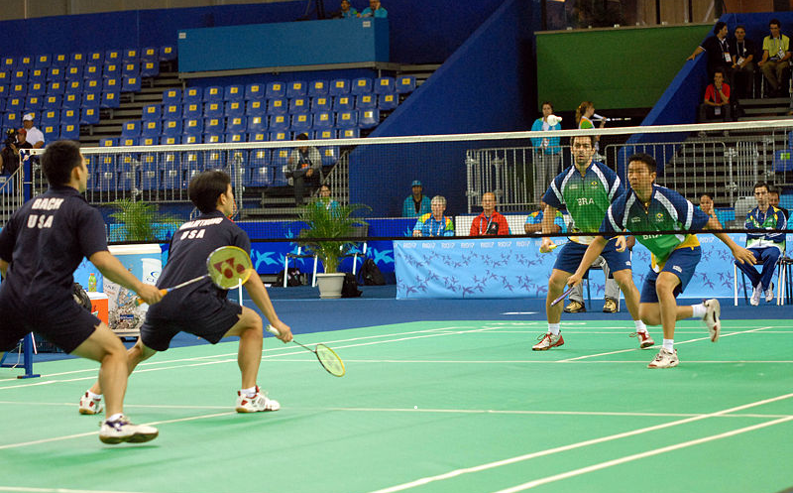
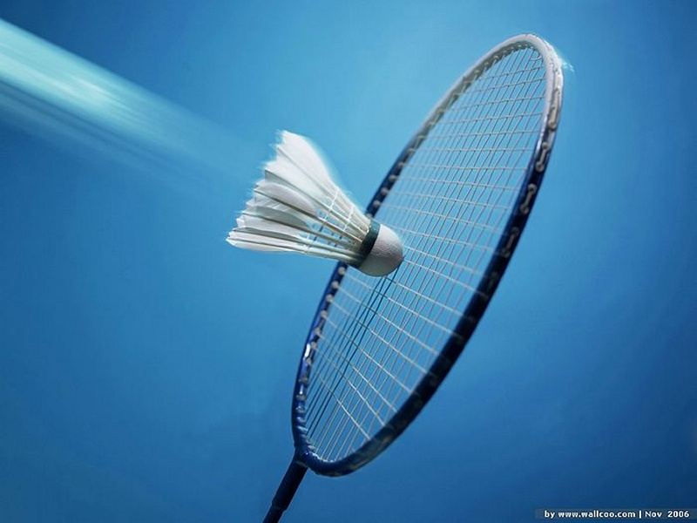

Badminton

Slide 13
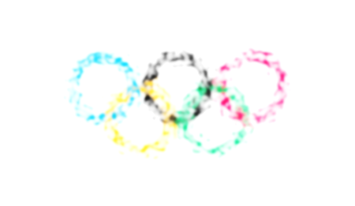
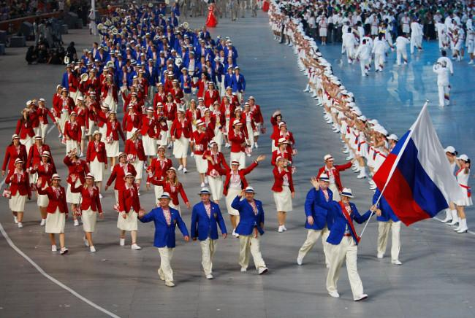
Russia will be presented at Summer Olympic Games in London in 2012 at least in 13 kinds of sports.

