Slide 1
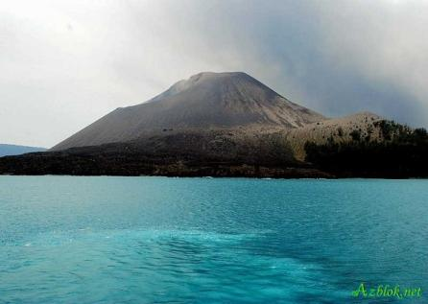

Krakatoa.

Slide 2
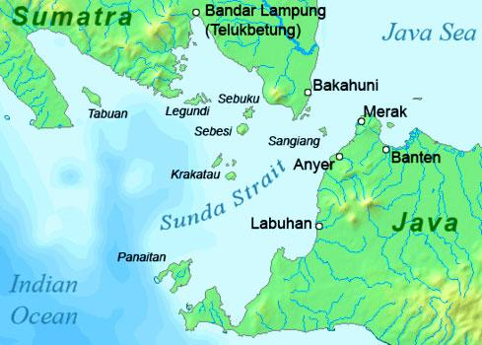
Krakatoa is a great volcano
on the island of Krakatoa
between Java and Sumatra
in present day in Indinesia.
Island of Karakatoa

Slide 3
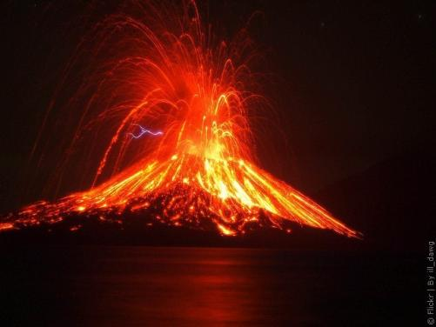
History of the volcano.
On August, 26th 1883 the volcano erupted.

Slide 4
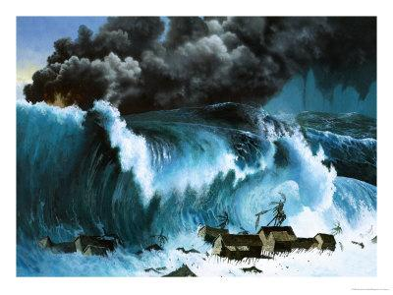
There were big waves
in the sea.
They were 15 metres high
and travelled 13,000 km

Slide 5
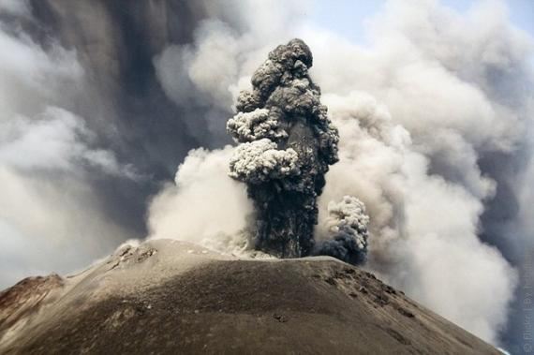
Dust from the volcano travelled all around the world.

Slide 6
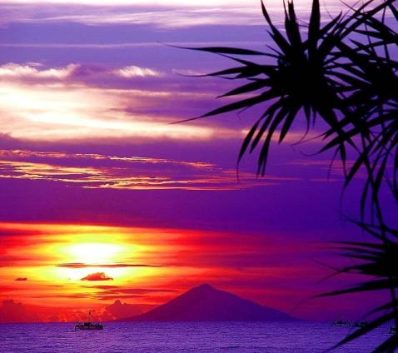
For three years people saw colourful bright sunsets.

Slide 7
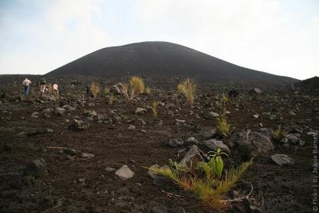
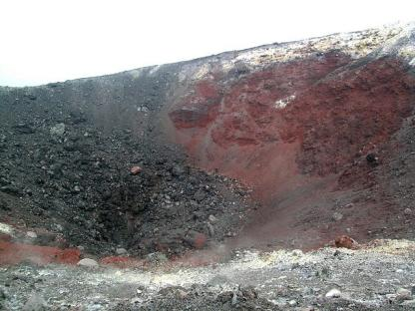
Everything was buried
under a thick layer of ash.
Plants and animal life
didn’t begin in these
islands for nearly
five years.

Slide 8
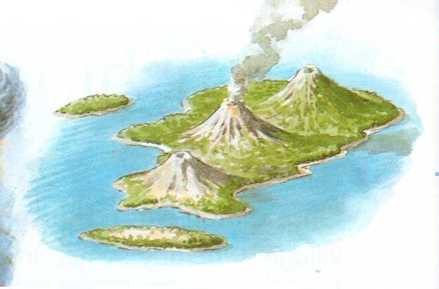
In 1928 a new island appeared.
It started to grow bigger and bigger.

Slide 9
All about volcanoes.

Slide 10
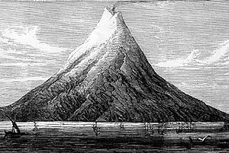

Slide 11
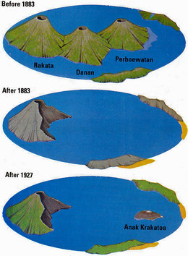
The history of Krakatoa

Slide 12
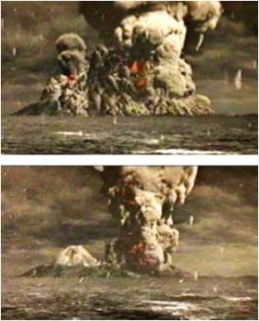
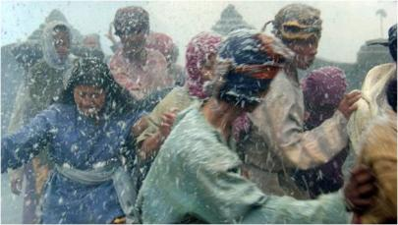
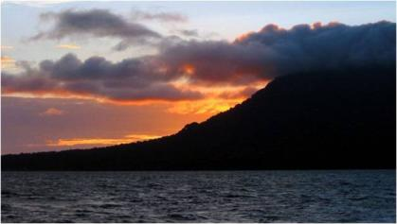
ash
Colourful sunset
eruption

Slide 13
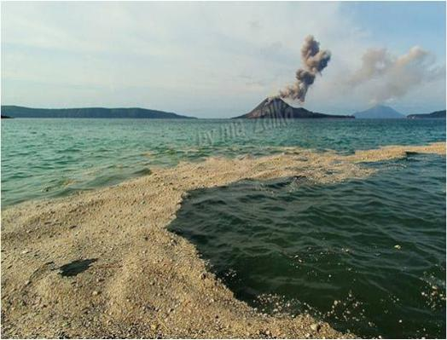
Pumice

Slide 14
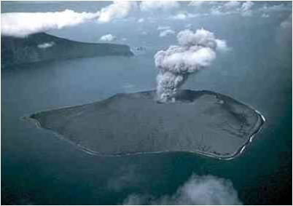
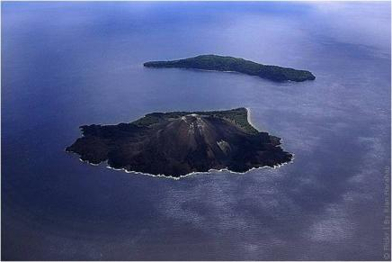
There are extinct volcanoes.
We think they can’t erupt again.
There are also dormant volcanoes.
These volcanoes are sleeping.

Slide 15
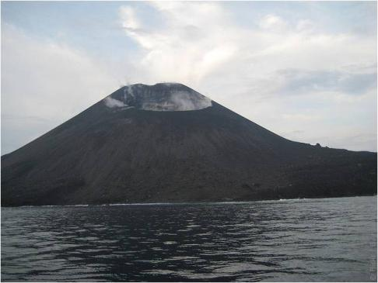
There are active volcanoes,
because they erupted in the past
and they can erupt again.

Slide 16
Krakatao was a small , beautiful island in Indonesia.
The volcano destroyed most of the island.
The waves in the sea were 15 metres high.
About 36,000 people died.
For three years people saw beautiful bright sunsets.
In 1928 a new island appeared.
Krakatoa is an active volcano.
People of Indonesia are in danger now!

