Slide 1
Inventions & discoveries | Where? | Books & Films | Cars | Made from …
100 | 100 | 100 | 100 | 100
200 | 200 | 200 | 200 | 200
300 | 300 | 300 | 300 | 300
400 | 400 | 400 | 400 | 400
500 | 500 | 500 | 500 | 500

Slide 2

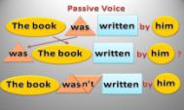
100
Inventions and discoveries
Whom was the light bulb invented by?

Slide 3
100
Inventions and discoveries
What was invented by Thomas Edison?

Slide 4

200
Inventions and discoveries
Whom were airplanes invented by?

Slide 5
200
Inventions and discoveries
What was invented by Wright brothers?
5 см

Slide 6

300
Inventions and discoveries
Whom was the telephone invented by?

Slide 7
300
Inventions and discoveries
What was invented by
Alexander Graham Bell?

Slide 8

400
Inventions and discoveries
Whom was the Internet Explorer
invented by?

Slide 9
400
Inventions and discoveries
What was invented by Bill Gates?

Slide 10

500
Inventions and discoveries
Whom was the law of relativity
invented by?

Slide 11
500
Inventions and discoveries
What was invented by Albert Einstein?

Slide 12
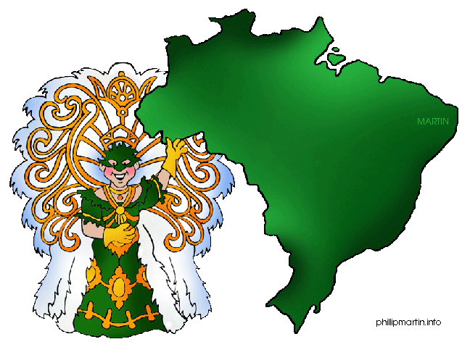
100
Where?
Where are bananas grown?

Slide 13
100
Where?
What is grown in Brazil?

Slide 14

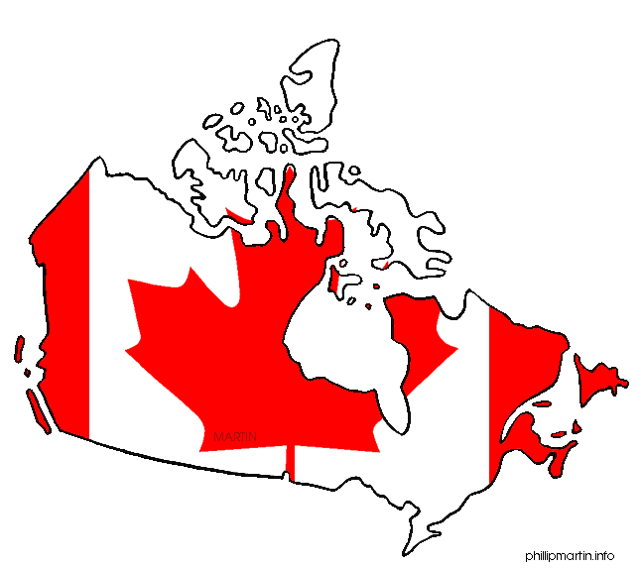
200
Where?
Where are apples grown?

Slide 15
200
Where?
What is grown in Canada?

Slide 16
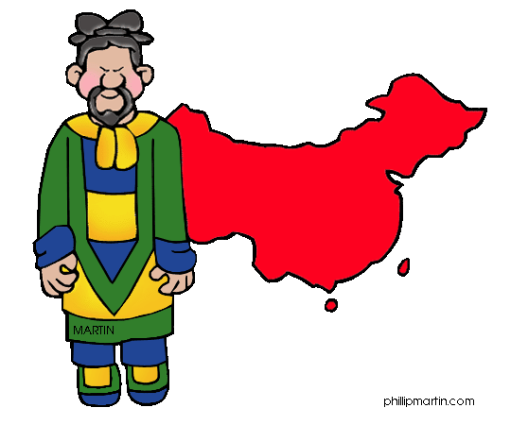
300
Where?
Where is rice grown?

Slide 17
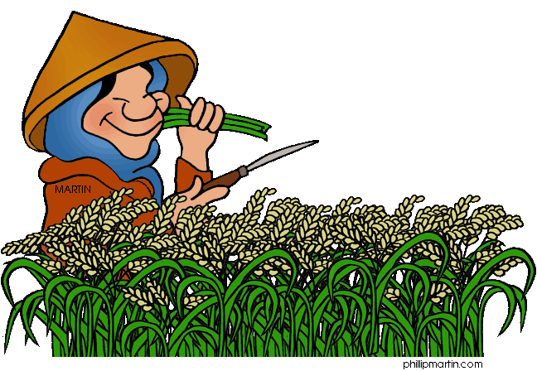
300
Where?
What is grown in China?

Slide 18
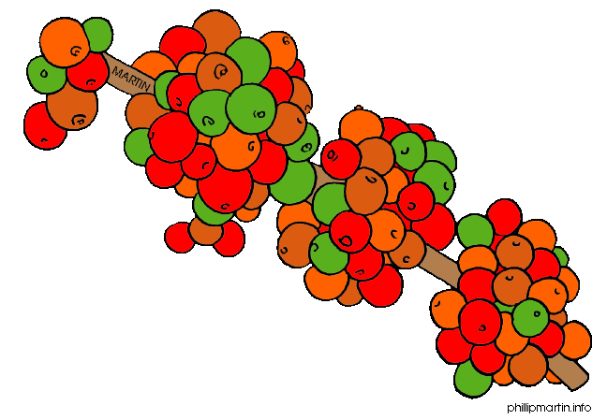
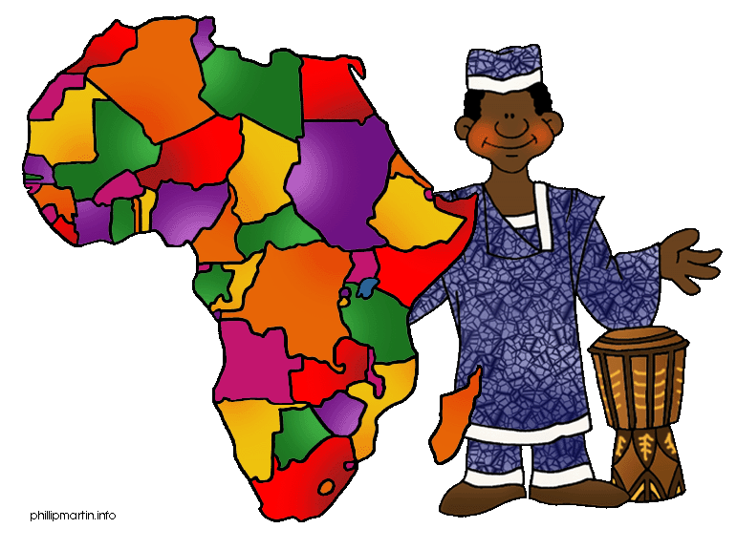
400
Where?
.
Where are coffee beans grown?

Slide 19
400
Where?
What is grown in Africa?

Slide 20
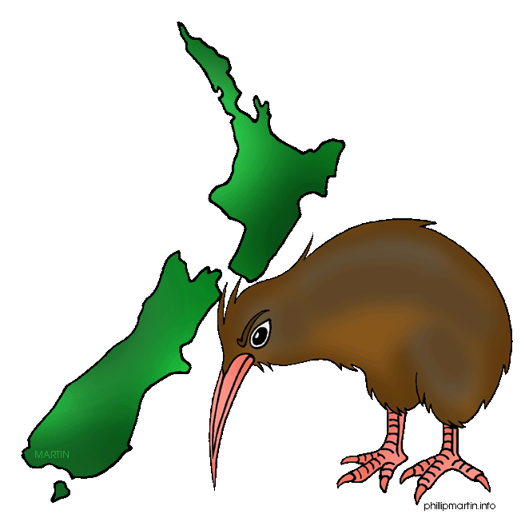
500
Where?
Where are kiwis grown?

Slide 21
500
Where?
What is grown in New Zealand?

Slide 22
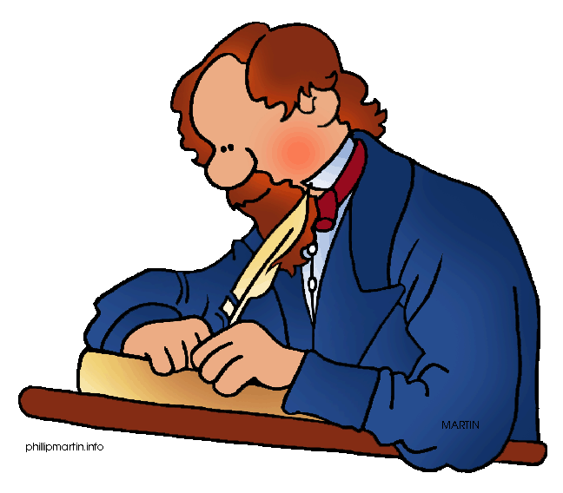
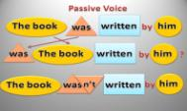
100
Books and Writers
Whom was “Oliver Twist” written by?

Slide 23

100
Books and Writers
What was written by Charles Dickens?

Slide 24
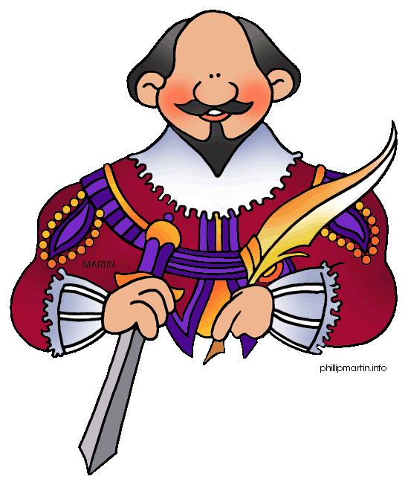
200
Books and Writers
Whom was “Romeo and Juliet” written by?

Slide 25
200
Books and Writers
What was written by
William Shakespeare?

Slide 26
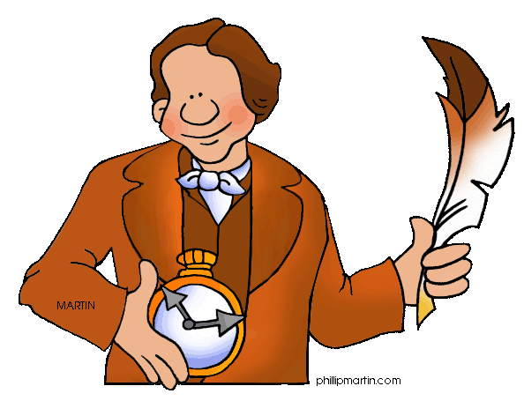
300
Books and Writers
Whom was “Alice in Wonderland”
written by?

Slide 27
300
Books and Writers
What was written by
Lewis Carroll?

Slide 28
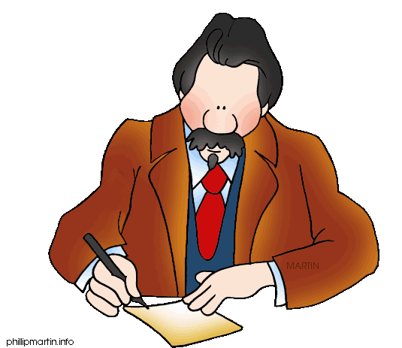
400
Books and Writers
Whom was “Treasure Island”
written by?

Slide 29
400
Books and Writers
What was written by
Robert Louis Stevenson?

Slide 30
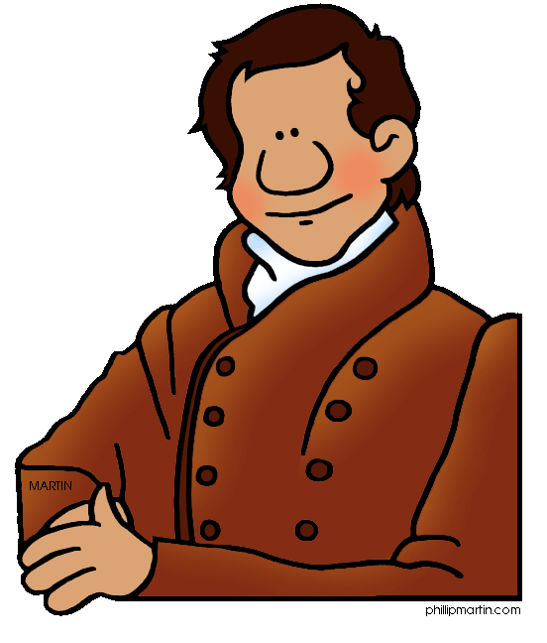
500
Books and Writers
Whom was “The Last of the Mohicans”
written by?

Slide 31
500
Books and Writers
What was written by
James Fenimore Cooper?

Slide 32
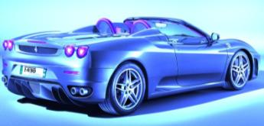
100
Cars
Whom was a sports car built by?
Porsche
Hyundai
Toyota

Slide 33
100
Cars
What car was built by Porsche?

Slide 34
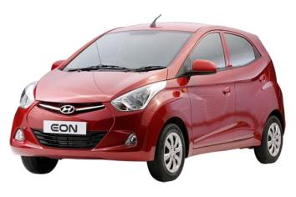
200
Cars
Whom was a compact car built by?
Porsche
Hyundai
Toyota

Slide 35
200
Cars
What car was built by Hyundai?

Slide 36
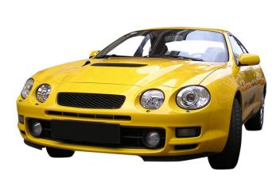
300
Cars
Whom was the yellow sports car built by?
Porsche
Hyundai
Toyota

Slide 37
300
Cars
What car was built by Toyota?

Slide 38
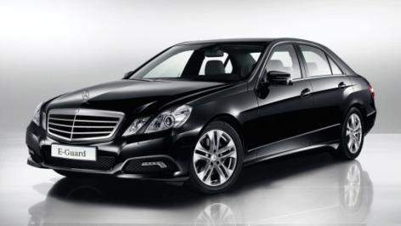
400
Cars
Whom was this car invented by?
Mercedes
Ford
Benz

Slide 39
400
Cars
What car was invented by Benz?

Slide 40
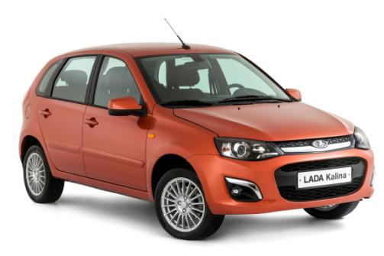
500
Cars
Whom was this car produced by?

Slide 41
500
Cars
What car was produced by AvtoVAZ?

Slide 42

100
Made from
What is pop corn made from?

Slide 43

100
Made from
What is made from corn?

Slide 44
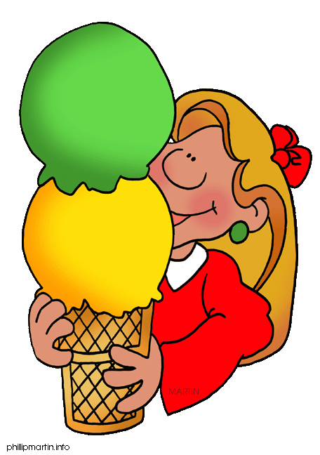
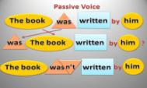
200
Made from
What is ice ream made from?

Slide 45
200
Made from
What is made from milk?

Slide 46

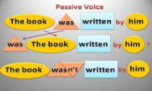
300
Made from
What are T-shirts made of?

Slide 47

300
Made from
What is made of cotton?

Slide 48
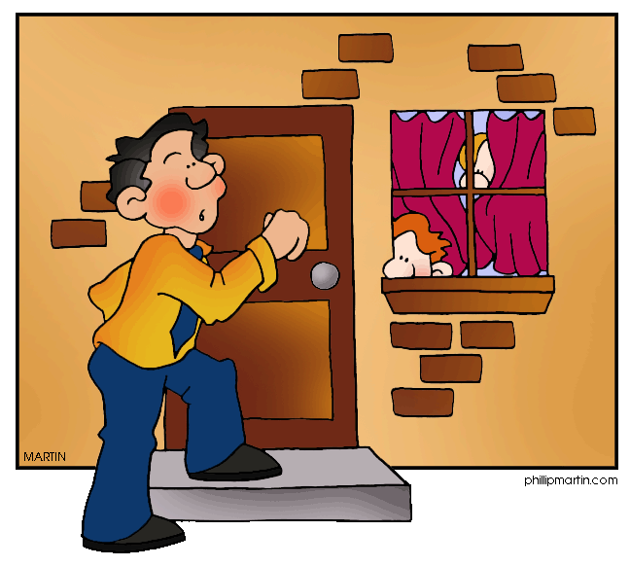
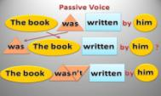
400
Made from
What is the house made of?

Slide 49
400
Made from
What is made of bricks?

Slide 50

500
Made from
What is the Statue of Liberty made of?

Slide 51

500
Made from
What is made of copper?

Slide 52
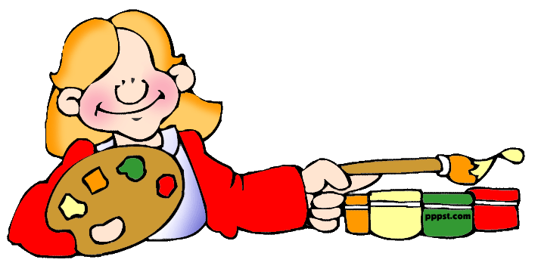
Источник иллюстраций
http://www.pppst.com/clipart.html
FREE Original Clipart for Kids, Teachers, Parents, Schools, Churches, WebPages,
wherever you can find a non-profit use for it

