Slide 1



Презентация к уроку-празднику
Учитель английского языка: Шихвердиева Алла Сергеевна
Средняя общеобразовательная школа №717 CAO г. Москвы

Slide 2

Let`s sing! Давайте петь!

Slide 3
























The English Alphabet
A
B
C
D
E
F
G
H
I
J
K
L
M
N
O
P
Q
R
S
T
U
V
W
X
Y
Z

Slide 4

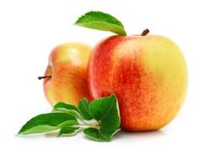
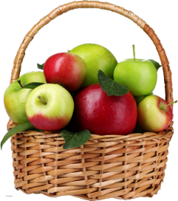
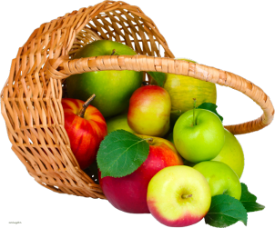
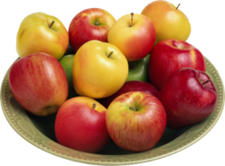
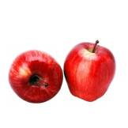
Aa
an apple — яблоко
Apples here, apples there,
Apples, apples everywhere!

Slide 5

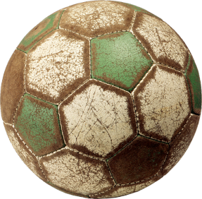
Bb
a ball — мяч
Bounce! Bounce! It is my ball!
It doesn`t want to stop at all.

Slide 6

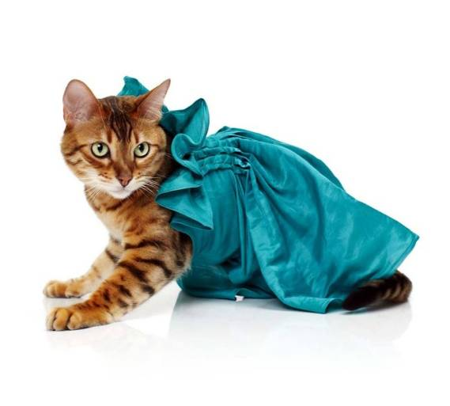
Cc
a cat — кошка
I`m the cat. My name is Hat.
I`m not fat. I like to chat!

Slide 7

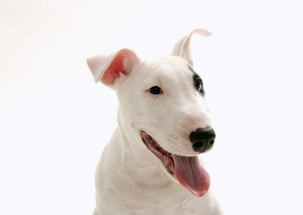
Dd
a dog — собака
I`m the dog. My name is Jack.
My coat is white. My nose is black.

Slide 8

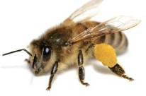
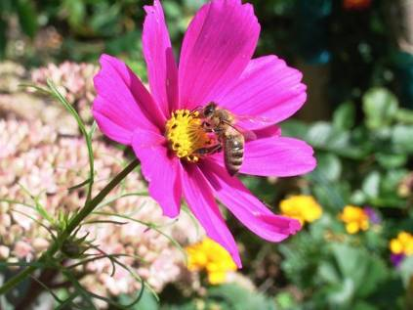
Ee
a bee — пчела
Little yellow bee, bee, bee!
How many flowers can you see?

Slide 9


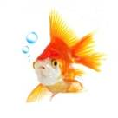
Ff
a fish — рыбка
One, two, three, and four, and five!
I have got a fish alive!

Slide 10

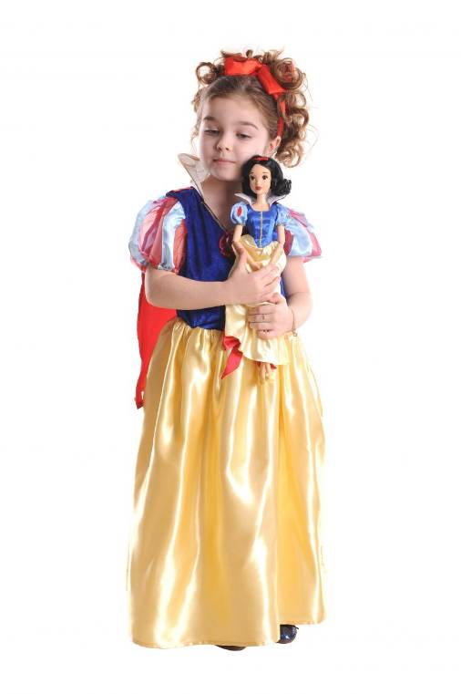
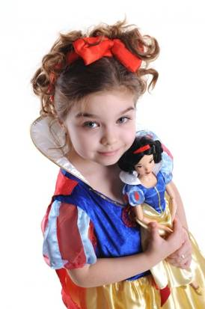
Gg
a girl — девочка
I`m a girl. I`ve got a doll.
Her name is May.
We like to play.

Slide 11

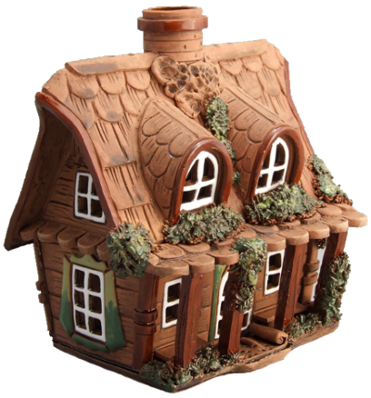
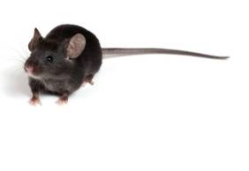
Hh
a house — дом
Little mouse,
little mouse!
Where is your house?
I`m a poor mouse,
I have no house.

Slide 12


Ii
ice — лёд
Spring is coming. Warm and nice.
Ice is melting. Poor ice!

Slide 13


Jj
jeans — джинсы
Merry Jimmy Jinn
is jumping in his jeans.

Slide 14

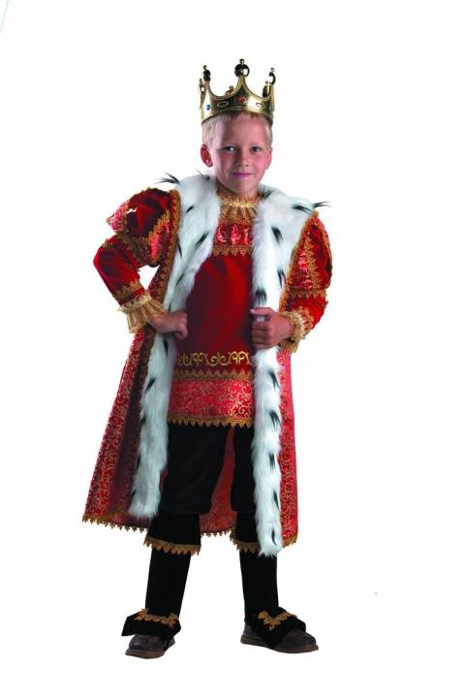
a king — король
Kk
The king is strong.
The king is brave.
What is his name? He is Nick Grey.

Slide 15

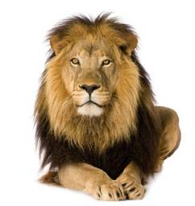
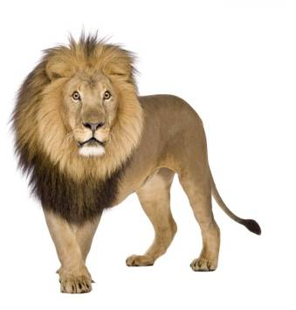
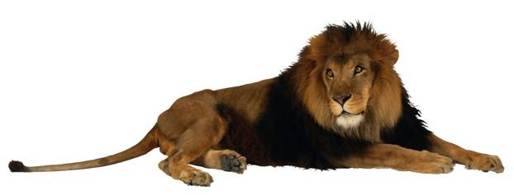
Ll
a lion — лев
Who lives in Africa?
He, she or me?
One lion, two lions, three…

Slide 16

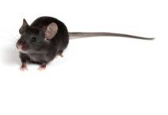
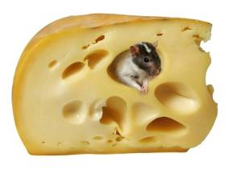
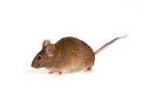
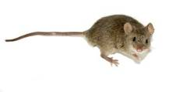
Mm
a mouse — мышка
mice — мыши
Little mice, little mice!
Would you like a piece of ice?
We would like a piece of cheese. Yes, please!

Slide 17

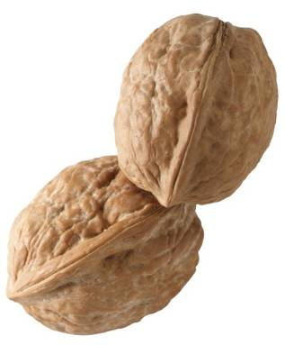
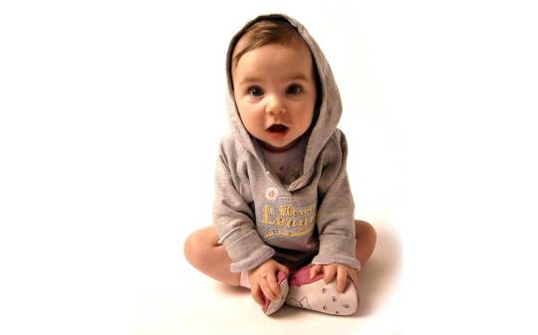
Nn
nuts — орехи
one — один
How much is one plus one?
Two big nuts for little son.

Slide 18

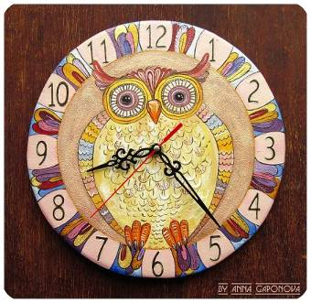
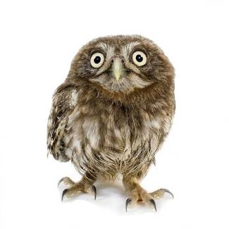
Oo
a clock — часы
an owl — сова
“Tick-Tock! Tick-Tock!
Play and walk,” says the clock.

Slide 19

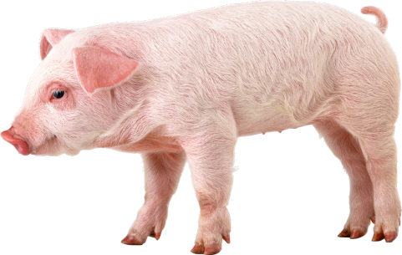
Pp
a pig — свинья
a pet — питомец
I`v got a pet. My pet is a pig.
His name is Pick. He is not big.

Slide 20

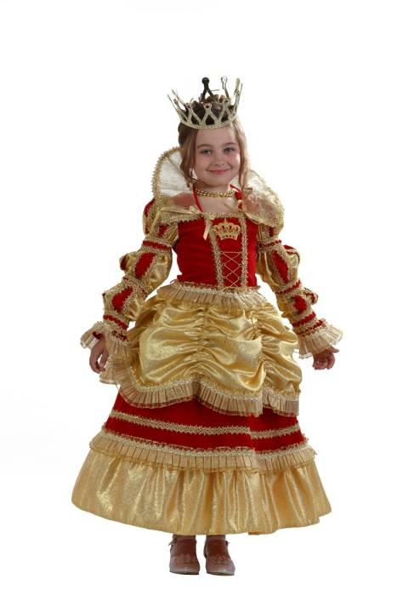
a Queen — королева
Qq
Mary the Queen
can dance and sing.

Slide 21


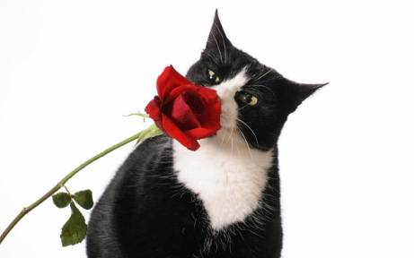
Rr
a rose — роза
red — красный
One, two, three!
One, two, three!
Nice red roses you can see!

Slide 22

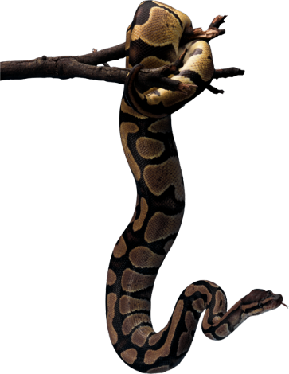
Ss
a snake — змея
Oh, Mary!
Come and see!
A big snake is in the tree!

Slide 23

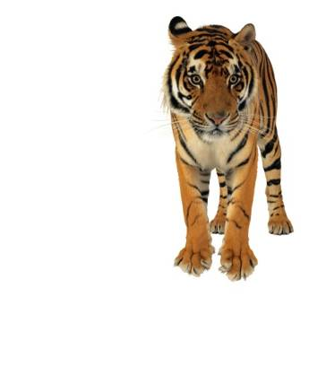
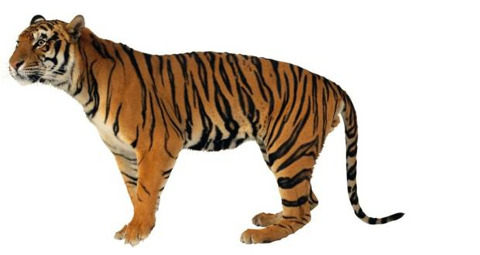
Tt
a tiger — тигр
to talk — разговаривать
When tigers walk
They like to talk.

Slide 24

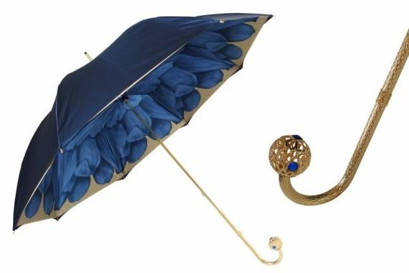
Uu
an umbrella — зонтик
Hurry, hurry Cinderella!
Quickly bring my blue umbrella!

Slide 25

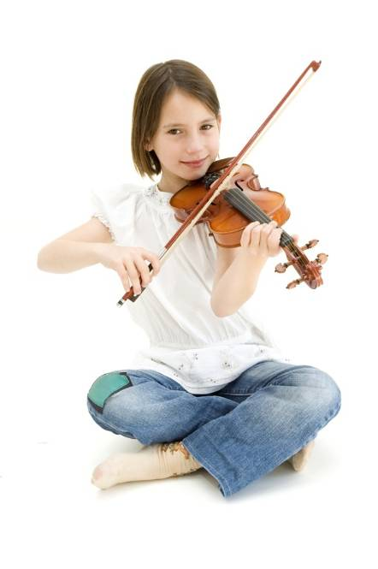
a violin — скрипка
Vv
Can you dance?
Can you sing?
I can play the violin.

Slide 26


words — слова
a window — окно
a wall — стена
Ww
Hey, Letter W!
I like the words with you!
Whу, what, who,
Window, wall, two,
Swim, white, owl,
Down, town… Wow!

Slide 27

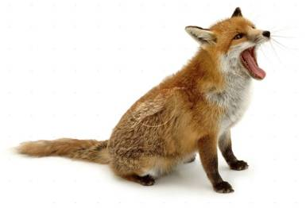
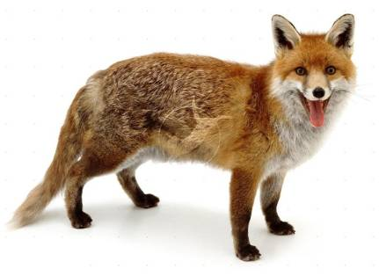

Xx
a fox — лиса
a box — коробка
I see two funny foxes
With two small boxes.

Slide 28


to fly — летать
a sky — небо
Yy
Fly! Fly! In the sky!
My nice and funny kite!

Slide 29

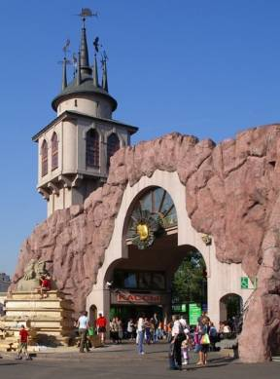
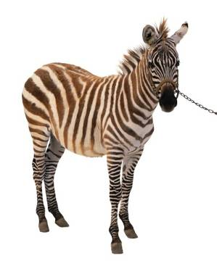
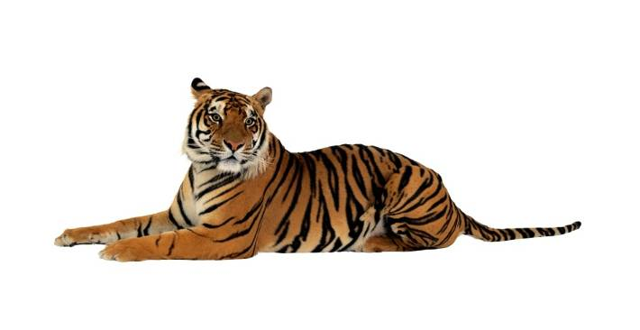
a zoo — зоопарк
a zebra — зебра
Zz
We go, we go, we go to the zoo!
We can see a tiger and a zebra, too.

Slide 30

Colours
WHITE
GREEN
YELLOW
BROWN
BLUE
RED
ORANGE
PURPLE
BLACK
GREY
PINK

Slide 31
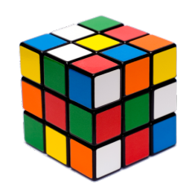
Scrambled words
“Colours”
1. DER
7. RELUPP
2. LUBE
8. TWIHE
3. KPIN
9. GARONE
4. REGY
10. EWLYOL
5. ERENG
11. WROBN
6. CLABK

Slide 32
Scrambled words
“Colours”
1. RED
7. PURPLE
2. BLUE
8. WHITE
3. PINK
9. ORANGE
4. GREY
10. YELLOW
5. GREEN
11. BROWN
6. BLACK

Slide 33
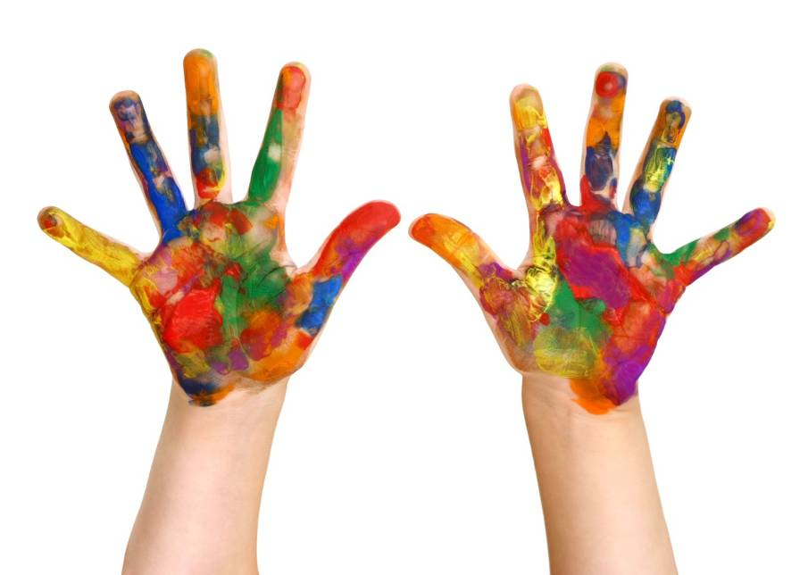
Let`s sing the “Colour Song”!

Slide 34
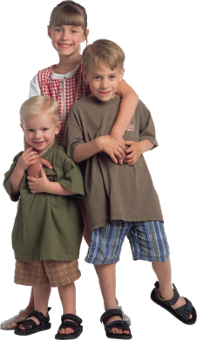
Green
Yellow
Red
Blue

Slide 35





Pink
Brown
Orange
White
Black

Slide 36



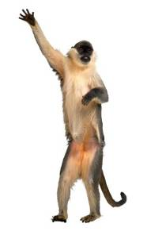











































1
Merry numbers
ONE
2
TWO
3
THREE
4
FOUR
5
FIVE
6
SIX
7
SEVEN
8
EIGHT
9
NINE
10
TEN
A
B
C
D
E
F
G
H
I
J

Slide 37
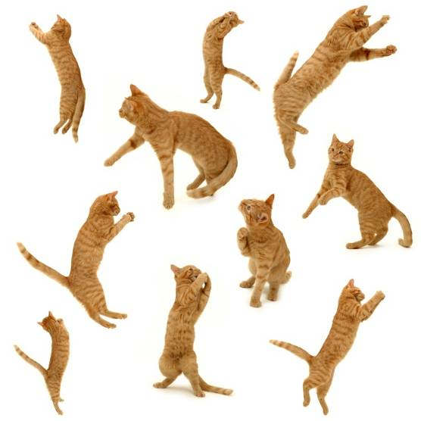
Ноw many cats? Count!

Slide 38

Ноw many flowers?

Slide 39
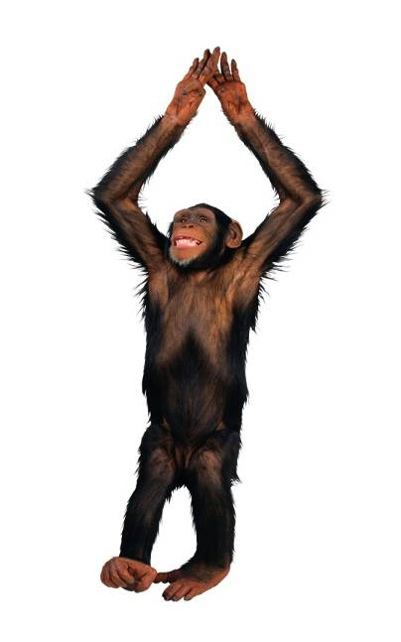
Let`s play! Давайте поиграем!

Slide 40
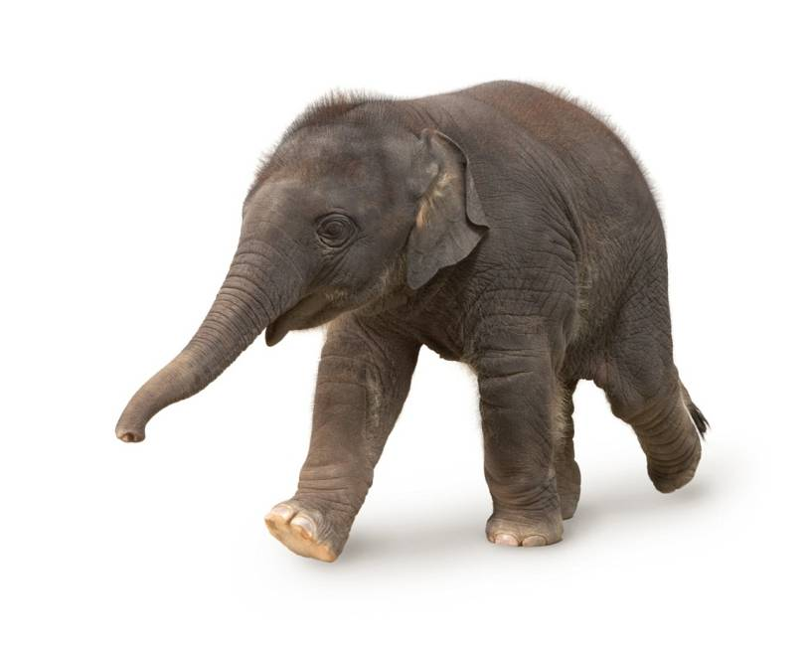
Walk like an elephant!

Slide 41
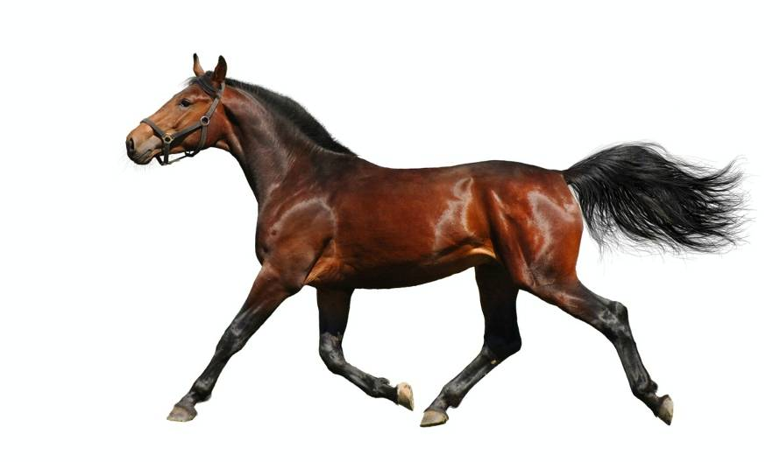
Run like a horse!

Slide 42
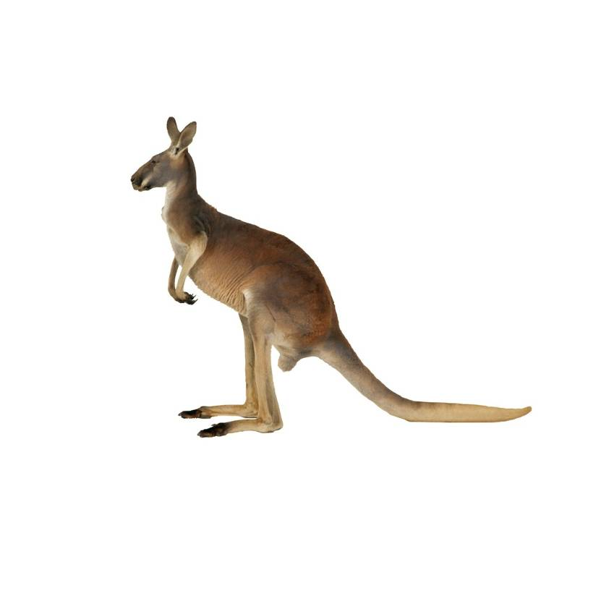
Jump like a kangaroo!

Slide 43
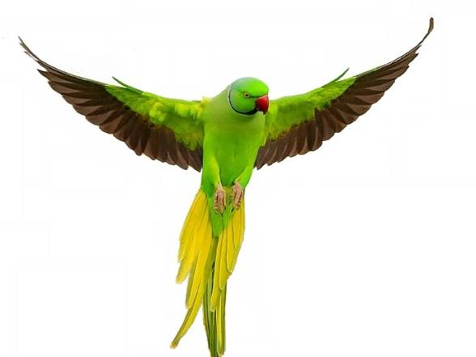
Fly like a parrot!

Slide 44

Swim like a frog!

Slide 45

Climb like a monkey!

Slide 46

Sit like a dog!

Slide 47

Sleep like a bear!

Slide 48


Funny zoo.
Paint this picture.

Slide 49

Funny zoo.

Slide 50

Let`s dance! Давайте тацевать!

Slide 51

Источники
Иллюстрации:
lifeonwhite.com
ajawells.com (Colouring page)
lenagold.ru
www.wallpowper.com
trendland.com
badgerrockfarm.blogspot.ru
russellink.org
www.wallsgeneration.ru
www.jaky.org
www.hdwallpapers.in
www.livemaster.ru/alpa-art
districtcrossfit.com
www.hagen.de
www.childcentredpractice.co.uk
www.truslowphoto.com
createyoursuccess.wordpress.com
Видео и звуки:
havefunteaching.com
www.djckidsmedia.com
www.freesound.org
wooi.ru
Литература:
Биболетова М. З., Книга для учителя к учебнику “Enjoy English” для 2 кл. общеобразовательных учреждений,
Издательство Обнинск: Титул, 2010

