Slide 1
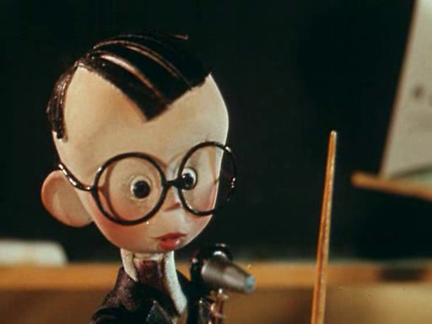
THE ABC PARTY

Slide 2
ТHE ENGLISH ABC
Aa Bb Cc Dd Ee Ff Gg
Hh Ii Jj Kk Ll Mm Nn Oo Pp
Qq R r S s T t U u Vv Ww
Xx Yy Zz
Xx Yy Zz.
This is called the alphabet
Which we never must forget!

Slide 3
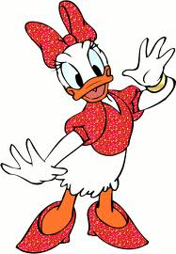
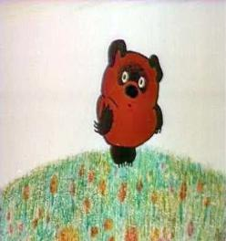
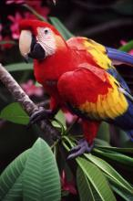
Minnie, Winnie the Pooh and Polynesia

Slide 4

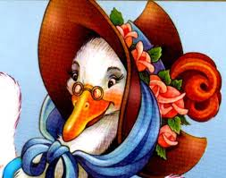
Ariel and Mother Goose

Slide 5
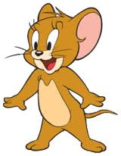
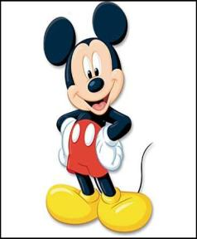
Jerry and Mickey Mouse

Slide 6
НАЙДИТЕ ПАРЫ
A a B b Cc Dd Ee Ff Gg Hh Ii Jj Kk Ll Mm Nn Oo Pp Qq R r S s T t U u Vv Ww Xx Yy Zz
[em] [si:] [bi:] [dʒi:] [ef] [dʒei] [eitʃ] [ei] [pi] [ai] [i:] [di:] [kju:] [a:] [el] [ou] [es] [en] [ti:] [kei] [zed] ['dʌblju:] [eks] [wai] [vi:] [ju:]

Slide 7
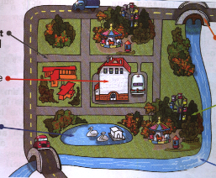
Назовите слова на эти буквы
S, B, H P, R, L
P, R, L
P, R, L
P, R, L

Slide 8

Конкурс «Ромашка»
Заполните ромашку буквами английского алфавита

Slide 9

Конкурс «Цвета»
Назовите цвет и букву, с которой начинается цвет

Slide 10
SING A RAINBOW
Red and orange and yellow and green
Blue and dark blue and purple
I can sing a rainbow
Sing a rainbow
Sing a rainbow, too.

Slide 11

диплом за знание алфавита
DIPLOMA
I KNOW THE ABC

