Slide 1
Oscar Wilde

Slide 2
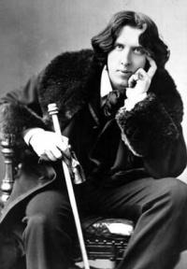
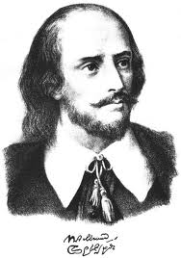
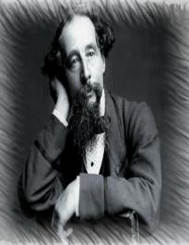
There are 3 photos of English writers. Where is O.Wilde?

Slide 3
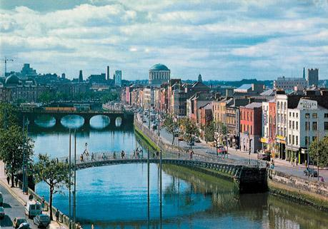
When and where was
Oscar Wilde born?
Dublin. 1854

Slide 4
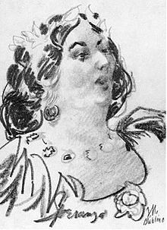
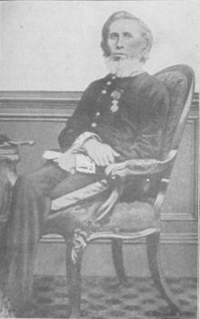
What were his mother and his father?
A poet
A doctor

Slide 5
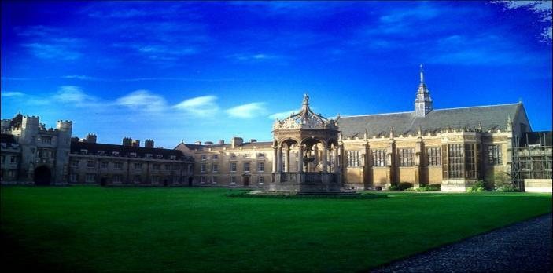
Where did Oscar Wilde study?
Trinity College

Slide 6
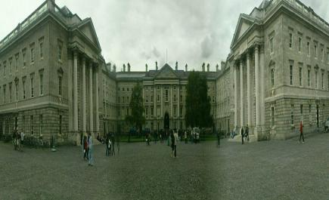
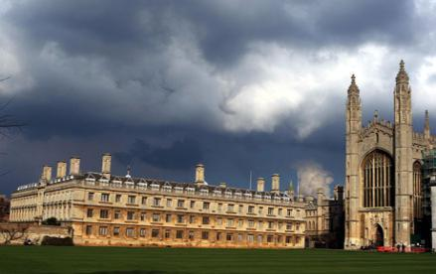
There are 2 photos ( Trinity College in Dublin and Trinity College in Cambridge). Where is Oscar Wilde ‘s college?
Trinity College in Dublin

Slide 7
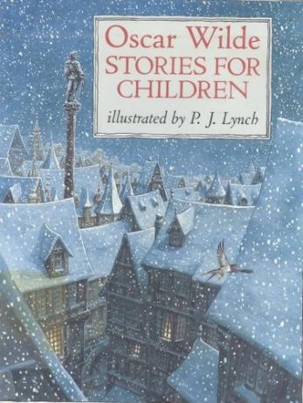
When did Oscar Wilde
write his first book?
1881

Slide 8



Where did he travel ?
U S A
Canada
France

Slide 9
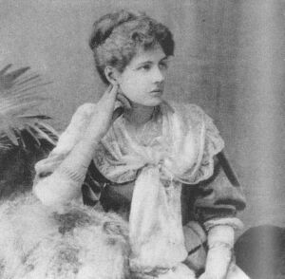
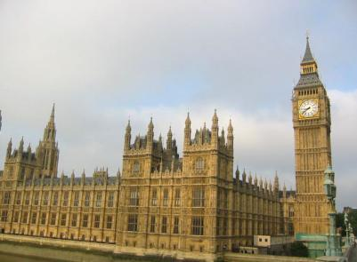
Where did he meet his future wife?
In London

Slide 10
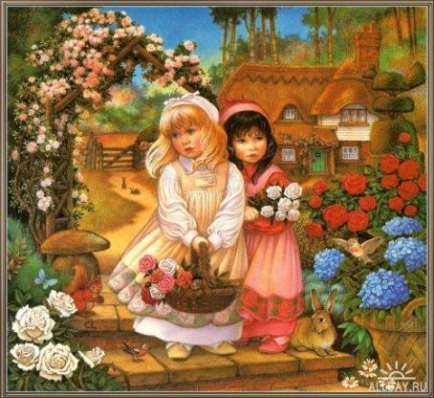
Whom did he write his fairy tales for?
For his children

Slide 11
Finish the names of the books:
1) A woman of …
no importance
2) The happy prince and…
other tales
3)The Importance of …
Being Earnest
4)The Picture of …
Dorian Gray

Slide 12
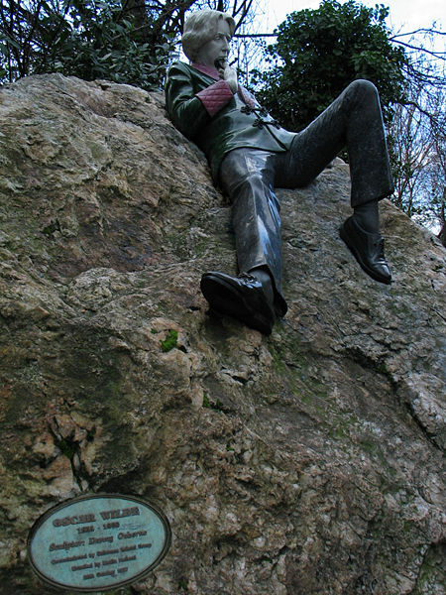
Where is the monument to Oscar Wilde situated?
In Dublin

Slide 13
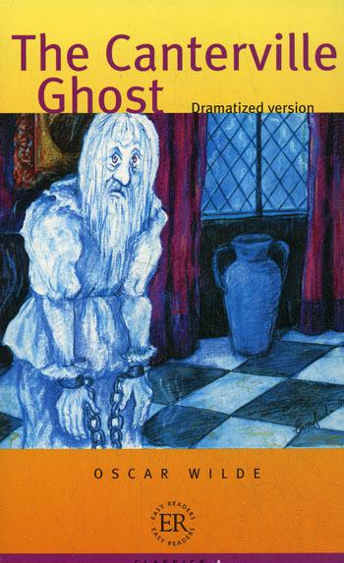
The Canterville Ghost is a detective story , isn’t it ?
A fantastic adventure story

