Slide 1


Slide 2

Magazine Health
Grime for Health
Dirty cosmetics
Humorous stories
Crossword
Read our magazine
and enjoy yourselves!

Slide 3

Russian Bath
Russian bath makes us healthy and gives us a sense of strength. Even in ancient times doctors valued effect of a bath on peoples health.

Slide 4
A Public Opinion Poll
buy sweets instead of healthy food
don’t eat meat and fish
52%
30%
Important!!!
Meat- helps you have a strong and healthy body by providing protein, iron and several B vitamins.
Fats and sugar are fast sources of energy.

Slide 5
A Public Opinion Poll
have bad eyesight
have curvatures of the spine
68%
47%
Important!!!
Fruit and vegetables help them have good eyesight
Morning exercises, sleeping on a hard bed and a right seat at the desk would help them.

Slide 6

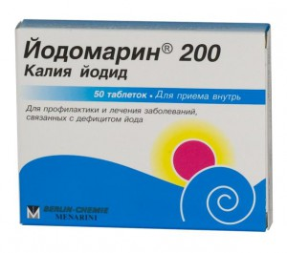
Advertising of Iodomarin
Pills of ‘Oidomarin’ will help you. You’ll get rid of fatigue with the help of it. That drug is a very good remedy for development of mental abilities. You’ll be very energetic during the day.

Slide 7

McDonalds Fast Food
Medical research shows that people eating fast food have high level of cholesterol in their blood. And as for a liver after three months of fast food it can look like a liver of an alcoholic.
We’d better eat “эчпечмак”!

Slide 8


Kolobok
This is a glass of milk. Dairy builds strong teeth and bones by providing calcium. Milk is so useful.

Slide 9

Kolobok
Carrot will give you some power and help you have healthy gums and teeth , good eyesight by providing Vitamins A and C.

Slide 10

Kolobok
Apples contain iron and vitamins. Apple’s are fast sources of energy.

Slide 11

Kolobok
Here is condensed milk. It is like cream candy.

Slide 12

The rules
Get up early and go to bed early to keep fit.

Slide 13

The rules
Take regular exercises to keep fit.

Slide 14
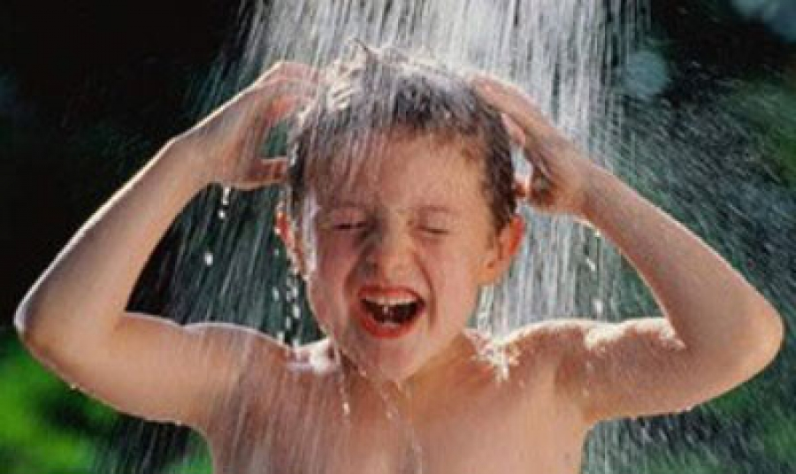
The rules
Take a cool/cold shower to keep fit.

Slide 15

The rules
Eat healthy food to keep fit

Slide 16
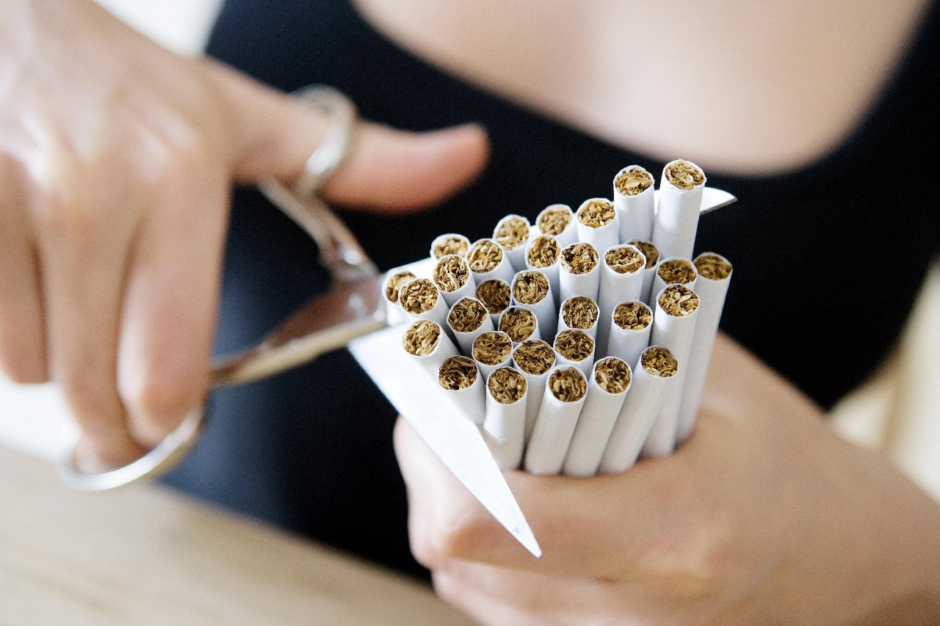
The rules
Never smoke to keep fit.

Slide 17
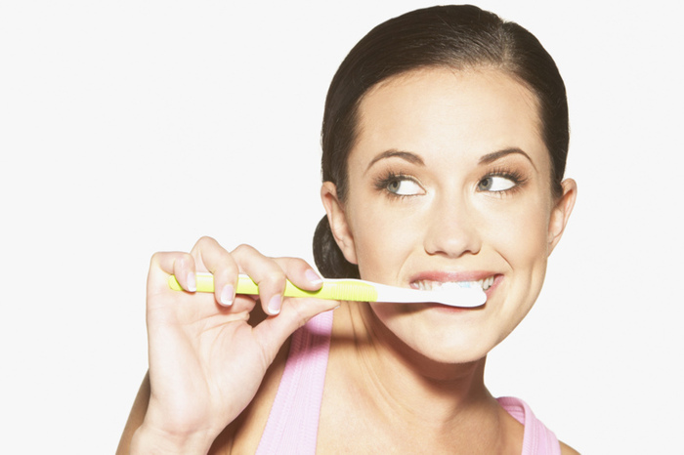
The rules
Clean your teeth every morning and every evening to keep fit

Slide 18
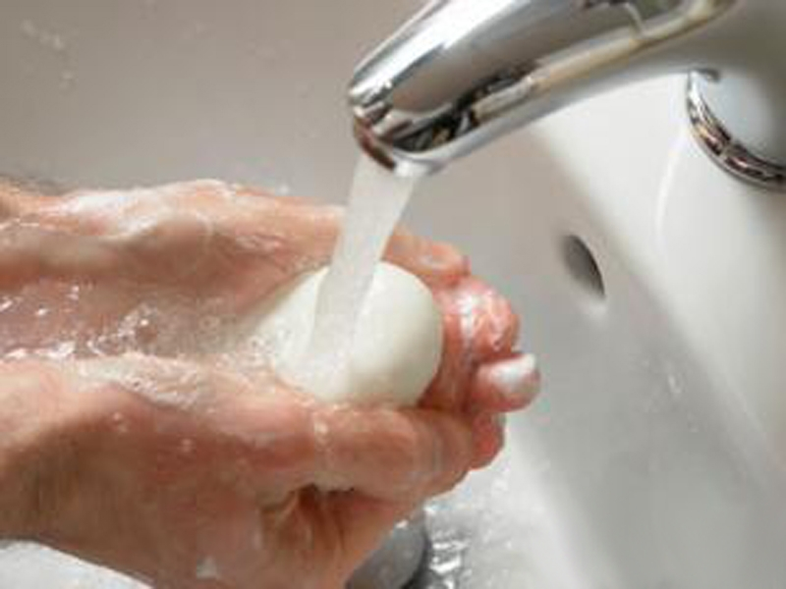
The rules
Wash your hands before you eat to keep fit.

Slide 19
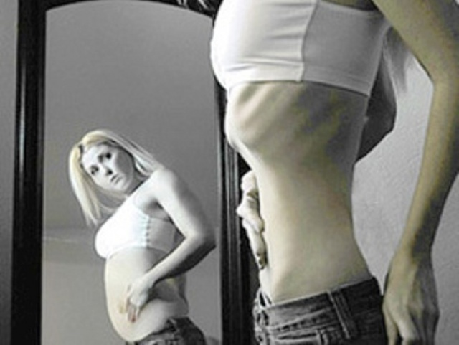
Don’t forget:
Too little food makes you thin.

Slide 20
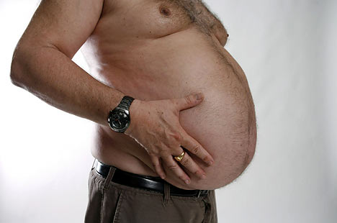
Don’t forget:
Too much food makes you fat.

Slide 21

Don’t forget:
The wrong food makes you ill.

Slide 22

Don’t forget:
The right food keeps you well.

Slide 23
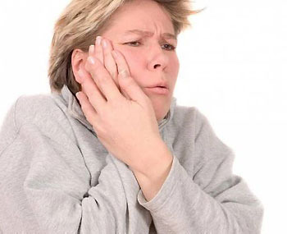
Don’t forget:
Too many sweets are bad for you especially for your teeth.

Slide 24
Thank you for your attention.

