Slide 1
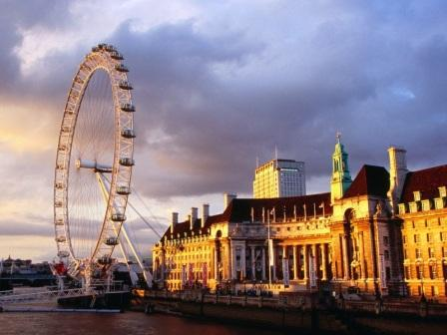
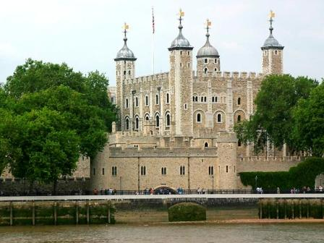
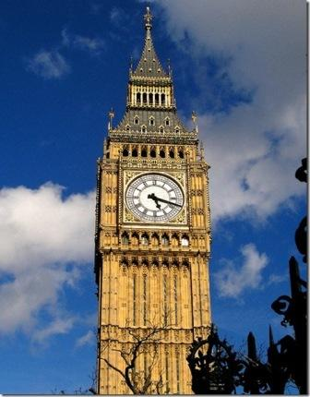
Sights of London
Булатова Н.Л.
МБОУ Калманская СОШ
имени Г.А.Ударцева
с.Калманка, 2012г.
Notes:
Переход к следующему слайду (игровое поле) – по щелчку мыши. Переход к слайду с ресурсами – по управляющей кнопке в левом нижнем углу.

Slide 2
Museums
Parks, Gardens
History
Streets, Squares
Entertainment
10
20
30
40
50
10
20
30
40
50
10
20
30
40
50
10
20
30
40
50
10
20
30
40
50
Notes:
Каждое игровое поле с очками является гиперссылкой на соответствующий вопрос.

Slide 3
Museums - 10
The museum was founded during the First World War in 1917 and intended as a record of the war effort and sacrifice of Britain and her Empire.
Notes:
Переход к слайду с ответом осуществляется по управляющей кнопке (знак вопроса), к слайду с игровым полем – изображение домика.

Slide 4
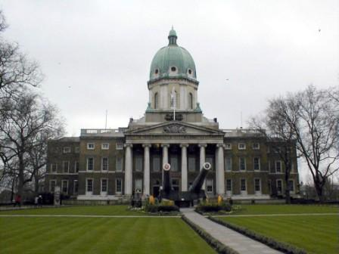
Imperial War Museum
Notes:
Переход к игровому полю осуществляется по управляющей кнопке (домик).

Slide 5
Museums - 20
It contains one of the finest collections of pictures in the world.

Slide 6
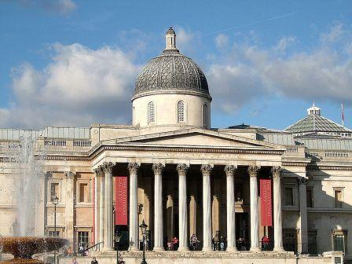
the National Gallery

Slide 7
Museums - 30
It is a museum of human history and culture in London.

Slide 8
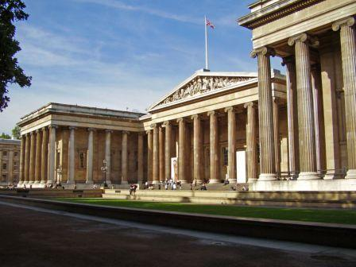
the British Museum

Slide 9
Museums - 40
The museum is particularly famous for its exhibition of dinosaur skeletons.

Slide 10
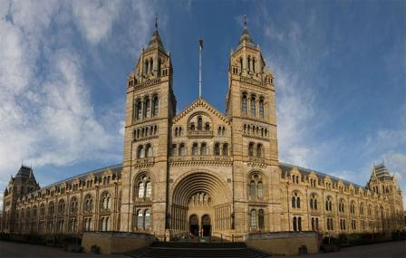
the Natural History Museum

Slide 11
Museums - 50
It is the world's largest museum of decorative arts and design, housing a permanent collection of over 4.5 million objects.

Slide 12
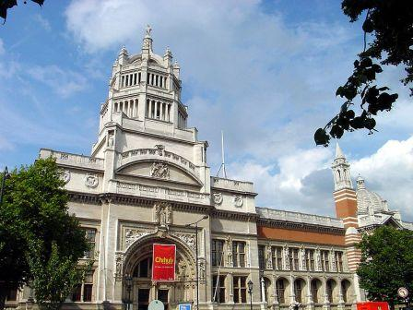
Victoria and Albert Museum

Slide 13
Parks, Gardens - 10
It is the largest park in London.

Slide 14
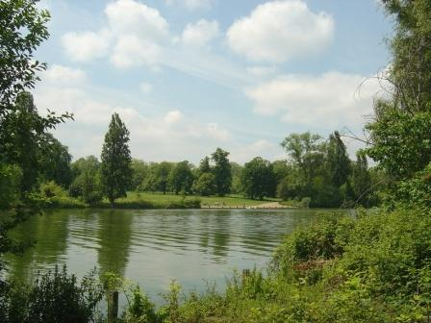
Hyde Park

Slide 15
Kultur - 20
Parks, Gardens - 20
It contains Regent’s College and the London Zoo.

Slide 16
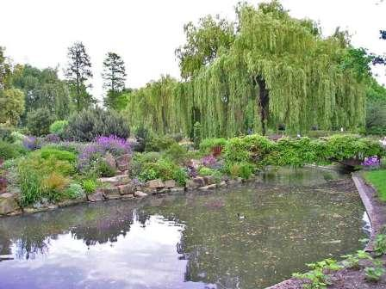
Regent‘s Park

Slide 17
Kultur - 30
Parks, Gardens - 30
Children gather here by the statue of Peter Pen, James Barrie’s well-know storybook character.

Slide 18
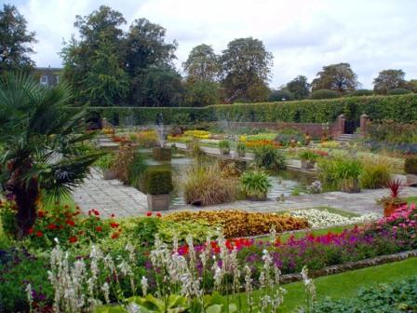
Kensington Gardens

Slide 19
Kultur - 40
Parks, Gardens - 40
It is the oldest of the Royal Parks of London.

Slide 20
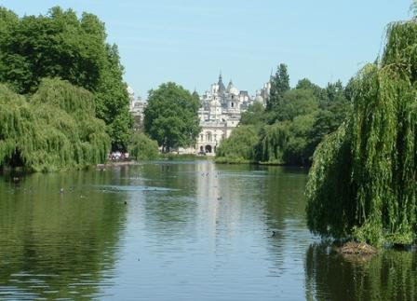
St.James Park

Slide 21
Kultur - 50
Parks, Gardens - 50
The park has no lakes, no buildings and few monuments.

Slide 22
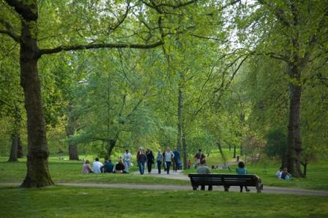
the Green Park

Slide 23
History - 10
It is a monument in Trafalgar Square built to commemorate the death of Admiral Nelson at the Battle of Trafalgar in 1805.

Slide 24
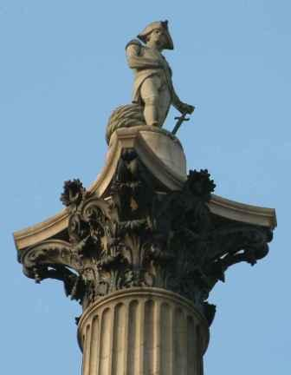
Nelson‘s Column

Slide 25
History - 20
The Clock Tower known the world over.

Slide 26
Big Ben

Slide 27
History - 30
It is a historic castle on the north bank of the River Thames. It was used as a fortress, a royal residence and a prison. Now it is a museum of amour.

Slide 28
the Tower of London

Slide 29
History - 40
It is the greatest of English churches. It was built by the famous English architect Sir Christopher Wren (1632-1723).

Slide 30
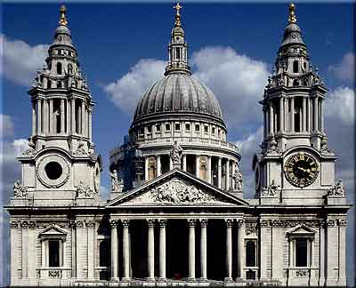
St.Paul‘s Cathedral

Slide 31
History - 50
It is the traditional place of coronation and burial site for English, later British and later still (and currently) monarchs of the Commonwealth Realms.

Slide 32
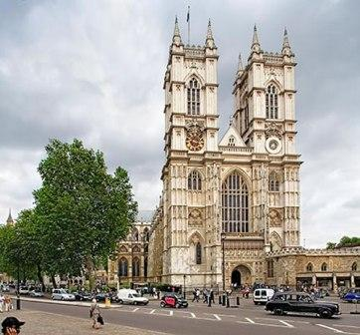
Westminster Abby

Slide 33
Streets, Squares - 10
Colloquially known in the United Kingdom as “Number 10”, it is the official residence and office of the First Lord of the Treasury of the United Kingdom or the Prime Minister.

Slide 34
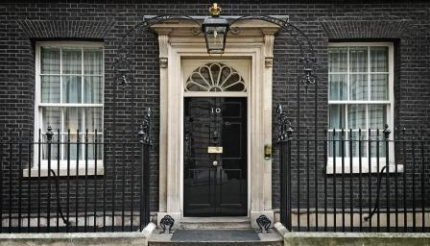
10 Downing Street

Slide 35
Streets, Squares - 20
Its centre is Nelson's Column, which is guarded by four lion statues at its base.

Slide 36
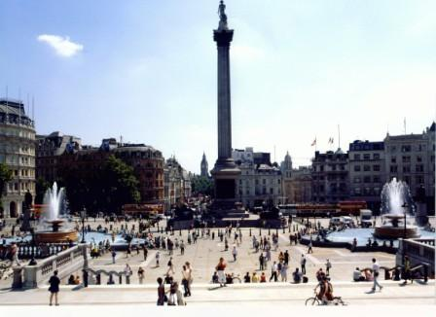
Trafalgar Square

Slide 37
Streets, Squares - 30
There are 548 shops in this Street; it is Europe’s busiest shopping street, as well as the most dense.

Slide 38
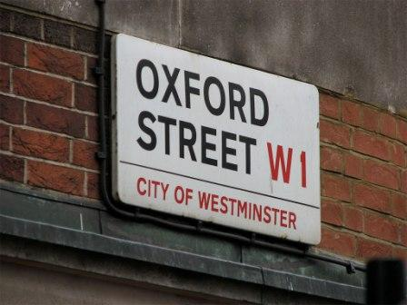
Oxford Street

Slide 39
Streets, Squares - 40
It was the home of the British press until the 1980s. Now it continues to be used as a metonym for the British national press.

Slide 40
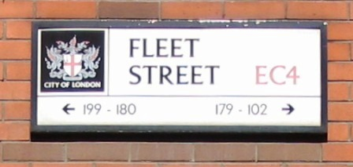
Fleet Street

Slide 41
Streets, Squares - 50
It is a famous road junction and public space of London’s West End in the City of Westminster.

Slide 42
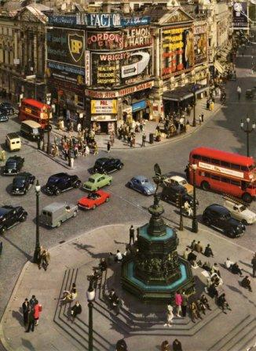
Piccadilly Circus

Slide 43
Entertainment - 10
Today it houses a collection of 755 species of animals, with 15,104 individuals, making it one of the largest collections in the United Kingdom.

Slide 44
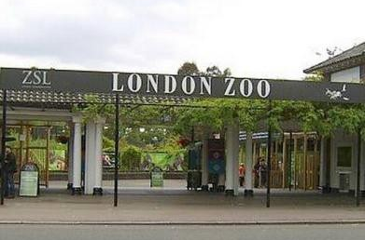
Zoo

Slide 45
Entertainment - 20
It is a 135-metre (443 ft) tall observation wheel situated on the banks of the River Thames in the British capital.

Slide 46
Eye of London

Slide 47
Entertainment - 30
It is famous for recreating famous people, or celebrities, in wax.

Slide 48
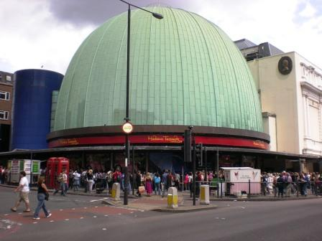
Madame Tussauds

Slide 49
Entertainment - 40
It was built in 1599 by Shakespeare’s playing company.

Slide 50
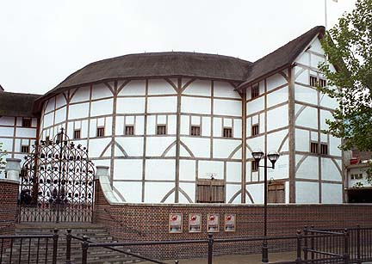
the Globe Theatre

Slide 51
Entertainment - 50
Since its opening by Queen Victoria in 1871, the world’s leading artists from every kind of performance genre have appeared on its stage.

Slide 52
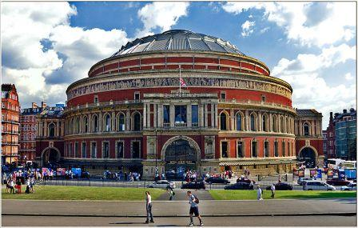
the Royal Albert Hall

Slide 53
Links:
Автор шаблона для презентации – учитель ИЗО КГОУ «Бийский лицей-интернат Алтайского края» Явнова А.Г. (Сеть творческих учителей – http://www.it-n.ru/board.aspx?cat_no=4262&tmpl=Thread&BoardId=132864&ThreadId=126255&page=0
http://travelsplendid.ro/wp-content/uploads/2010/09/Imperial_War_Museum_Front-1024x768.jpg
http://www.europetrotteur.com/images/londres/national_gallery_london.jpg
http://vte.qc.ca/uploads/Images/Londres/800px-British_Museum_from_NE_2.JPG
http://www.origins.org.ua/pictures/800px-Natural_History_Museu.jpg
http://www.wordtravels.com/dbpics/countries/England/Originals/vanda_museum.jpg
http://www.azcentral.com/i/B/C/F/PHP4DB6033551FCB.jpg
http://images.fanpop.com/images/image_uploads/Hyde-Park-london-436385_800_600.jpg
http://nefelikas.files.wordpress.com/2009/01/the-regents-park-london.jpg
http://www.meridian-express.ru/ru/images/public/uk/london_parks/st_james_park/1.jpg
http://img-fotki.yandex.ru/get/3813/galtchonok.8/0_20abe_8001317e_XL

Slide 54
http://fr.academic.ru/pictures/frwiki/78/Nelson_On_His_Column_-_Trafalgar_Square_-_London_-_240404.jpg
http://lifeglobe.net/media/entry/667/1229339673_3_3.jpg
http://www.bsi-spb.ru/upload/towerlondon.jpg
http://anmblog.typepad.com/.a/6a00d8341c565553ef0162fc28a62d970d-500wi
http://static.neatorama.com/images/2007-09/westminster-abbey-1.jpg
http://www.dailybusiness.ro/imgs/uploads/articles/27/4e3d7a1600c05.jpg
http://sfw.org.ua/uploads/posts/2011-09/1316072998_1315722372_38.jpg
http://theducks.org/pictures/gallery/Oxford_Street.jpg
http://www.london-architecture.info/059-FleetStreetSign.jpg
http://www.oldukphotos.com/graphics/England%20Photos/London,%20Piccadilly%20Circus%20-%201960%27s.jpg
http://kazan24.ru/images/news/lon22_original.jpg
http://www.wallpampers.ru/pictures/4875/800_Evening%20Light%20Falls%20on%20the%20London%20Eye%20and%20County%20Hall,%20London,%20England.jpg
http://img-fotki.yandex.ru/get/3908/bill52.117/0_42ff0_60acf889_XL.jpg
http://www.e-scoala.ro/engleza/pic/globe.jpg
http://images.wikia.com/eurostarcontest/pl/images/a/a2/800px-royal_albert_hall.jpg

