Slide 1
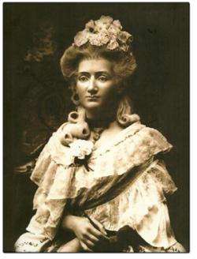
Madame Tussauds Waxworks Museums Around the World
Done by Belikova
Marina Pavlovna
school №9
Madame Marie Tussaud: 1761 - 1850
Stanitsa Baturinskaya
2013

Slide 2
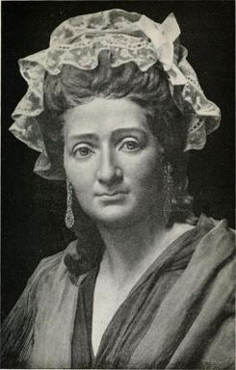
The amazing life and time of Madame Tussaud
Marie Grosholz was born in Strasbourg, France, on December 16, 1761.

Slide 3
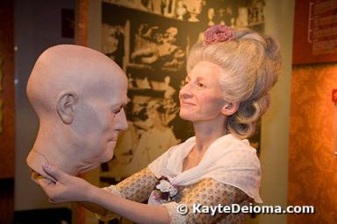
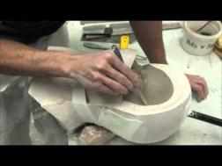
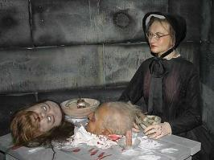
The amazing life and time of Madame Tussaud
Dr Curtius taught Marie, how to model in wax.
Soon, Marie and her mother moved with Doctor Curtius to Paris, where he founded his own wax museum. Dr Curtius acted as a tutor to Marie, schooling her in the techniques of wax portraiture and casting.

Slide 4
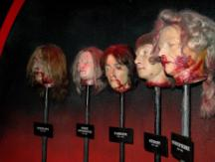
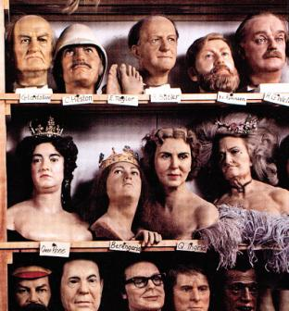
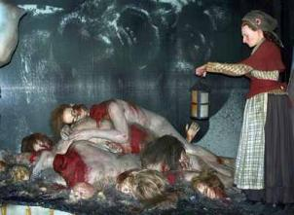
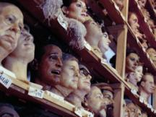
French Revolution
Marie was made to take death masks from the heads of famous people, who had been guillotined, including King Louis XVI and his wife, Marie Antoinette.
She was very daring and patient.
In 1794, Curtius died and and Marie inherited the business.

Slide 5


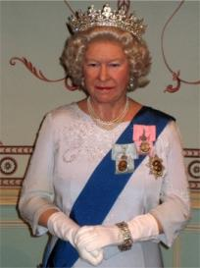
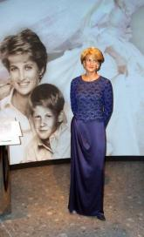
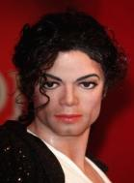

Madame Tussauds Waxworks Museums Around the World
Madam Tussaud’s is the most popular and talked about wax museum in the world. There are wax models of the famous and infamous, both living and dead, from every walk life.
Elvis Presley, the Beatles, the Rolling Stones, Marilyn Monro, Michael Jakson, Alfred Hitchcock, Charlie Chaplin, the British Royal family, Bill Clinton, Jack the Ripper…

Slide 6


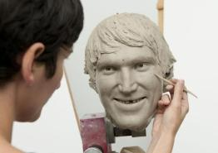
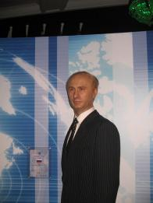
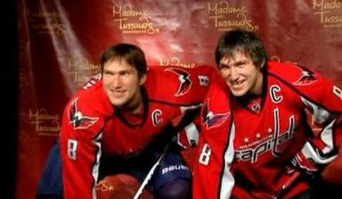
Who is else?
From KGB Lieutenant to President of Russia in just eight years, Putin is arguably the most
powerful man in the world after George Bush. Under his eight year watch, he has restored
order to his country and seen the Russian economy bounce back and has clamped down on
the political ambitions of the oligarchs. With four out of five of his countrymen in favour of his
presidency, he remains the most popular politician in Russia.
The Washington branch of the MadaThe Washington branch of the Madame T
ussaud's wax museum is making a wax statue of the Russian NHL star
Alexander Ovechkin, the museum said in its Twitter blog.
me Tussaud's wax museum is making a wax statue of the Russian
NHL star Alexander Ovechkin, the museum said in its Twitter blog.

Slide 7
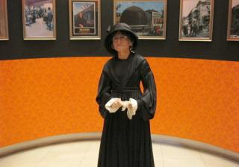
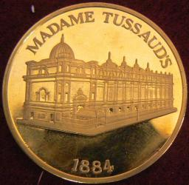
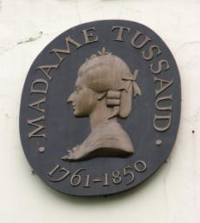
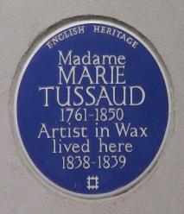
200 years of fame
Today, her official wax works museums, which are all now owned and run by Merlin
Entertainments, and exhibit models of famous film stars, musicians, politicians
and historical figures, are one of the world's
biggest tourist attractions, with exhibition halls
now located in 15 major cities ( 2 presently under

Slide 8
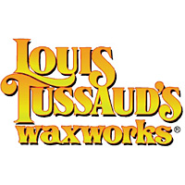
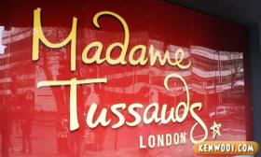
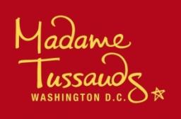
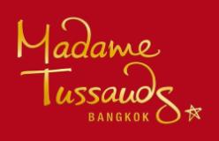
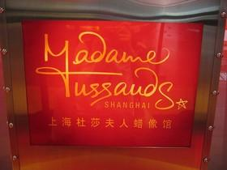
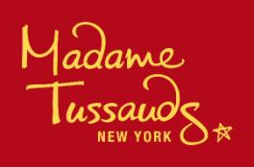
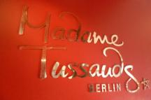
Madame Tussauds Waxworks Museums Around the World.

Slide 9
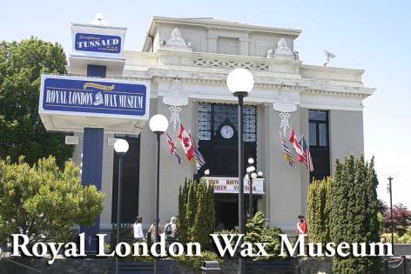
Madame Tussauds Waxworks Museums Around the World
Royal London Wax Museum originally opened 1961 in a street level location
of the Crystal Garden at the corner of Belleville and Douglas.

Slide 10
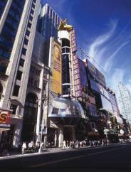
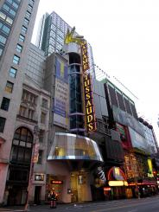
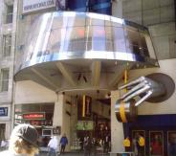
Madame Tussauds Waxworks Museums Around the World
This museum is the heart of Manhattan’s Clinton neighborhood.
Located at 234 West 42nd Street, this museum exemplifies the spirit of New York City.

Slide 11
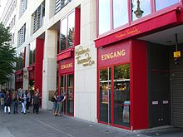
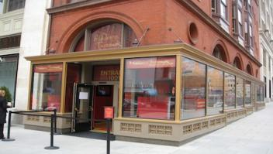
Madame Tussauds Waxworks Museums Around the World
Entry of Madame Tussauds in Berlin

Slide 12
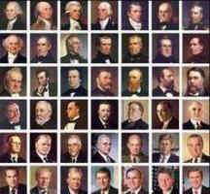
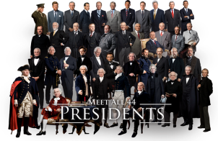
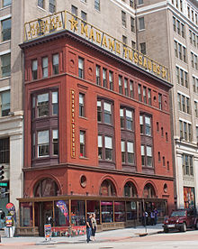
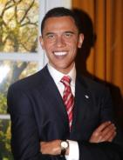
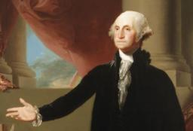
Madame Tussauds Waxworks Museums Around the World
Washington, D.C. location

Slide 13
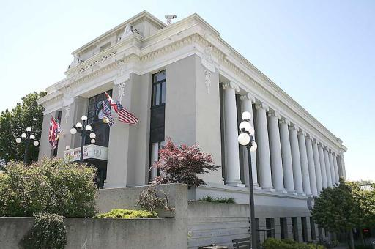
Madame Tussauds Waxworks Museums Around the World
Madame Tussauds Wax Museum in Bangkok

Slide 14
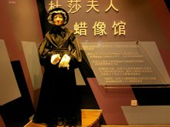
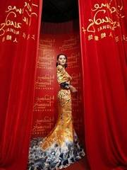
Madame Tussauds Waxworks Museums Around the World
Shanghai won over more than 30 candidate cities around the world and was chosen for one of the few Madame Tussauds wax museums.
The Shanghai

Slide 15
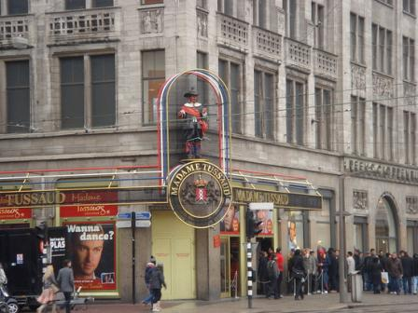
Madame Tussauds Waxworks Museums Around the World
The museum started an overseas expansion in 1970, when it opened a branch location in Amsterdam.

Slide 16
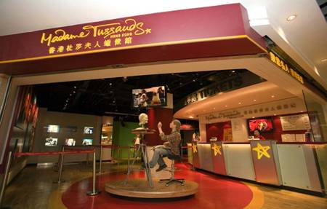
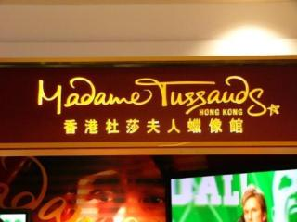
Madame Tussauds Waxworks Museums Around the World
Located near the Peak complex on Hong Kong Island itself, this location is (barely)
the cheapest of all the Madame Tussauds locations, which is a bit surprising since
Hong Kong is generally a bit more expensive than at least two other cities on this list,
namely Shanghai and Bangkok.

Slide 17
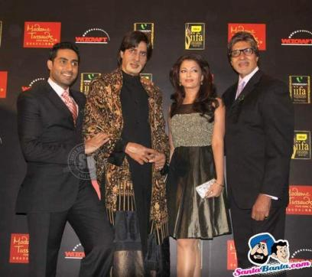
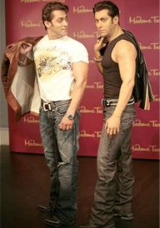
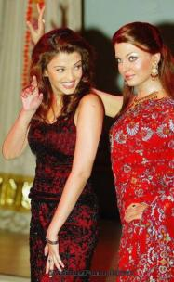
Madame Tussauds Waxworks Museums Around the World
Indian Celebrities Wax Statues at Madamme Tussauds Museum
There are six Indian Celebrities who got the honor to be immortalized by the Madame
Tussaud’s Wax Museum at London and also in Times Square, New York.

Slide 18

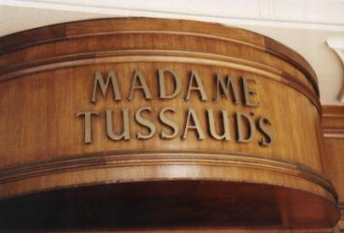



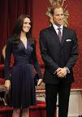

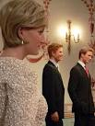

Millions and millions of people have flocked through the doors of Madame Tussauds since they first opened over 200 years ago and it remains just as popular as it ever was.
Conclusion

Slide 19

Conclusion

