Slide 1
Автор: Кошелева Е.В.
преподаватель английского языка ГБОУ СПО Московский авиационный техникум имени
Н.Н. Годовикова

Slide 2
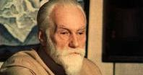
Are these people of different age? Are they of different sex?
Are they of different nationalities? Are they alike?

Slide 3
PEOPLE’S APPEARANCE
(for second-year students)
Notes:
1

Slide 4
What do people usually describe if they want to get a clear portrait of a person?
Appearance
?
?
?
?
?
?
?

Slide 5
What do people usually describe if they want to get a clear portrait of a person?
Appearance
nose
height
age
other details
weight
hair
general appearance

Slide 6
Teenager, overweight, hook, fair, curly, ugly, handsome, snub, slim, a scar, a beard, short, good-looking, long, a fringe, a birth-mark, beautiful, plain, middle-aged, fat, wrinkles, tall, young, freckles, a moustache, pimples, a pony-tail, chestnut, a dark complexion
Hair: …
Nose: …
Weight: …
Age: …
Height: …
Other details: …
General appearance: …

Slide 7
What’s this? Match the left column to the right
1. a dark complexion
2. a scar
3. a birth-mark
4. pimples
5. a pony-tail
6. chestnut
small, hard spots on the skin
a kind of hair style
a natural dark colour of the skin or face
the result of injury or illness
a mark on the body at or from one’s birth
colour of hair (reddish-brown)

Slide 8
The right answers
Hair: fair, curly, long, a fringe, a pony-tail, chestnut
Nose: hook, snub
Weight: overweight, slim, fat
Age: teenager, middle-aged, young
Height: short, tall
Other details: a scar, a beard, a birth-mark, wrinkles, freckles, a moustache, pimples, a dark complexion
General appearance: ugly, handsome, plain, good-looking, beautiful

Slide 9
Order the words from ‘General Appearance’ as shown below

Slide 10
Order the words from ‘General Appearance’
ugly plain good-looking ^{beautiful}
^{handsome}

Slide 11
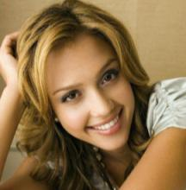
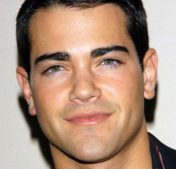
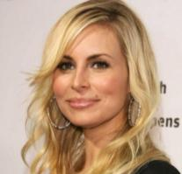
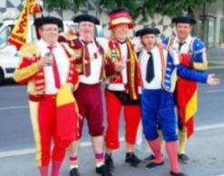
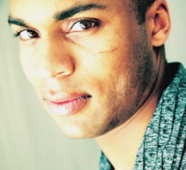
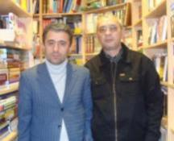
Match the sentences to the pictures
A
B
He has a dark complexion, dark hair and a scar on his face.
He is young with dark short hair and brown eyes. He is rather handsome.
These are middle-aged men. They are plain and unattractive.
She’s young and beautiful with fair hair. Her smile is charming.
She is smiling. She has blond hair and a small birth-mark above her lips.
D
C
E
F

Slide 12
Finish the sentences
This man is only 1 metre 52. He’s quite … .
Every morning she makes her hair into a … .
Models are usually … and … .
Her skin is not light, she has dark … .
After a car crash Michael has a … on his face.
He’s from Africa, he’s got … hair.
Fat people usually have a huge stomach and a … chin.
Teenagers often have … on their faces.
John is proud of his wonderful … , he cares about it a lot: cut and brush it every morning.
She has a small … nose, like a knob.

Slide 13
Finish the sentences
This man is only 1 metre 52. He’s quite short.
Every morning she makes her hair into a pony-tail.
Models are usually slim and tall.
Her skin is not light, she has dark complexion.
After a car crash Michael has a scar on his face.
He’s from Africa, he’s got curly hair.
Fat people usually have a huge stomach and a double chin.
Teenagers often have pimples on their faces.
John is proud of his wonderful moustache, he cares about it a lot: cut and brush it every morning.
She has a small snub nose, like a knob.

Slide 14
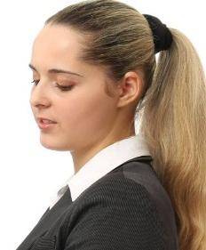
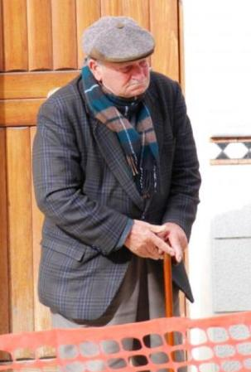
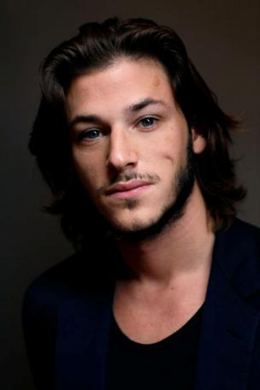
What do they look like?

Slide 15
Read the texts and find out what they are
a novel
an instruction
an article
a police report
a letter
a lecture
an essay

Slide 16
Read the police report. What information is given in the police report?
_______
_______
_______
_______
_______

Slide 17
What information is given in the police report?
a date and time
a place
an incident (what happened)
a person
the appearance of the person

Slide 18
What of appearance is described in the police report?
_______
_______
_______
_______
_______
_______
_______

Slide 19
What of appearance is described in the police report?
sex (female/male)
age
height
build
hair (if it’s possible)
eyes (if it’s possible)
clothes

Slide 20
The final task
Work in groups of four. Each group has a picture of a person. This person is wanted by the police. Help the police to get his or her clear portrait and the details of the incident. You have 15 minutes. If the police get all information, they will find the person.

