Slide 1
“What is your favourite TV show?”
9 - form

Slide 2




















Answer the questions:
How often do you watch TV?
When do you usually watch TV? .
Which of the following possible aims of television do you think is the most important? • to instruct • to inform • to entertain
What TV channels are popular in Russia, in the UK, the USA?
What are your favourite TV channels?

Slide 3
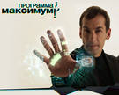






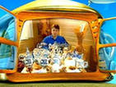




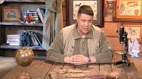



What TV programmes do you like best?
What TV programmes don’t you like?
Do you watch serious programmes?
What are the most popular television programmes in our country?
The minute of glory
What? Where? When?
6 shots
The cleverest
The Maximum
Galileo
House 2
Wonders field
Health
A hundred to one
Travels club
Today
The big races
Russian sensations
The big difference
Projectorperishilton
Dialogues about animals
While everybody’s at home
The special correspondent
Time

Slide 4
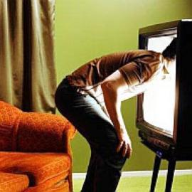
Guess the types of programmes:
1. Programmes that is broadcast several times a day which tells you about all the important events.
2. Film stories for children made by photographing a series of drawings.
3. TV stories about a group of people and their lives which is broadcast regularly for many years.
4. Situation comedies, a popular form of humorous TV having a number of standard characters who appear in different stories every week.
5. Films in which excitement and emotional appeal are the essential elements.
6. Programmes that gives you facts and information about a serious subject such as history, science or social problems.
7. Programmes showing animals, birds etc. in their natural surrounding (environment).
8. Programmes deal with systematic training and instruction of different subjects. With the help of these programmes one can get knowledge.
9. Programmes on which members of the audience are asked questions, in case of correct answer they receive prizes.
documentaries
wild life programmes
thrillers
the news
sitcoms
soap operas
educational programmes
quiz programmes
cartoons

Slide 5
Listening SB Ex.1, p.84
1. To eliminate – исключать
A record dial – контракт на запись диска
2. What TV shows does Jack like?
What TV shows does Jessica like?
3. Which of the following points did Jack and Jessica mention talking about their favourite shows?

Slide 6
Reading text
Use the texts to prove it.
What kind of programme is it?
What channel is it broadcast on?
What time is it broadcast at?
Who is the host of the programme?
What do the participants do in the show?
What are the reasons why each of them likes the show?
What is the most exciting moment of the show?

Slide 7




In your culture
What would you tell your foreign friends about the Russian versions of these shows?
Are they differences? Use the Fact Files.

Slide 8

Who Wants to Be a Millionaire?
Quiz show
Channel 1 (Perviy)
Started in 1998
Hosted by Maxsim Galkin (Dmitriy Dibrov)
Cash prize – 3000000 Russian roubles
In 2006, the Walkway SMS game was added

Slide 9



Slide 10
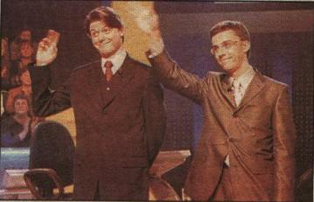
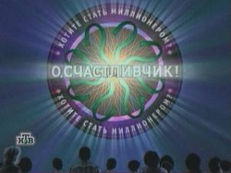
It is a quiz show in which everyone can win 3 millions Russian roubles . The game was started in Russian in 1998 and it was a copy of the British game “Who wants to be a millionaire”. It has been broadcasting on Channel 1 since 2001. The programme is hosted by Maxim Galkin.

Slide 11
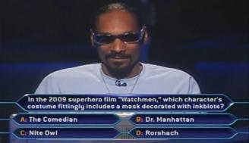
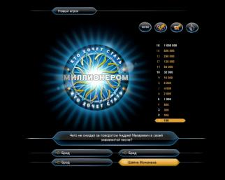
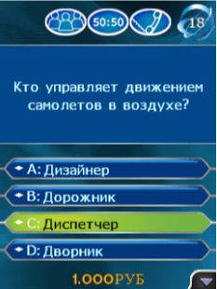
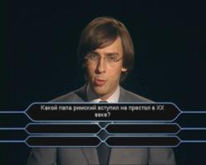
To get this prize participants answer 15 questions from different categories. Each question has 4 variants of answers, only one of which is correct. Each question has its price.

Slide 12
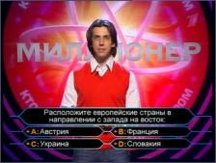
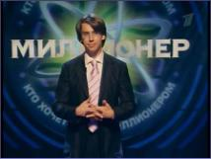
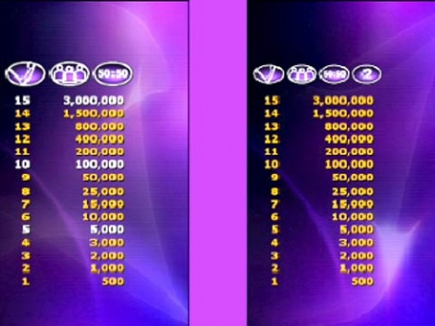

During the game you can use 4 prompts
50:50
your friend`s help =)
TV view`s help
right for a mistake

Slide 13
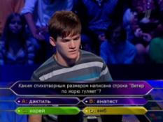

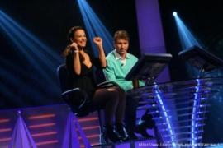
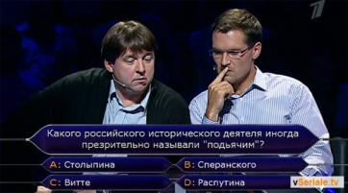
The end of the game is marked by the final signal which means the participant will continue the game in the next programme.

Slide 14
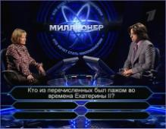
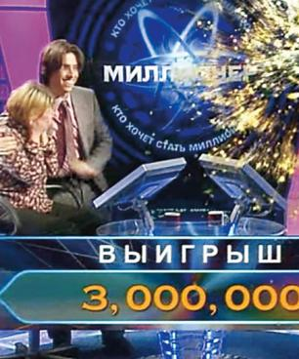

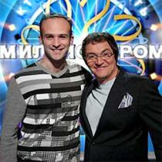
The winners who received the prize were Irina and Yuriy Chudinovsky from Kirov in 2003, Igor Sazeev from St. Petersburg in 2001, Svetlana Yaroslavtseva from Troitsk in 2006 and Timur Budaev from Pyatigorsk in 2010.

Slide 15
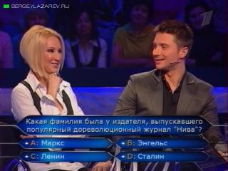
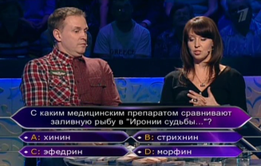
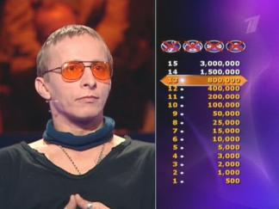
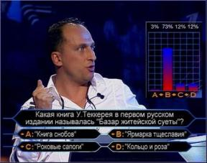
The game “Who wants to be a millionaire” is one of the most popular games in Russia nowadays.

Slide 16
Thank you for your attention!

Slide 17

Star Academy
Channel 1
The international Star Academy format
Started in 2000
Six seasons
Hosted by Yana Churikova
The most successful graduates: girl band “Fabrika”, Boy band “ Korni”, Yulia Savicheva, Dmitriy Koldun
Awards: a record deal or a cash prize

Slide 18
Star Factory
Vozhakin Mihail
9 C class

Slide 19

reference
"Star Factory" is a television musical project to support young artists. Issued on Channel 13 October 2002. The fifth edition of the project was known as the "Star Factory Alla Pugacheva", as it was the singer became artistic director of this season's draft. The last "Star Factory-7" was published under the direction of Konstantin and Valeriy Meladze.
March 12, 2011 launched a new, 8-I "Star Factory", called "Star Academy”. The Return. "At this time, compete with each other not obscure contenders, and established artists brilliant - the graduates 'American Idol' in different years, each of which once began his career in the "Star House".

Slide 20

History
"Star Factory" is a Russian version of the successful television project of TV company "Endemol" «Star Academy". The project idea belongs to the Spanish company "Dzhestmyuzik", a subsidiary company "Endemol". However, the first country that started the project broadcast October 20, 2001, was France. Two days later, after the program in France, a show called "Operation Triumph" aired in Spain.
Since then the show began to spread around the world, including it happened in Russia in 2002. Currently, "Academy of Stars" ranked second in popularity only to show "Big Brother", the project gained recognition in the markets not only in Europe but also India, Arab countries and the United States.

Slide 21
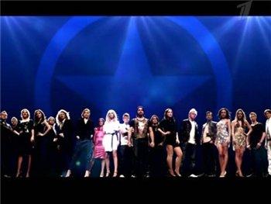
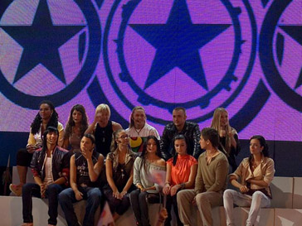
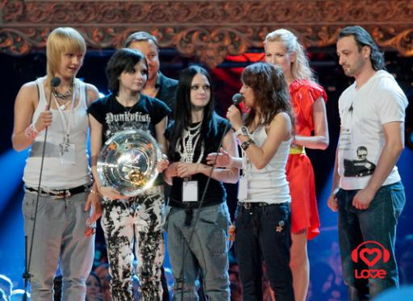
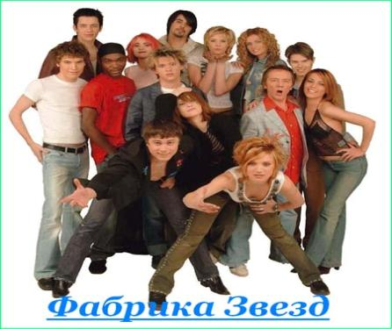

Slide 22
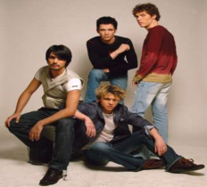
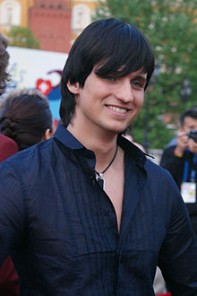
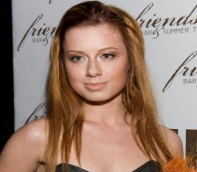
About the graduates
The Roots - Russian music group, the winner of Stars Factory 1. The producer and principal songwriter - Igor Matvienko.
Belarusian singer, winner of Project Channel Stars Factory 6. Represented Belarus at Eurovision 2007.
Julia Savicheva Russian pop singer, a graduate of the TV project Star Factory 2, a participant of Eurovision Song Contest 2004, the actress.

Slide 23
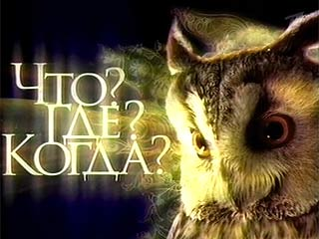
What? Where? When?
An intellectual game show
Original production of the Russian Television
Invented in 1975 by Vladimir Voroshilov
Broadcast live on Channel 1
Hosted by Boris Kryuk
Team of 6 people answer questions within 60 seconds
The best players: Al. Drouz, M. Potashev, B. Burda

Slide 24
What? Where? When?
Platonenko Constantine
9 C class

Slide 25
What? Where? When? is an intelligent TV show, the most common in the Russian-speaking environment. It was created September 4, 1975 TV presenter Vladimir Voroshilov. The game quickly became so popular that in addition to the original television version appeared sports version of the game. The essence of the game is in the opposition team Fanciers (gaming team of six people), a team of TV viewers. Experts have one minute with the help of brainstorming to find an answer to a question sent to the viewer. Typically, players are given questions to answer which you can use the general knowledge and logic. For each correct answer the team receives one point for connoisseurs, in the case of an incorrect response team point is rewarded viewers. The game is played up to six points.

Slide 26

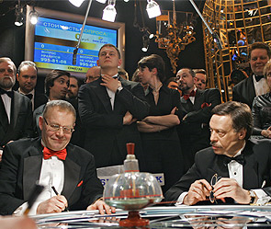
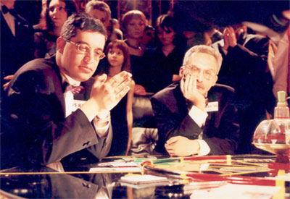
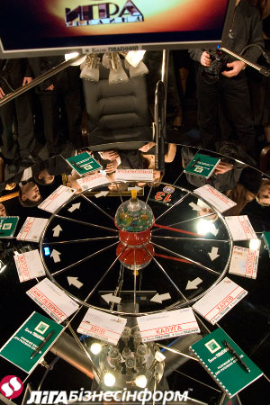

Slide 27
Overview
The game requires a great education and a broad outlook of modern science, the ability to quickly, original and extraordinary thinking. From the brief description of the game may be mistaken to conclude that for the successful conduct of the game to remember lots of facts. In fact, questions that require knowledge of little-known facts, usually not interested in such matters avoided. A good question should contain everything you need to answer, except that knowledge may be required at the secondary level, attention, observation, etc. Often, some superfluous, not very suitable in this context, the word or grammatical subtlety is a strong hint, a role play puns, etc., so that issues are often untranslatable, and assume a knowledge of cultural studies.
Questions relate to different areas of knowledge and have a different style, so the best players will be the most knowledgeable and well-read. In a strong team should be established harmonious cooperation between people with different ways of thinking, if possible - the specialists in different fields. Much depends on the training capacity for mutual understanding within the team.

Slide 28
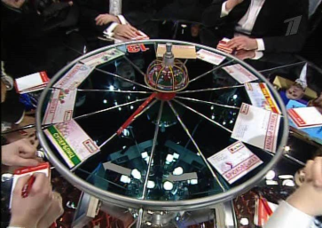
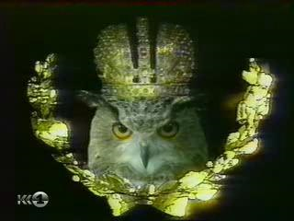
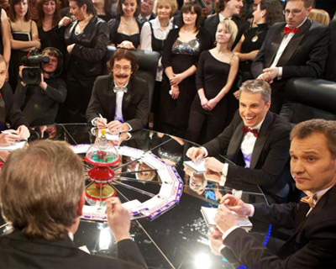
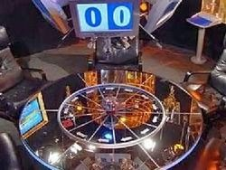

Slide 29
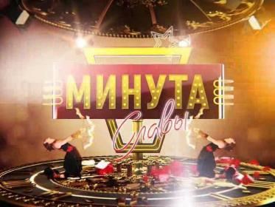
Minute of Fame
A talent TV show
Fist broadcast on Channel 1 in 2007
Country of origin: the US talent show America’s Got Talent; similar show-the British talent contest Opportunity Knocks
Hosted by Garik Martirosyan
Judges: Tatyana Tolstaya & Alexander Maslyakov
Participants: ordinary people with unique talent
No age limit
Voting: by TV viewers through a telephone poll
Cash prize – 1000000 Russian roubles
Final results decided by a public vote
The first prize winner: Maxim Tokayev

Slide 30
Homework
AB ex.3, p. 53, ex.1,p.56 (write in your exercise books)

