Slide 1
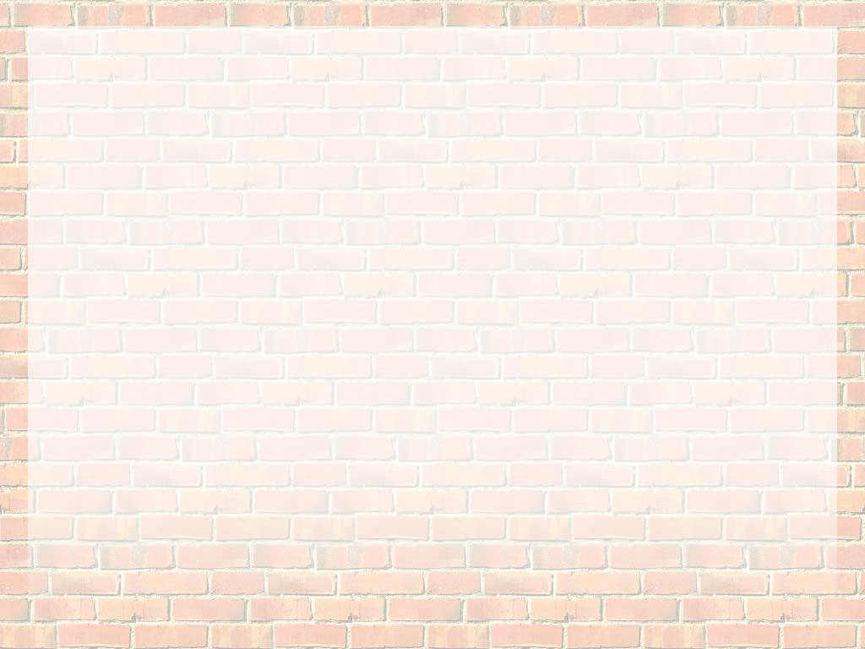
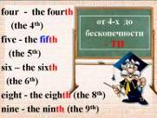
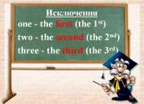
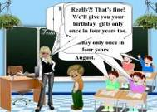
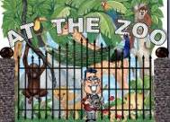
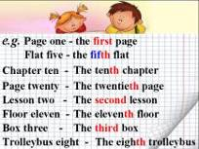
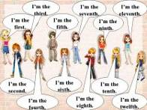
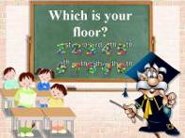
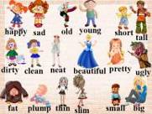
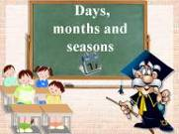

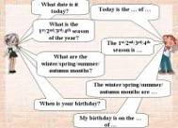

Slide 2
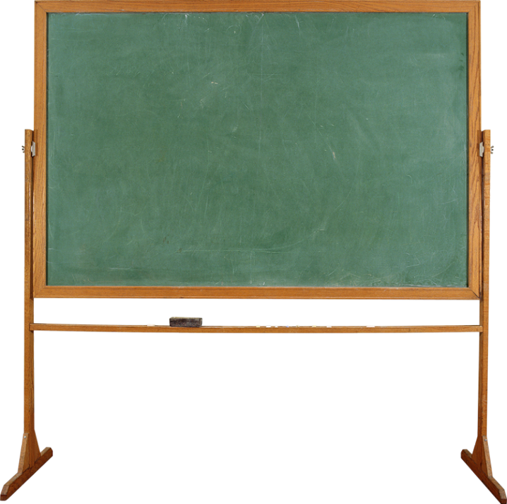
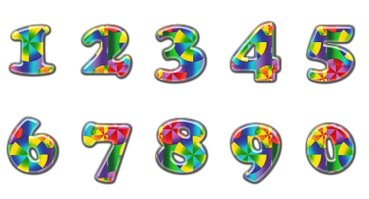

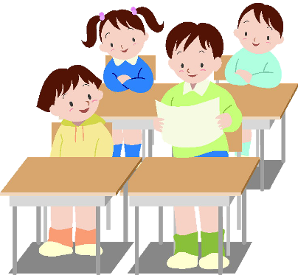
Numerals
Hello everybody! I’m Mr. Help. I’ll be your teacher. Today we are going to talk about …
Числительные

Slide 3
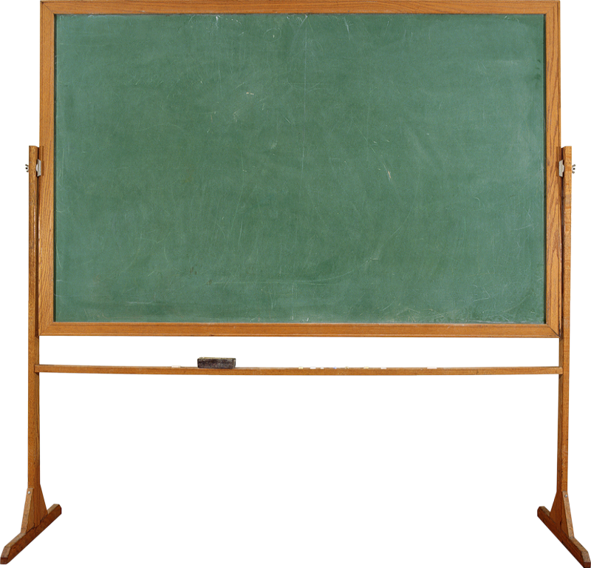

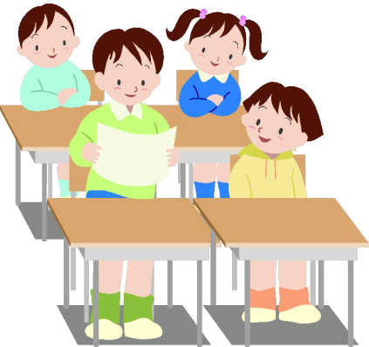
Порядковые числительные
st
nd
rd
th
th
th
th
th
th
th

Slide 4
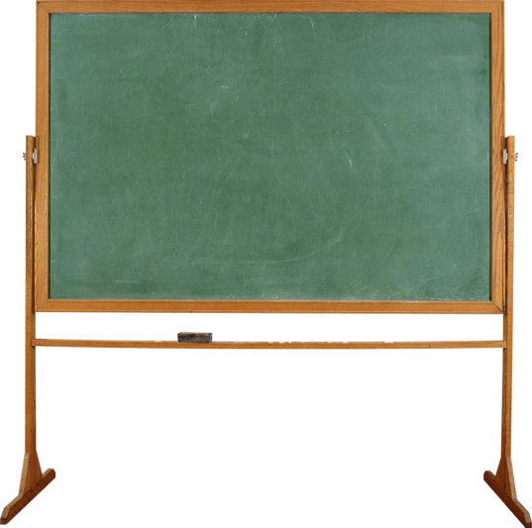

от 4-х до бесконечности - TH
four - the fourth
(the 4th)
five - the fifth
(the 5th)
six – the sixth
(the 6th)
eight - the eighth (the 8th)
nine - the ninth (the 9th)

Slide 5
twelve - the twelfth (the 12th )
thirteen - the thirteenth (the 13th)
fifteen - the fifteenth (the 15th)
twenty - the twentieth (the 20th)
one hundred –
the one hundredth
(the 100th)

Slide 6
Исключения
one - the first (the 1st)
two - the second (the 2nd)
three - the third (the 3rd)

Slide 7
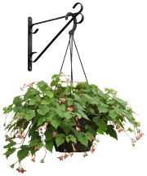
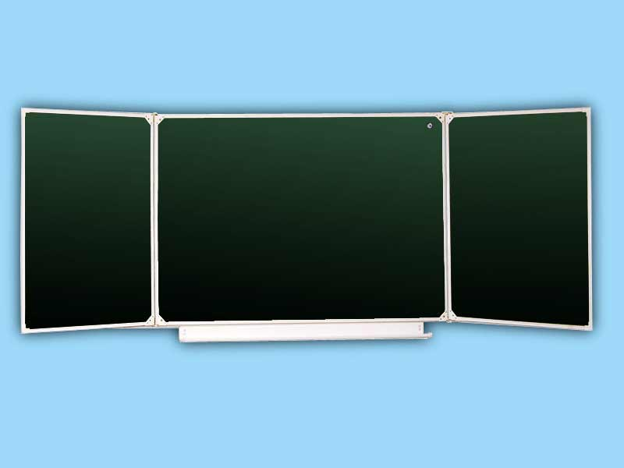
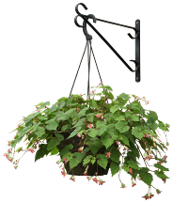

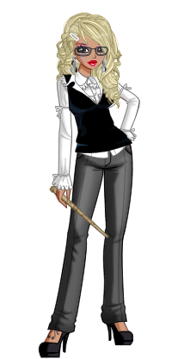
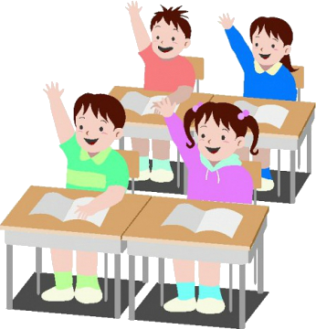
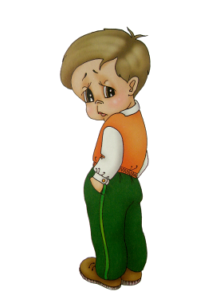
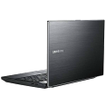
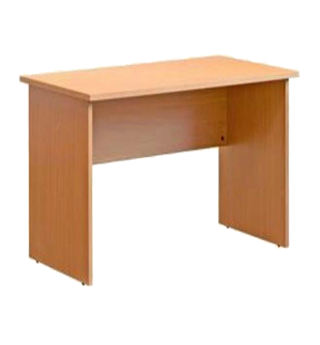
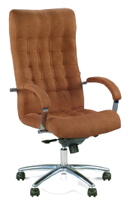



Today is the … of …
Today we are going to talk about your birthdays. When is your birthday, Nick?
And when is your birthday, Liz?
And when is your birthday, Tom?
Really?! That’s fine! We’ll give you your birthday gifts only once in four years too.
And when is your birthday, Ann?
Good morning, children. What date is it today?
What day of the week is it today?
My birthday is on the 15th of November.
I was born on the 29th of February. So I have my birthday only once in four years.
My birthday is on the 21st of April.
Today is the … of …
It is … today.
My birthday is on the 3rd of August.
It is …

Slide 8
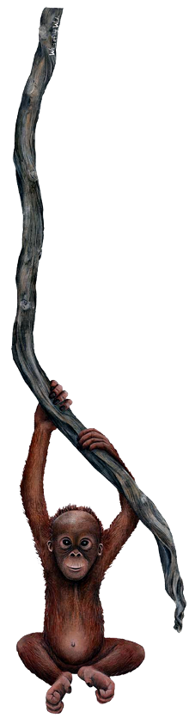
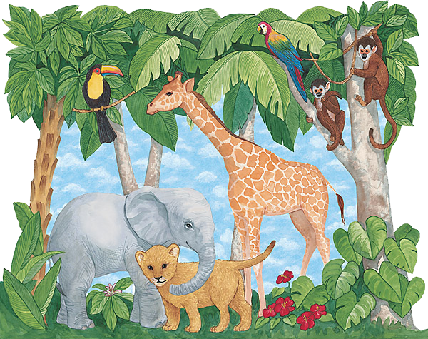
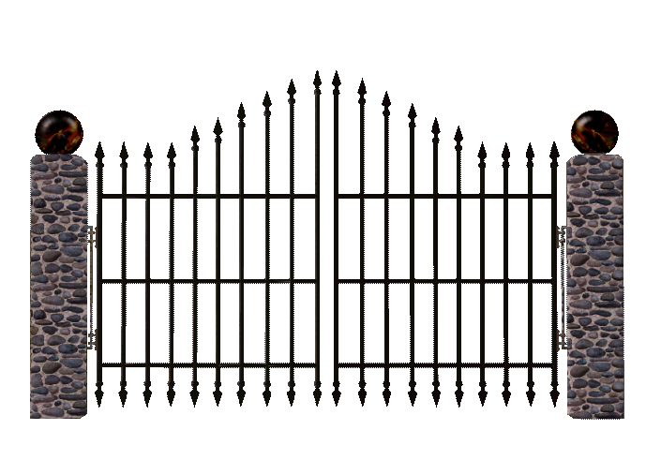
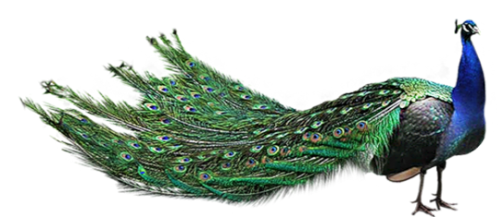

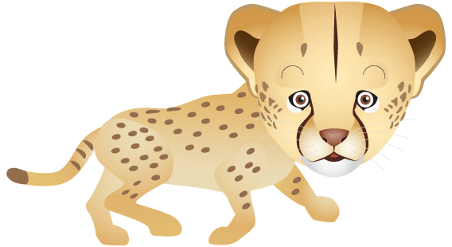
AT THE ZOO

Slide 9
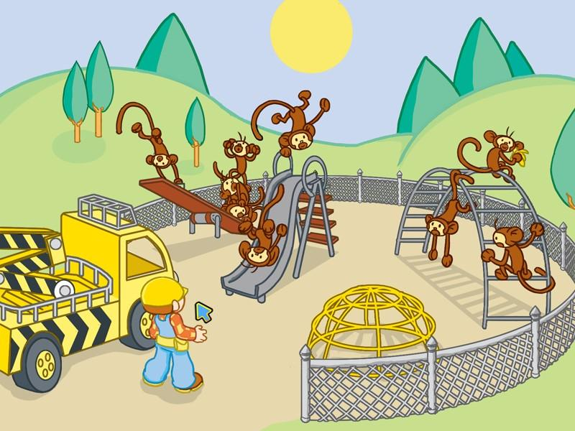



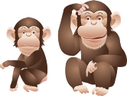
There are twelve monkeys
at the zoo:

Slide 10

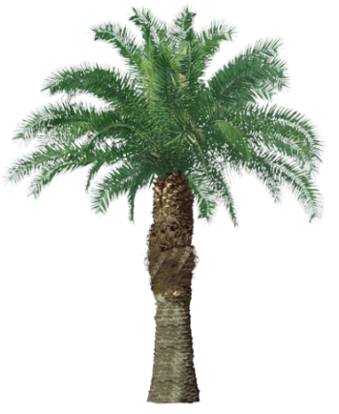
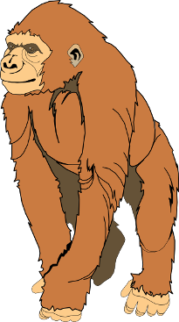
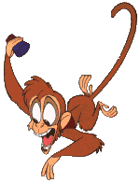
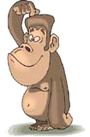
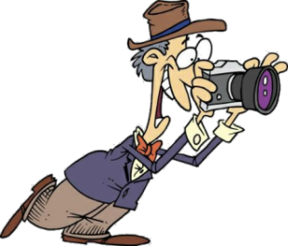
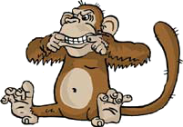

The first monkey is kind,
The second monkey is wild,
The third monkey is small,
The fourth monkey is tall,

Slide 11
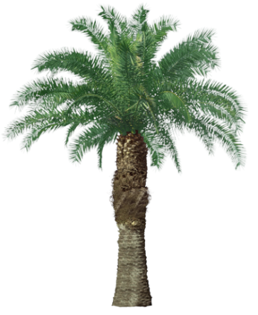
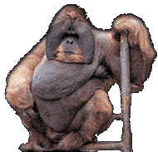
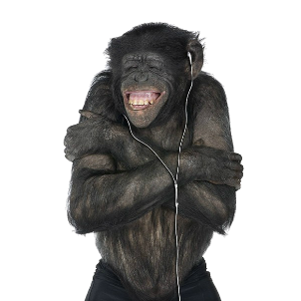
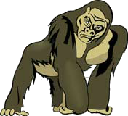
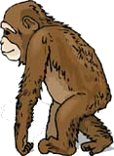
The fifth monkey is fat,
The sixth monkey is sad,
The seventh monkey is cold,
The eighth monkey is old.

Slide 12
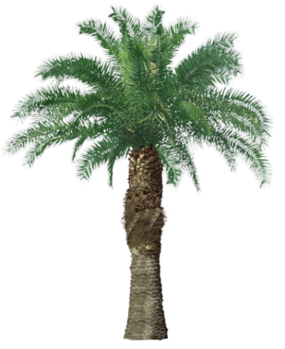
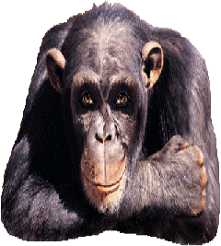
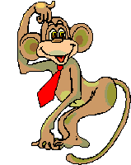
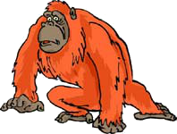

The ninth monkey is nice,
The tenth monkey is wise,
The eleventh monkey is strong,
The twelfth monkey is wrong.

Slide 13



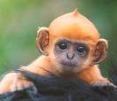











There are twelve monkeys at the zoo:
The first monkey is kind,
The second monkey is wild,
The third monkey is small,
The fourth monkey is tall,
The fifth monkey is fat,
The sixth monkey is sad,
The seventh monkey is cold,
The eighth monkey is old,
The ninth monkey is nice,
The tenth monkey is wise,
The eleventh monkey is strong,
The twelfth monkey is wrong.

Slide 14
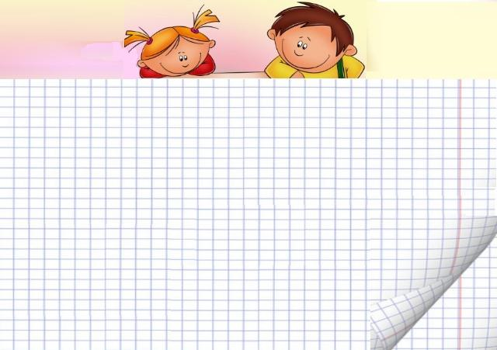
e.g. Page one - the first page
Flat five - the fifth flat
Chapter ten -
The tenth chapter
Page twenty -
The twentieth page
Lesson two -
The second lesson
Floor eleven -
The eleventh floor
Box three -
The third box
Trolleybus eight -
The eighth trolleybus

Slide 15












I’m the third.
I’m the
seventh.
I’m the eleventh.
I’m the first.
I’m the fifth.
I’m the ninth.
I’m the second.
I’m the sixth.
I’m the tenth.
I’m the eighth.
I’m the twelfth.
I’m the fourth.

Slide 16
Which is your floor?
st
nd
rd
th
th
th
th
th
th
th

Slide 17






the ground floor
the seventh floor
There are eight floors in this building.
the sixth floor
the fifth floor
the fourth floor
the third floor
the second floor
the first floor

Slide 18































37
And our address is 37 Green Street.
Our address is 35 Green Street.
What is your address?
35
Green Street

Slide 19


37
And how many floors are there in your houses?
And which is your
floor?
10 floors
19 floors
35

Slide 20














Hello. I am Kitty. I live on the ground floor and I can’t see much from our window.
Hello. These are my children. They are twins Tom and Joy. Our address is 37 Green Street. We live on the twelfth floor.
Hello. We are Ann and Bill. And this is our house. We live on the fifth floor.
Hello. I am Nick. And this house is mine. I live on the eighteenth floor. I can see much more from my balcony.
Hello. I am Ben. This is my house too. But I live on the ninth floor. I can see a lot from my balcony.
37
And which is your floor?
35

Slide 21


















happy
old
young
sad
short
tall
dirty
neat
pretty
clean
beautiful
ugly
fat
plump
thin
slim
small
big

Slide 22
happy
big
old
clean, neat
short
young
beautiful, pretty
fat, plump
dirty
tall
thin, slim
sad
small
ugly

Slide 23


The 1st girl is short.
The 2nd girl is tall.
The 1st girl is plump.
The 2nd girl is slim.
The 1st girl is small.
The 2nd girl is big.
The 1st girl is young.
The 2nd girl is young too.
The 1st girl is happy.
The 2nd girl is happy too.

Slide 24










The
1st
2nd
3rd
4th
5th
6th
child
girl
boy
man
woman
is ….

Slide 25

Days,
months and seasons

Slide 26


60 minutes in an hour.
24 hours in a day.
7 days in a week.
There are
4 weeks in a month.
12 months in a year.
365 or 366 days in a year.

Slide 27




Let’s play a bit. I’ll be a teacher and you’ll be a student.
Bow-wow!

Slide 28




You are right. There are 60 seconds in a minute. And how many minutes are there in an hour?
You are right again. There are 24 hours in a day. And how many days are there in a week?
Right you are. There are 60 minutes in an hour. And how many hours are there in a day?
Right you are. There are 12 months in a year. And how many days are there in a year?
How clever you are! There are 7 days in a week. And how many weeks are there in a month?
You are right again. There are 4 weeks in a month. And how many months are there in a year?
You are right. There are 365 or 366 days in a year.
You are such a clever dog! Help yourself!
Answer my questions. How many seconds are there in a minute?
Bow-wow!
Bow-wow! Bow-wow!
Bow-wow!
Bow-wow!
Bow-wow! Bow-wow!
Bow-wow!
Bow-wow! Bow-wow!
Bow-wow!
Bow-wow! Bow-wow!
Bow-wow!
Bow-wow! Bow-wow!
Bow-wow!
Bow-wow! Bow-wow!
Bow-wow!

Slide 29


How many minutes are there in an hour?
There are … minutes in an hour. And how many hours are there in a day?
There are … hours in a day. And how many days are there in a week?
There are … days in a week. And how many weeks are there in a month?
There are … weeks in a month. And how many months are there in a year?
There are … months in a year.

Slide 30
Sunday Thursday
Monday Friday
Tuesday Saturday
Wednesday

Slide 31

auSydn
ynMado
eysdauT
eWdsadeny
ardTsyuh
iFaydr
rataSdyu
Sunday
Monday
Tuesday
Wednesday
Thursday
Friday
Saturday

Slide 32



Sunday
Monday
Tuesday
Wednesday
Thursday
Friday
Saturday
1st
2nd
3rd
the 4th
5th
6th
7th
day of the
week.
is

Slide 33

winter
spring
summer
autumn

Slide 34


Winter
Spring
Summer
Autumn
1st
2nd
3rd
4th
season of the year.
is
the

Slide 35
July
August
September
October
November
December
January
February
March
April
May
June

Slide 36


January
February
March
April
May
June
July
August
September
October
November
December
1st
2nd
3rd
4th
5th
the 6th
7th
8th
9th
10th
11th
12th
is
month of the year.

Slide 37





December
January
February
1st
the 2nd
3rd
is
winter month.
March
April
May
1st
the 2nd
3rd
is
spring month.
June
July
August
1st
the 2nd
3rd
is
summer month.
September
October
November
1st
the 2nd
3rd
is
autumn month.

Slide 38
What date is it today?
Today is the … of …
What is the 1st/2nd/3rd/4th season of the year?
The 1st/2nd/3rd/4th season is …
What are the winter/spring/summer/autumn months?
The winter/spring/summer/
autumn months are …
When is your birthday?
My birthday is on the … of …

Slide 39


Thank you for the lesson! Good-bye!

