Slide 1

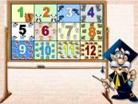

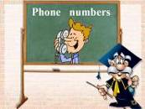
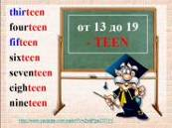
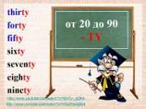
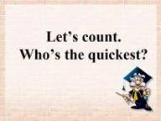
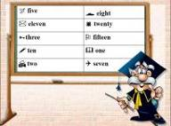
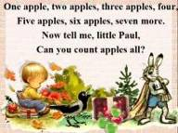

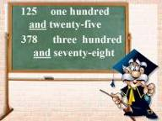

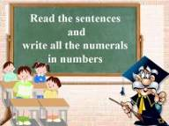



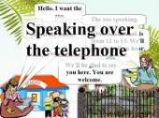

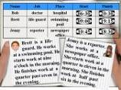

Slide 2
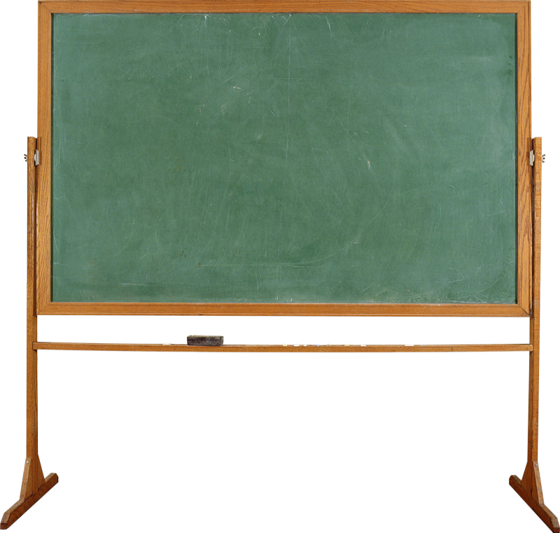
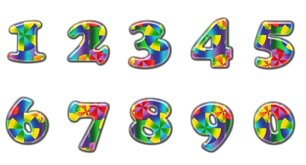

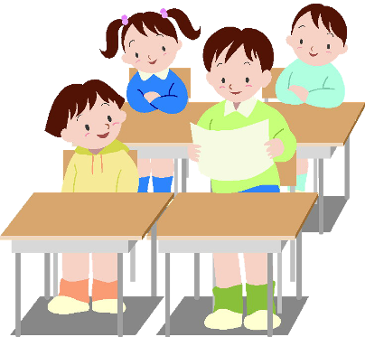
Numerals
Hello everybody! I’m Mr. Help. I’ll be your teacher. Today we are going to talk about …
Числительные

Slide 3

Количественные числительные

Slide 4















1
2
3
4
5
6
7
8
9
10
11
12

Slide 5




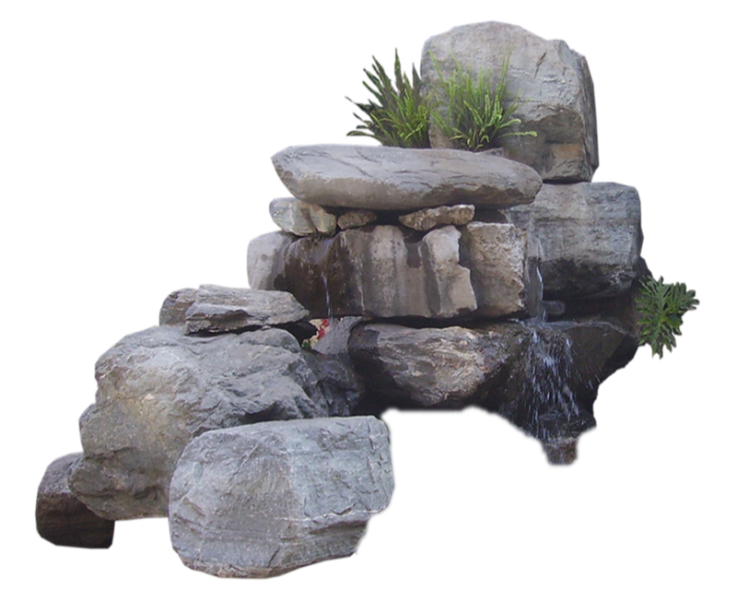


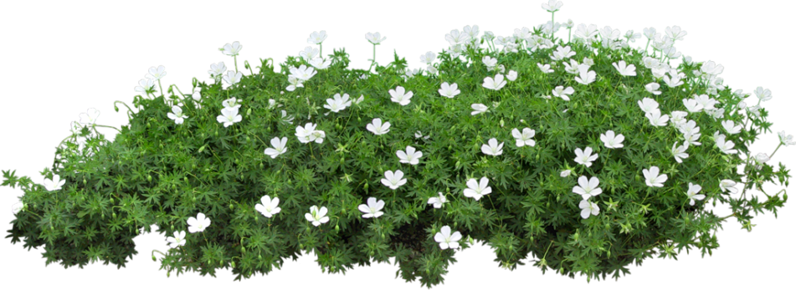
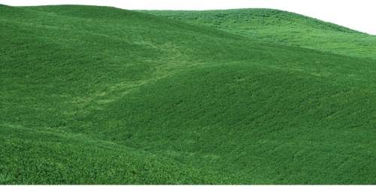
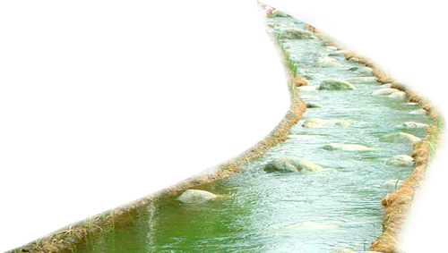

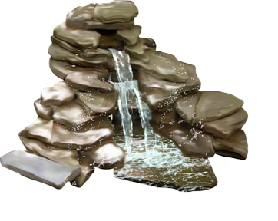


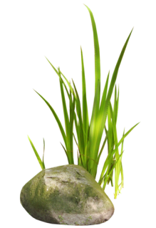



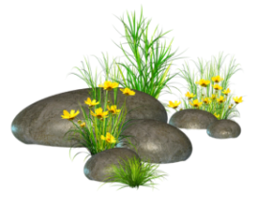
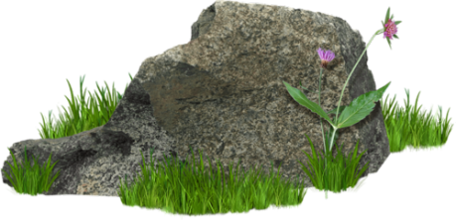

12
11
9
10
8
7
6
5
4
3
2
1

Slide 6



one
12
twelve
eleven
four
seven
eight
11
ten
nine
two
five
six
three
10
9
8
7
6
5
4
3
2
1

Slide 7
1
2
3
4
one
two
three
four
5
6
7
8
five
six
seven
eight
9
10
11
12
nine
ten
eleven
twelve

Slide 8
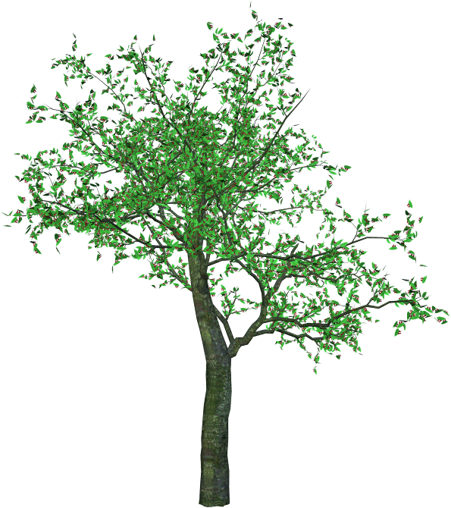
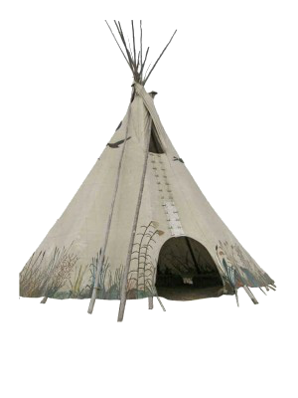
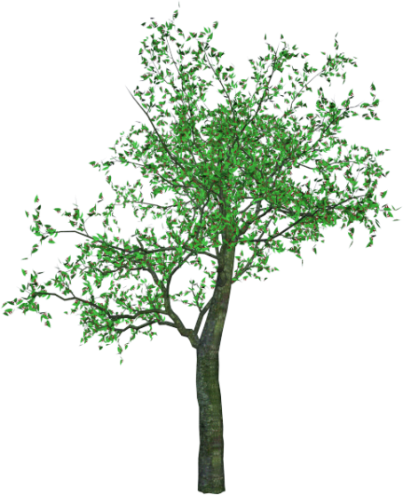
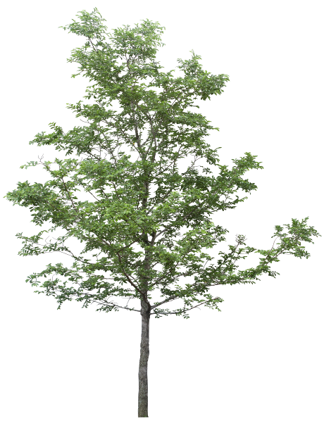

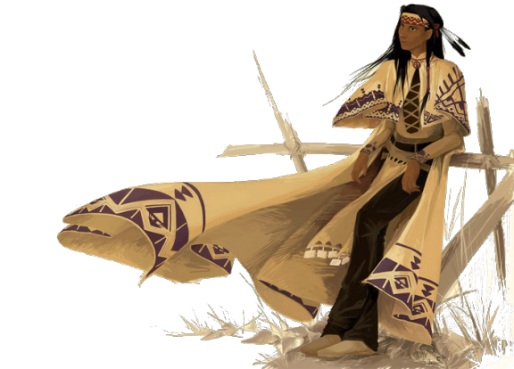

Ten Little
Indian Boys

Slide 9
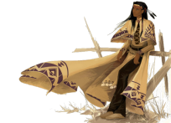

One little, two little, three little Indians Four little, five little, six little Indians Seven little, eight little, nine little Indians Ten little Indian boys.
Ten little, nine little, eight little Indians Seven little, six little, five little Indians Four little, three little, two little Indians One little Indian boy.
http://www.youtube.com/watch?v=urdg94V7NLE
http://www.youtube.com/watch?v=k0SkWCCWrF8

Slide 10
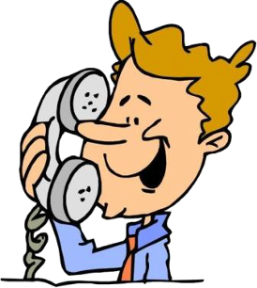
Phone numbers

Slide 11
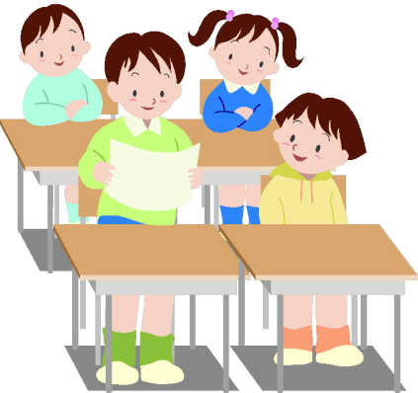
350 2871
44 0378 543 0157
687 054 265 six-eight-seven-oh-five-four- two-six-five
double four-oh-three-
seven-eight-five-four-
three-oh-one-five-seven
three-five-oh-two-eight-seven-one

Slide 12
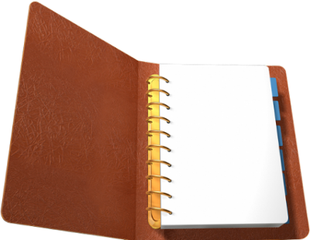

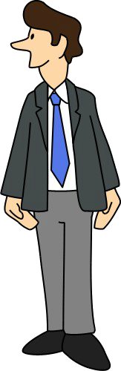

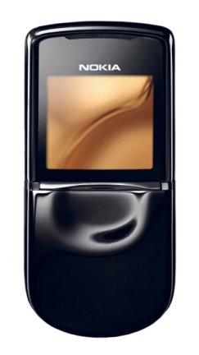

James
Hunter
945 07 82
English classes
321 4510 0789
Mrs Tailor
Last call
623 485 53
CALL NOW
1 888 962 962
for more
information

Slide 13
My mobile number is … It’s …
My home number is … It’s …
My phone number is … It’s …

Slide 14

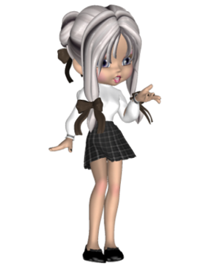
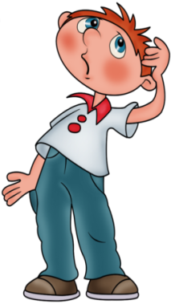
Hello. What’s your home number?
Hello. My home number is …
OK. And what’s your mobile number?
My mobile number is …
OK. And what’s your mum’s/ dad’s
mobile/work number?
My mum’s/dad’s mobile/work number is …

Slide 15
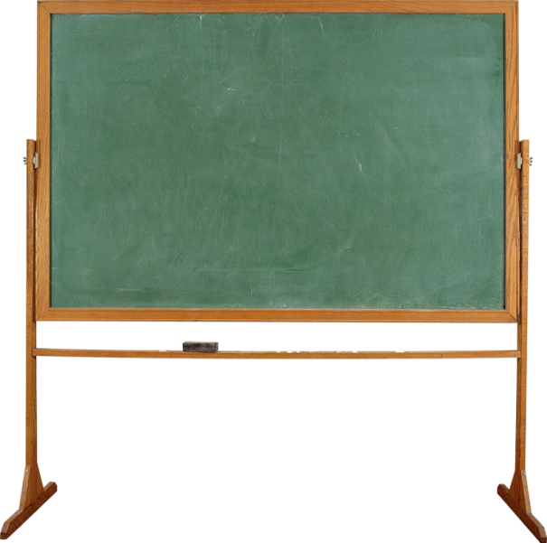
от 13 до 19 - TEEN
thirteen
fourteen
fifteen
sixteen
seventeen
eighteen
nineteen
http://www.youtube.com/watch?v=Zw6Fps2O7XY

Slide 16
от 20 до 90 - TY
thirty
forty
fifty
sixty
seventy
eighty
ninety
http://www.youtube.com/watch?v=SN7y-_q28l4
http://www.youtube.com/watch?v=K0pZHpvg0y4

Slide 17
11 | 8 | 22 | 17 | 3
5 | 19 | 1 | 14 | 24
16 | 12 | 21 | 6 | 10
2 | 9 | 18 | 15 | 25
13 | 20 | 4 | 23 | 7
Let’s count. Who’s the quickest?

Slide 18
2 | 21 | 10 | 16 | 8
7 | 14 | 23 | 4 | 19
18 | 3 | 15 | 25 | 12
11 | 9 | 20 | 1 | 22
5 | 17 | 24 | 13 | 6

Slide 19
 five | □ eight
 eleven |  twenty
three |  fifteen
 ten |  one
 two |  seven
Let’s draw and count

Slide 20
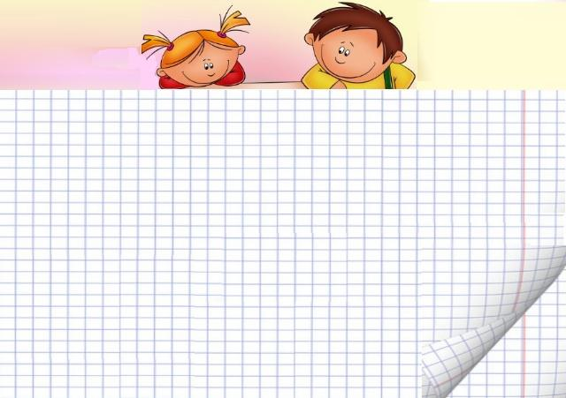
 five     | □ eight □ □ □ □ □ □ □
 eleven           |  twenty                   
three   |  fifteen              
 ten          |  one
 two  |  seven      

Slide 21

There is/there are … in the picture.
I can see … in the picture.
I have got …
 five     | □ eight □ □ □ □ □ □ □
 eleven           |  twenty                   
three   |  fifteen              
 ten          |  one
 two  |  seven      

Slide 22
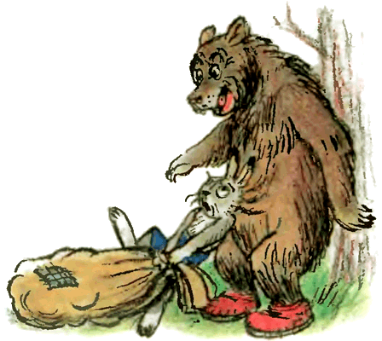
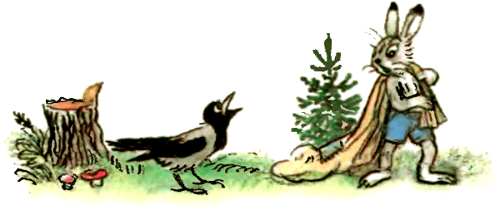




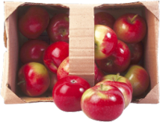


One apple, two apples, three apples, four,
Five apples, six apples, seven more.
Now tell me, little Paul,
Can you count apples all?

Slide 23

?
28
25
?
?
31

Slide 24


Well done! How clever of you!

Slide 25

Oops! You are mistaken!

Slide 26





Count!
Count!
Count!
Count!
Count!
Count!
http://www.youtube.com/watch?v=v9-pEVaO4pM

Slide 27

1 | 2 | 3 | 4 | 5 | 6 | 7 | 8 | 9 | 10
11 | 12 | 13 | 14 | 15 | 16 | 17 | 18 | 19 | 20
21 | 22 | 23 | 24 | 25 | 26 | 27 | 28 | 29 | 30
31 | 32 | 33 | 34 | 35 | 36 | 37 | 38 | 39 | 40
41 | 42 | 43 | 44 | 45 | 46 | 47 | 48 | 49 | 50
51 | 52 | 53 | 54 | 55 | 56 | 57 | 58 | 59 | 60
61 | 62 | 63 | 64 | 65 | 66 | 67 | 68 | 69 | 70
71 | 72 | 73 | 74 | 75 | 76 | 77 | 78 | 79 | 80
81 | 82 | 83 | 84 | 85 | 86 | 87 | 88 | 89 | 90
91 | 92 | 93 | 94 | 95 | 96 | 97 | 98 | 99 | 100
http://www.youtube.com/watch?v=nrybTLLVqw0

Slide 28
2 | 4 | 6 | 8 | 10 | 12 | 14 | 16 | 18 | 20
22 | 24 | 26 | 28 | 30 | 32 | 34 | 36 | 38 | 40
42 | 44 | 46 | 48 | 50 | 52 | 54 | 56 | 58 | 60
62 | 64 | 66 | 68 | 70 | 72 | 74 | 76 | 78 | 80
82 | 84 | 86 | 88 | 90 | 92 | 94 | 96 | 98 | 100
1 | 2 | 3 | 4 | 5 | 6 | 7 | 8 | 9 | 10
5 | 10 | 15 | 20 | 25
30 | 35 | 40 | 45 | 50
55 | 60 | 65 | 70 | 75
80 | 85 | 90 | 95 | 100
http://www.youtube.com/watch?v=u9pRwbTc_9c
http://www.youtube.com/watch?v=_awKlEMyleA
http://www.youtube.com/watch?v=ykAhScPdFNg

Slide 29
125 one hundred and twenty-five
378 three hundred and seventy-eight

Slide 30
211
two hundred and eleven
333
three hundred and thirty-three
415
four hundred and fifteen

Slide 31
555
five hundred and fifty-five
679
six hundred and seventy-nine
721
seven hundred and twenty-one

Slide 32
812
eight hundred and twelve
913
nine hundred and thirteen
1,000
one thousand

Slide 33
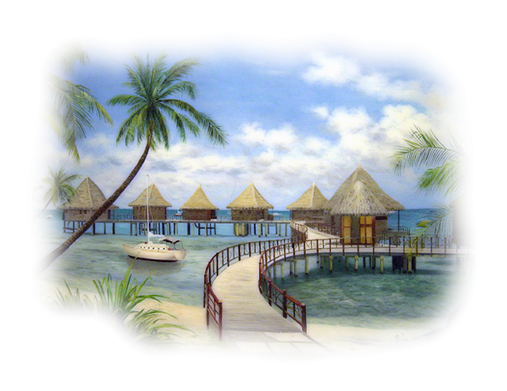






Hello!I am a hotel manager. Welcome to our hotel!
At the hotel

Slide 34

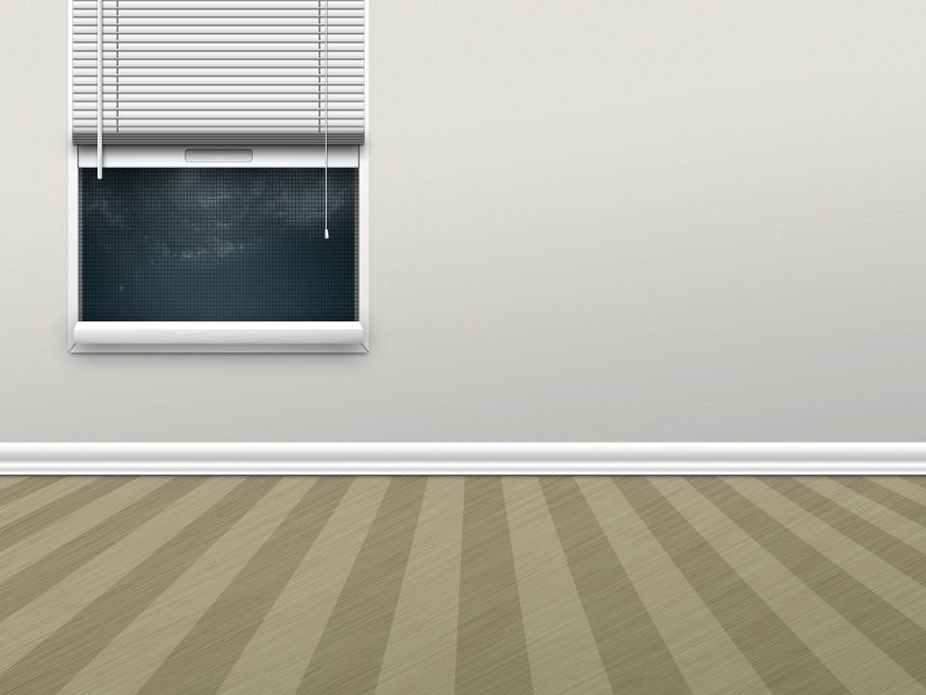



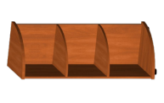





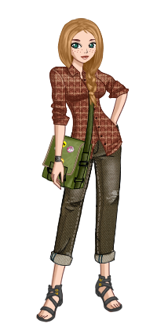





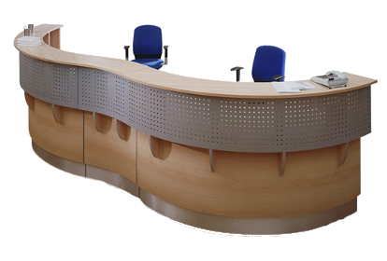



Excuse me, can I have the key to my room?
Certainly. What’s your room number?
Here it is.
It’s 359.
Thank you.
You are welcome.

Slide 35
Read the sentences
and
write all the numerals
in numbers

Slide 36
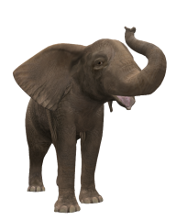


40,000
An elephant’s trunk has no bones but it has about forty thousand ( ……. ) muscles.
A trunk can kill a lion with one ( ……. ) blow.
It can also pick up a feather. An elephant can hold seven ( ……. ) litres of water in its trunk. An elephant’s tusks can be three
( ……. ) metres long and can weigh two hundred (……. ) kilos.
1
7
3
200

Slide 37
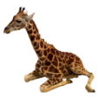
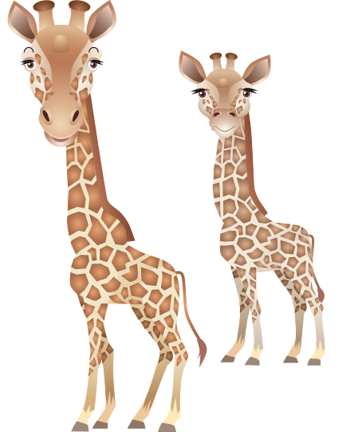

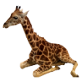
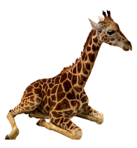
A giraffe’s tongue is forty ( ……. )
centimeters long.
Giraffes can live for one ( ……. ) month without water.
A baby giraffe can be two ( ……. ) metres tall. It can stand up and walk twenty( ……. )
minutes after its birth.
40
1
2
20

Slide 38



Beavers have very strong jaws and very sharp teeth.
It takes them only fifteen ( ……. ) minutes
to cut down a small tree.
They are good swimmers and they can
stay underwater for about fifteen ( ……. ) minutes.
15
15

Slide 39



The Great Barrier Reef is in the north-east
of Australia. It is more than two thousand
( ……. ) kilometres long and it is the
biggest coral reef in the world. More than
three hundred and fifty ( ……. ) kinds of coral grow there. More than one thousand
( ……. ) kinds of fish live
there.
2,000
350
1,000

Slide 40

What time is it now?

Slide 41



past
to
It’s two (minutes)
to eight.
It’s twelve o’clock.
It’s eleven (minutes) past ten.

Slide 42
half past …
a quarter past …
to …

Slide 43



















5 past, 10 past, a quarter
past 6,
20 past, 25 past, half
past 6,
25 to, 20 to, a quarter
to 7,
10 to, 5 to, 4, 3, 2, 1 -
It’s seven o’clock
And the day has begun.

Slide 44





It’s four o’clock.
It’s seven (minutes) past six.
It’s ten (minutes) to four.
It’s a quarter to six.
It’s half past nine.

Slide 45











What time is it?
A. It’s a quarter past eight.
1.
B. It’s half past eight.
A. It’s seven minutes to twelve.
2.
B. It’s seven minutes to one.
A. It’s twenty minutes past four.
3.
B. It’s twenty minutes past three.
A. It’s twenty-two minutes past three.
4.
B. It’s twenty-two minutes to eleven.
5.
A. It’s ten minutes past ten.
B. It’s ten minutes past eleven.

Slide 46





1. It’s a quarter past eight.
a. It’s ten ten.
2. It’s seven minutes to twelve.
b. It’s eight fifteen.
3. It’s twenty minutes past three.
c. It’s ten thirty-eight.
d. It’s three twenty.
4. It’s ten minutes past ten.
e. It’s eleven fifty-three.
5. It’s twenty-two minutes to eleven.

Slide 47


At the railway station
What time does our train arrive?
Our train arrives at 2.36 am.

Slide 48







What time do we land in Moscow? I mean in Sheremetyevo.
Our plane leaves in nine minutes at 10.19 pm. Gate 7.
What time does our plane leave?
In three hours. At 13.19 pm. Just at lunch time.
The number of our flight is 5602WR.
What is the number of our flight?
At the airport

Slide 49









Hello. I want the zoo.
The zoo speaking.
Speaking over
the telephone
When are you closed for lunch?
Our lunch break is from 12 to 13. We’ll open in half an hour.
Thank you.
We’ll be glad to see you here. You are welcome.

Slide 50


























The first lesson usually starts at 8.30 in the morning.
The sixth lesson usually ends at two o’clock pm.
There are twenty-seven students in our form.
It’s 8.25. Oh, come on. Hurry up! We shouldn’t be late.
Hello. Let’s get acquainted.
I am in the fifth form.
There are 15 boys and 12 girls in our form.
What time is it now?
Usually we have six lessons a day.
How many boys and how many girls are there in your form?
How many lessons do you usually have every day?
When does the first lesson usually start?
When does the sixth lesson usually end?
Hello. Let’s get acquainted.
What form are you in?
How many students are there in your form?
At school
WELCOME

Slide 51








Name | Job | Place | Start | Finish
Bob | doctor | hospital
Brett | life-guard | swimming-pool
Jenny | reporter | newspaper office
06:30
20:30
09:00
19:15
Look at the chart. Read and translate all the information. Then make sentences, as in the example.
10:45
18:30
Bob is a doctor.
He works at a
hospital. He starts work
at half past six in the
morning. He finishes
work at half past eight
in the evening.
Brett is a life-
guard. He works
at a swimming pool. He
starts work at nine
o’clock in the morning.
He finishes work at a
quarter past seven in
the evening.
Jenny is a reporter.
She works at a
newspaper office.
She starts work at a
quarter to eleven in the
morning. She finishes
work at half past
six in the evening.

Slide 52



Thank you for the lesson! Good-bye!

