Slide 1

PROFESSIONS
Выполнила – учитель английского языка МБОУ “СОШ№2
им. Г.В.Кравченко”
Галицких Лилия Анатольевна

Slide 2



Repeat the sounds [r]- wr, [∫]-sh, [t∫]-ch, [ŋ]-ng, [ə] – er.
I am a pupil.
You are a writer.
She is a teacher.
He is a singer.

Slide 3
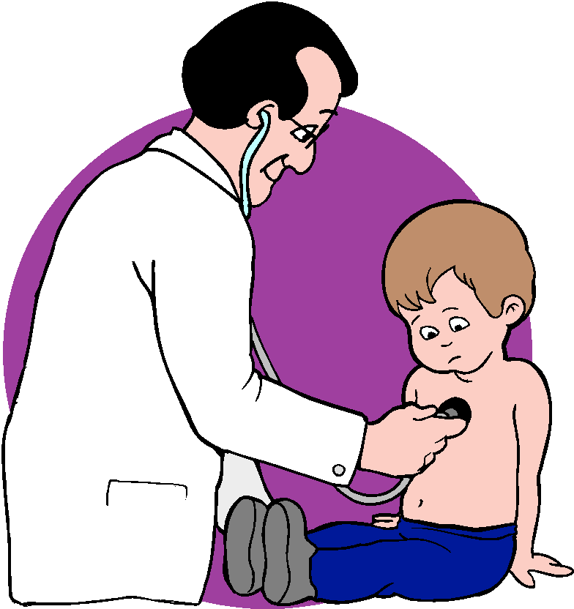
a doctor

Slide 4
a teacher

Slide 5
a writer

Slide 6
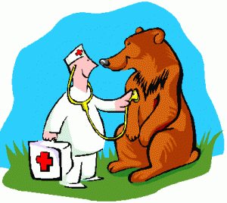
a vet (veterinarian)

Slide 7
a singer

Slide 8

a model

Slide 9
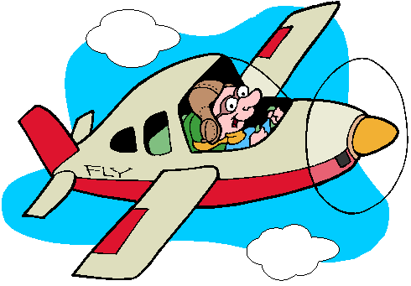
a pilot

Slide 10

a reporter

Slide 11

a sportsman

Slide 12
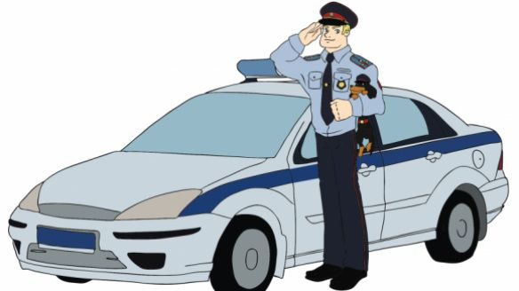
a police officer

Slide 13
a farmer

Slide 14
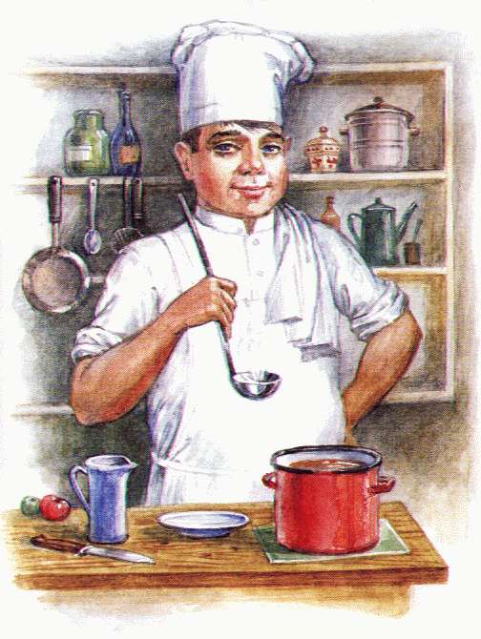
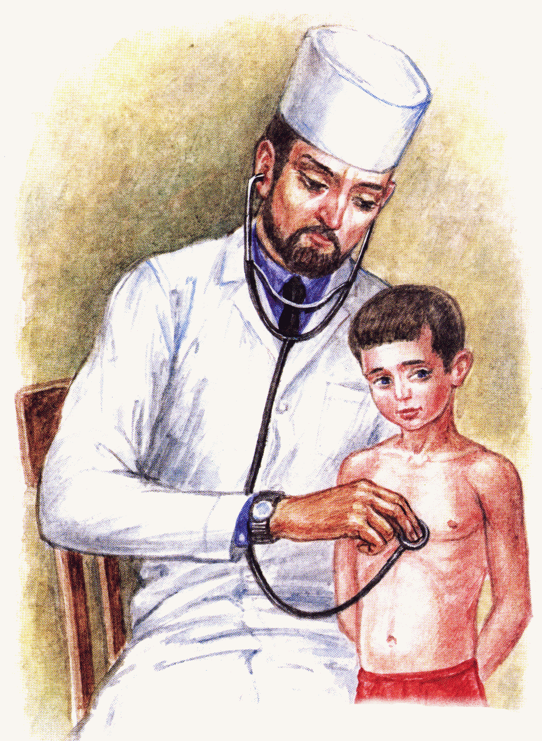
Is it a teacher?

Slide 15
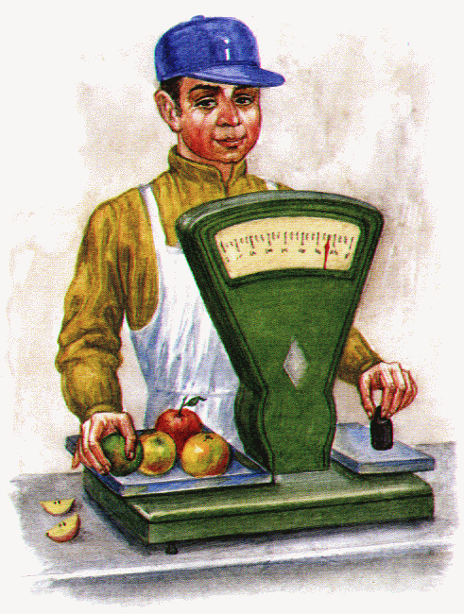
Is it a farmer?

Slide 16
Unscramble the words
rotcdo
chteare
rtwrie
gisrne
ledom
lopit
terpreor
raferm

Slide 17
Who works in a hospital and helps sick people?

Slide 18
Who works in a school?

Slide 19
Who flies a plane?

Slide 20
Who sings and plays music?

Slide 21
Match the sentences
A teacher
A writer
A doctor
A vet
A singer
A model
looks after animals.
helps people.
works in a school.
writes books.
sings song and play music.
wears wonderful clothes.

Slide 22
Correct the mistakes
My mother is a singer .
My father is a police officer .

Slide 23
Correct the mistakes
My brother is a writer .
My sister is a reporter .

Slide 24
CROSSWORD
1. |  |  |  | p
 |  | 2. |  | i
3. |  |  |  | l
 |  |  | 4. | o
 |  | 5 |  | t

