Slide 1
Famous British and American writers

Slide 2

What is the most well-known novel by Oscar Wilde?
“The Chronicles of Narnia”
“Mary Poppins”
“The Picture of Dorian Gray”
“New Moon”

Slide 3
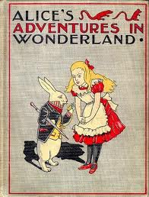
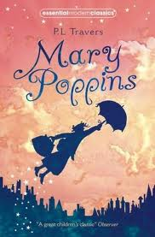
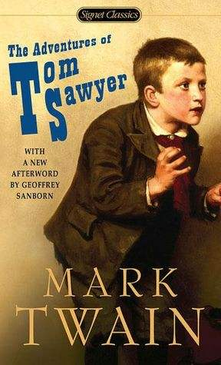
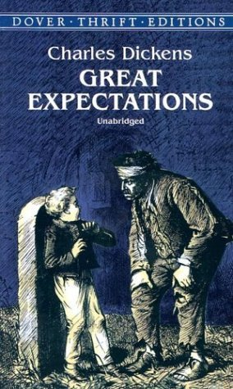
Match the author and the book
Mark
Twain
Charles
Dickens
Lewis
Carroll
Pamela
Travers

Slide 4
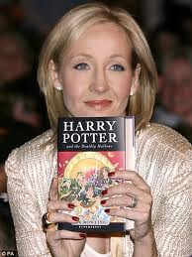
Is Joanne Rowling
a British writer?

Slide 5
Can you find A.A. Milne’s characters?
Edmund, Lucy, Peter, Susan
Tom Sawyer, Huckleberry Finn
Edward, Bella, Jacob
Piglet, Eeyore, Christopher Robin

Slide 6
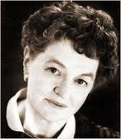
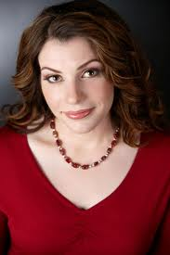
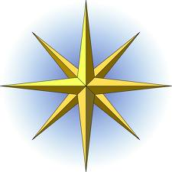
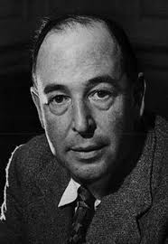
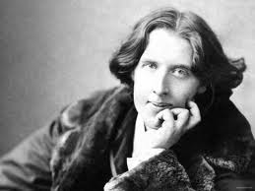
Match the writer and the country
Great
Britain
the USA
Ireland
Australia

Slide 7
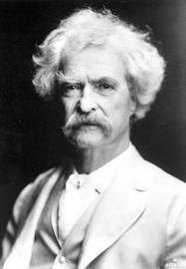
Is this Mark Twain’s
portrait?

Slide 8
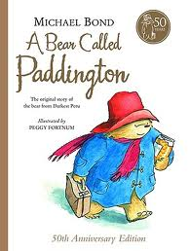
Find the author of this book
Roald Dahl
A.A. Milne
Lewis Carroll
Michael Bond

Slide 9
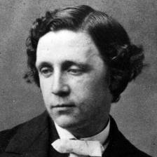
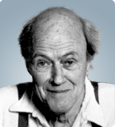
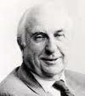
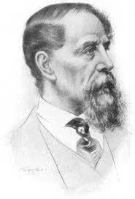
Match the writers with
their portraits
Michael
Bond
Roald
Dahl
Lewis
Carroll
Charles
Dickens

Slide 10
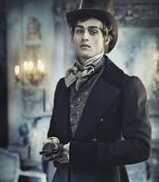
Is Pip the main character of “Prince and the Pauper”?

Slide 11
Clive Staples Lewis lived in
1898-1963
1832-1989
1835-1910
1812-1870

Slide 12
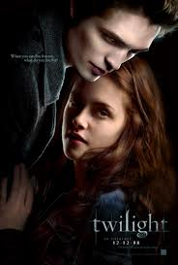

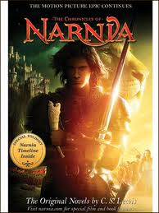
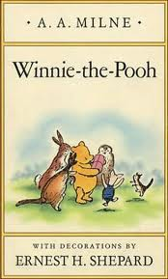
Match the character and the book
Tigger
Pip
Prince
Caspian
Jacob

Slide 13
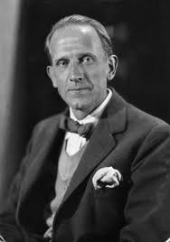
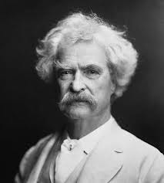
Tell us about one of the following writers as much as you can. Use the plan
The name of the writer
The country he/she comes from
When he/she lived (lives)
Famous books
Well-known characters

Slide 14
Well done ☺

