Slide 1
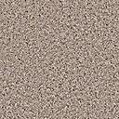
ANIMALS
Выполнила учитель английского языка
Ланина И.В.
ГБОУ СОШ № 2047
г. Москва

Slide 2
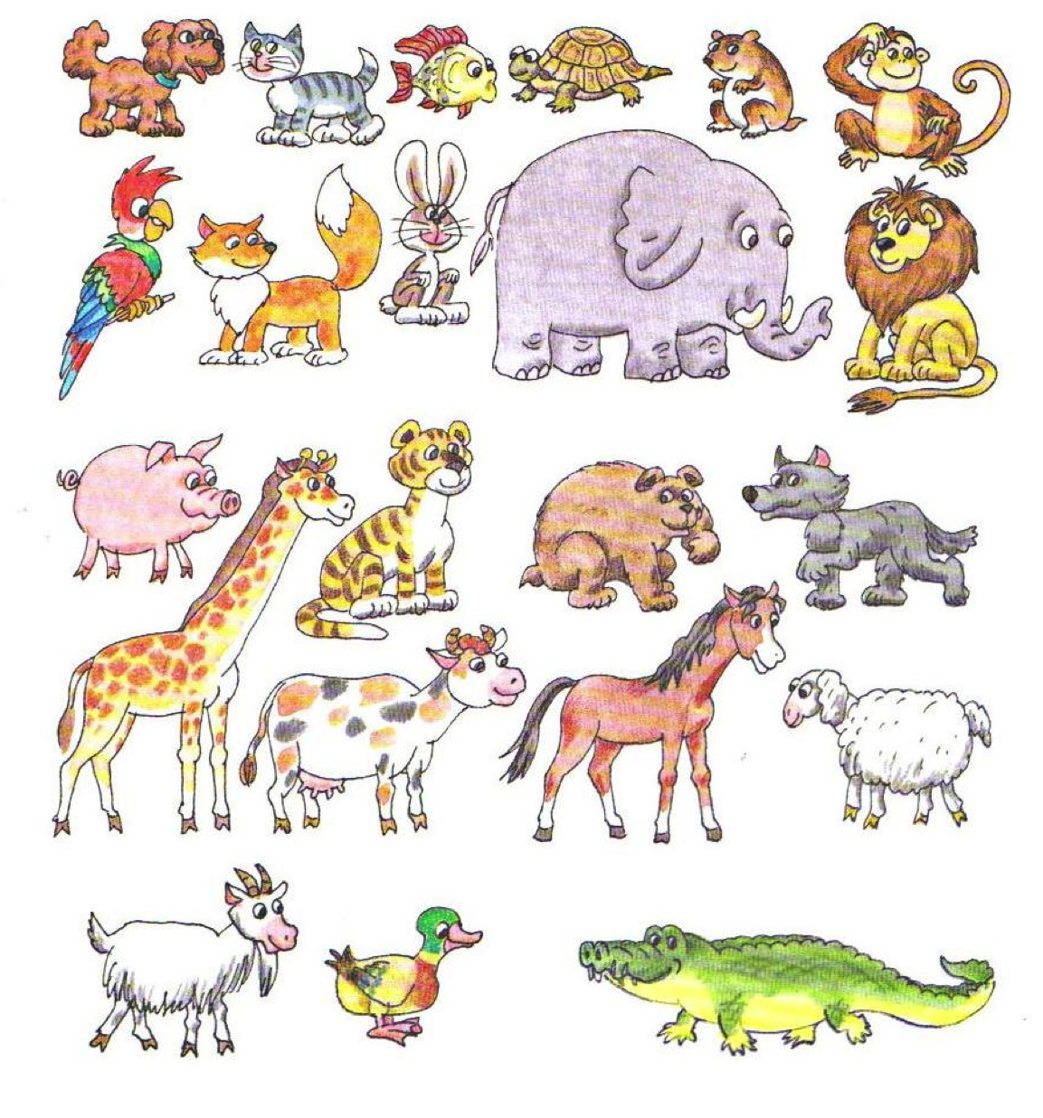
Example: It is a cat.
ANIMALS

Slide 3

ANIMALS
Can swim
Can
jump
Can run
Eat corn
eat grass and hay
Eat fruit
Eat
meat
A hare
A mon-
key
A dog
A cat
A hamster
A fox
An elephant
A lion a giraffe
A pig a cow
A tiger a horse
A wolf a sheep
A bear a goat
A dog
A fish
A turtle
A croco
-dile
A duck
A hamster
A duck
A parrot
A pig
A tortoise
A giraffe
A hare
An elephant
A dog
A fox
A lion
A tiger
A wolf
A bear
A croco
-dile
A cow
A sheep
A goat
A horse

Slide 4
ПРИЛАГАТЕЛЬНЫЕ
Односложные (один слог) | Двусложные (два слога) | Многосложные (более двух слогов)
Big | Nice | Interesting
Hot | Happy | Popular
Slim | Sunny | Beautiful
New | Funny | Wonderful
Black | Snowy | Comfortable

Slide 5
СТЕПЕНИ СРАВНЕНИЯ ПРИЛАГАТЕЛЬНЫХ
Положительная степень
Превосходная степень
Сравнительная степень

Slide 6
DEGREES OF COMPARISON
POSITIVE
COMPARATIVE(than)
SUPERLATIVE
(best of all)
long
longer
The longest
big
bigger
The biggest
funny
funnier
The funniest
nice
nicer
The nicest
new
newer
The newest
old
older
The oldest
REMEMBER

Slide 7
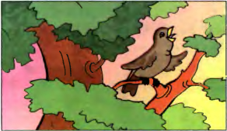
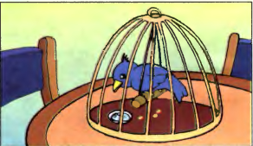
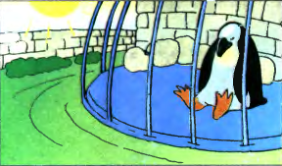
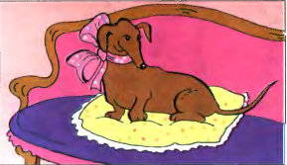
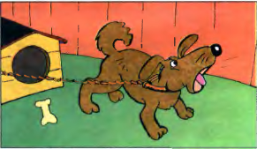
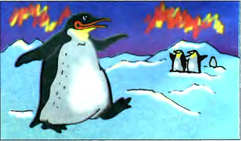
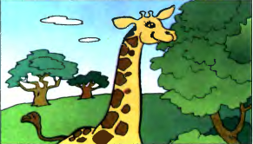
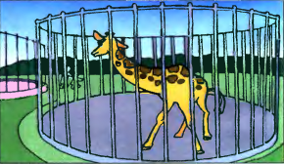
Look at the pictures and say: Which one is happier?
or
In hot summer
In the tree
In the cage
or
or
In the house
In the yard
or
In cold winter
In Africa
In the zoo

Slide 8
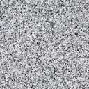
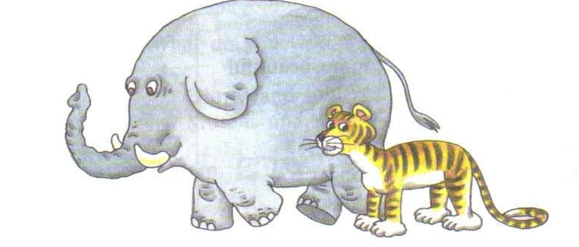
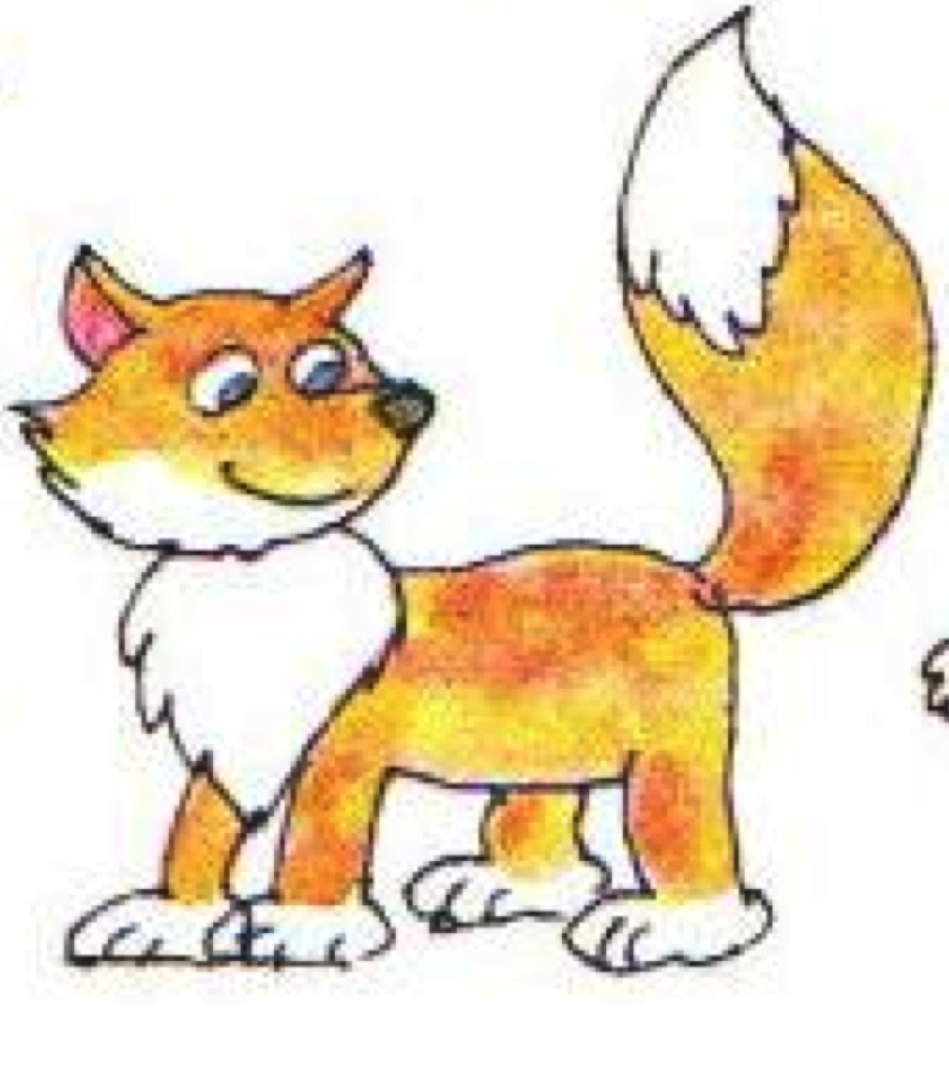
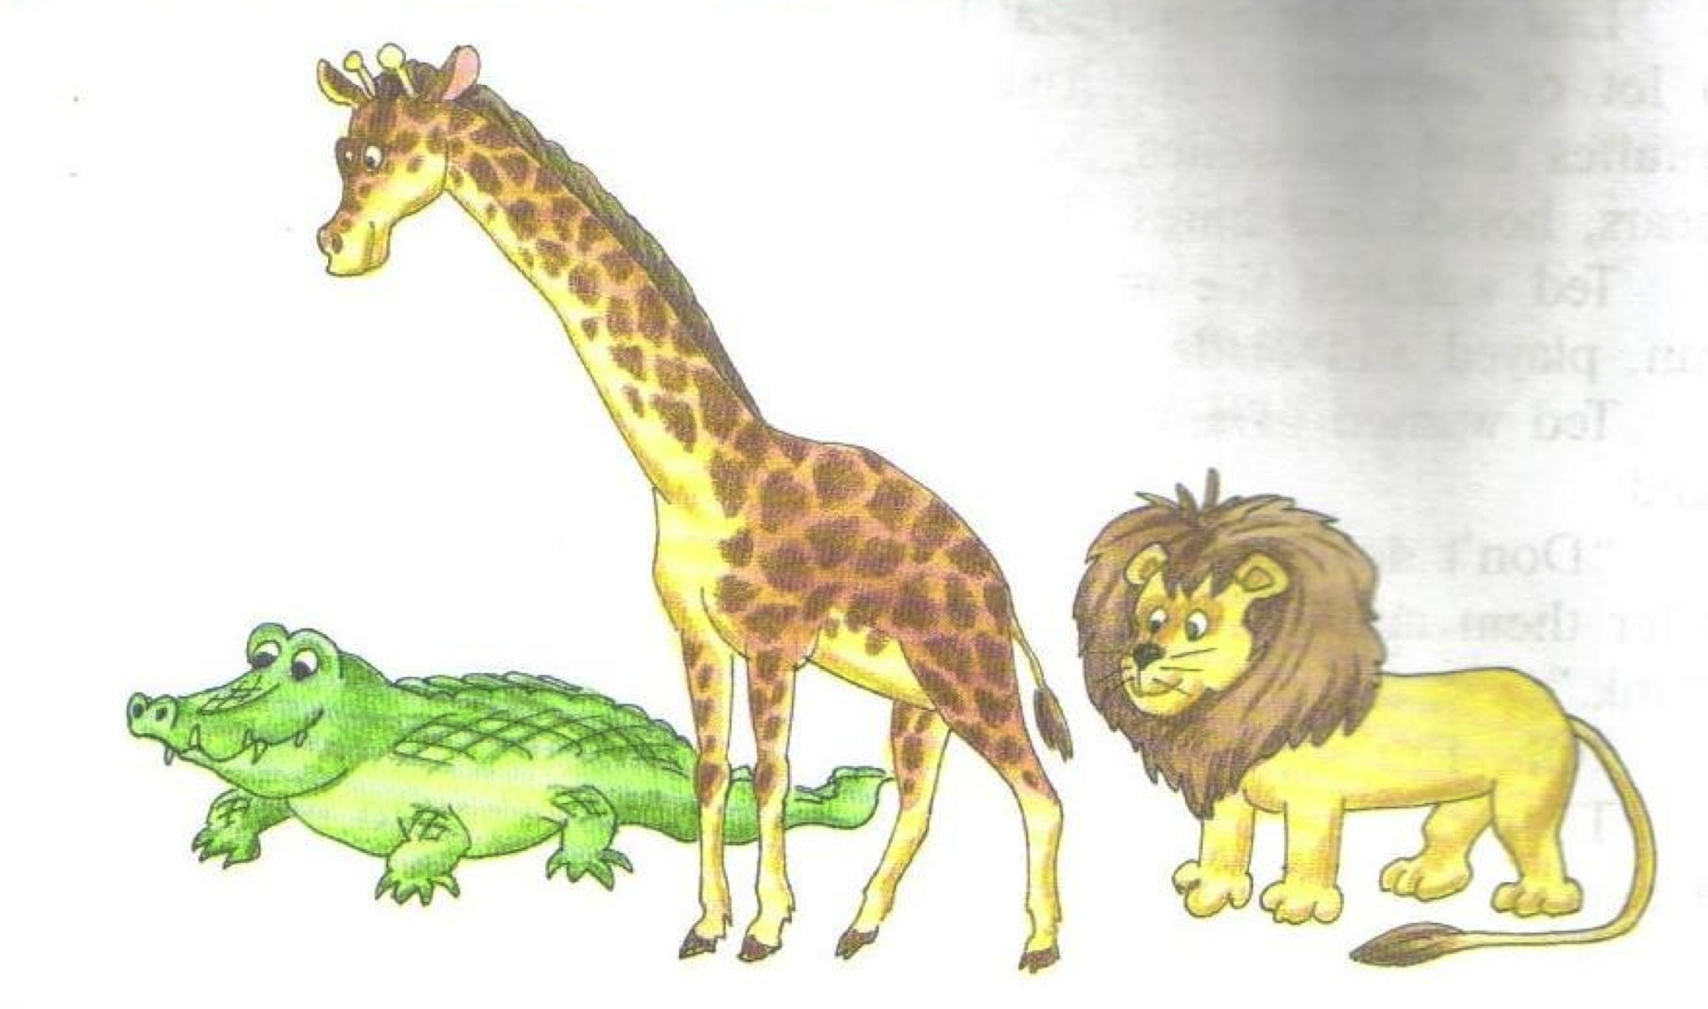
COMPARE THESE ANIMALS
The tiger is ….(big) than the fox.
The elephant is the…….(big).
The lion’s neck is …(long)than the crocodile’s.
The giraffe’s neck is the …(long).

Slide 9
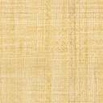
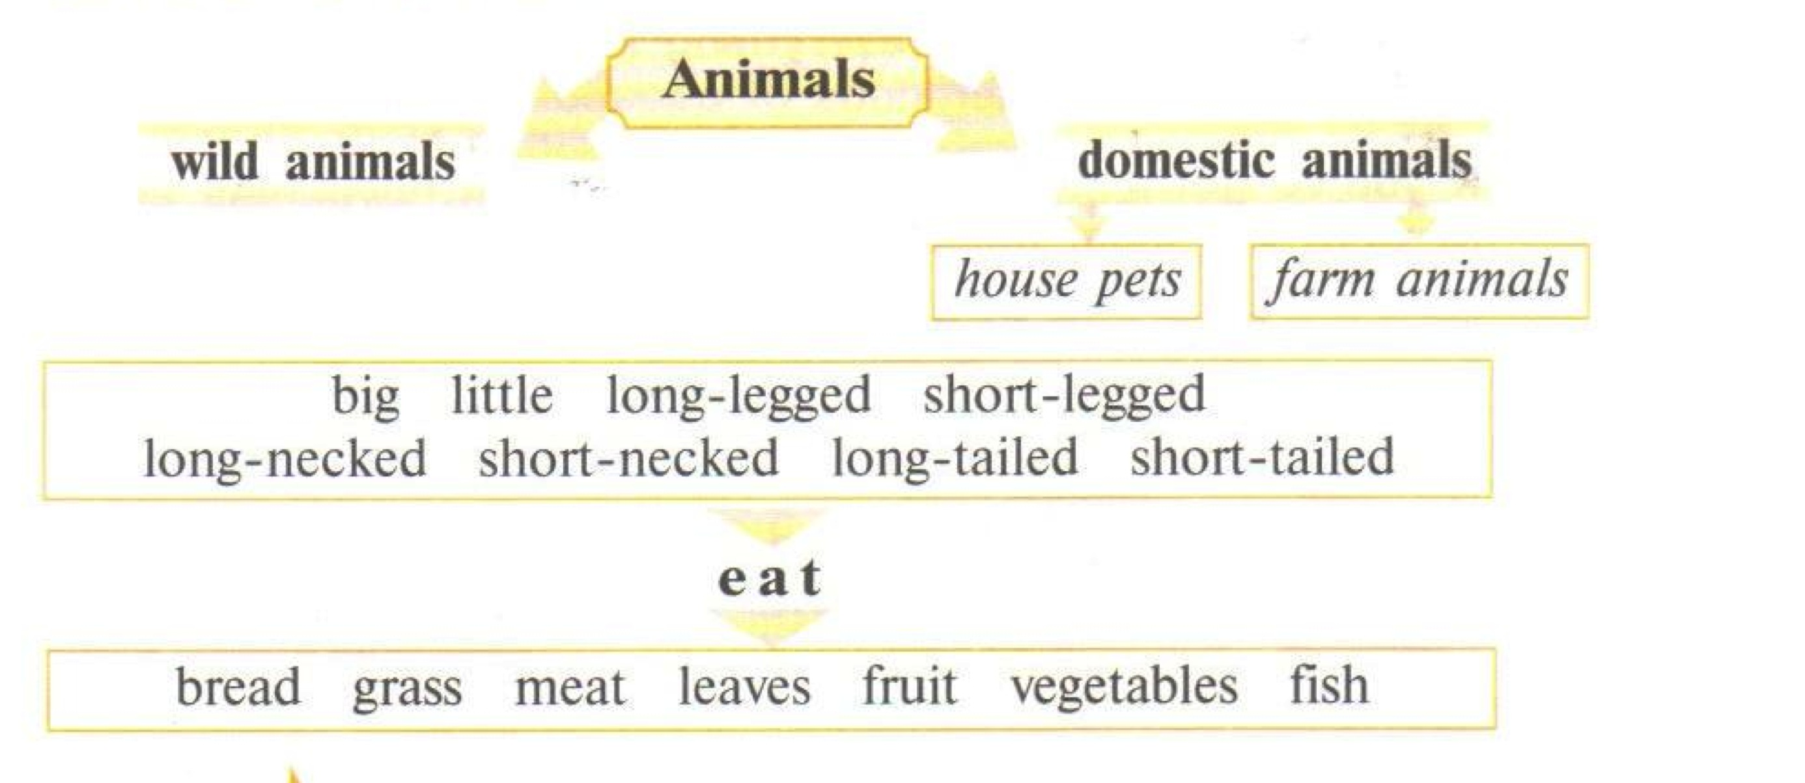

Slide 10

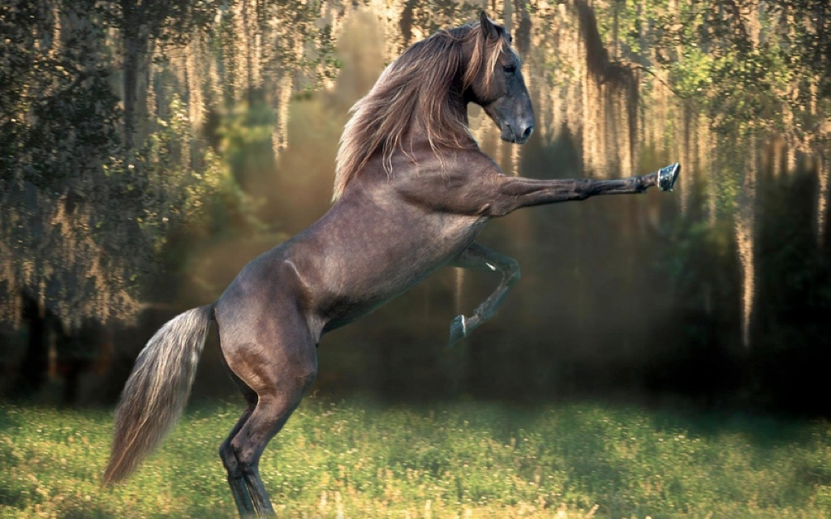
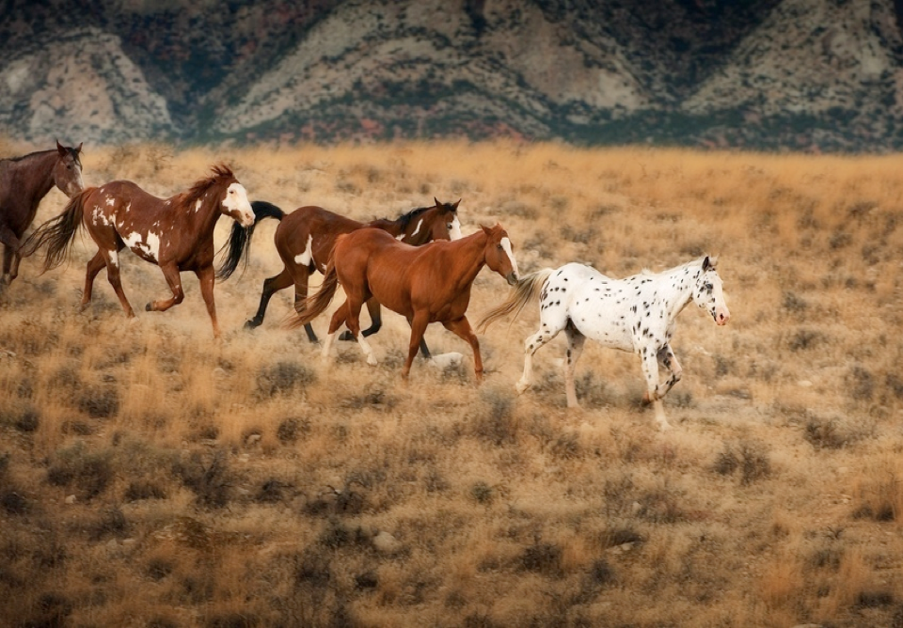
Examples
I know…wild animals. They are…
I know…domestic animals. They are…
…are long-legged wild animals. They…
The horse is a domestic animal. It’s a farm animal. It’s big. It’s black, brown,red and white. The horse has got long legs, a long neck and a long tail. It eats grass.

Slide 11

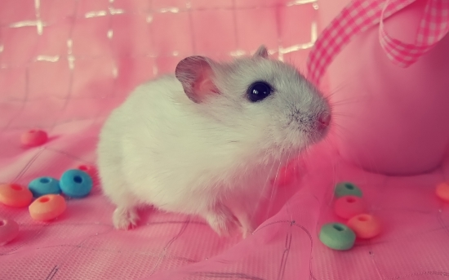
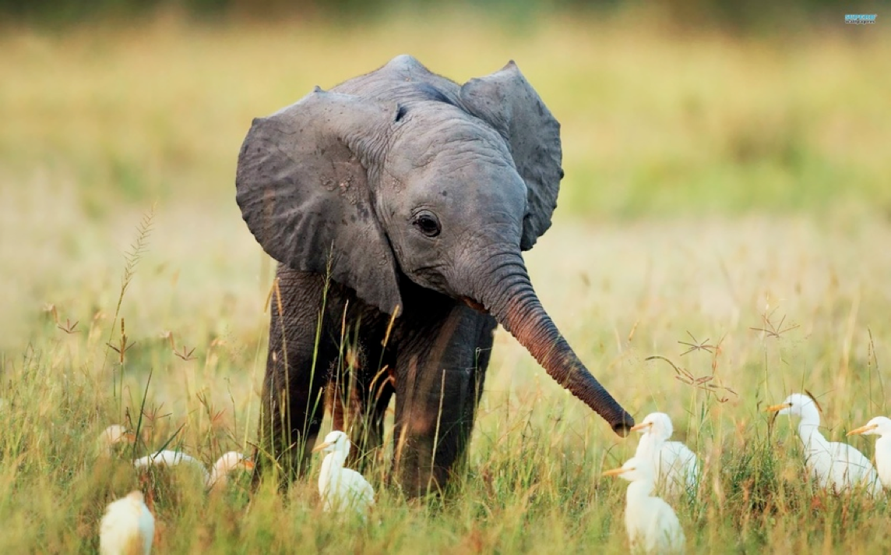
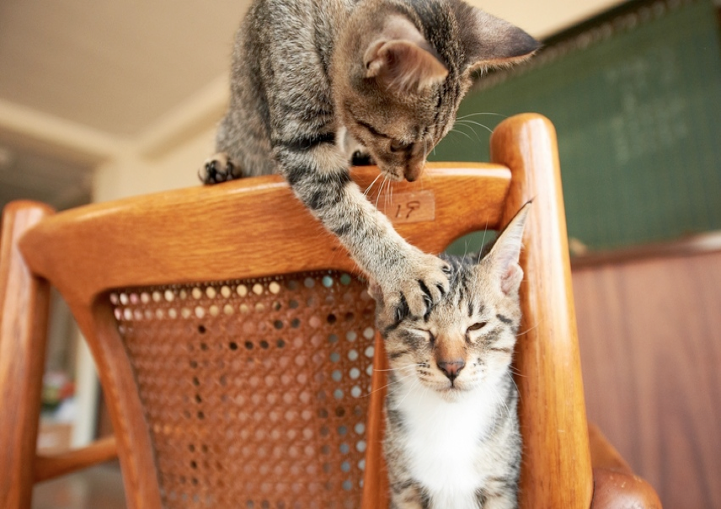
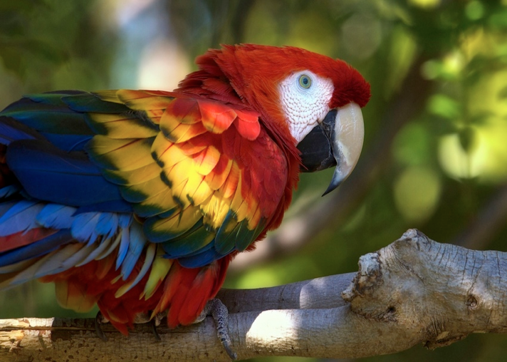
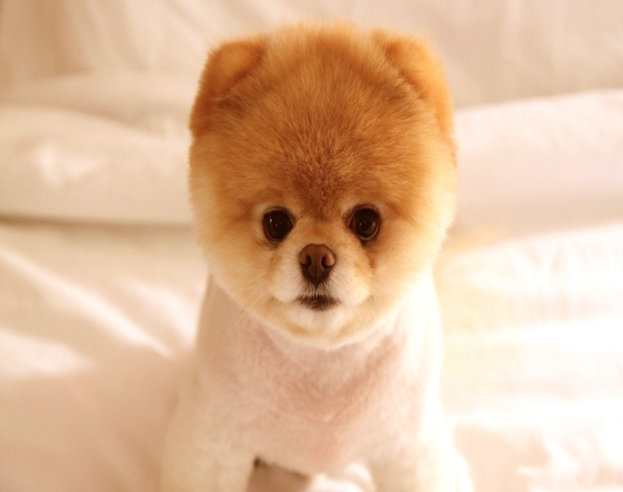
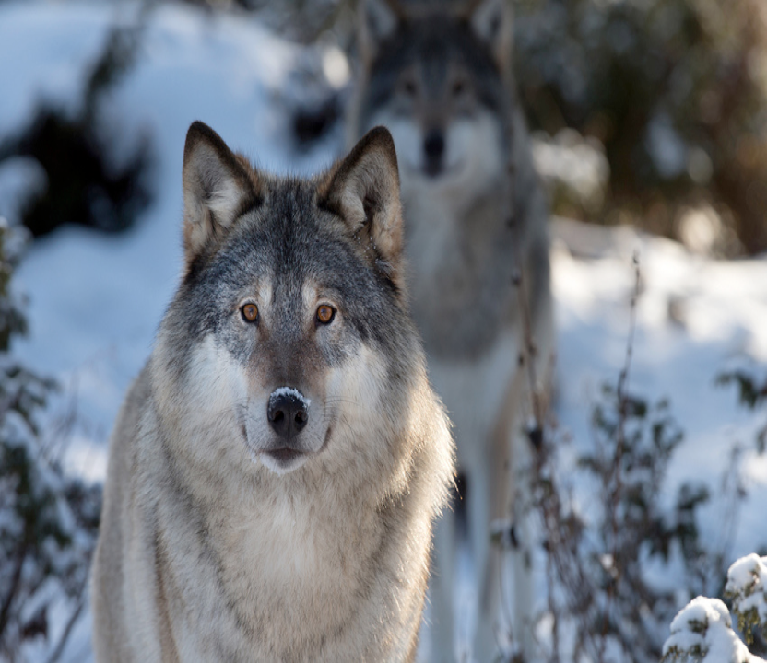
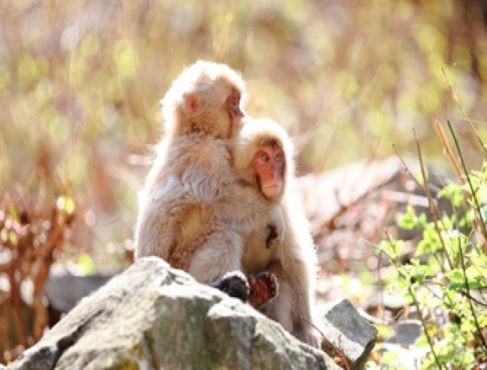
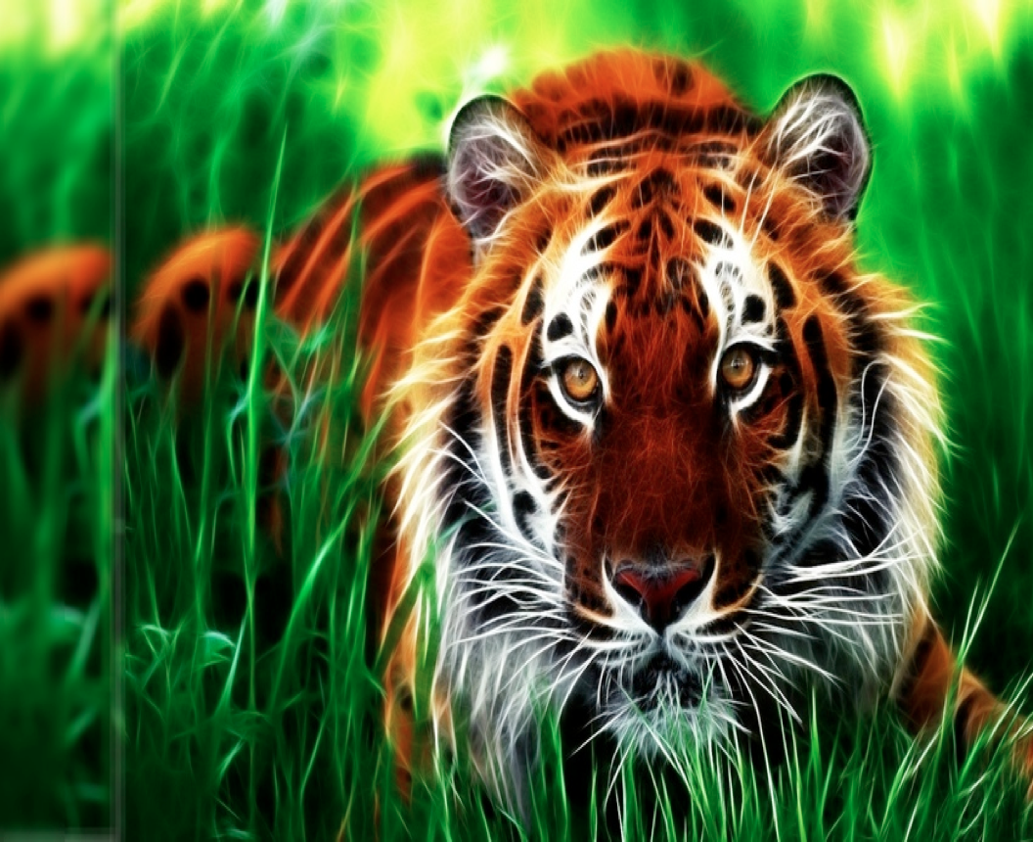
Guess riddles about animals:
It is big and grey.
It has a long nose.(?)
It is white and little.
It does not like cats. (?)
It is a man's friend.
It lives at home. (?)
It can fly. It can talk.
It can be red, yellow and blue. (?)

Slide 12
Список использованной литературы
И.Н.Верещагина , Т.А. Притыкина Английский язык 3класс“English ”-М.-Просвещение -2010.
THE END
http://www.kartinki24.ru
http://www.fonstola.ru

