Slide 1
Art and Design

Slide 2
What is ART?

Slide 3
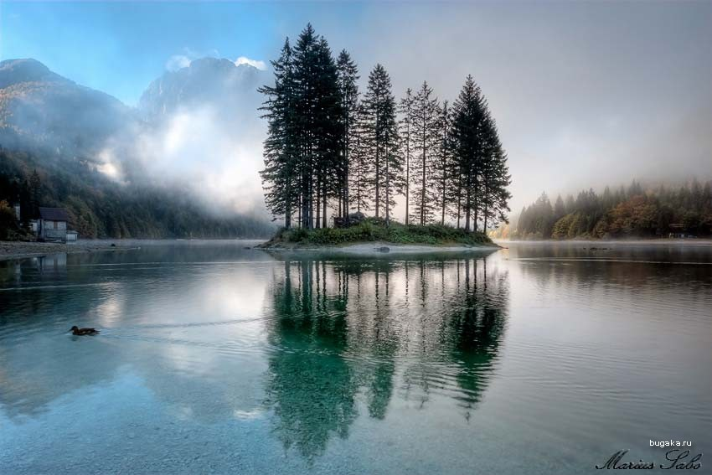
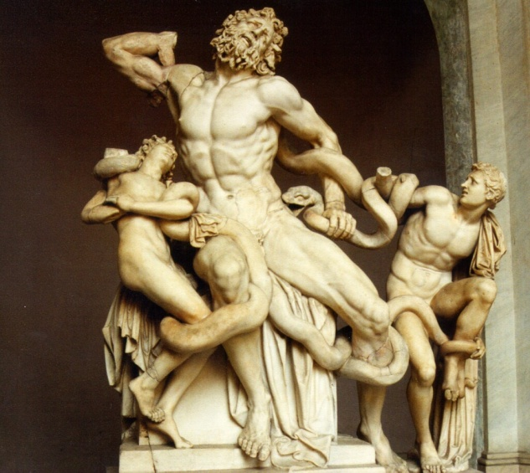
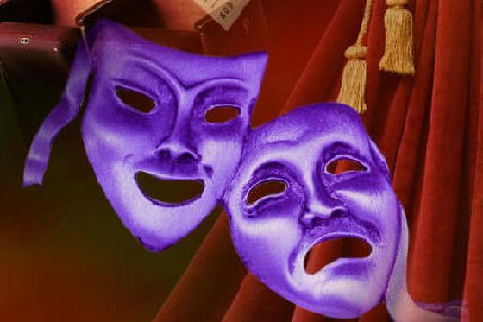
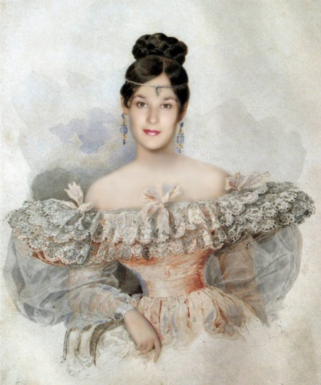
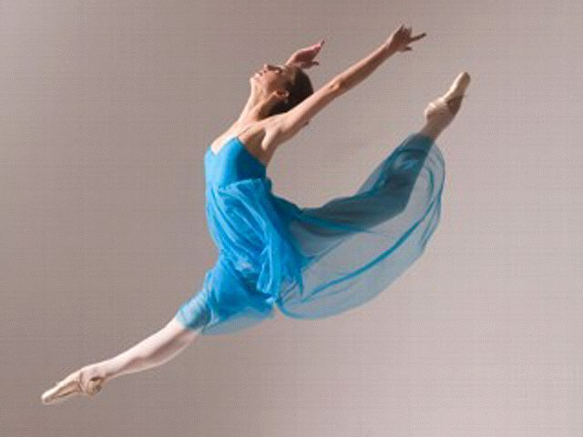
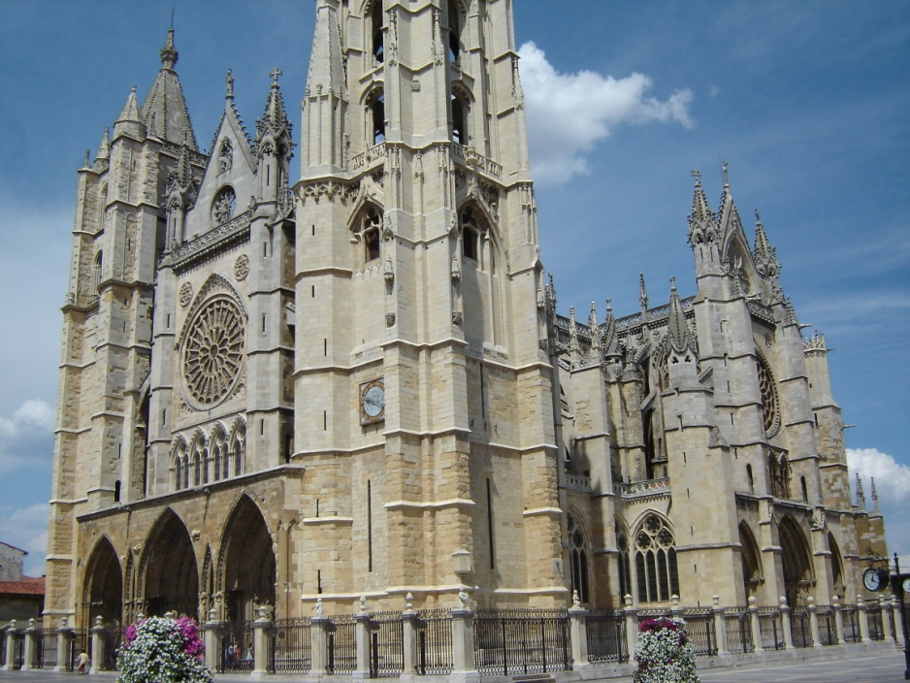
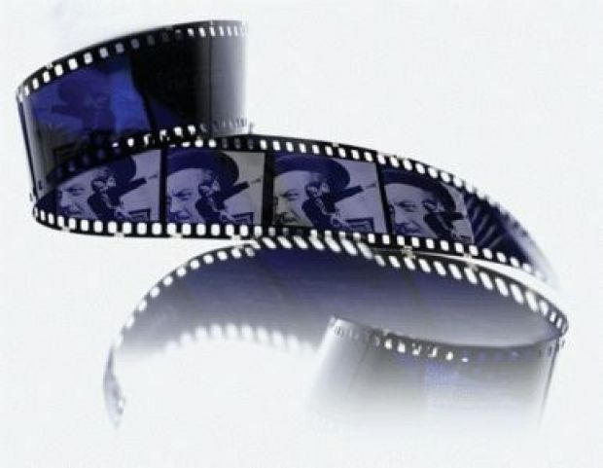
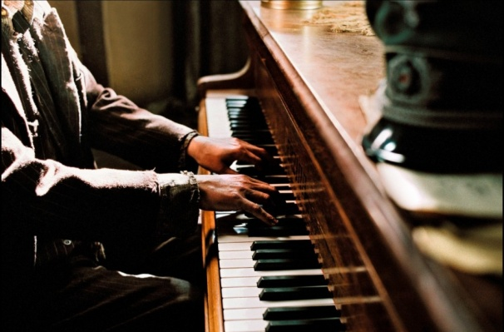
Art is a diverse range of human activities and the products of those activities.
ART

Slide 4
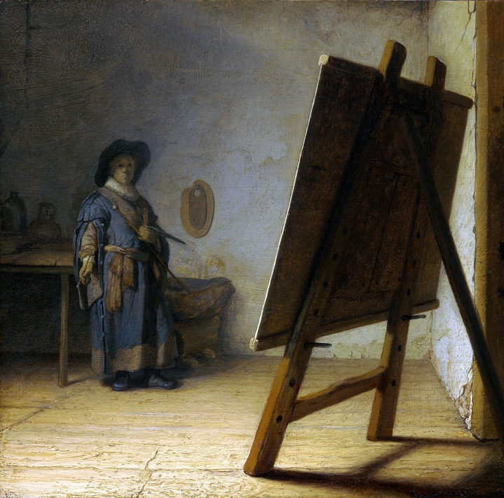
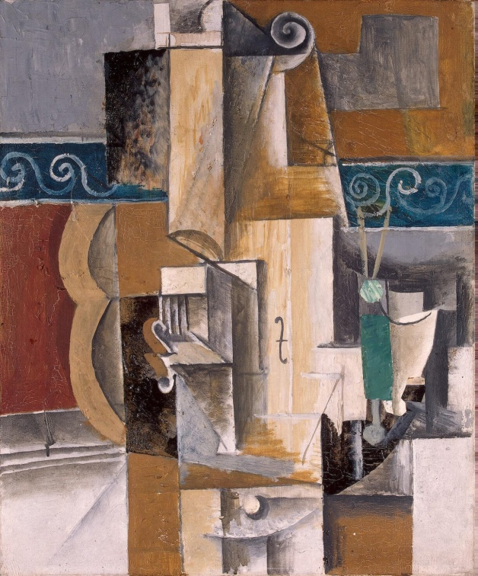
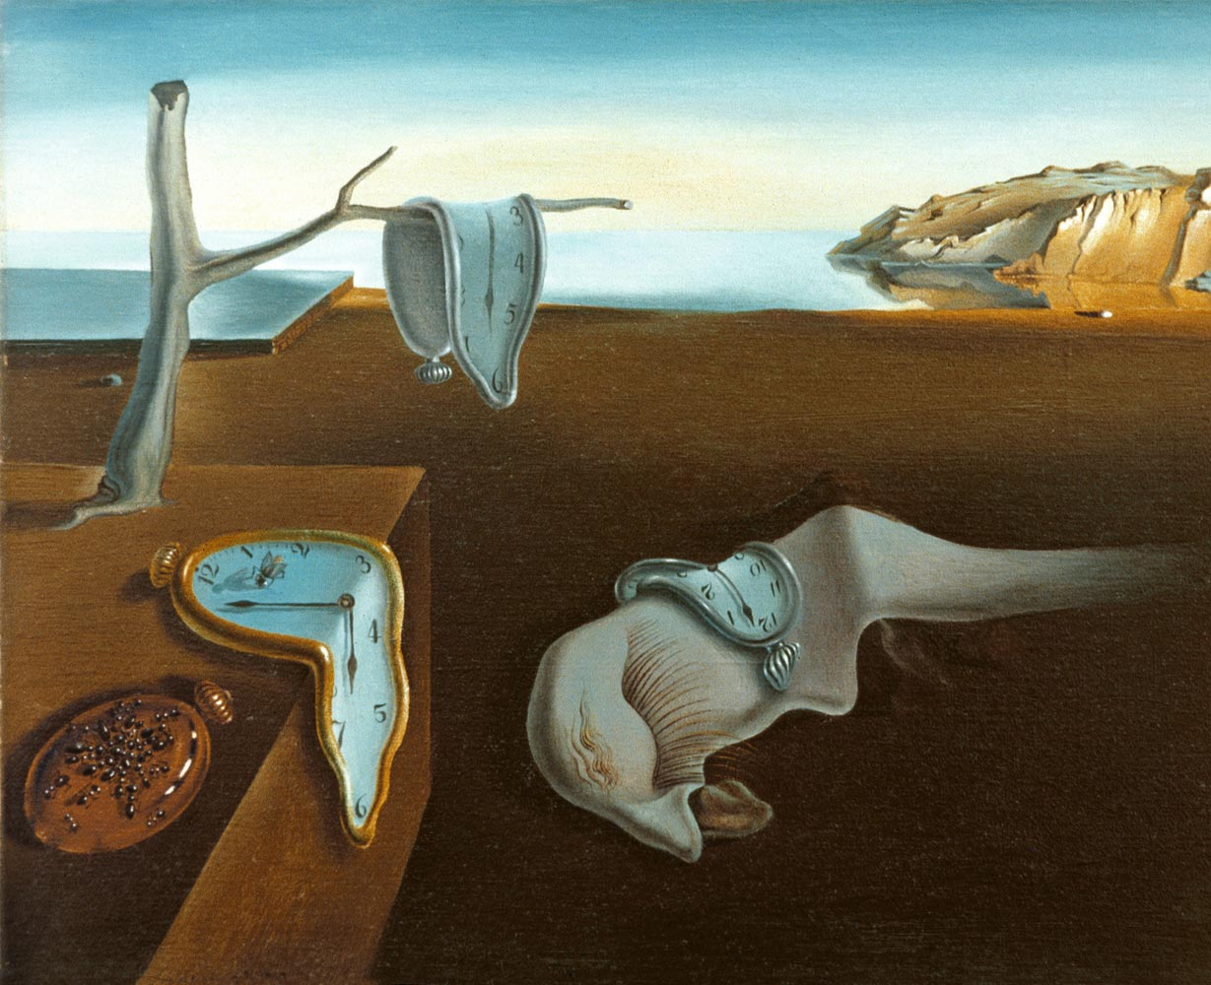
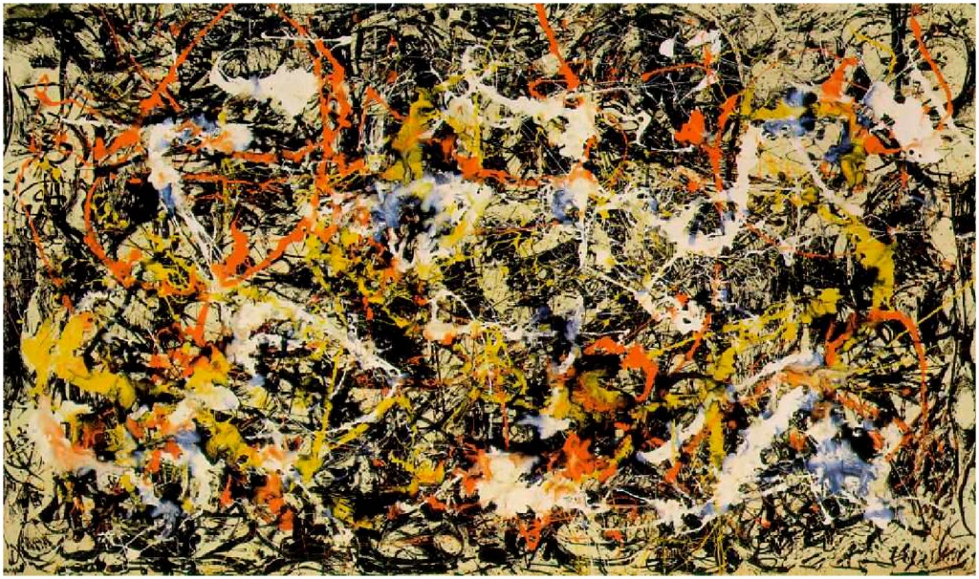
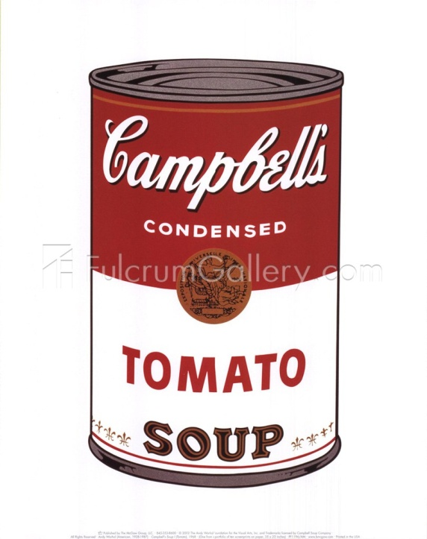
Painting styles
1
2
3
Action painting
4
5
Pop art
Cubism
Classical
Surrealism

Slide 5
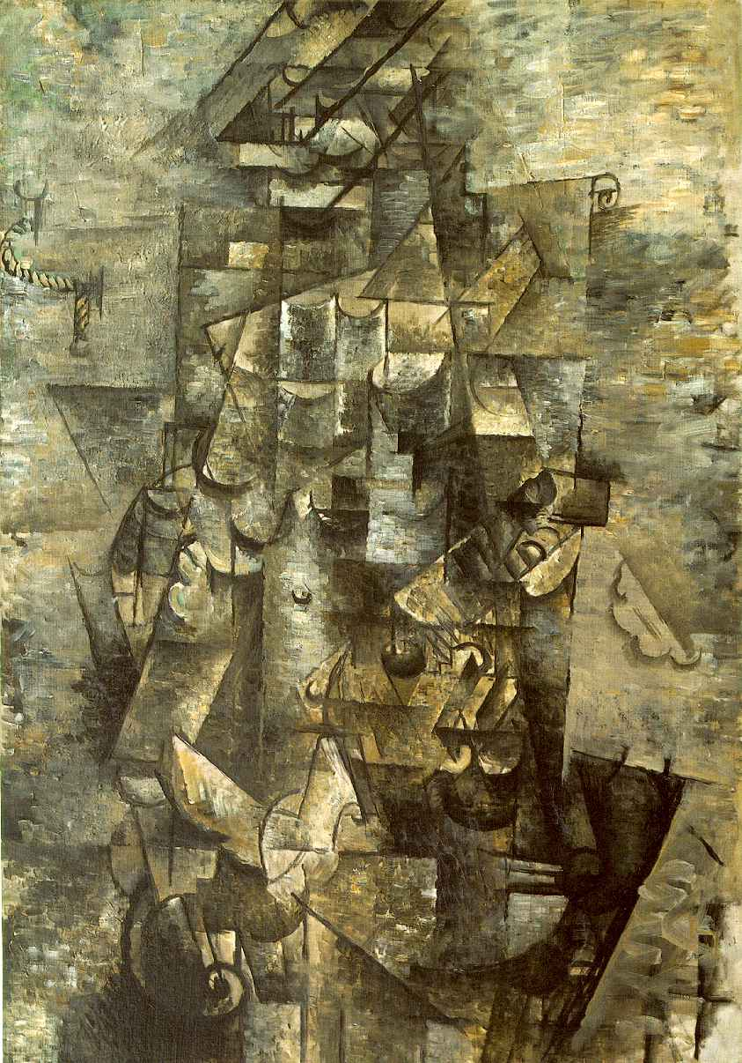
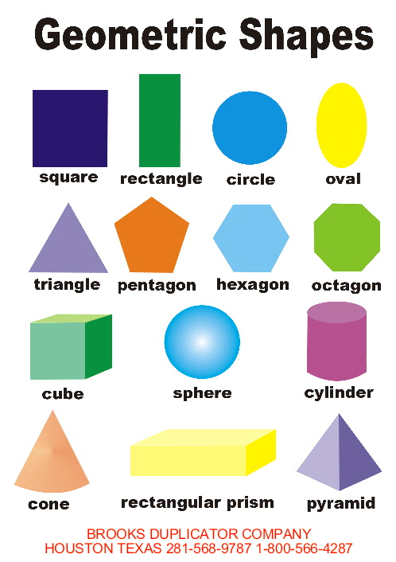
Cubism – Geometric Shapes
triangle
square
rectangle
Georges Braque Man with a Guitar

Slide 6
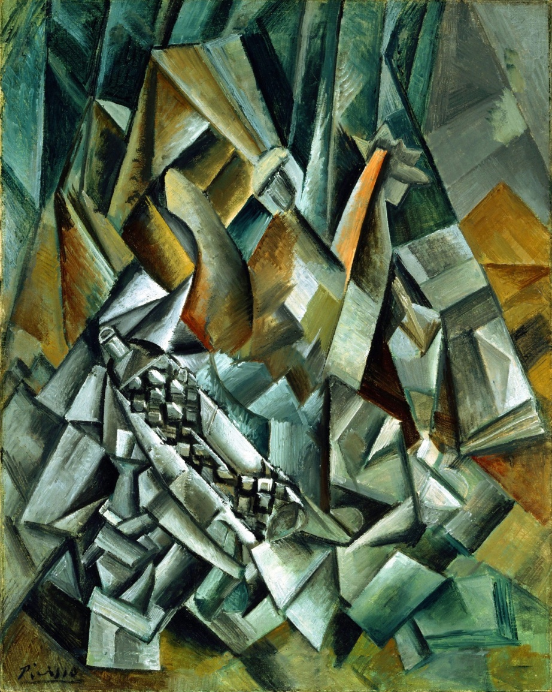
Cubism – Colours and Feelings
Colours:
dark
dull
brown
grey
grim
Useful phrases:
the picture shows…
seem to have many layers
from a number of different viewpoints
the painting makes me feel…
Feelings:
gloomy
sad
depressed
unhappy
confused

Slide 7
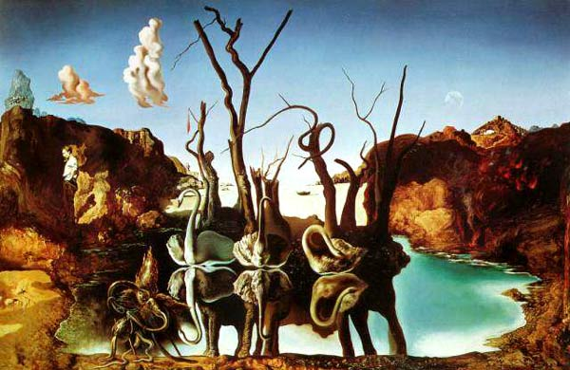
Surrealism
Salvador Dali Swans Reflecting Elephants (1937)
Useful phrases: an element of surprise, strange images, to create strange representation of things, to create an impact, to show something in an unusual way, to feel astonished.

Slide 8
Questions
1. When was Cubism popular?
2. How did Cubist painters create their works?
3. What effect does the use of geometric shapes and dark colours produce?
4.When was Surrealism popular?
5. Where did Surrealist painters get the ideas for their paintings?
6. What creates a big impact?

Slide 9
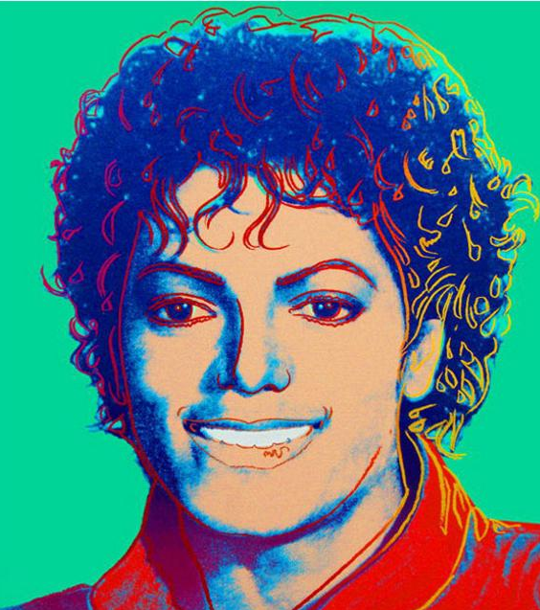
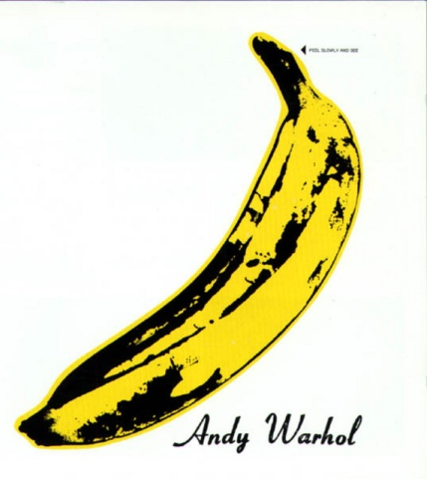
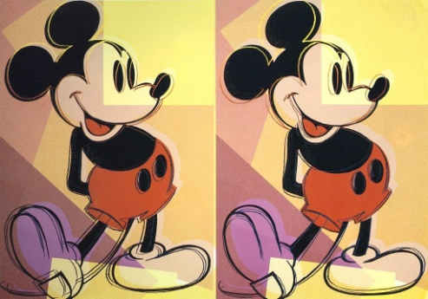
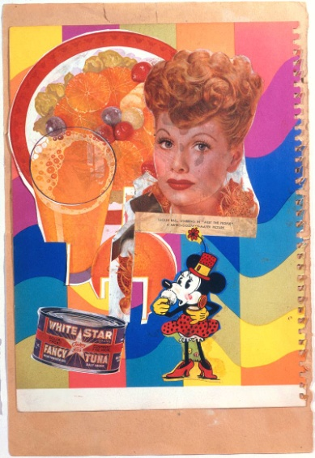
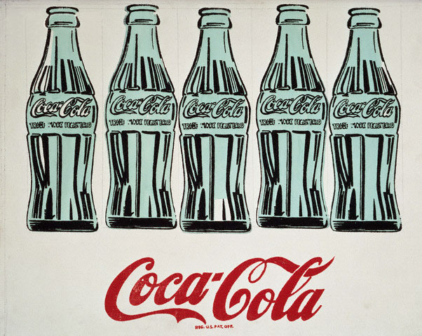
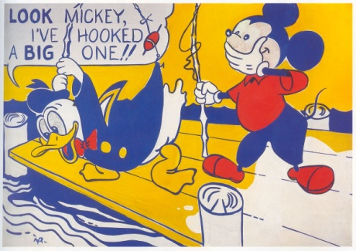
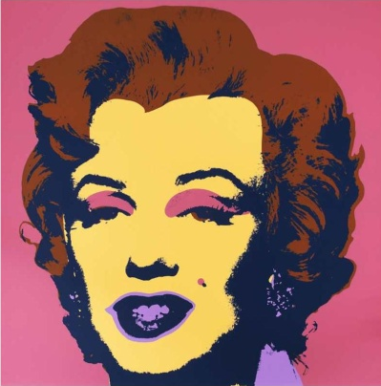

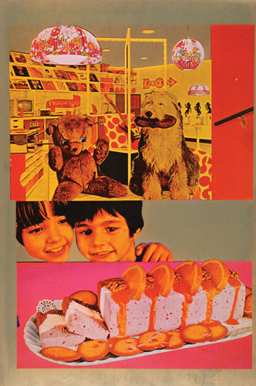
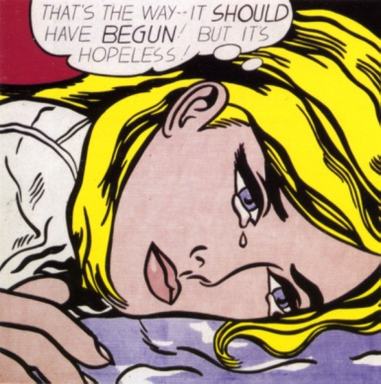
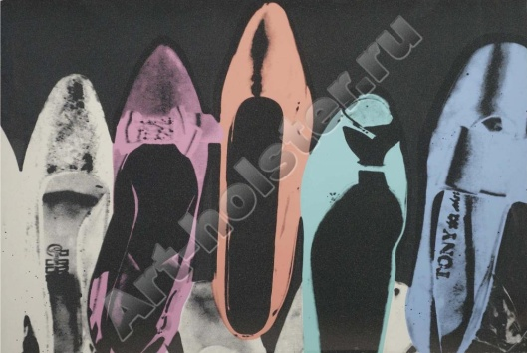
Pop Art

Slide 10
Pop Art
Read the text and complete the sentences.
1. Pop Art is a style of art that represents …
everybody’s everyday experiences.
2. Pop artists were fascinated by …
realistic images from everyday life.
3. All people are ….
consumers.
4. Many Pop artists used images of …
products from supermarkets or advertisements.
5. Andy Warhole painted products like …
Coca Cola bottles and bananas.
6. Roy Lichtenstein’s works were similar to …
images in the comic books.
7. Many people in the art world …
do not accept Pop Art as a real art form.
8. Many original Pop Art works have sold for …
millions of dollars.
9. The most important result of Pop Art is that …
it has created a new artistic way of looking at the everyday world.

Slide 11

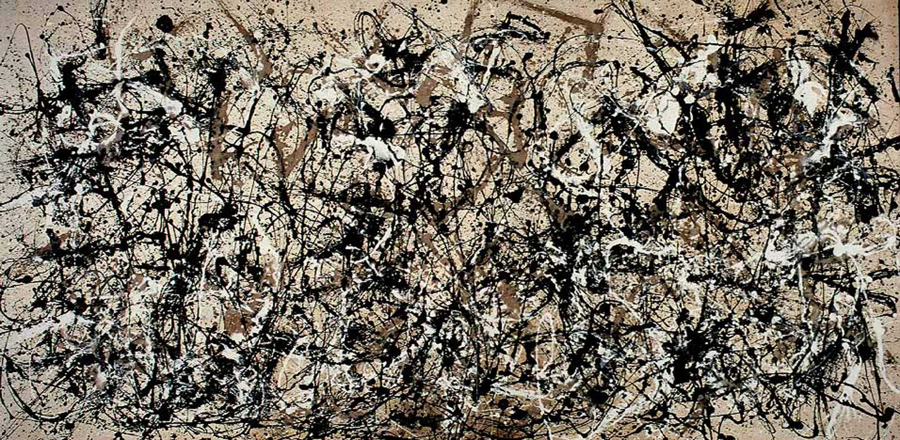
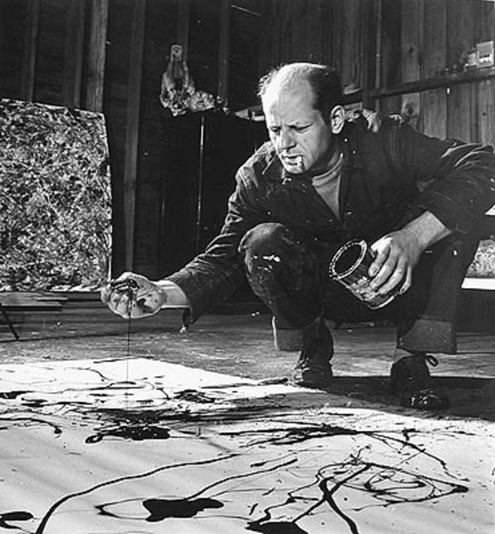
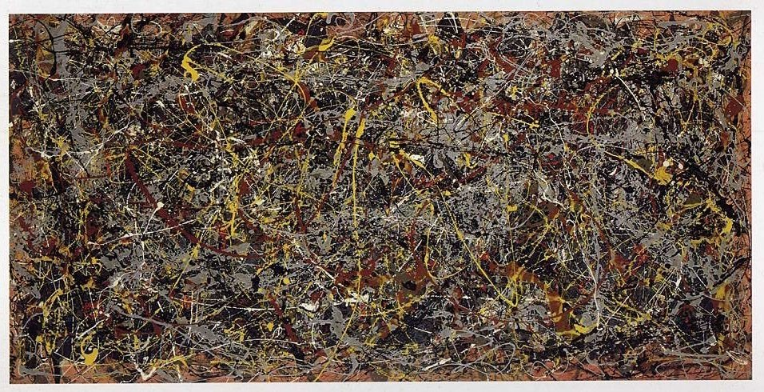
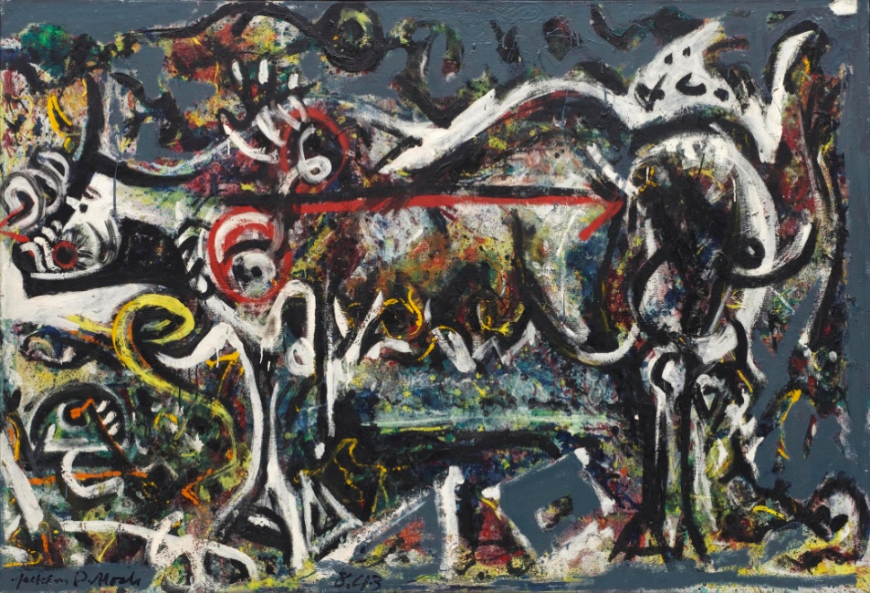
Abstract Art – Action Painting

Slide 12
Jackson Pollock No. 5, 1948
Year 1950
Type Oil on fiberboard
Dimensions 2.4 m × 1.2 m (8 ft × 4 ft)
Location Private collection, New York
Sold for 140 million dollars

Slide 13
Homework
Prepare a report about Impressionism.

