Slide 1
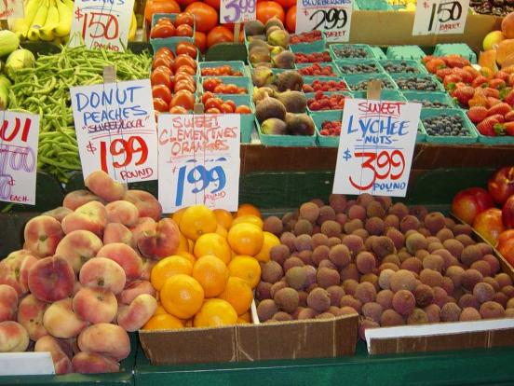
In the market.

Slide 2
Speech bubbles:
There’s some _____ .
There are some _____ .
Is there any _____ ?
There isn’t any _____ .
Are there any _____ ?
There aren’t any _____ .

Slide 3
There | is isn’t are aren’t | some any | apples meat carrots cheese tomatoes bread honey butter melons oil milk sugar oranges | in the | market.

Slide 4
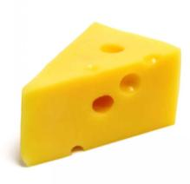
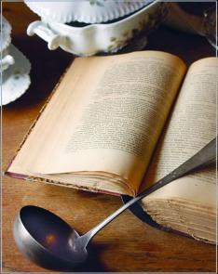
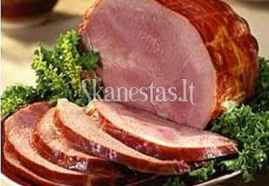
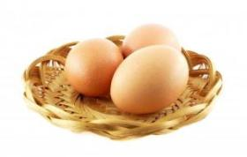
In the market.
I bought some eggs,
I bought some cheese,
I bought some ham,
But I didn’t buy any peas.
I went back home and opened my book –
What kind of meal am I going to cook?

Slide 5
In the market.
I bought ________
I bought ________
I bought ________
But I didn’t buy _______
I went back home and opened my book –
What kind of meal am I going to cook?

Slide 6
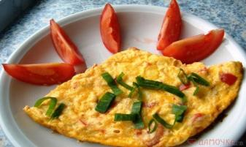
Recipes
Take six eggs. Break them into a bowl and add some milk. Mix together. Put a little oil in a pan and add the eggs and milk. Add salt and pepper. Slice three tomatoes and grate some cheese. Add these when the eggs are nearly cooked. Serve with potatoes and salad.

Slide 7
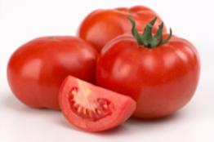
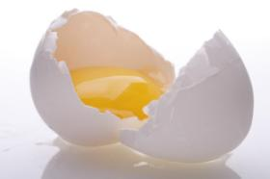
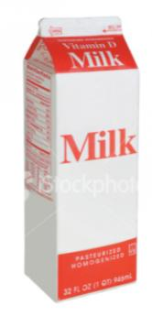
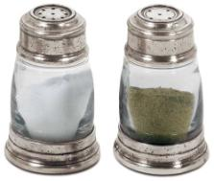
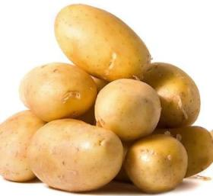
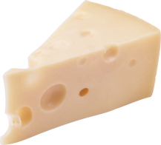
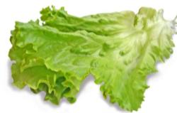
Shopping list
Tomatoes
Six eggs
Milk
Salt and pepper
Potatoes
Cheese
Salad

