Slide 1
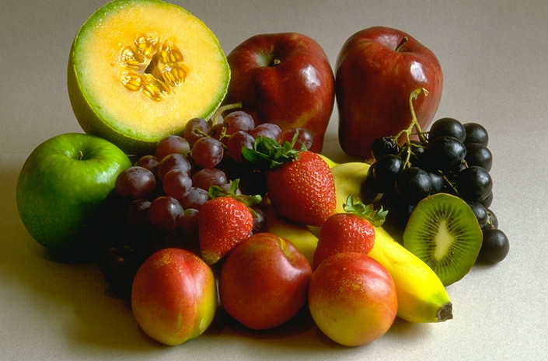
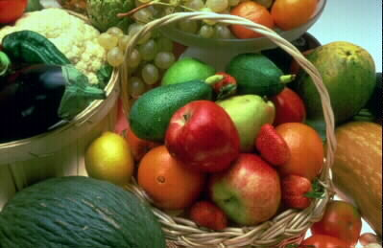
“Tasty
treats”

Slide 2
Countable
Lemon-лимон | Cucumber - огурец
Beans-бобы | Sandwich(es)-бутерброд
Mango-манго | Sausage-сосиска
Coconut-кокос | Pizza-пицца
Pineapple-ананас | Carrot-морковь
Tomato-помидор | Orange-апельсин
Banana-банан | Cake - торт
Egg(s)-яйцо | Cherry – вишня
Potato(es)-картофель | Onion - лук
Biscuit(s)-печенье

Slide 3
Uncountable
Butter-масло(сливочное) | Chocolate-шоколад
Flour-мука | Rice-рис
Olive oil-оливковое масло | Chips-жареная картошка
Sugar-сахар, песок | Milk-молоко
Salt-соль | Salad-салат
Pepper-перец | Jam-джем
Bread-хлеб | Yogurt-йогурт
Cheese-сыр | Lamb-баранина
Juice-сок | Beef-говядина
Water-вода | Tea-чай
Lemonade-лимонад

Slide 4
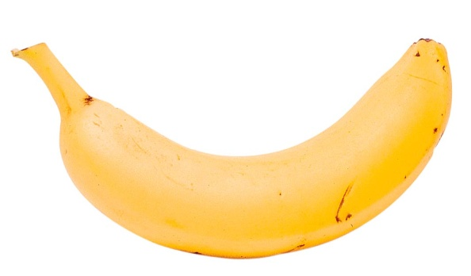
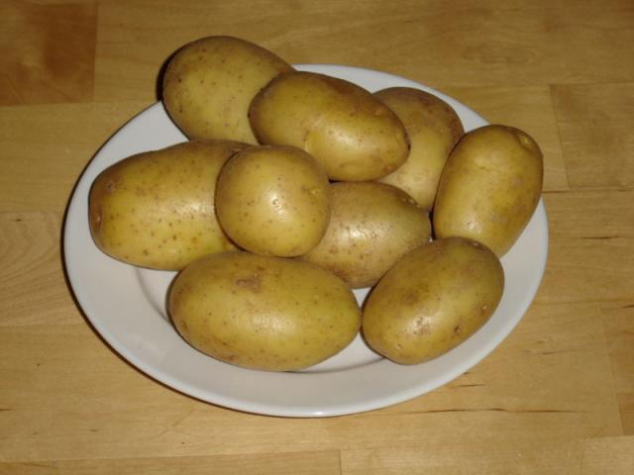
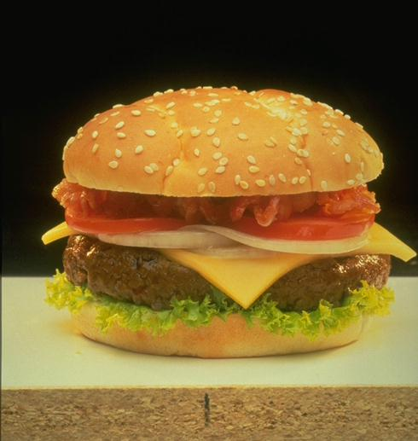
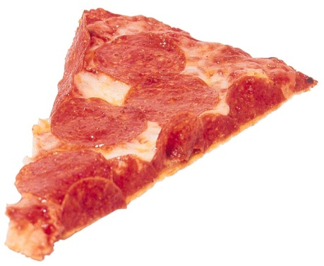
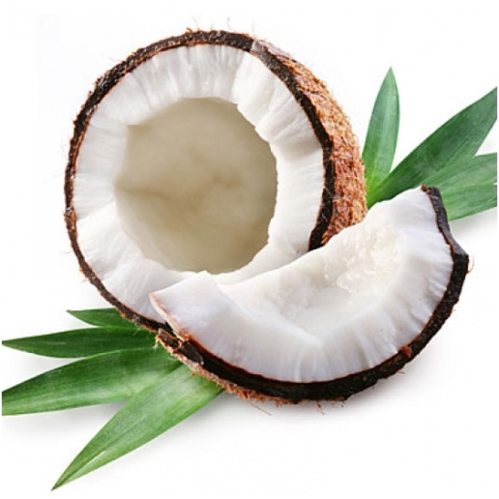
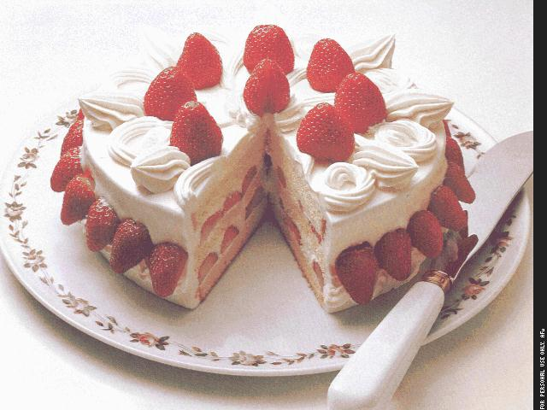
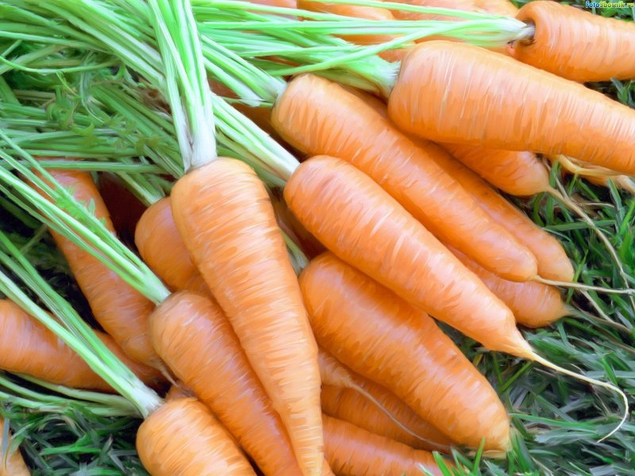
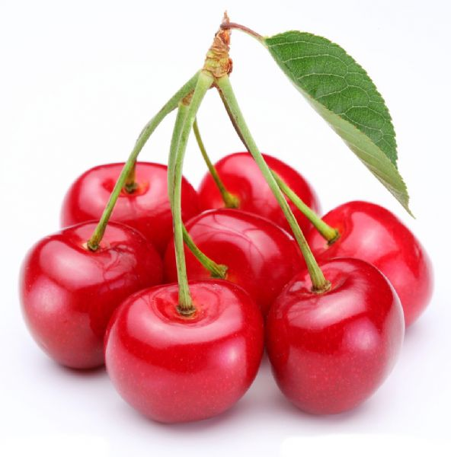
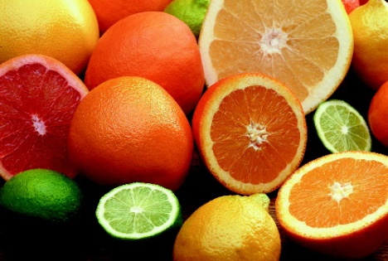
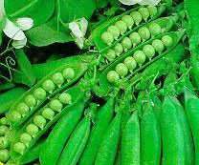
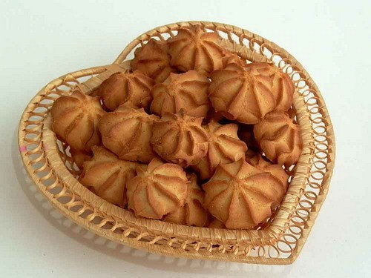
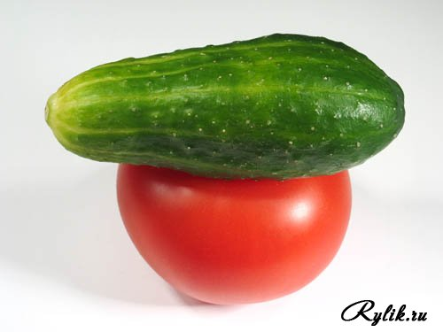
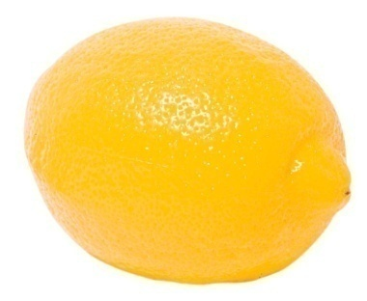
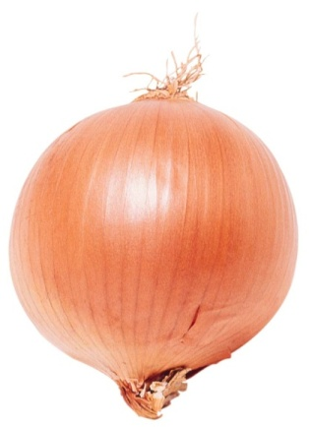
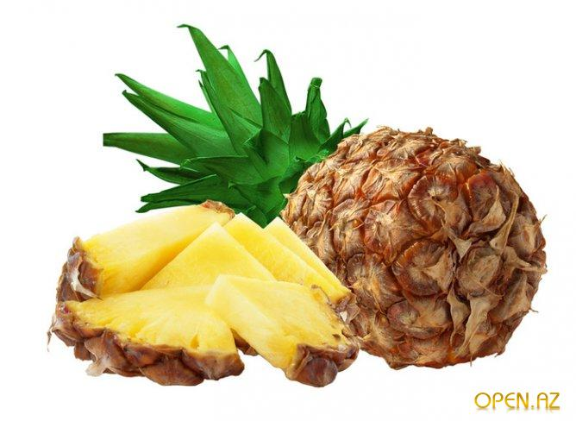
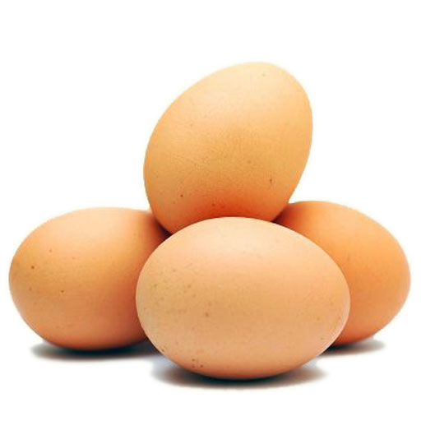
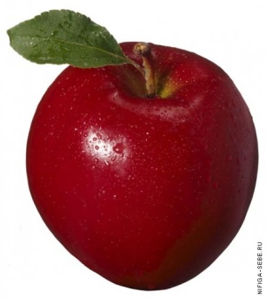
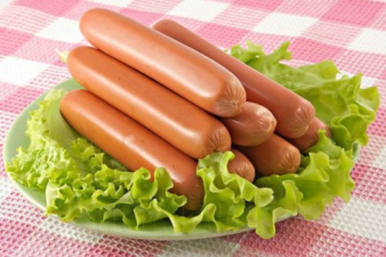
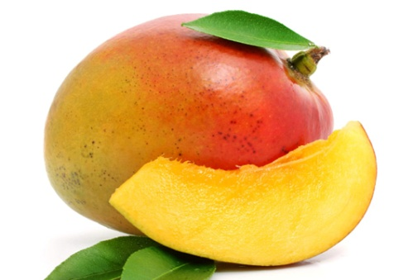
Countable

Slide 5
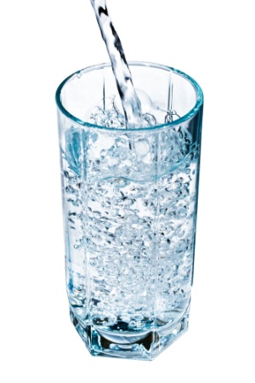
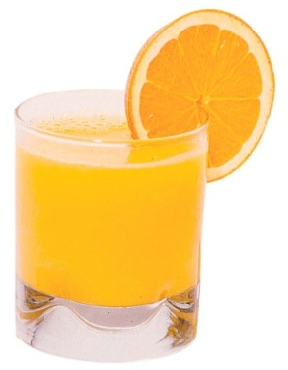
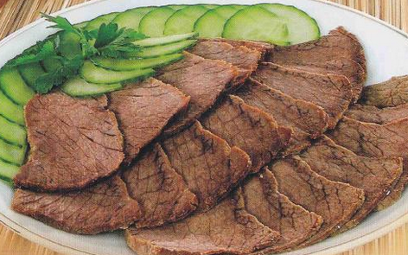
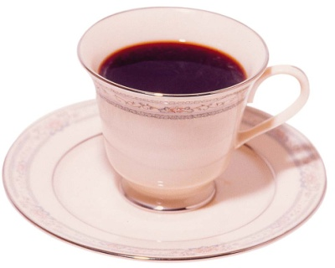
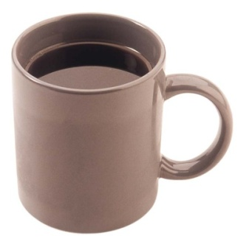
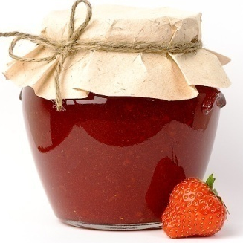
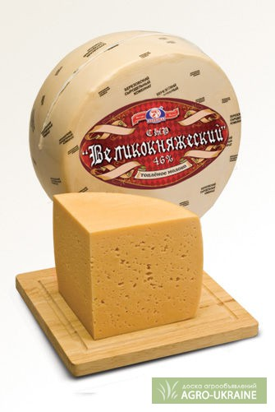
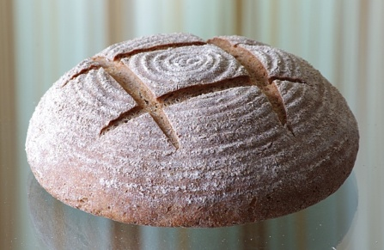
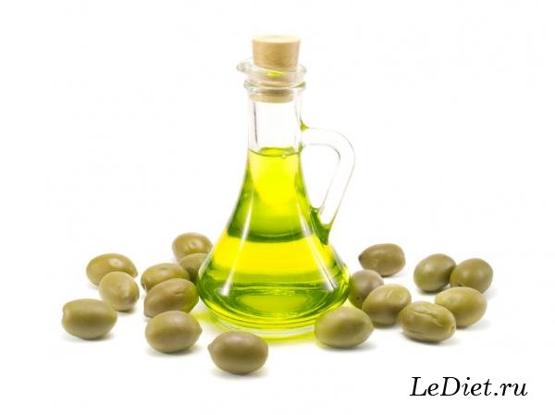
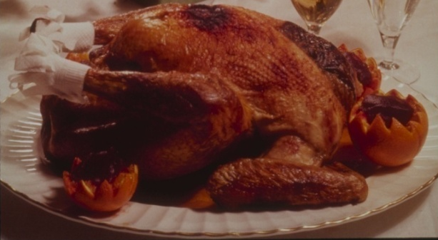
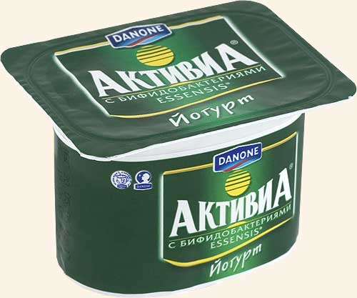
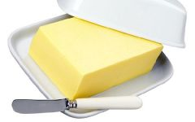
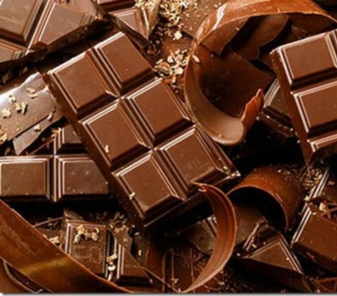
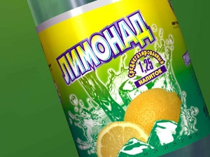
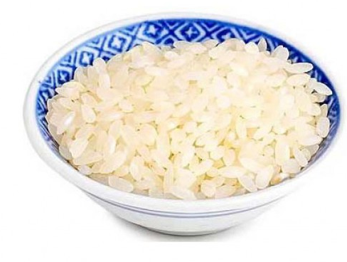
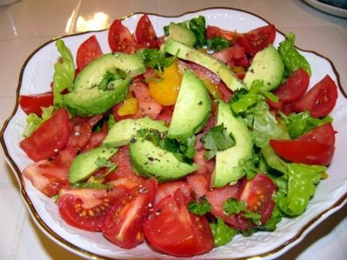
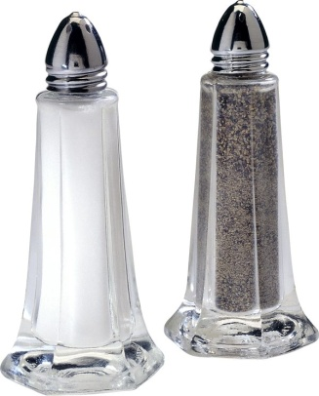
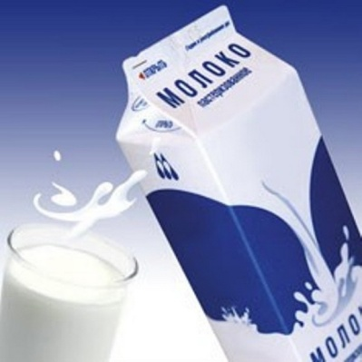
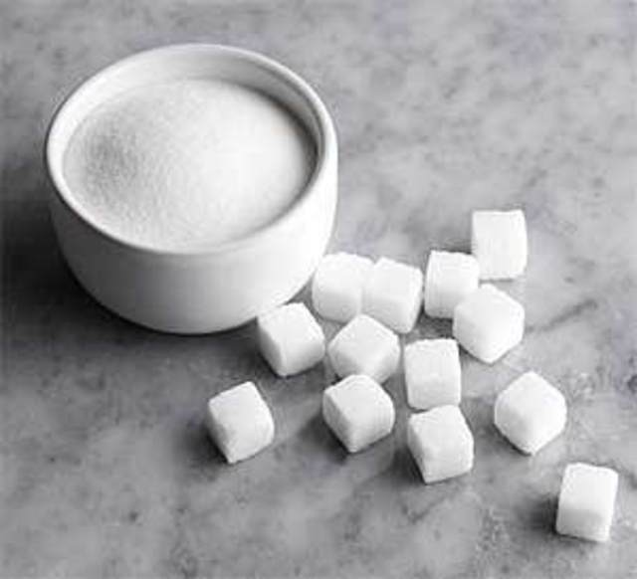
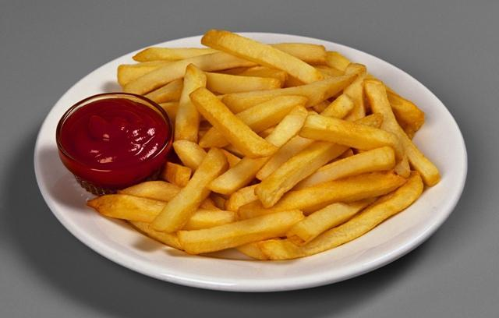
Uncountable

Slide 6
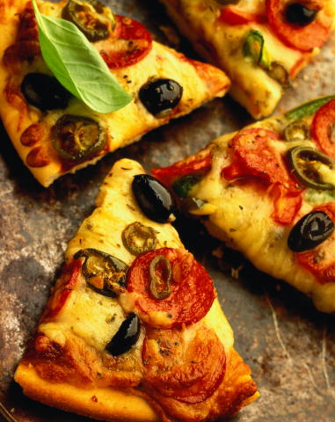
MENU
I have got with for breakfast.

Slide 7
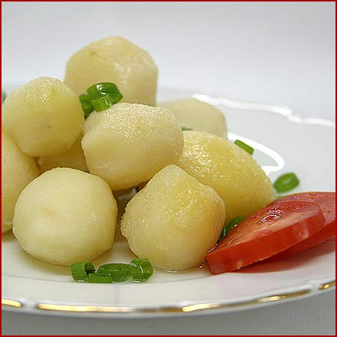

MENU
I have got with and
for lunch.

Slide 8

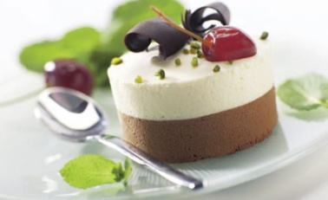
MENU
I have got with and
with for dinner.

Slide 9
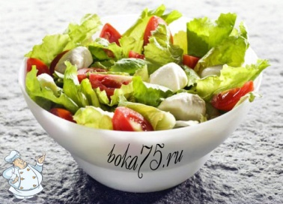
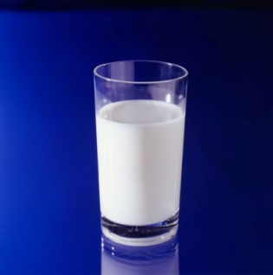
MENU
I have got with and
for supper.

Slide 10
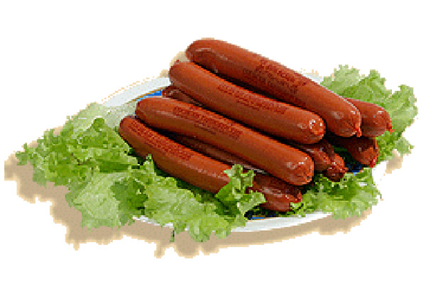
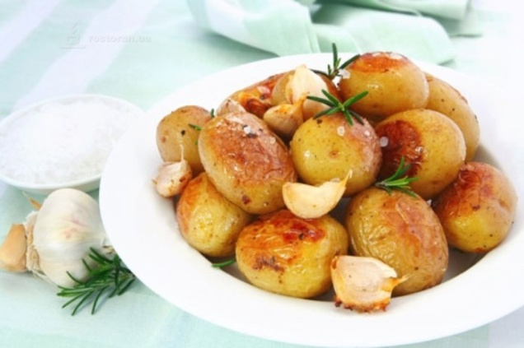
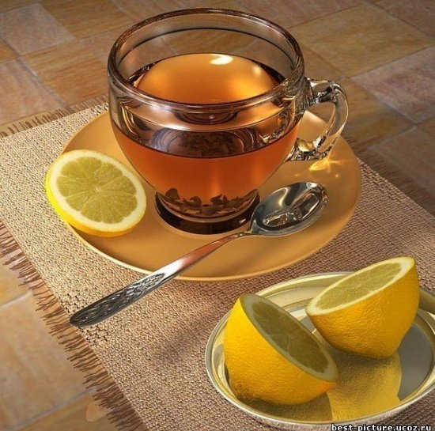
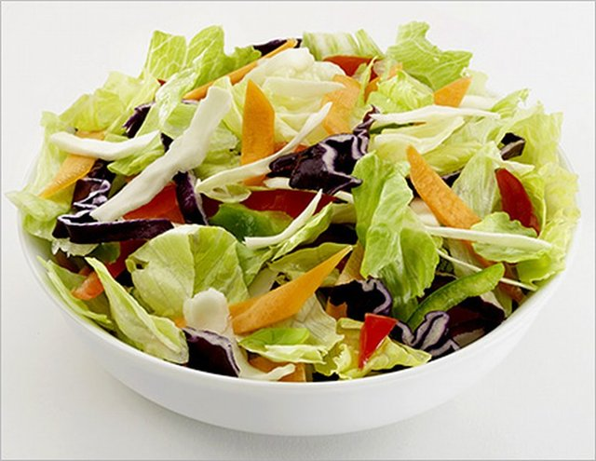

MENU

Slide 11


… pass
…?

Slide 12

!
How
many
much
…?

Slide 13


Not
many
much

Slide 14



Slide 15


Slide 16



… pass
!
How
many
much
1
2
…?
…?
Not
many
much
3
5
4

Slide 17
Много
Many
Much
(Countable)
(Uncountable)
_
_
?
?

Slide 18
We’ve got a lot of sugar.
We’ve got a lot of eggs.

Slide 19
Много
Many
A lot (of)
Much
(Countable)
(Countable,
(Uncountable)
_
_
uncountable)
?
?
+

Slide 20
Many\Much\A lot(of)
1. I have got…..butter in the fridge.
2. Have we got….. potatoes in the box?
3. They haven’t got….. sugar in the cake.
4. How…..eggs do you need? Not….
5. You’ve got…..onions in the soup.
6. I haven’t got……cucumbers in the salad.
7. Have they got…..tomatoes on the table?
8. How ….milk do we need? Not….

Slide 21

Homework:
Ex.3 p.46(Student’s book)

