Slide 1
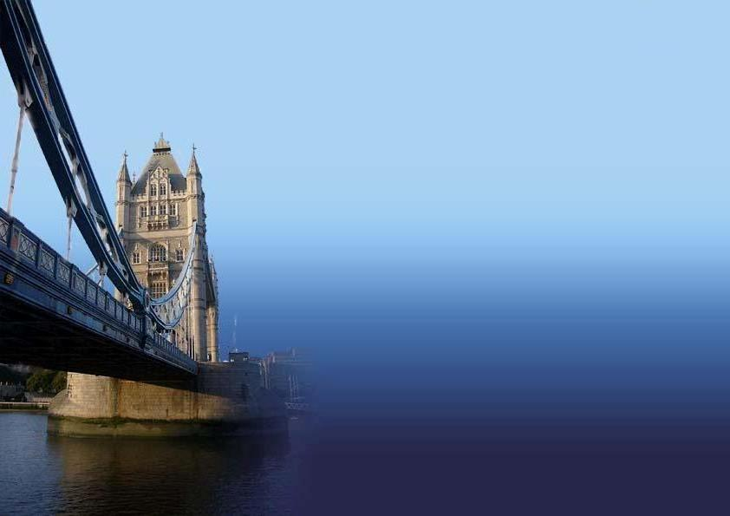
All About England
Булатова Н.Л.
МБОУ Калманская СОШ
с.Калманка, 2013
Notes:
Переход к следующему слайду (игровое поле) – по щелчку мыши. Переход к слайду с ресурсами – по управляющей кнопке в левом нижнем углу.

Slide 2
Location
Sights, icons
Daily life
History, politics
Holidays, food
10
20
30
40
50
10
20
30
40
50
10
20
30
40
50
10
20
30
40
50
10
20
30
40
50
Notes:
Каждое игровое поле с очками является гиперссылкой на соответствующий вопрос.

Slide 3
Location - 10
England is situated on the British …
Notes:
Переход к слайду с ответом осуществляется по управляющей кнопке (знак вопроса), к слайду с игровым полем – изображение домика.

Slide 4
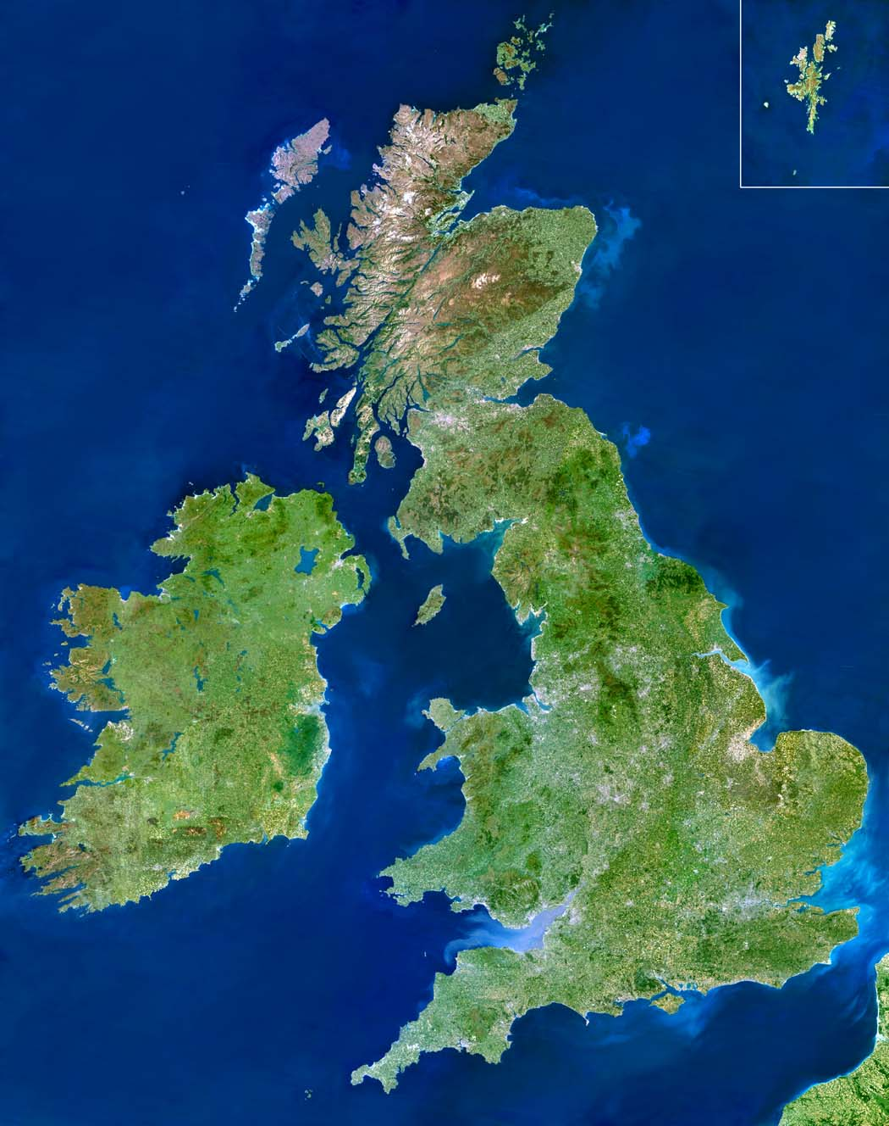
Isles
Notes:
Переход к игровому полю осуществляется по управляющей кнопке (домик).

Slide 5
Location - 20
It is the longest river wholly in England. It flows through London, the capital city.

Slide 6
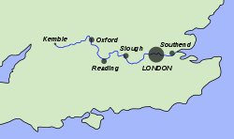
the Thames

Slide 7
Location - 30
England is a country that is a part of …

Slide 8
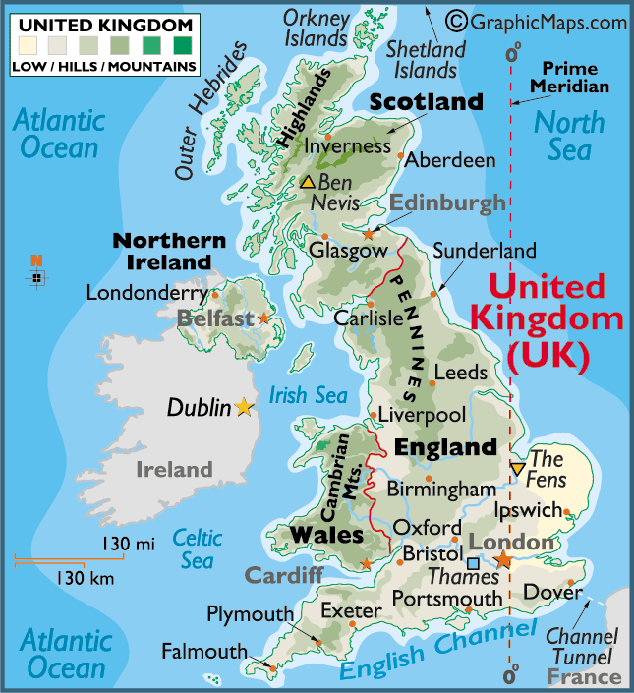
the UK

Slide 9
Location - 40
It is the piece of water between France and England.

Slide 10
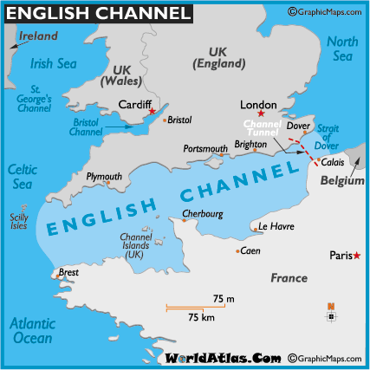
the English Channel

Slide 11
Location - 50
It is the oldest known name of the island of Great Britain.

Slide 12
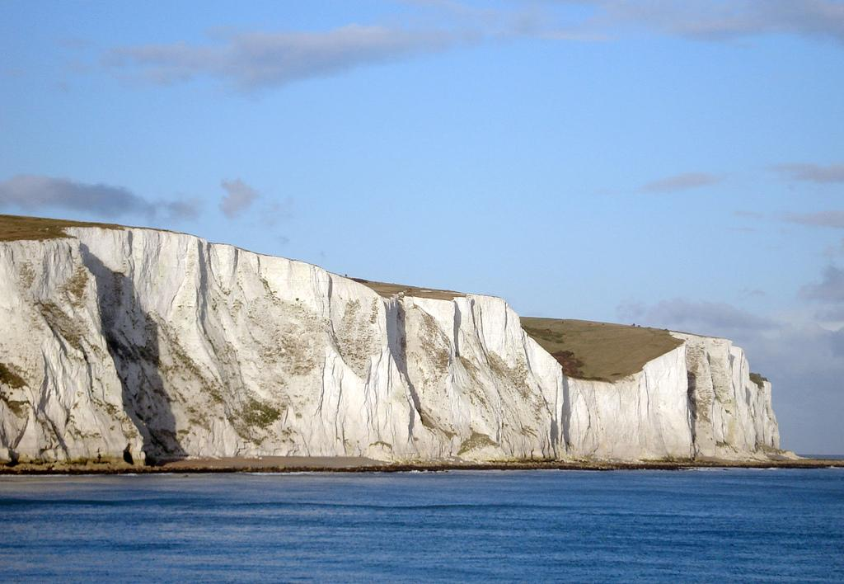
Albion

Slide 13
Sights, icons - 10
The Clock Tower in London is known the world over.

Slide 14
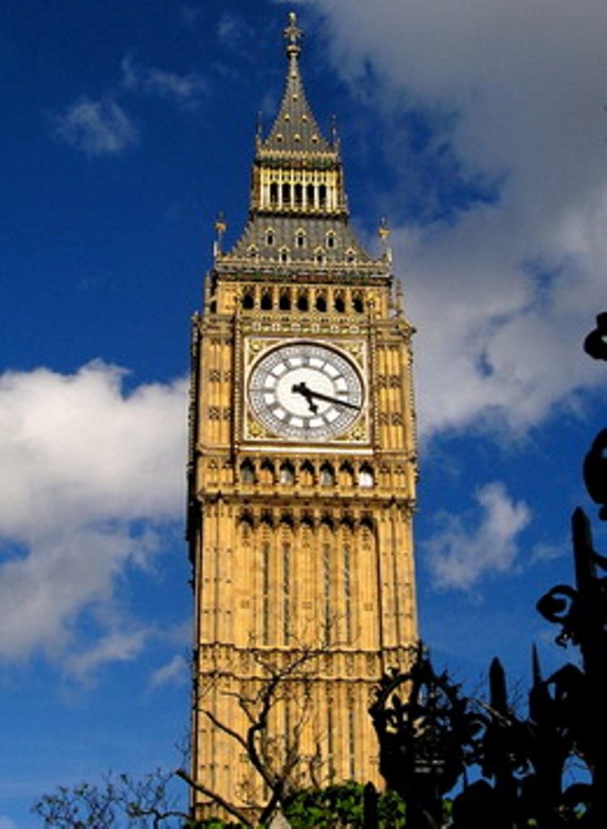
Big Ben

Slide 15
Sights, icons - 20
It is the official London residence of the British monarch.

Slide 16
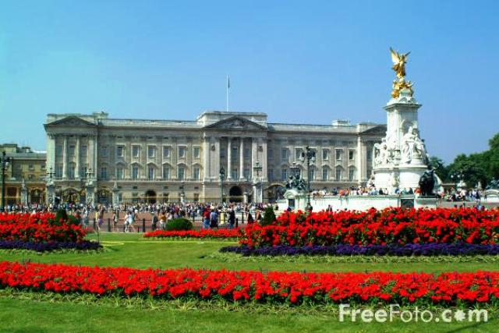
Buckingham Palace

Slide 17
Sights, icons - 30
It has two levels or 'decks'. They are in common use throughout the United Kingdom.

Slide 18
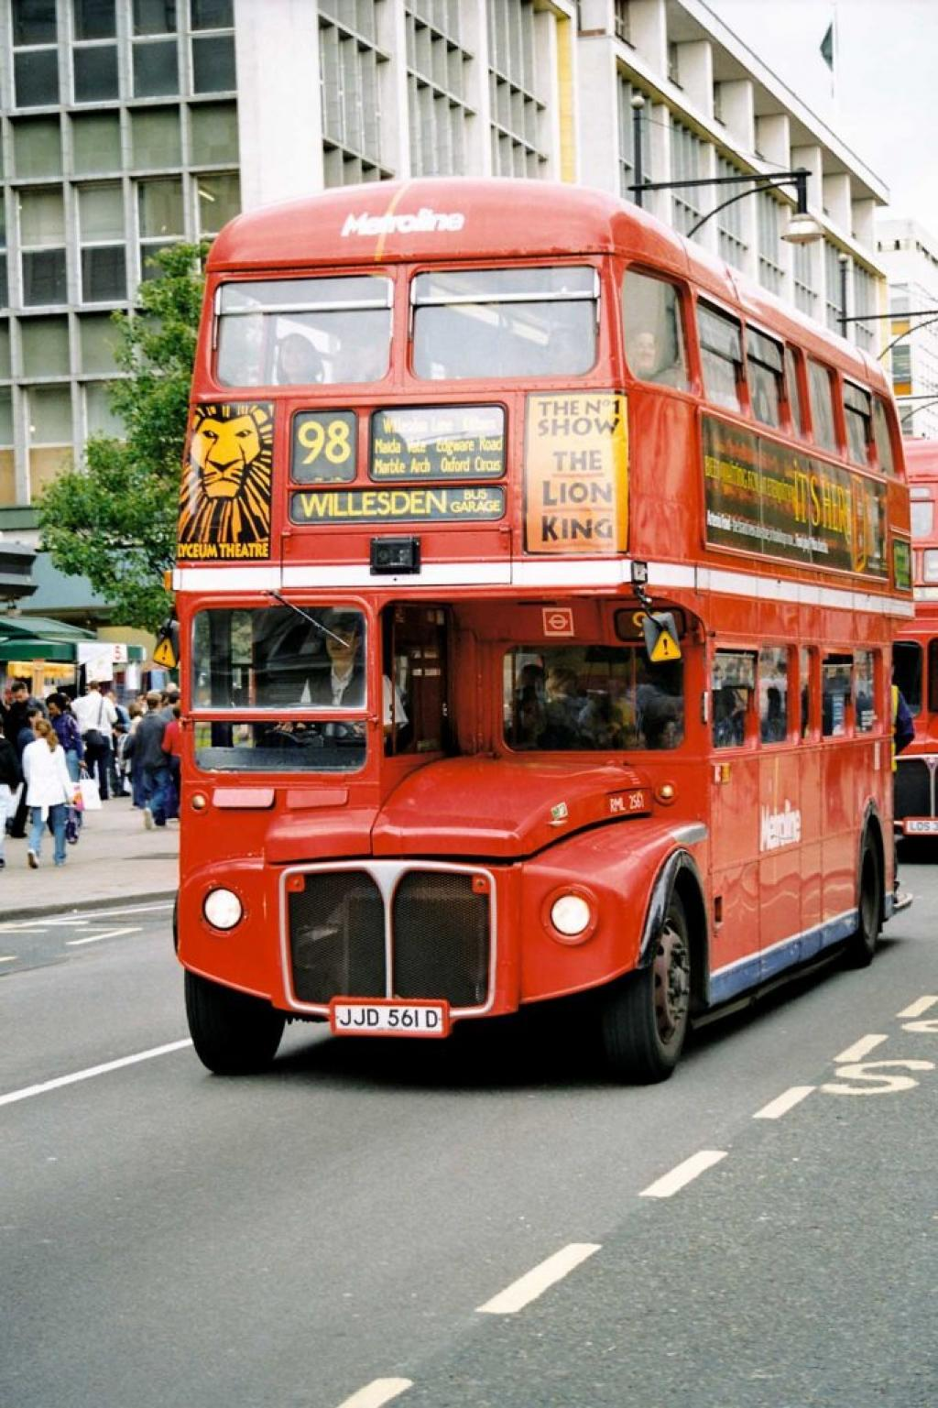
Double-Decker Bus

Slide 19
Sights, icons - 40
It is the most famous prehistoric monument in England.

Slide 20
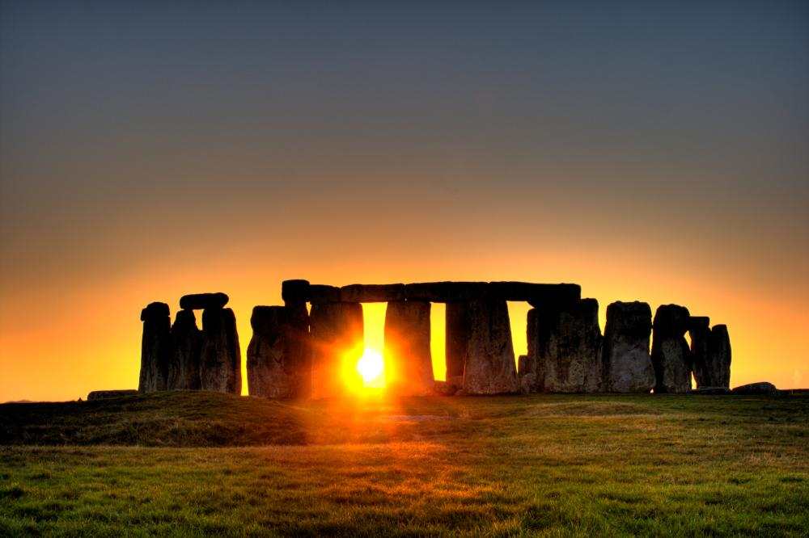
Stonehenge

Slide 21
Sights, icons - 50
The two "ancient universities" have many common features and are often jointly referred to as …

Slide 22


Oxbridge

Slide 23
Daily life - 10
England is a … -drinking nation. The most English like their … strong and dark, but with a lot of milk.

Slide 24
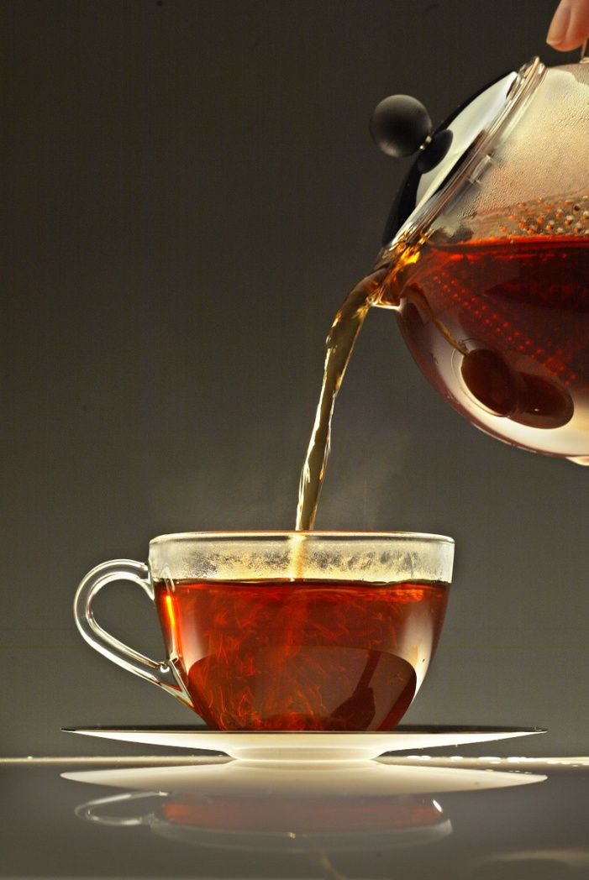
Tea

Slide 25
Daily life - 20
People talk about it more here than in the most parts of the world.

Slide 26
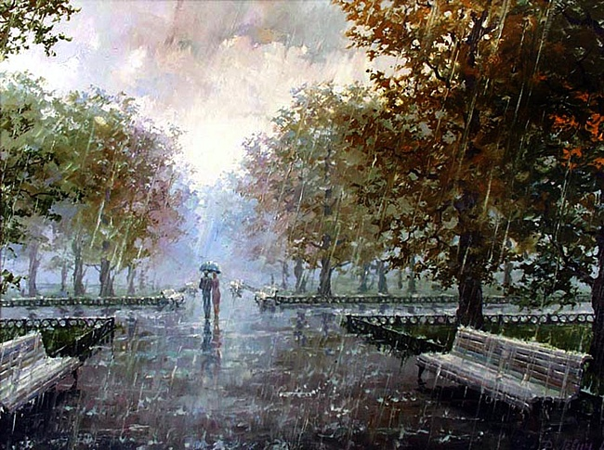
Weather

Slide 27
Daily life - 30
People talk, eat, drink, meet their friends and relax there.

Slide 28
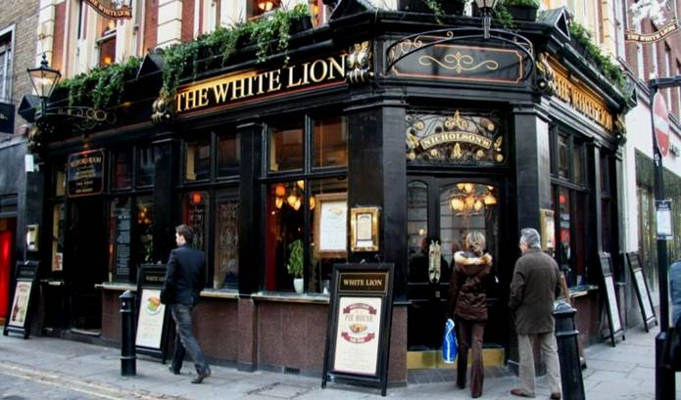
Pubs

Slide 29
Daily life - 40
There are many laws and organizations which exist here to protect … .

Slide 30
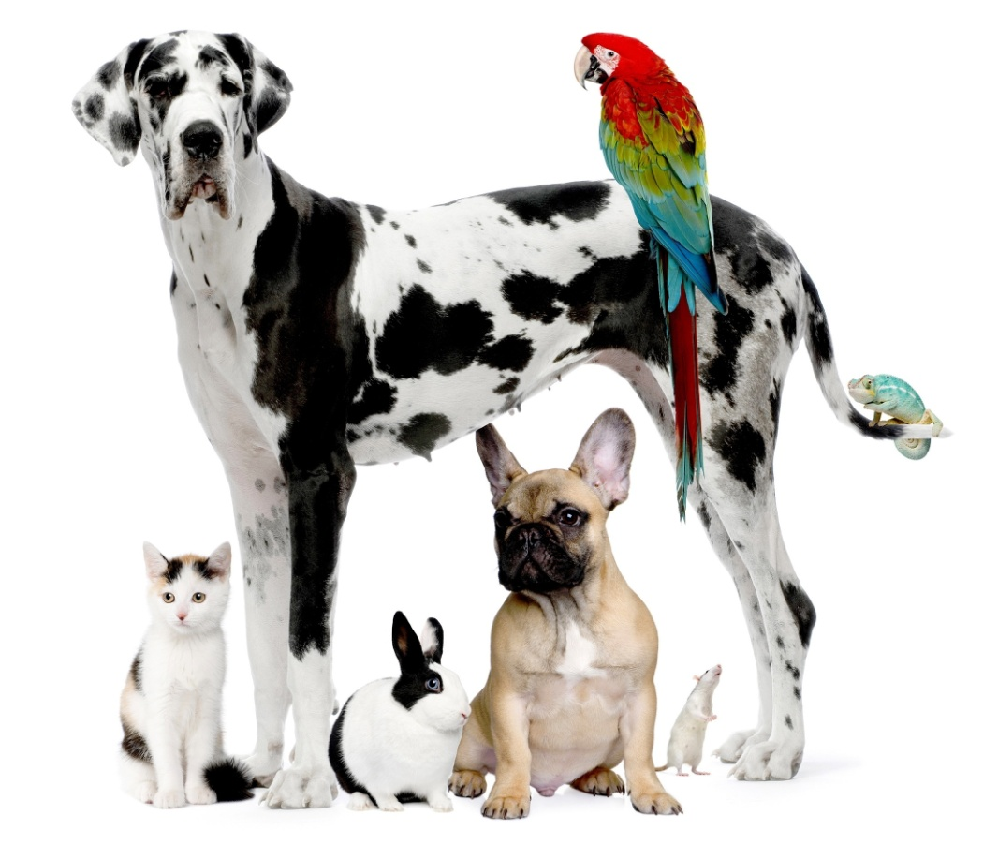
Animals

Slide 31
Daily life - 50
The term … is used for ‘traditional’ songs for young children in England.

Slide 32

Nursery rhymes

Slide 33
History, politics - 10
The capital of the UK.

Slide 34
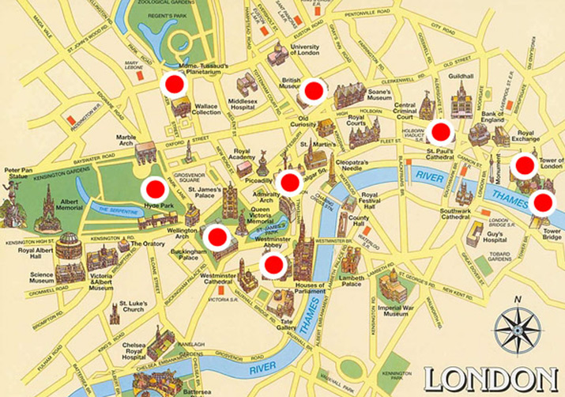
London

Slide 35
History, politics - 20
The UK is a constitutional monarchy. The official head of the state is the king or … .

Slide 36
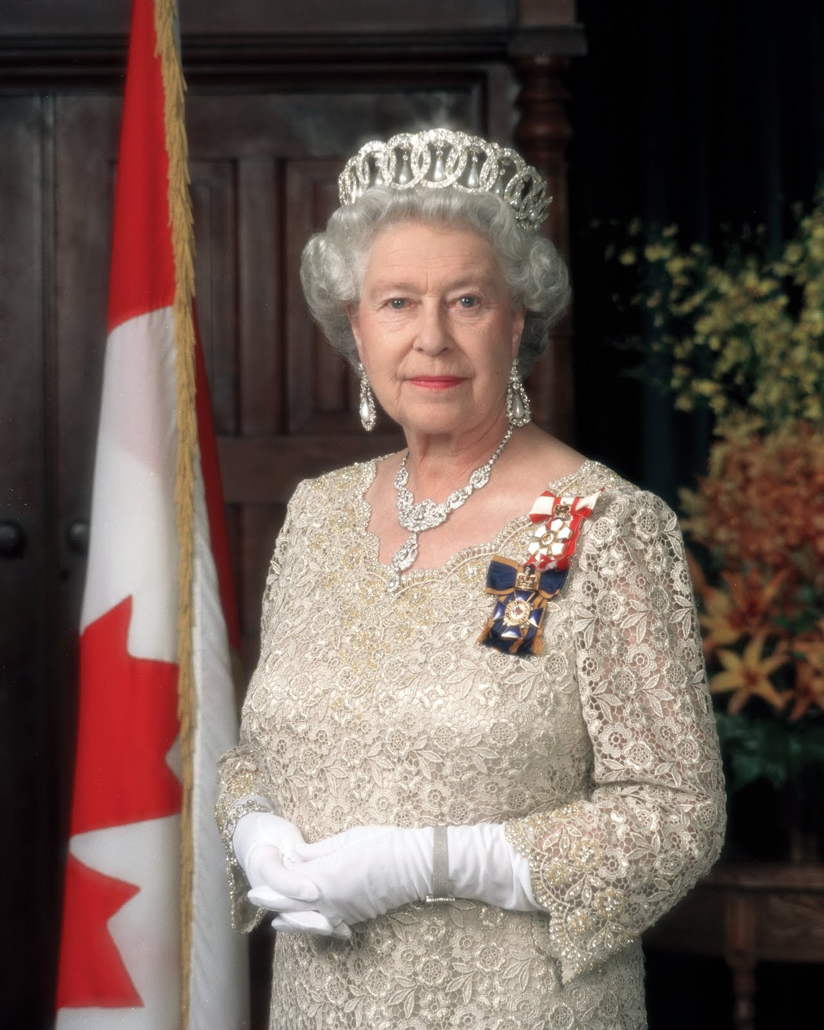
the Queen

Slide 37
History, politics - 30
The national symbol of England. It is connected with the history of the country.

Slide 38

the Red Rose

Slide 39
History, politics - 40
The symbol of national strength and of the British monarchy.

Slide 40

the Lion

Slide 41
History, politics - 50
It has existed since 1265 and consists of two chambers or houses: the House of Lords and the House of Commons.

Slide 42
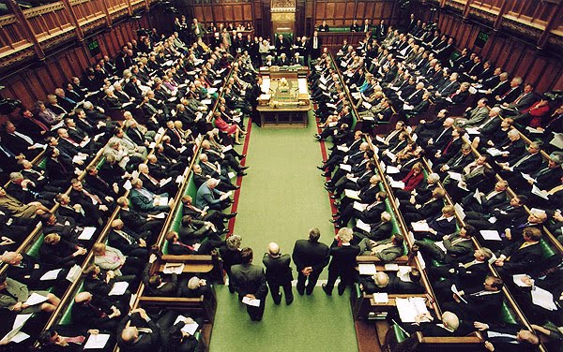
Parliament

Slide 43
Holidays, food - 10
It is celebrated on December 25. It is very popular in England.

Slide 44
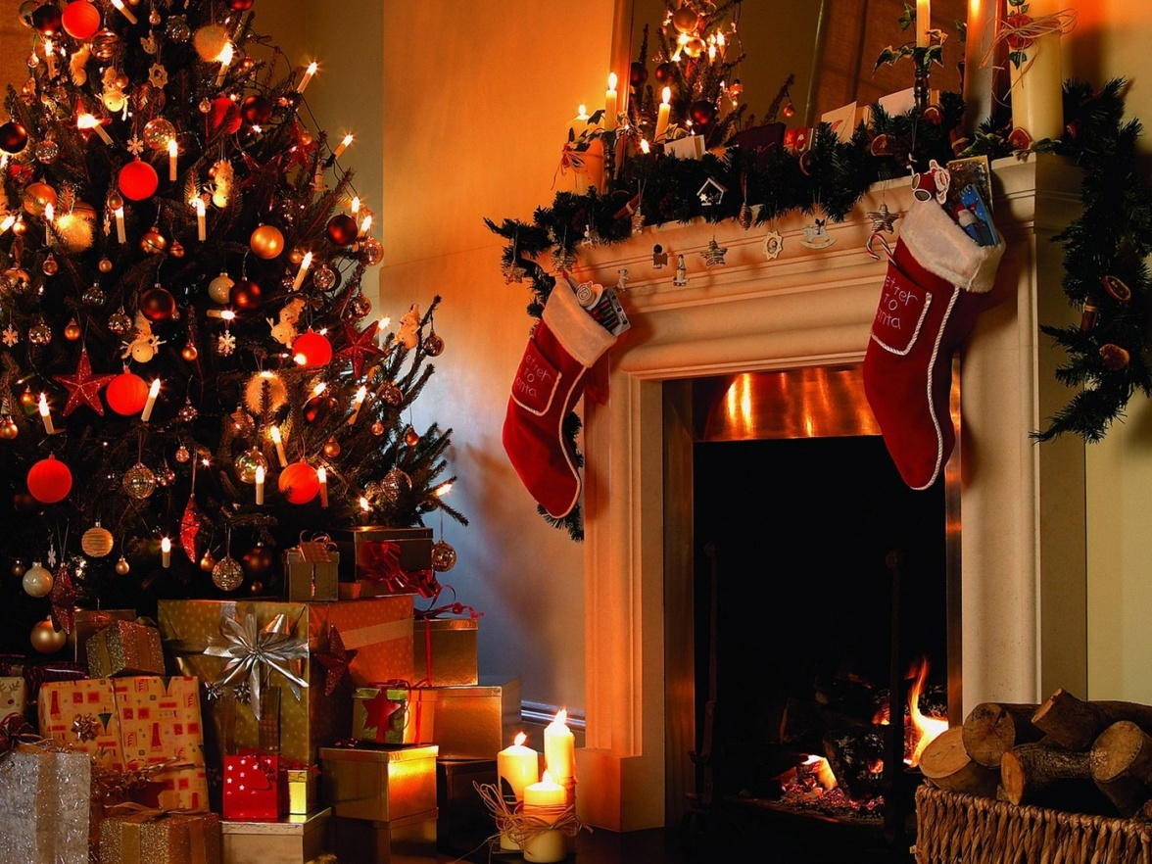
Christmas

Slide 45
Holidays, food - 20
The night of October 31 when it was formerly believed that the spirits of the dead appeared.

Slide 46
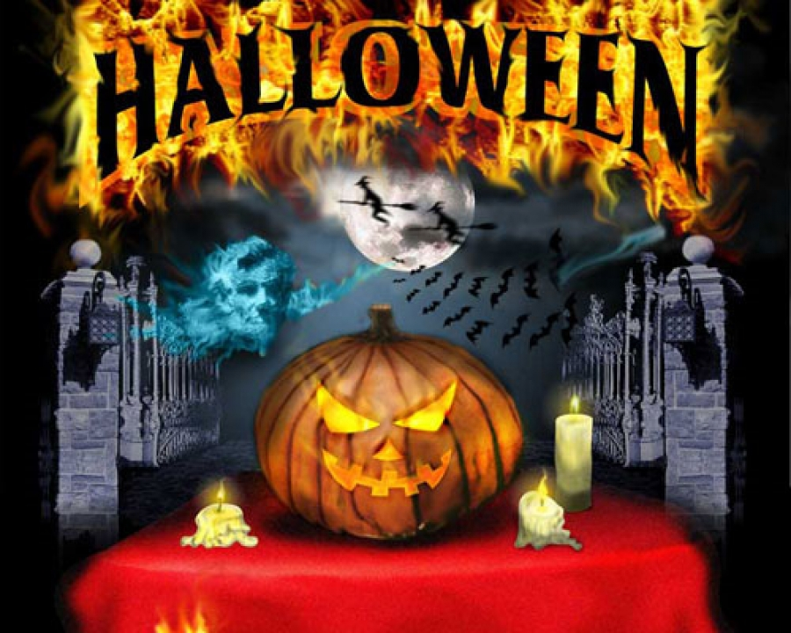
Halloween

Slide 47
Holidays, food - 30
It is a popular take-away food.

Slide 48
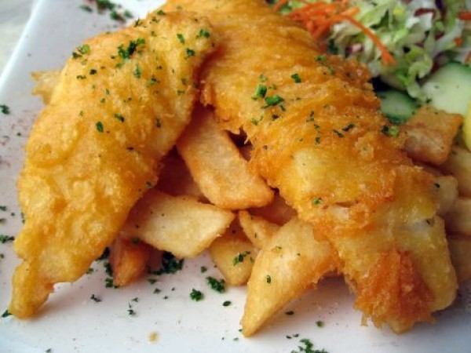
Fish and Chips

Slide 49
Holidays, food - 40
November 5th when people light fireworks and burn a guy on a bonfire.

Slide 50
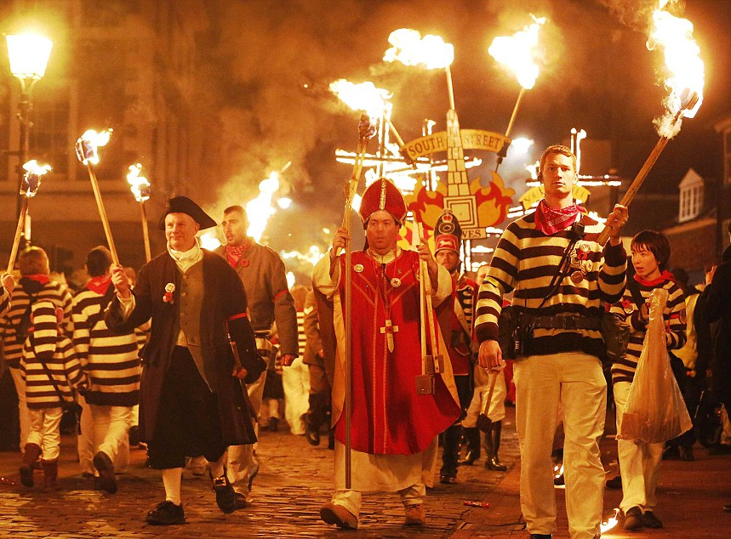
Guy Fawkes’ Night

Slide 51
Holidays, food - 50
It is a dish that originated in Yorkshire, England, and has attained wide popularity.

Slide 52
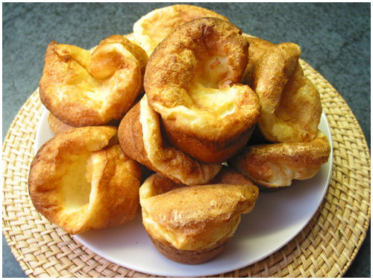
Yorkshire Pudding

Slide 53
Links:
http://dic.academic.ru/dic.nsf/ruwiki/13140
http://www.betravel.ru/images/maps/GB-large.gif
http://www.davidicke.com/wordpress/wp-content/uploads/legacy_images/stories/April_2010/englishc.gif
http://unusualplaces.aggress.ru/wp-content/uploads/2011/07/White-Cliffs-of-Dover-Ocean.jpg
http://www.geodus.com/globe-map/tresgrand/planet-observer_POPBRI.jpg
http://ama3onki.ucoz.ru/_nw/0/60416.jpg
http://www.exploreurope.net/wp-content/uploads/2009/06/31_02_1-buckingham-palace.jpg
http://redtrv.ru/wp-content/gallery/velikobritaniya/26770.jpg
http://www.kim-watkins.com/blog/wp-content/uploads/2013/06/Summer-Solstice-Stonehenge.jpg
http://icdn.lenta.ru/images/0000/0091/000000918476/detail_1358521753.jpg
http://www.against-the-grain.com/wp-content/uploads/2013/01/cambridge_university_press-tw.rpi_.edu_.gif
http://latimesblogs.latimes.com/photos/uncategorized/2009/03/25/tea.jpg
http://i.dailymail.co.uk/i/pix/2012/11/05/article-2228318-15DCE36F000005DC-710_964x634.jpg
http://receptyotkulinara.ru/up/article/img/35-yorkshirskiy-puding.jpg

Slide 54
Links:
http://dic.academic.ru/dic.nsf/ruwiki/13140
http://qrok.net/uploads/posts/2010-09/1284111337_allday.ru_24.jpeg
http://vilnews.com/wp-content/uploads/great-britain_files/image009.jpg
http://www.tapeta-krolik-psy-kot-szczurek-papuga.na-pulpit.com/zdjecia/krolik-psy-kot-szczurek-papuga.jpeg
http://www.comparestoreprices.co.uk/images/vt/vtech-nursery-rhymes-book.gif
http://www.200stran.ru/images/maps/1279460862_cc5f31.jpg
http://1.bp.blogspot.com/_dXvGSWAPHOE/TK5yoFKk17I/AAAAAAAACEU/HNb3khjBAwg/s1600/QueenElizabethII.jpg
http://upload.wikimedia.org/wikipedia/commons/thumb/2/28/Red_rose.jpg/393px-Red_rose.jpg
http://www.bankrollmob.com/userimages/2009/1046.jpg
http://4.bp.blogspot.com/-sBFfX54Tsds/TVkMYQongII/AAAAAAAAA7s/vXfZBXdWlyI/s1600/house%2Bof%2Bcommons.jpg
http://www.look.com.ua/pic/201209/1400x1050/look.com.ua-24130.jpg
http://mistonagori.com.ua/wp-content/uploads/2012/11/184b7cb84d7b456c96a0bdfbbeaa5f14_XL.jpg
http://culinar.bzi.ro/public/upload/photos/15/Peste.jpg

