Slide 1
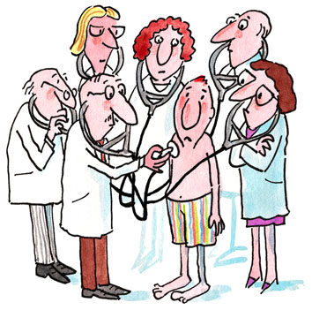
Health & Medicine

Slide 2
The Plan:
Fill in the blanks. Reading.
Fill in the prepositions.
Complete the sentences.
Match the parts of the sentences.
Match the words with their definitions.
Listening.
Paraphrase.
Word formation.
Choose the right variant.
Guess the word.

Slide 3
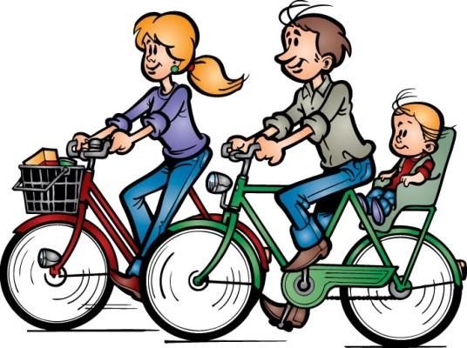
Fill in the blanks. The first letter of each missing word has been given.

Slide 4
A Picture of Health.
People nowadays are more health-conscious than they used to be. We jog to keep(1) f… or take other forms of regular(2) e…. Thousands of us go to a(3) g… on a regular basis. Many more(4) d… to lose weight. Fortunately, (5) s…
has been banned on most flights and in most public places because everyone agrees it does(6) h… to our health.

Slide 5
A Picture of Health
However, there are killer (7) d… like AIDS and cancer which still seem to be incurable. And malaria is the biggest cause of (8) d… in the Third World. Heart (9) a… remain the most common cause of death in Europe. The importance of (10) h… is reflected in everyday expressions such as “ to drink to someone’s health” or saying “ Your health!” as we drink a glass of wine.

Slide 6

The Answers:
1 fit
2 exercise
3 gym
4 diet
5 smoking
6 harm
7 diseases
8 death
9 attacks
10 health

Slide 7
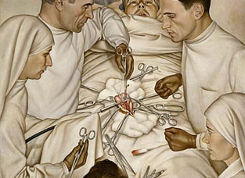
Fill the gap with an appropriate word from the list. You need to use some words twice.

Slide 8
For
from
on
against
out
with
in
1.Children should be vaccinated….measles and rubella.
2.Paul won’t be in work today- he's gone down….flu.
3.Pollution in cities is causing more and more children to be treated….asthma.
4.You ‘re so ….of condition! Don't you think swimming every morning will help?
5.Too many people die….lung cancer due to smoking.

Slide 9
for
from
on
against
out
with
in
6.If you have a fever, there is definitely something wrong….you.
7.I spent the weekend in a health farm and feel….really good shape now.
8.She’s still recovering….the stomach bug she picked up on holiday.
9.It’s the best that we operate….you and remove the lump from your breast.
10.I’ve injected your mother….a painkiller so that she can sleep.

Slide 10
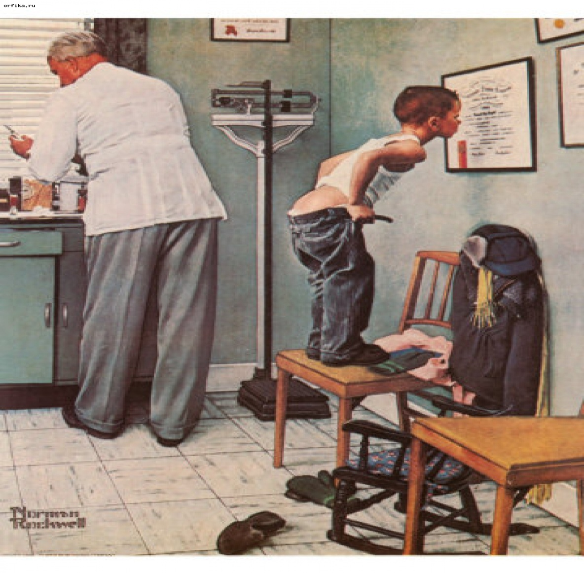
The answers:
1.Against
2.With
3.For
4.Out
5.From
6.With
7.In
8.From
9.On
10.with

Slide 11
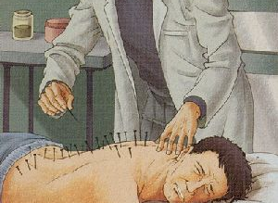
Fill in each blank with an appropriate word from the list.

Slide 12
m
Lie down
hurt
fainted
symptoms
had
Pain-
less
1.I am feeling ill- I think I’d better go and….
2.I felt so dizzy that I nearly….
3.I had to have an internal examination but it was quite….
4.They gave me an injection and it really….
5.The….are a high temperature and a rash.
6.He….a heart attack and had to be rushed to hospital.

Slide 13
agony
agony
aching
die
Suffer-
ed
7.The doctor prescribed some drops for my earache but it’s still….
8.I fell down the stairs and I was in….waiting for the ambulance to arrive.
9. He….from an incurable illness for many years.
10. I hope…. I in my bed of old age,

Slide 14
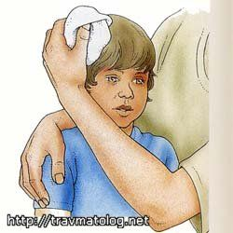
The answers:
1 lie down
2 fainted
3 painless
4 hurt
5 symptoms
6 had
7 aching
8 agony
9 suffered
10 die

Slide 15
Match the first part(1-10) with the second part (a-j) of these sentences.
1.If you’ve got a bad headache,
2.You have a heart problem and
3.He sprained his ankle and
4.She went out in the pouring rain and caught
5.She’s not at work because she’s gone down
6.He works out in the gym because
7.She went on a diet and
8.He had spots all over his face because
9.After aerobics last week
10. Not all cancers are
a. with flu
b. incurable
c. lost weight
d. was in great pain for days
e. need an operation
f. he had measles
g. a cold
h. he wants to feel fit
i. take an aspirin
J. my legs felt really sore

Slide 16
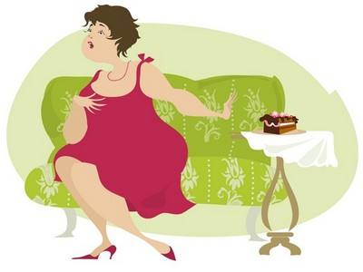
The answers:
1 i
2e
3 d
4 g
5 a
6 h
7 c
8 f
9 j
10 b

Slide 17
Find the words that match the definitions.
1.to use a needle to put medicine into your body
2.a soft substance you rub on your skin as a treatment
3.a room in a hospital you stay in while you are ill
4.a pain in your head
5 a doctor writes on it what medicine a sick person needs
6. many cases of an infectious disease occurring at the same time
7. that causes a person to die
8.an illness of the mind
9.to make someone who is ill well again
10.thin and weak because you are old or very ill
Cure
Fatal
Frail
Inject
Mental illness
Prescription
Epidemic
Ointment
Ward
Headache

Slide 18
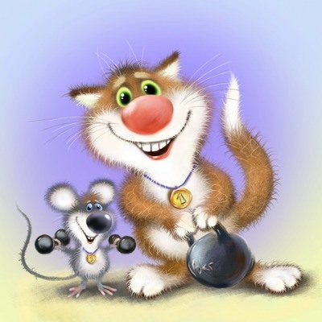
The answers:
1 inject
2 ointment
3 ward
4 headache
5 prescription
6 epidemic
7 fatal
8 mental illness
9 cure
10 frail

Slide 19
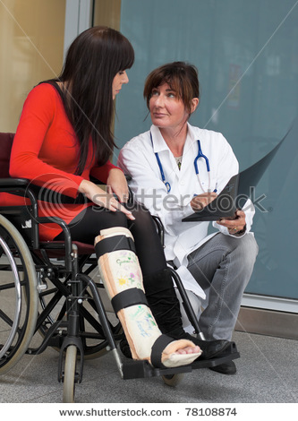
You will hear a doctor talking to a girl who has had an accident. For each question, fill in the missing information in the numbered space.

Slide 20
Name of patient: Lucy Martin
Type of injury: twisted (1)…
Cause: fell during gym lesson
Advice given:
-try to (2)… the ankle
-don’t (3)… for the next few days
-put (4)…on regularly.
-put elastic bandage on.
-take pain killers if necessary- not more than (5)… tablets in 24 hours.
Next appointment: seven days 'time in Clinic 6 – to be shown (6)…

Slide 21
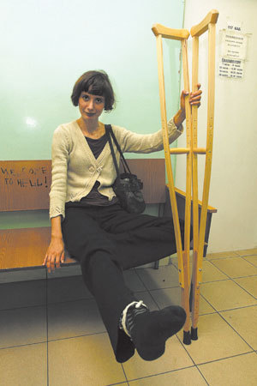
The answers:
1 ankle
2 rest
3 walk
4 ice
5 eight
6 exercises

Slide 22
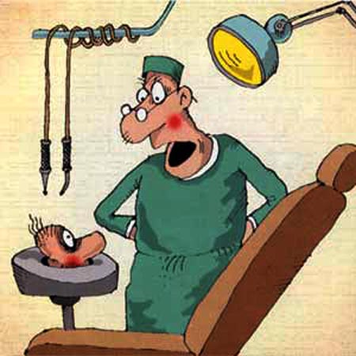
Complete the second sentence so that it is as similar in meaning as possible to the first, using the word given. Do not change this word.

Slide 23
1.I had to have a tooth extracted last week.
out
I had my….
2.Has he recovered from his illness yet?
over
Has….
3.He took care of you while you were ill.
after
He….

Slide 24
4.You’ve gained a lot of weight since I last saw you!
on
You’ve…..
5. The drugs aren’t having any effect now.
off
The effect….
6.After fainting he regained consciousness after a few minutes.
round
Having….

Slide 25
7. He caught flu and had to have time off work.
down
He….
8. She has had a lovely baby girl and is feeling fine.
birth
She has….

Slide 26
9. Since her heart attack, my mother has not been at all well.
poor
Ever….
10. Michelle often has terrible headaches.
from
Michelle….

Slide 27
The answers:
1.tooth out last week.
2.he got over his illness yet?
3.looked after you while you were ill.
4.put on a lot of weight since I last saw you!
5. of the drugs has worn off now.
6. fainted, he came round after a few minutes.
7. came down with flu and had to have time off work.
8. given birth to a lovely baby girl and is feeling well.
9.since her heart attack, my mother has suffered from poor health.
10. suffers from terrible headaches.

Slide 28
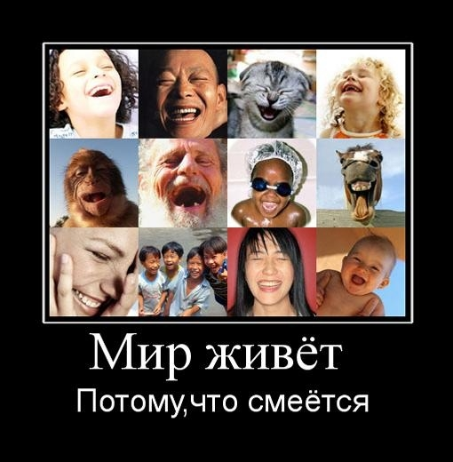
Use the word given in capitals at the end of each line to form a word that fits in the space in the same line.

Slide 29
Read the text. Use the word given in capitals at the end of each line to form a word that fits in the space in the same line.
Happy is Healthy.
Medical research has found that(1) happy
has a strongly beneficial effect on
health. The healing properties of ( 2 ) laugh
are such that humour is now being
used alongside more ( 3) courses of tradition
(4 ) in some hospitals. In a London treat
children’s hospital, for example, two
clowns are provided for the (5 ) of entertain
patients. Doctors say that these clowns
are ( 6) in making the children feel happy. success

Slide 30
Happy is healthy.
It seems that when we laugh, there
can be a( 7 ) in both blood pressure reduce
and the amount of( 8 ) in our muscles. tense
Although it is( 9 ) to prove it at the possible
moment, this may also mean that
people who feel unhappy and who are,
therefore,( 10 ) to laugh so much, likely
suffer more often from physical( 11 ). ill

Slide 31
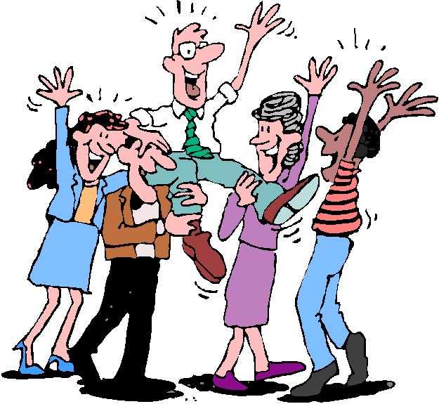
The answers:
1 happiness
2 laughter
3 traditional
4 treatment
5 entertainment
6 successful
7 reduction
8 tension
9 impossible
10 unlikely
11 illness

Slide 32
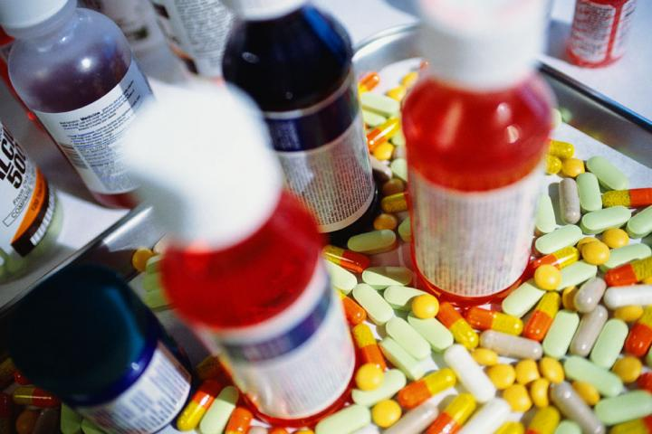
Read the text and choose the correct word for each space.

Slide 33
An Amazing Pill
Doctors have a new way to find ( 1 ) what is happening in your stomach. All you ( 2 ) to do is take a small pill. The pill, which is about the same ( 3 ) as a thumb nail, contains a light and a video camera. When it gets to the stomach, the camera starts to (4) pictures which are recorded by equipment on a special belt ( 5 ) around the patient’s stomach.
1 A out B at C on D in
2 A must B should C have D can
3 A taste B size C use D type
4 A take B make C show D paint
5 A carried B worn C shown D dressed

Slide 34
An Amazing Pill
The pill can ( 6 ) to work for up to seven hours and can be used to see ( 7 ) the patient has any stomach problems (8 ) as bleeding. The amazing tablet was ( 9 ) by the American space agency NASA, and can certainly
go where no medical equipment has gone before! Doctors say it is a ( 10 ) cheaper and safer way of discovering the (11) of stomach pain than having an operation.
6 A continue B keep C press D move
7 A as B unless C whether D invent
8 A like B same C such D so
9 A done B found C built D invented
10 A very B most C much D more
11 A causes B reasons C directions D places

Slide 35
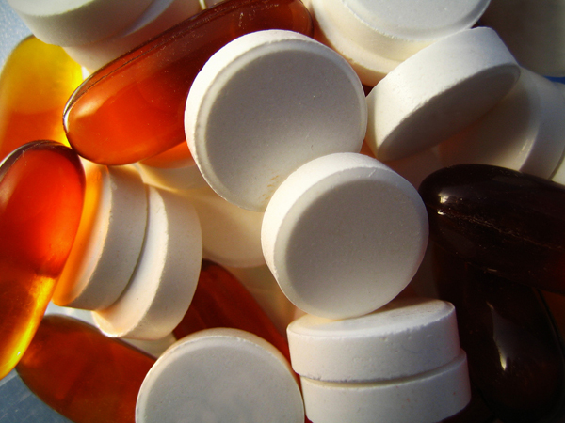
The answers:
1 A
2 C
3 B
4 A
5 B
6 A
7 C
8 C
9 D
10 C
11 A

Slide 36
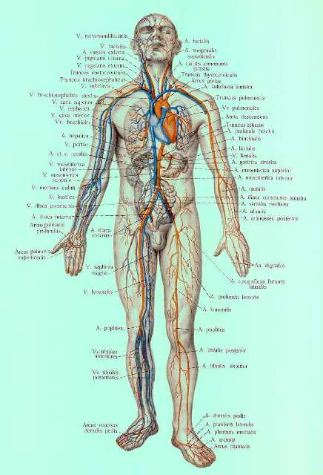
Complete these words. The first letter is given. They are all parts of the body.

Slide 37
1 .t….( you have one on each hand)
2 .l….( two parts of your mouth)
3. e….( you hear with these)
4. g….(your teeth grow in them)
5.e….( the middle part of your arm)
6. s….( the part under your foot)
7. h….( Achilles had a problem with this)
8. k….( a joint in your leg)
9. c….( the part below your mouth)
10.s….(the soft part below your waist)

Slide 38
11.n….(it holds up your head)
12. s….( the row of bones down the centre of your back)
13. w….( you put your watch round it)
14. n….( the small hollow place in the centre of your stomach)
15. c….( you have one on each side of your face)
16. e….( the flap that comes down over your eye while you sleep)
17.n….( the holes of your nose)
18.s….( the front part of your lower leg)
19. f….( the part of your face above your eyes)
20. t….( the front part of your neck)

Slide 39
The answers:
1.thumb
2.lips
3.ears
4.gums
5.elbow
6.sole
7.heel
8.knee
9.chin
10.stomach
11.neck
12.spine
13.wrist
14.navel
15.cheek
16.eyelid
17.nostrils
18.shin
19.forehead
20.throat

Slide 40
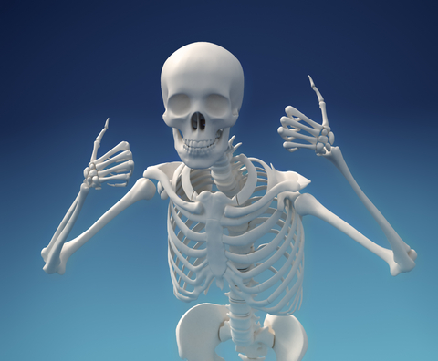
Good luck! And don’t be afraid of doctors!

