Slide 1
ЙОШКАР-ОЛИНСКИЙ АГРАРНЫЙ КОЛЛЕДЖ
Иностранный язык
Группа Э-41
Преподаватель Коновалова М.Н.

Slide 2
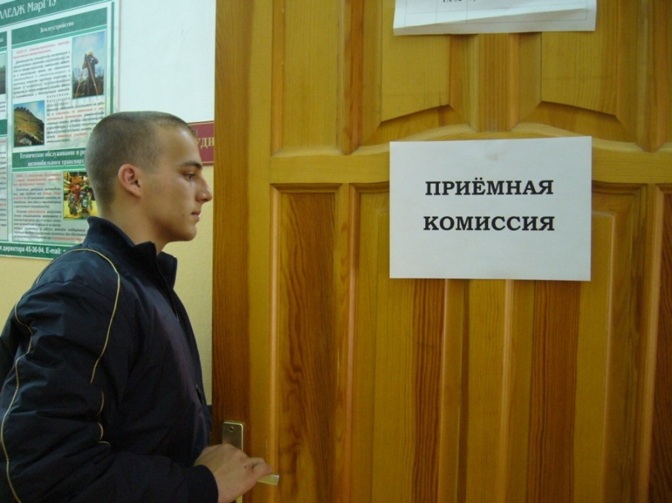
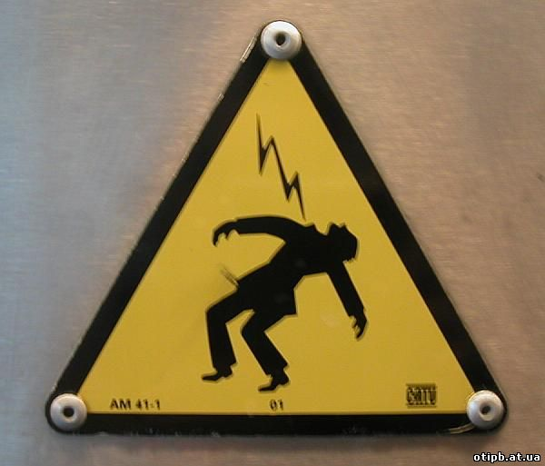
Иностранный язык
Electrician mistakes once
a life –
when he chooses profession
The second mistake –
may be fatal…

Slide 3
Иностранный язык
Lesson 9.
«SAFETY MEASURES
FOR ELECTRICIAN AT WORK»

Slide 4
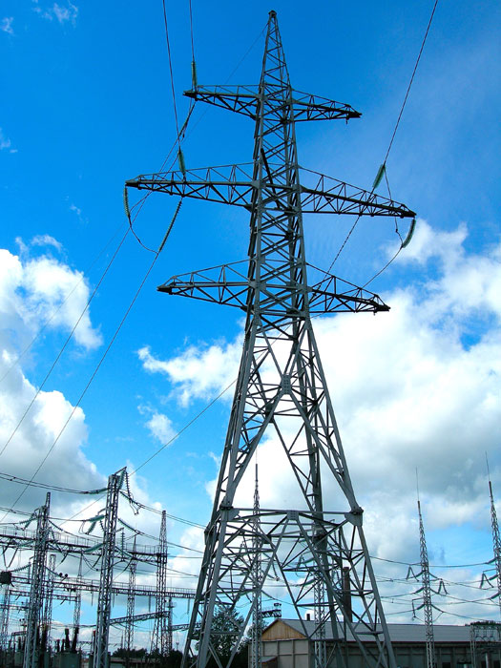
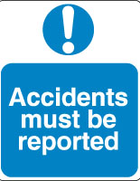

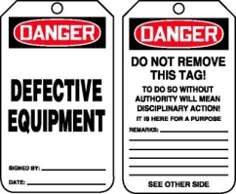

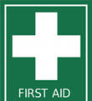
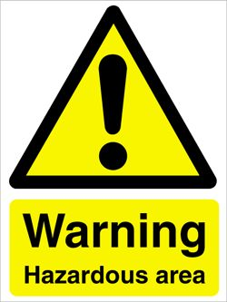
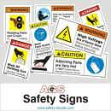
SAFETY MEASURES
FOR ELECTRICIAN AT WORK
Safety signs
Potential hazards at work
First aid rules
Means of individual protection
Protective equipment
Safe work practices
How to report an accident

Slide 5
SAFETY MEASURES
FOR ELECTRICIAN AT WORK
Safety signs
Potential hazards at work
First aid rules
Means of individual protection
Protective equipment
Safe work practices
How to report an accident

Slide 6
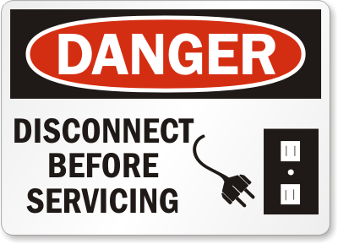
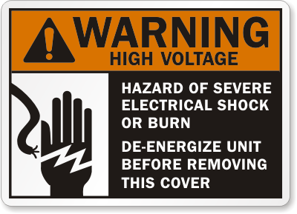
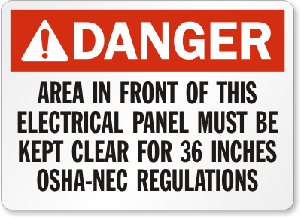
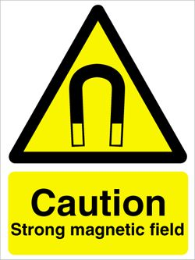
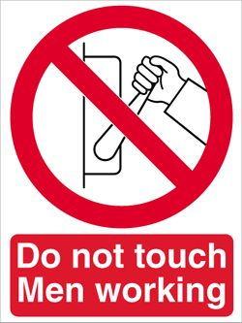

Safety signs

Slide 7
SAFETY MEASURES
FOR ELECTRICIAN AT WORK
Safety signs
Potential hazards at work
First aid rules
Means of individual protection
Protective equipment
Safe work practices
How to report an accident

Slide 8
Potential hazards at work
What are the three main electrical hazards?

Slide 9

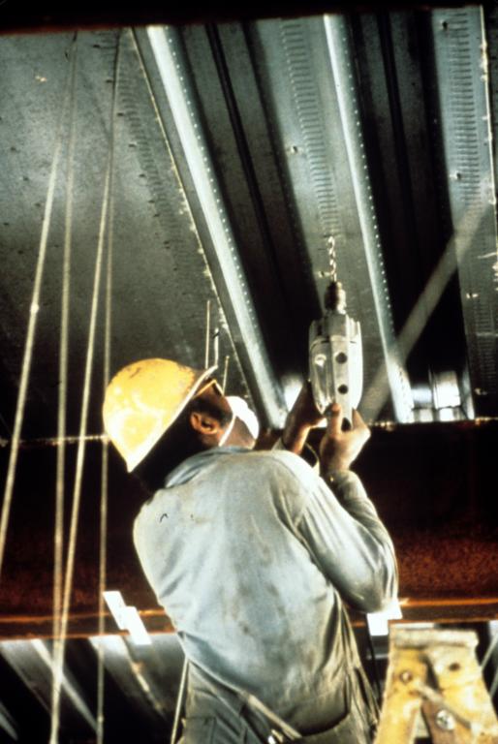
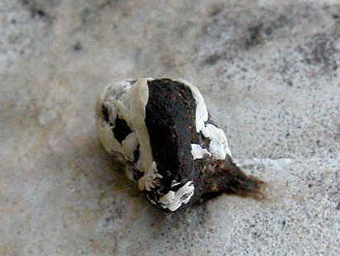
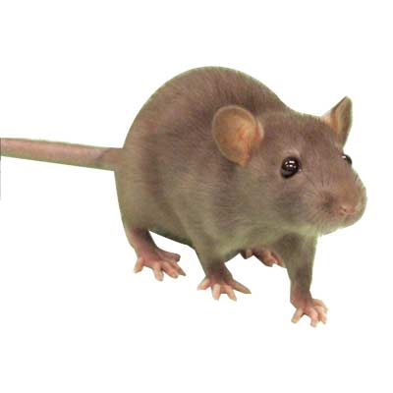
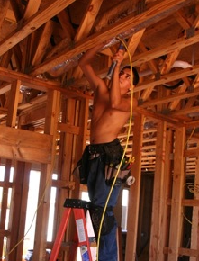
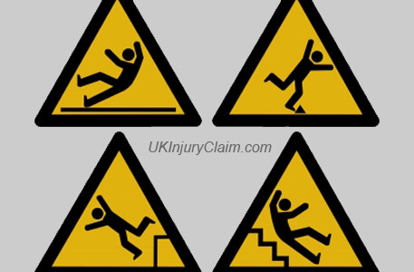
Potential hazards at work
COMMON HAZARDS
Lead, solvents, solder and other materials
Risk of pain and injuries from awkward positions
UV radiation
Risk of infection from bird or rodent dropping
Risk of eye injury from flying particles
Slips, trips and falls
Working in cold or wet rooms
Extreme temperatures

Slide 10
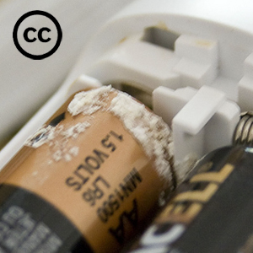
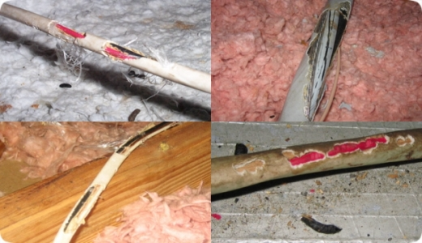
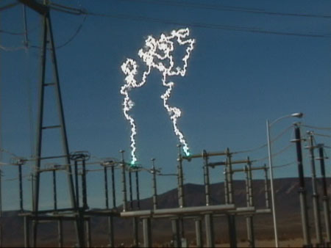
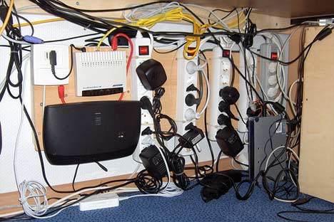
Potential hazards at work
ELECTRICAL HAZARDS
Wrong work of electrical equipment
Contact with electrical circuits
Spilling water or chemicals on electrical devices
Inadequate insulation on the wires
Using electric cords
Overloading
Loss of electric power
Electrical arc
STRESS HAZARDS
work in shifts
have extended work hours
work in confined spaces

Slide 11
Potential hazards at work
What are the three main electrical hazards?
The three main electrical hazards are:
electric shock
electrical burns
electrocution

Slide 12
Potential hazards at work
Current level (in milliamperes) | Probable effect on human body
 | Perception level. Slight tingling sensation. Still dangerous under certain conditions.
 | Slight shock felt; not painful but disturbing. Average individual can let go. However, strong involuntary reactions to shocks in this range may lead to injuries.
 | Painful shock, muscular control is lost. This is called the freezing current or "let-go" range.
 | Extreme pain, respiratory arrest, severe muscular contractions. Individual cannot let go. Death is possible.
 | Ventricular fibrillation (the rhythmic pumping action of the heart ceases.) Muscular contraction and nerve damage occur. Death is mostly like
 | Cardiac arrest, severe burns and probable death.
1 mA
5 mA
6-30 mA
50-150 mA
1000-4300 mA
10 000 mA

Slide 13
SAFETY MEASURES
FOR ELECTRICIAN AT WORK
Safety signs
Potential hazards at work
First aid rules
Means of individual protection
Protective equipment
Safe work practices
How to report an accident

Slide 14
First aid rules
What must you do first of all?

Slide 15
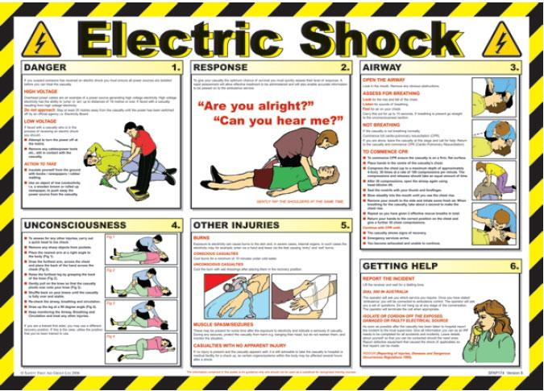
First aid rules
Turn off the power
Use non-conducting tools
Check breathing and pulse
If no breathing –
give artificial respiration
Call for help

Slide 16
First aid rules
What must you do first of all?
Switch off (turn off) the power source.

Slide 17
Safety measures for electrician at work
Task 6 Read the sentences and choose the correct item:
1. A man has climbed
a) a power pole, b) an electric tower
2. The rescue man was informed that power had been
a) put on the line, b) put off the line.
3. When he touched the wire……………. jawed him
a) 50 thousand volt, b) 15 thousand volt
4. Fortunately his ………… prevented him from falling
a) safety strap, b) safety cap
5. He was treated for surprisingly
a) major injuries, b) minor injuries.
Видеофрагмент 1

Slide 18
SAFETY MEASURES
FOR ELECTRICIAN AT WORK
Safety signs
Potential hazards at work
First aid rules
Means of individual protection
Protective equipment
Safe work practices
How to report an accident

Slide 19
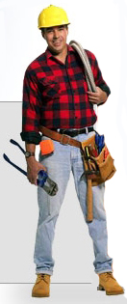
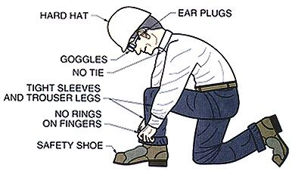
Means of individual protection
Is there any difference in MIPs for working
a) on the power pole b) in the basement?

Slide 20
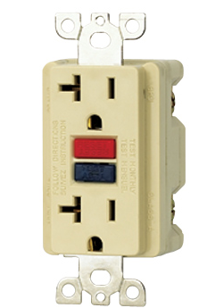
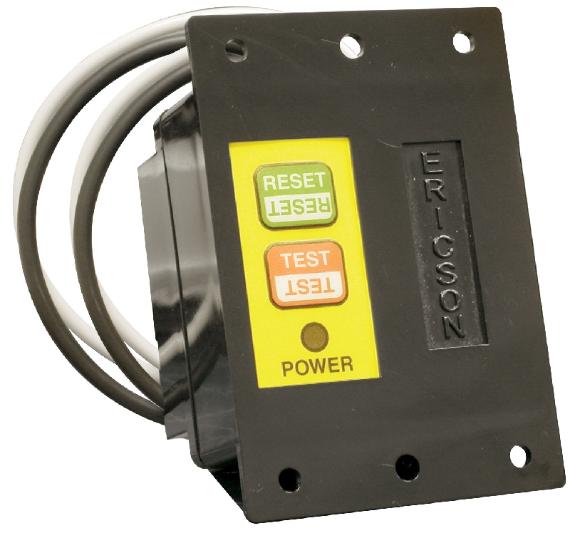
SAFETY MEASURES
FOR ELECTRICIAN AT WORK
a ground fault circuit interrupter
a GFCI safety outlet
аудиозапись

Slide 21
Lesson 9
SAFETY MEASURES
FOR ELECTRICIAN AT WORK
Safety signs
Potential hazards at work
First aid rules
Means of individual protection
Protective equipment
Safe work practices
How to report an accident

Slide 22
Protective equipment
1. What protective shields are used in Europe?
2. What kinds of plugs are used for grounding?
3. What circuit protection devices do you know?

Slide 23
Protective equipment
circuit protection
grounding
Fuses
Circuit breakers
GFCIs
guarding
use three-prong plugs
Use grounded outlets
insulation
Live parts at 50 volts and more must be guarded
Exposed live parts are placed behind Plexiglas shield
Sufficient insulation
No corrosive materials

Slide 24
Protective equipment
1. What protective shields are used in Europe?
2. What kinds of plugs are used for grounding?
3. What circuit protection devices do you know?
1. Plexiglas shields
2. Three-prong plugs
3. Fuses, circuit breakers, GFCIs

Slide 25
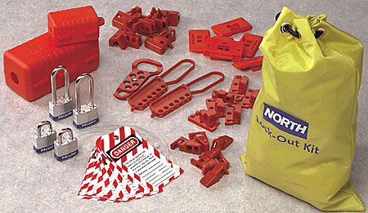
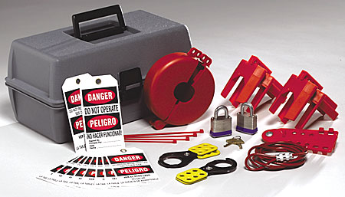
Protective equipment: lockout/tagout
1. Notify personnel
2. Initial evaluation
3. Shut down, lock or block
4. Apply completed tags
5. Flag if appropriate
6. Clear the area
7. Try equipment
Видеофрагмент 2

Slide 26
SAFETY MEASURES
FOR ELECTRICIAN AT WORK
Safety signs
Potential hazards at work
First aid rules
Means of individual protection
Protective equipment
Safe work practices
How to report an accident

Slide 27

Safe work practices
Don’t contact with energized circuits
Disconnect power source before
repairing equipment
Inspect wiring
Replace damaged equipment
Use multi-plug adapters
Know the location of the main switches
If safe, work with one hand only

Slide 28
SAFETY MEASURES
FOR ELECTRICIAN AT WORK
Safety signs
Potential hazards at work
First aid rules
Means of individual protection
Protective equipment
Safe work practices
How to report an accident

Slide 29
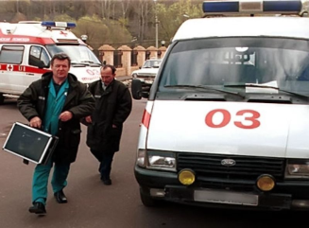
How to report an accident
About the accident |  | About the injured person
Date: ___Sept, 17___________________ Time: ___11.40 am__________________ Location: _________________________ Height above the ground: ______________ |  | Name: _Steve_Robinson______ Job title: ______________________ Injury: _______________________
Type of accident (tick one box) |  | Description of accident
• lifted something and injured self
• received an electric shock
• slipped, tripped or fell on the same level
• fell from a height
• other
rescue man
Bangkok, Thailand
electric shock
10 metres
A man has climbed a power pole. The rescue man was informed that power had been put off the line. When he touched the wire 50,000 volts jawed him. Fortunately his safety strap prevented him from falling.
×
Видеофрагмент 1

Slide 30
SAFETY MEASURES
FOR ELECTRICIAN AT WORK
Safety signs
Potential hazards at work
First aid rules
Means of individual protection
Protective equipment
Safe work practices
How to report an accident

Slide 31
Be safe!

