Slide 1

The United Kingdom of Great Britain and Northern Ireland

Slide 2
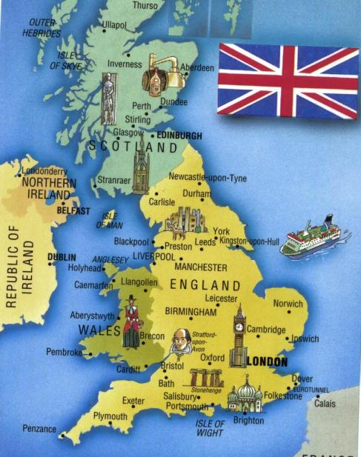
There are four parts of Great Britain:
England
Scotland
Wales
Northern Ireland

Slide 3
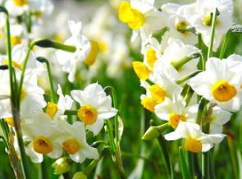

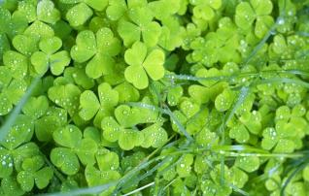
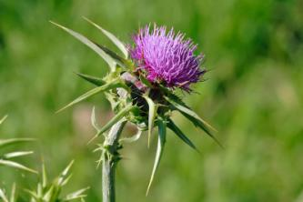
Match the words with the pictures.
A rose.
A thistle.
A daffodil.
A shamrock.

Slide 4
Check yourself
A rose – роза - England
A thistle – чертополох - Scotland
A daffodil – нарцисс - Wales
A shamrock – трилистник – Northern Ireland

Slide 5
“The UK population”

Slide 6
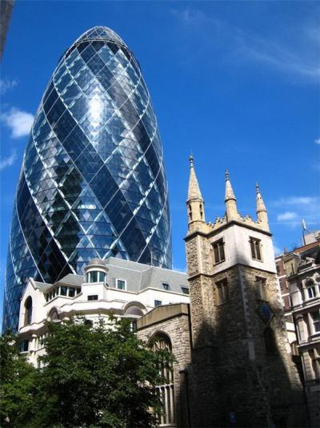
Interesting facts and places to visit in England, Scotland, Wales and Northern Ireland.
There is/are…………
In (your country) you can:
visit
take photos of
see
walk along

Slide 7
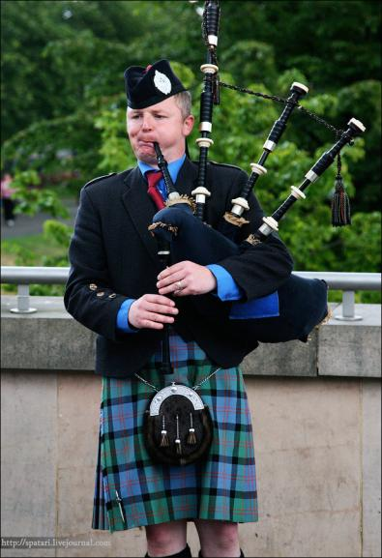
Unscramble the words
Litk
Donnol
Lerinad
Neque
Gapebip
Fiddafol

Slide 8
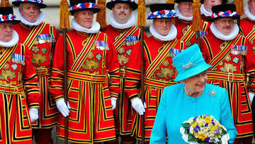
Check yourself
Kilt
London
Ireland
Queen
Bagpipe
Daffodil

Slide 9
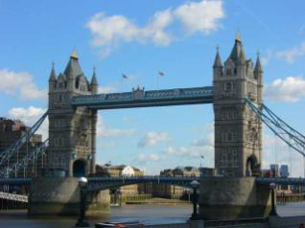
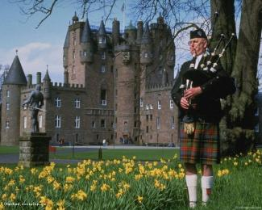
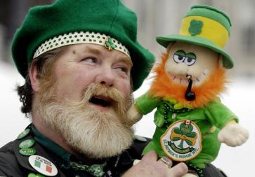

Match the pictures with countries
England
Scotland
Ireland
Wales

Slide 10
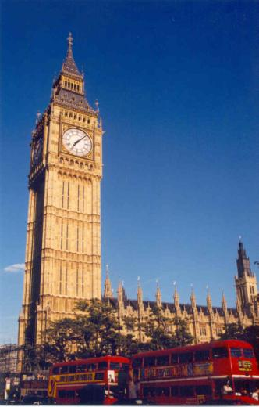
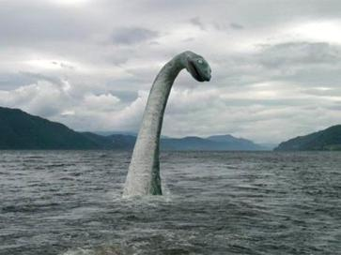
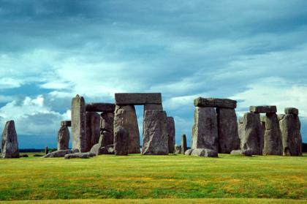
Name these places
Stonehenge
Big Ben
Loch Ness

Slide 11
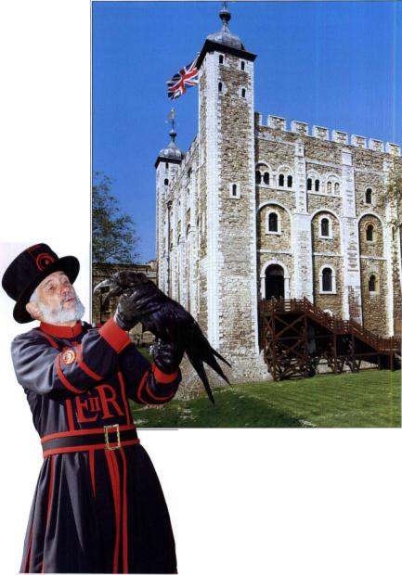
Answer the questions
1.Where is the most
population?
a. Scotland
b. England
c. Ireland
d. Wales

Slide 12
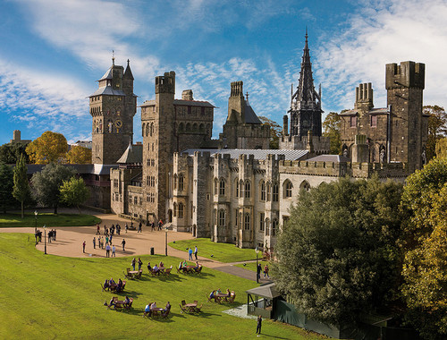
2.What is the capital of Wales?
a. London
b. Belfast
c. Edinburgh
d. Cardiff

Slide 13
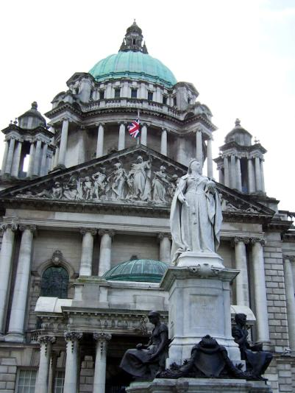
3.What is the capital of Northern Ireland?
a. London
b. Belfast
c. Edinburgh
d. Cardiff

Slide 14
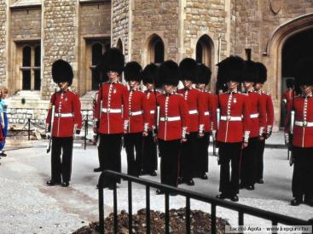
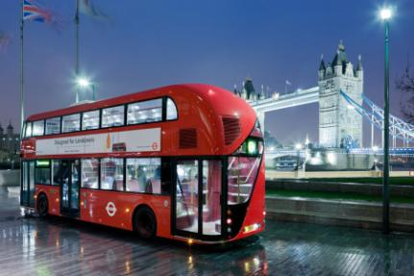
4.What is the symbol of Scotland?
a. Rose
b. Shamrock
c. Daffodil
d. Thistle
5.What is the symbol of England?
a. Rose
b. Shamrock
c. Daffodil
d. Thistle

Slide 15
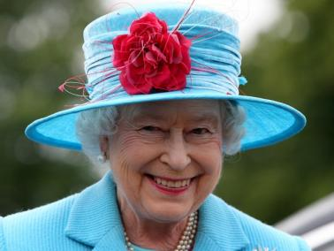
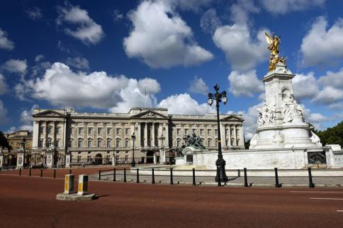
6. Where is the London home of Queen Elizabeth II, the British queen?
a. Kensington Palace
b. Windsor Palace
c. Buckingham Palace

Slide 16
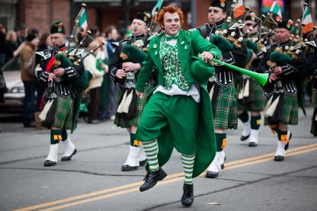
7.What is Big Ben? a. The clock tower of the Houses of Parliament
b. The clock
c. The largest bell at the top of the tower
8.Which capital is the newest capital in the world?
a. London
b. Belfast
c. Edinburgh
e. Cardiff

Slide 17
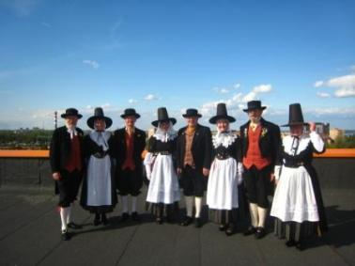
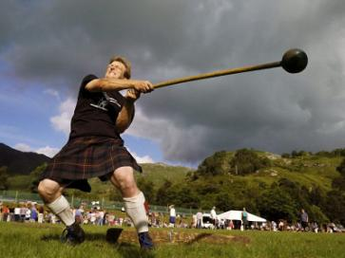
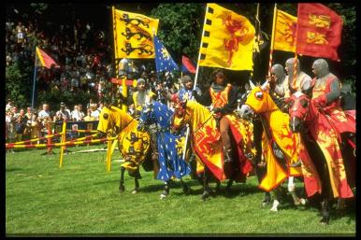
9.What country is the country of music and songs?
a. Scotland
b. Ireland
c. Wales
d. England

Slide 18
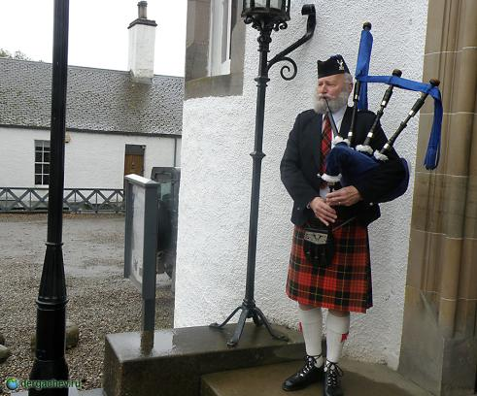
10.What is kilt?
a. A shirt b. A skirt
c. A musicale instrument

Slide 19
Check yourself
1 – b
2 – d
3 – b
4 – d
5 – a
6 – c
7 – c
8 – b
9 – c
10 - b

Slide 20
http://www.cdiscoveric.ru/velicobritanya
http://www.english-hilfen.de/en/exercises/countries/geography_grest_britain.htm
http://www.pedsovet.ru
http://www.historic.com
Крылова Марина Николаевна
2012г.

