Slide 1


Slide 2



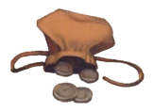

Slide 3







Slide 4


Slide 6


Slide 8
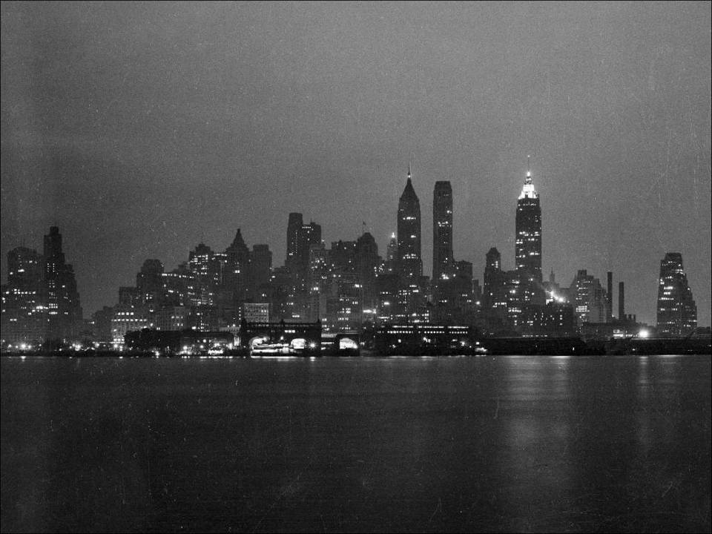

Slide 9


Slide 10
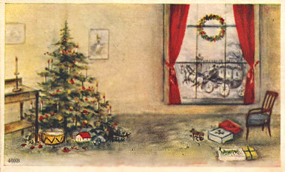

Slide 11
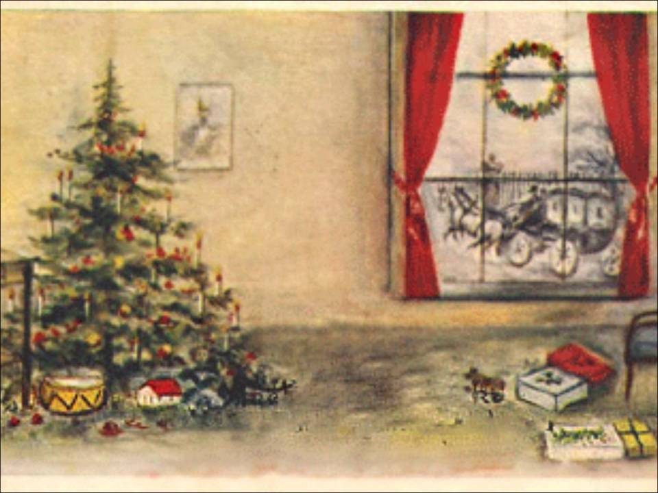

Slide 12


Slide 13


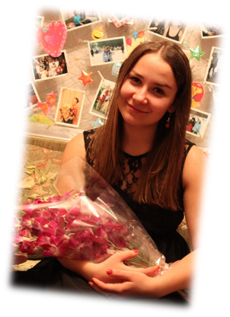
Careographers:
Ksenia Belina
Ekaterina Karpuhina

Slide 14


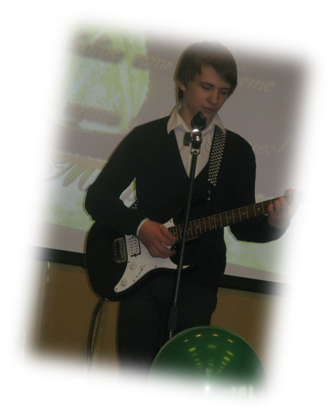
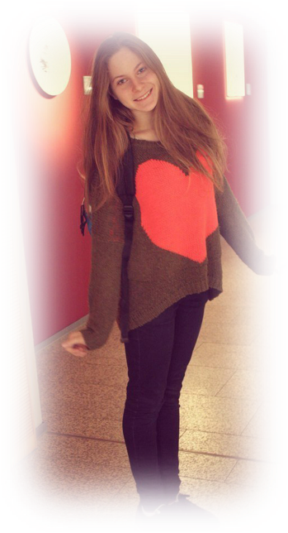
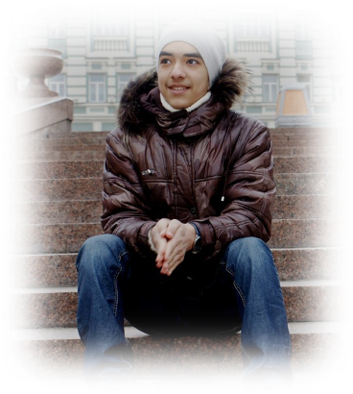
At cast:
Della - Alena Sulimenko
Jim – Dmitry Shulgin
Shop assistant 1 - Sasha Kosterina
Shop assistant 2 - Nikita Arumugam

Slide 15









Slide 16



